Slide 1
16.1% of employees left - where, why, and what HR can do
Talent & Learning Analytics Dashboard
1,470
237
16.1%
employees
leavers
attrition rate
Power BI | Power Query | DAX | Excel - IBM HR sample data (fictional), one point-in-time snapshot
Notes:
The question: why do people leave, and what can HR and L&D do about it? The answer comes from a Power BI dashboard built on the IBM HR sample.

Slide 2
From a raw CSV to a self-testing Power BI model
1
2
3
4
5
Raw data
Excel
Power Query
Model + DAX
Report
1,470 employees x 35 columns
Profiling + lookup tables
25 queries: clean, map, band
Star schema, 33 measures
8 pages, drill-through
498
automated checks passed, Steps 1-7
Every displayed number was compared with an independent calculation from the raw CSV
Notes:
Each stage is validated before the next one starts. The model also tests itself on every refresh (Data Quality page).

Slide 3
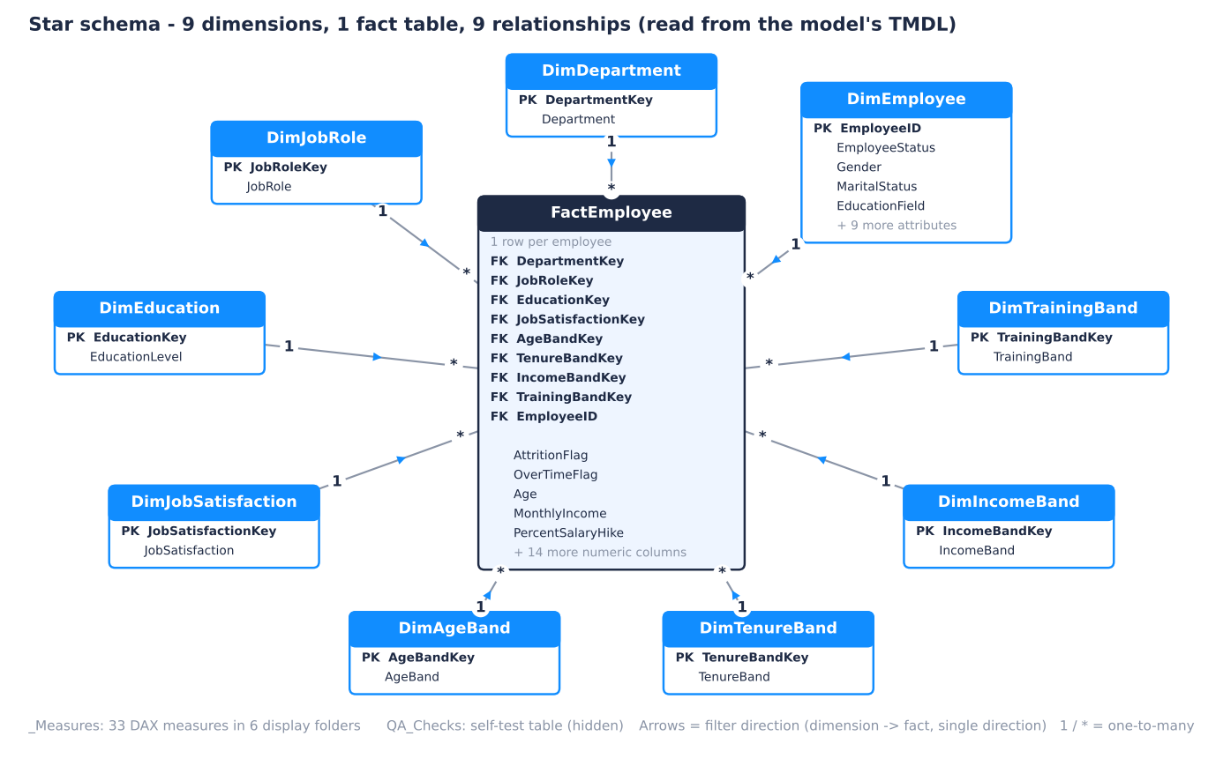
A star schema built for slicing
1
Single-direction filters
9 one-to-many relationships, dimension to fact - no ambiguous paths
2
Measures, not columns
33 DAX measures with DIVIDE, KEEPFILTERS and a REMOVEFILTERS company baseline
3
Self-testing
35 QA checks recalculated on every refresh
4
Code, not clicks
PBIP / TMDL text format: reviewable in Git and rebuildable from scripts
Notes:
Why a star schema on one flat file: clean slicers, simple DAX, and room to add real HR tables later.

Slide 4
Overtime and the first year stand out
2.9x
higher attrition with overtime (30.5% vs 10.4%); odds ratio 5.0 after controls
55.1%
attrition in the first 0-1 years when combined with overtime
+23.6 pts
Sales Representatives vs the company rate
Performance rating does not predict attrition (16.4% Outstanding vs 16.1% others). Associations in a snapshot, not proven causes.
Notes:
Overtime goes with higher attrition in 8 of 9 job roles, within roles (odds ratio 4.3) and in a logistic regression with tenure, satisfaction, job level, stock options and other factors (odds ratio 5.0).

Slide 5
Four actions to pilot, one data fix
1
Reduce sustained overtime
2
Make the first year stick
Monthly overtime reviews and workload rebalancing, starting with the highest-risk roles
90-day onboarding, a mentor for every new hire, front-loaded learning
Track: Overtime %, Attrition Rate - Overtime
Track: Early Tenure Attrition Rate (0-1 yrs)
3
Retain Sales Representatives
4
Act on engagement signals
Pay and incentive benchmark, career path to Sales Executive (39.8% attrition today)
Quarterly pulse survey, manager follow-up within 30 days
Track: Attrition vs Company (pts)
Track: % Low Job Satisfaction
Data fix: record course type, hours and completion, calibrate performance ratings, and add dates to measure whether the actions work.
Notes:
Each action has a measure in the dashboard to track it. Run them as pilots with a comparison group, because the data shows associations, not causes.

