Slide 1

K. J. Somaiya Institute of Technology, Mumbai
Department of Computer Engineering
KJSIT’s Student Achievement Portal with Optical Character Recognition Tool
Kapil Bhatia – 05
Palak Desai – 10
Devanshi Joshi – 24
Dakshita Kolte – 31
Supervisor
Dr. Jyoti Wadmare

Slide 2

OUTLINE OF PRESENTATION
INTRODUCTION
PROBLEM STATEMENT
LITERATURE SURVEY
SOFTWARE REQUIREMENTS
PROPOSED SYSTEM AND DESIGN
SYSTEM IMPLEMENTATION
RESULTS AND CONCLUSION
REFERENCES

Slide 3
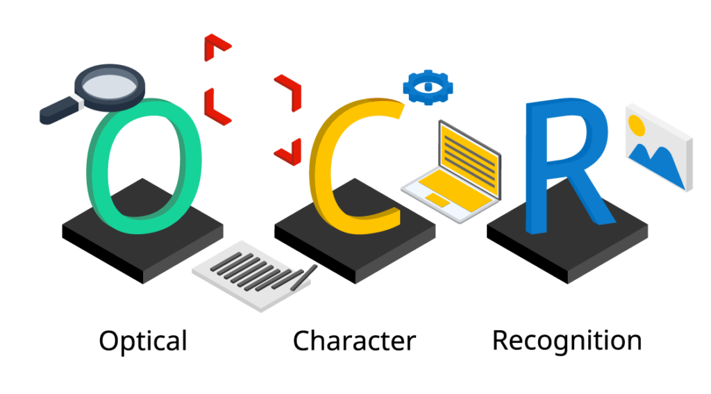
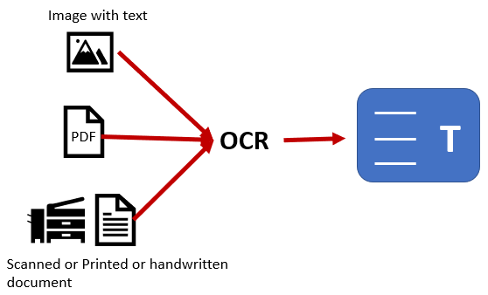
INTRODUCTION
Traditional Methods of collecting records of certificates
What is Optical Character Recognition Tool (OCR)?
Use of Optical Character Recognition Tool
Fig. OCR – Optical Character Recognition
Fig. Use of OCR

Slide 4

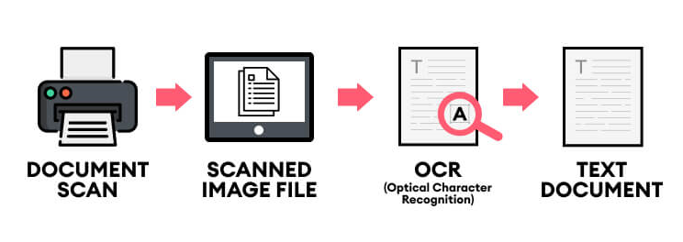
PROBLEM STATEMENT
Portal for Student Achievement
OCR Tool for Text Extraction
Fig. Student Achievement Portal
Fig. OCR Tool for Text Extraction

Slide 5

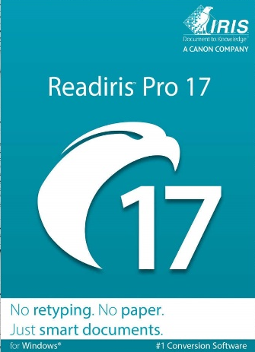



LITERATURE SURVEY
Initiate development of free OCR Tool
Organize and store extracted data in Excel File
Fig. Paid OCR Softwares

Slide 6












SOFTWARE
REQUIREMENTS

Slide 7
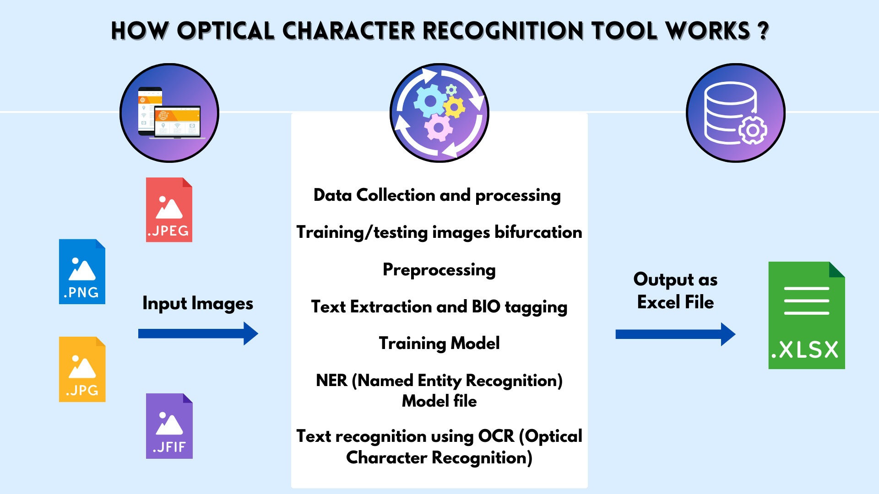
PROPOSED SYSTEM AND DESIGN
Fig. Working of Optical Character Recognition Tool

Slide 8
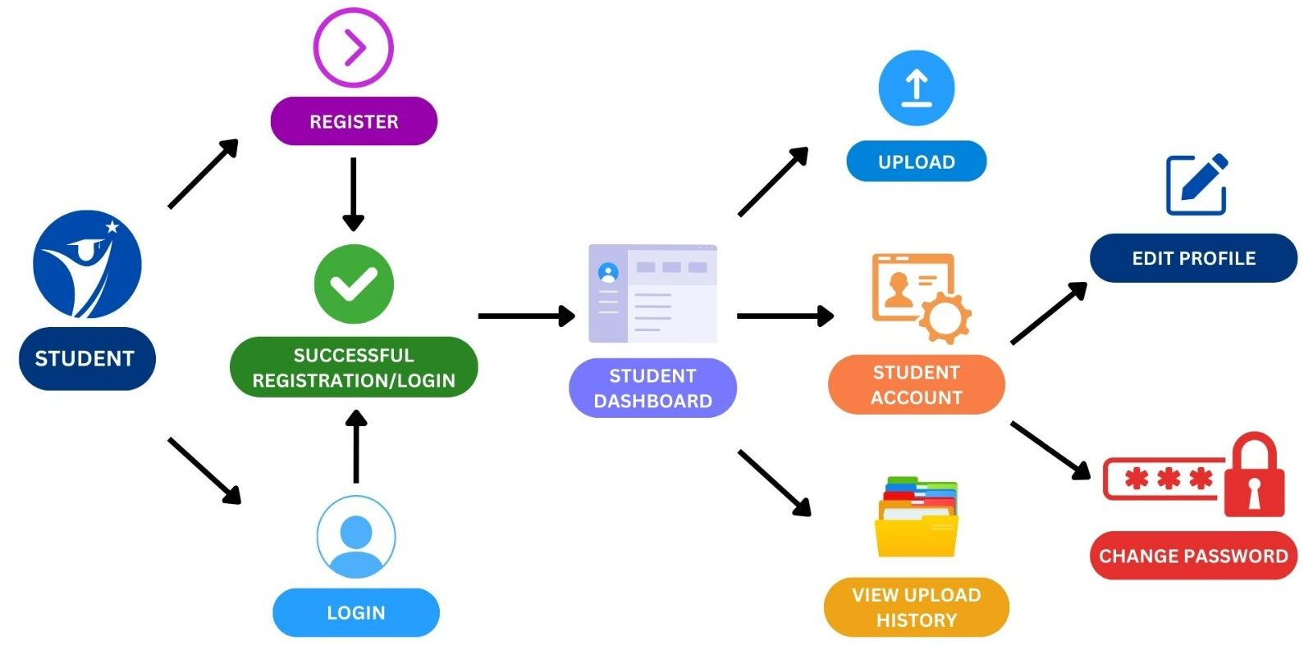
PROPOSED SYSTEM AND DESIGN
Fig. Student Section of KJSIT’s Student Achievement Portal

Slide 9
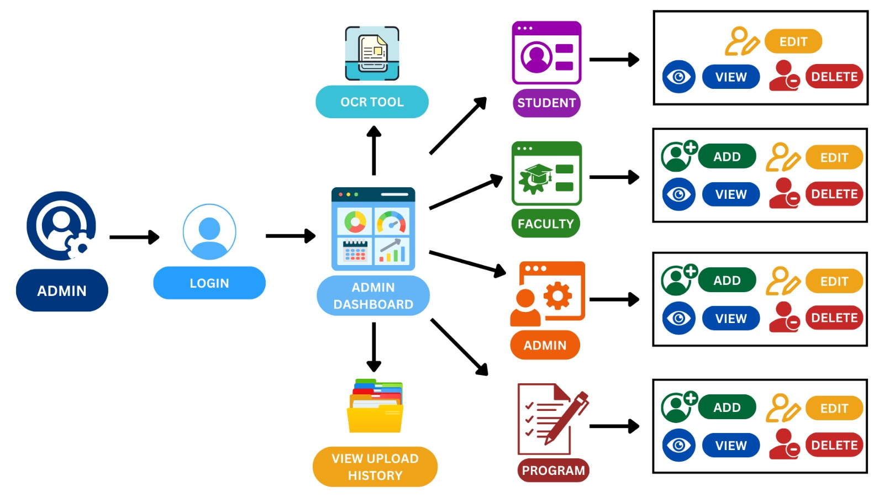
PROPOSED SYSTEM AND DESIGN
Fig. Admin Section of KJSIT’s Student Achievement Portal

Slide 10
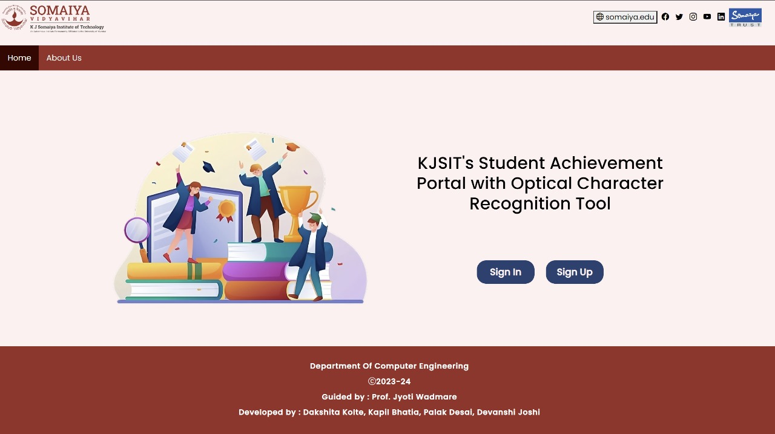
SYSTEM IMPLEMENTATION
Fig. Home Page of KJSIT’s Student Achievement Portal with Optical Character Recognition Tool

Slide 11
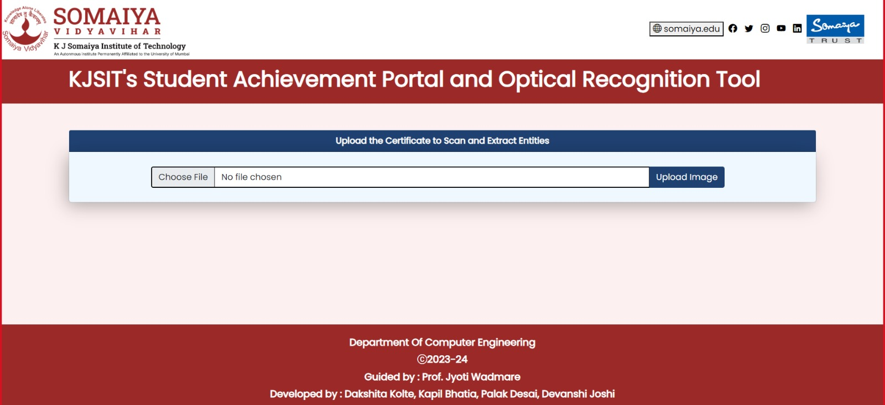
SYSTEM IMPLEMENTATION
Fig. Optical Character Recognition Tool

Slide 12
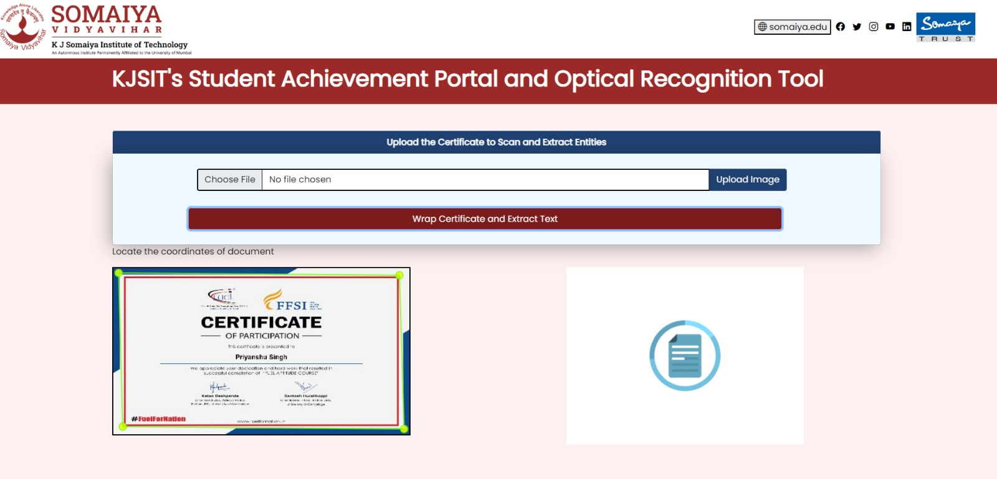
SYSTEM IMPLEMENTATION
Fig. Uploading Certificate on OCR Tool

Slide 13
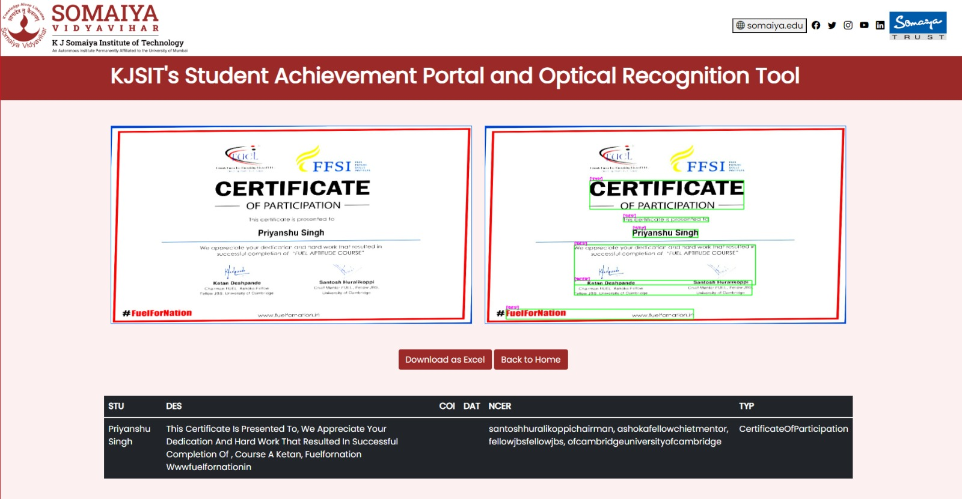
SYSTEM IMPLEMENTATION
Fig. Text Extraction from Certificate

Slide 14
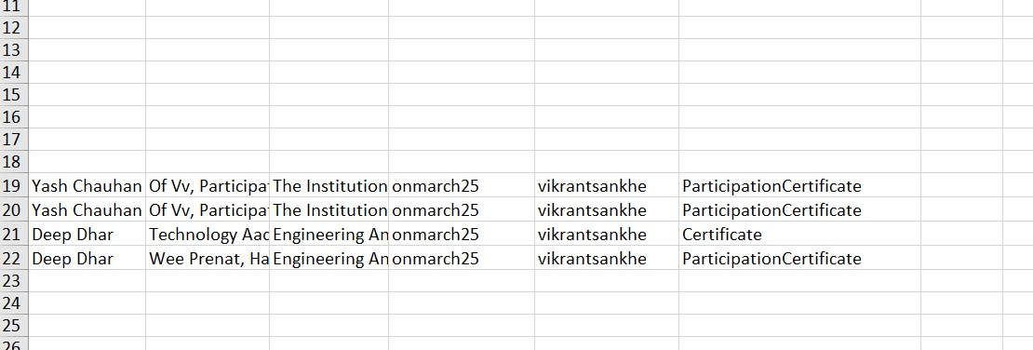
SYSTEM IMPLEMENTATION
Fig. Downloaded Excel after text extraction from OCR Tool

Slide 15

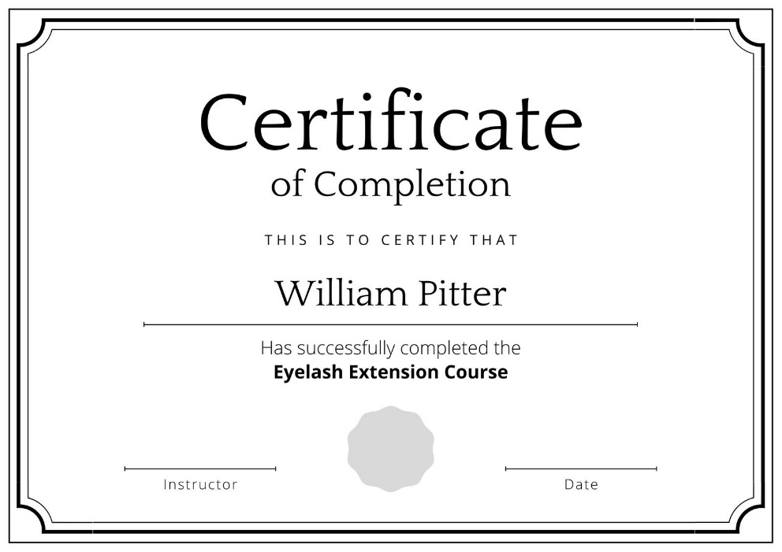
RESULTS AND CONCLUSION
Streamlining Certificate Management
User-friendly Interface
Administrative Efficiency
Power of OCR
Cost-Effective Solution
Fig. Power of OCR
Fig. Certificate

Slide 16
REFERENCES
[1] J. Memon, M. Sami, R. A. Khan and M. Uddin, "Handwritten Optical Character Recognition (OCR): A Comprehensive Systematic Literature Review (SLR)," in IEEE Access, vol. 8, pp. 142642-142668, 2020, doi: 10.1109/ACCESS.2020.3012542.
[2] Y. S. Chernyshova, A. V. Sheshkus and V. V. Arlazarov, "Two-Step CNN Framework for Text Line Recognition in Camera-Captured Images," in IEEE Access, vol. 8, pp. 32587-32600, 2020, doi: 10.1109/ACCESS.2020.2974051.
[3] A. A. Chandio, M. Asikuzzaman and M. R. Pickering, "Cursive Character Recognition in Natural Scene Images Using a Multilevel Convolutional Neural Network Fusion," in IEEE Access, vol. 8, pp. 109054-109070, 2020, doi: 10.1109/ACCESS.2020.3001605.
[4] J. Park, E. Lee, Y. Kim, I. Kang, H. I. Koo and N. I. Cho, "Multi-Lingual Optical Character Recognition System Using the Reinforcement Learning of Character Segmenter," in IEEE Access, vol. 8, pp. 174437-174448, 2020, doi: 10.1109/ACCESS.2020.3025769.
[5] M. Li, B. Fu, Z. Zhang and Y. Qiao, "Character-Aware Sampling and Rectification for Scene Text Recognition," in IEEE Transactions on Multimedia, vol. 25, pp. 649-661, 2023, doi: 10.1109/TMM.2021.3129651.

Slide 17
THANK YOU!!!

