Slide 1
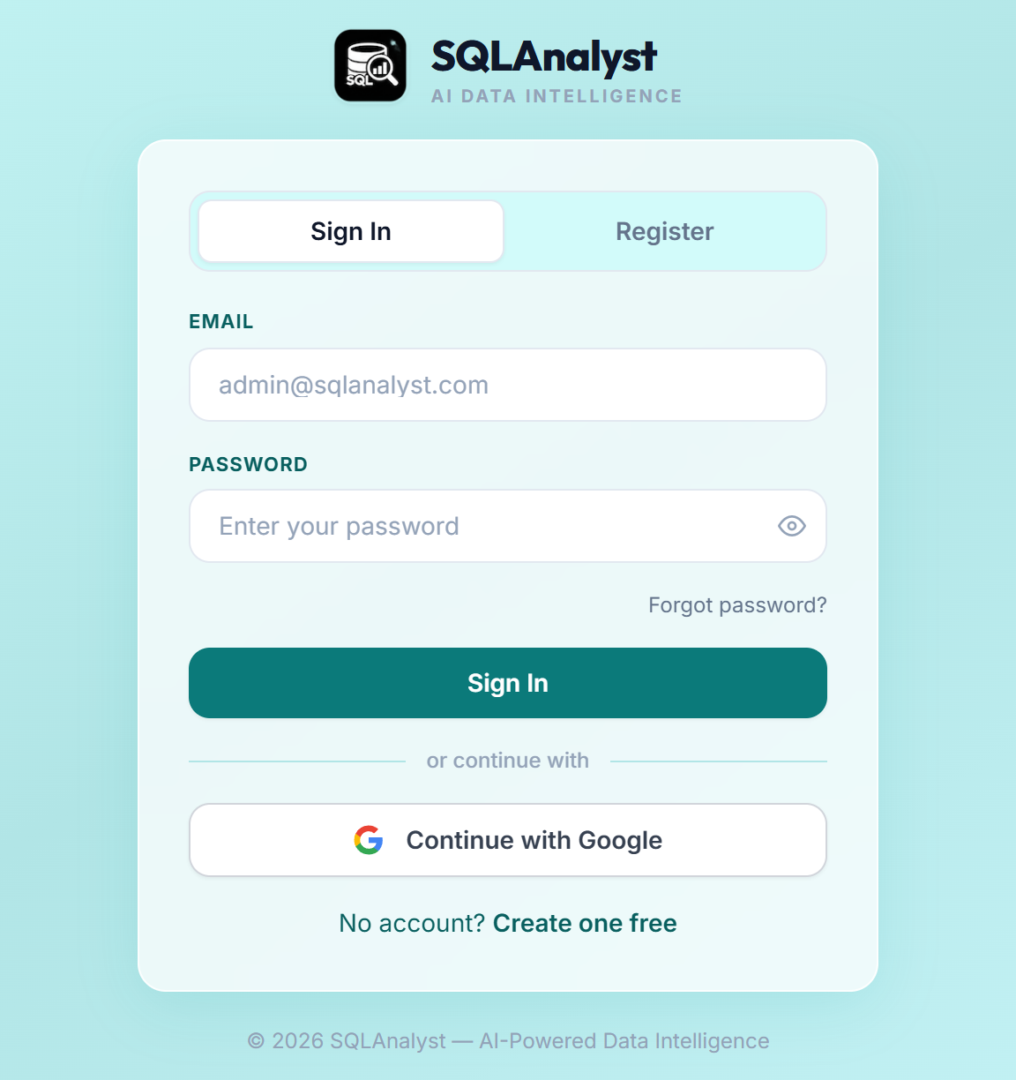
SQLAnalyst
localhost:3000/auth
Ask your database in plain English — get safe SQL, a table, a chart and an explanation
Plain English → SQL
11 safety checks
5 database types
Kapil Sen · Trainee final evaluation · October 2026
Notes:
Good morning. My project is SQLAnalyst: an AI assistant that lets anyone ask a database a question in plain English. It writes the SQL, checks that the SQL is safe, runs it read-only, and answers with a table, a chart and a short explanation. In the next minutes I will cover the problem, the architecture, how a question flows through the system, how it stays safe, the main features, and what I delivered.

Slide 2









Business answers are locked inside SQL databases
The problem
What SQLAnalyst must do
Most staff cannot write SQL
Every new question waits for an analyst.
Ask in plain English
Never harm the data
Groq's Llama 3.3 turns questions into SQL
Read-only SQL, 11 checks, always rolled back
Analysts become a queue
Simple lookups take days instead of seconds.
Direct access is risky
Work with any database
Clear answers
One wrong query can change or leak data.
PostgreSQL, MySQL, SQLite, SQL Server, Oracle
Result table, automatic chart, short summary
Goal
Let anyone ask in plain English — without ever putting the data at risk.
Roles and audit trail
Files too
Users, admins and a log of every query
Upload a CSV or Excel file and ask about it
Notes:
The problem: business staff need answers that live in SQL databases, but most of them cannot write SQL. So every question goes to an analyst and waits in a queue, and giving everyone direct database access is risky. From this I set six requirements: ask in plain English, never harm the data, work with the common databases, give answers people understand, support roles with an audit trail, and allow questions about uploaded CSV or Excel files.

Slide 3
One backend sits between browser, AI and data
Browser — Next.js 14 app
Chat · SQL console · schema diagram · admin panel
REST + Server-Sent Events · JWT
FastAPI backend
Auth and roles
JWT · bcrypt · email codes
Query pipeline
prompt → SQL → stream
SQL safety
11-check validator
Memory and files
FAISS · in-memory SQLite
Groq LLM
Llama 3.3 70B writes SQL
App database
users · history · audit
Default database
read-only queries
Data sources
added by admins
Redis
optional 5-min cache
Built with
Next.js 14
React 18
Tailwind
Framer Motion
FastAPI
SQLAlchemy 2
sqlglot
Groq
FAISS
Docker
Notes:
The architecture has one rule: the browser only ever talks to the FastAPI backend. The Next.js frontend handles the chat, the SQL console, the schema diagram and the admin panel. Inside the backend there are four parts: authentication and roles, the query pipeline that talks to the AI, the SQL safety validator, and conversation memory plus file handling. Below it: Groq hosts the Llama model, the app database stores users, history and the audit log, and the databases users ask about are only ever read. Redis is an optional cache.

Slide 4
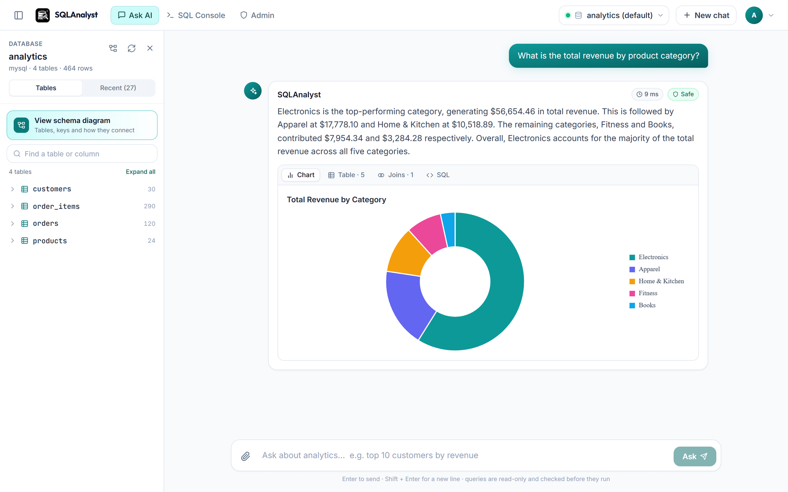
From question to answer in eight steps
1
Ask
Browser sends the question to /ask/stream
localhost:3000/dashboard
2
Recall
3 similar earlier answers from FAISS memory
3
Pick the database
Its SQL dialect and allowed tables
4
Write SQL
Groq writes it — or the user's own SQL is used
5
Validate
11 safety checks must all pass
6
Run
Read-only, row cap, timeout, rolled back
7
Stream
Table and chart first, then the explanation
8
Save
Chat history, memory and audit log
A real answer: SQL ran in 9 ms, automatic chart, summary streamed from Groq.
Notes:
Here is what happens when someone asks a question. The browser posts it to /ask/stream. The backend checks the login token and recalls the three most similar earlier answers from this conversation. It looks up the chosen database, so the AI and the safety checks use that database's own tables and SQL dialect. Groq writes the SQL, unless the user typed SQL themselves. Step five, highlighted, is the key one: the SQL must pass 11 safety checks. It then runs read-only, and the answer streams back: the table and chart appear first, then the explanation word by word. Finally the turn is saved. The screenshot is a real answer from the app: total revenue by product category, with an automatic chart.

Slide 5
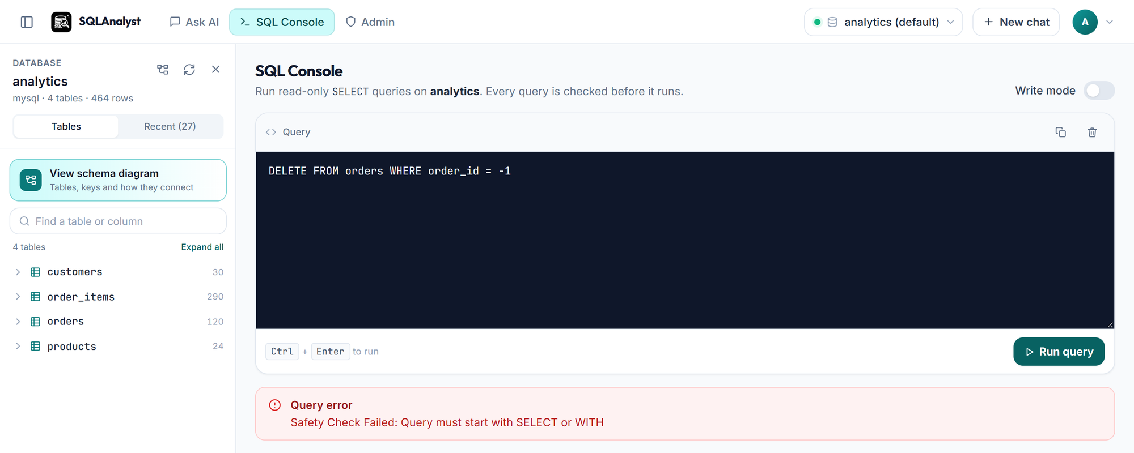
Eleven checks guard every query
Text checks
No comments or semicolons, starts with SELECT or WITH, no blocked words like DROP or INTO
localhost:3000/dashboard/sql
1–4
5–8
Syntax-tree checks
sqlglot parses it in the database's dialect: one statement, SELECT only, no write anywhere
9–11
Database rules
No system tables, only this database's tables, and a row cap is always added
Typed into the SQL console, a DELETE is refused before it ever reaches MySQL.
10,000
max rows returned
5–30 s
statement timeout
1
statement per query
Then it runs read-only and is always rolled back. Admin data changes run only after a confirm click.
Notes:
Safety is the heart of the project, because the AI writes SQL that runs on real data. Every query, whether written by the AI or typed by a user, passes eleven checks. Checks one to four are quick text checks. Five to eight parse the SQL with sqlglot into a syntax tree, so a DELETE hidden inside a subquery is still caught. Nine to eleven are database rules: no system tables, only this database's tables, and a row cap is always added. Even after that, the query runs in a transaction that is always rolled back, with a timeout. In the screenshot I typed a DELETE into the console and it was refused before reaching MySQL. Admins can change data, but only after confirming, and changes to a whole table need a second confirmation.

Slide 6
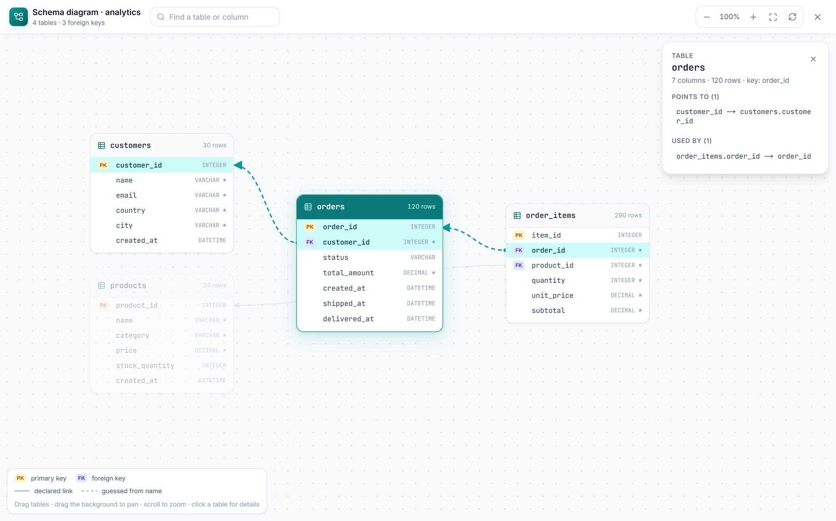
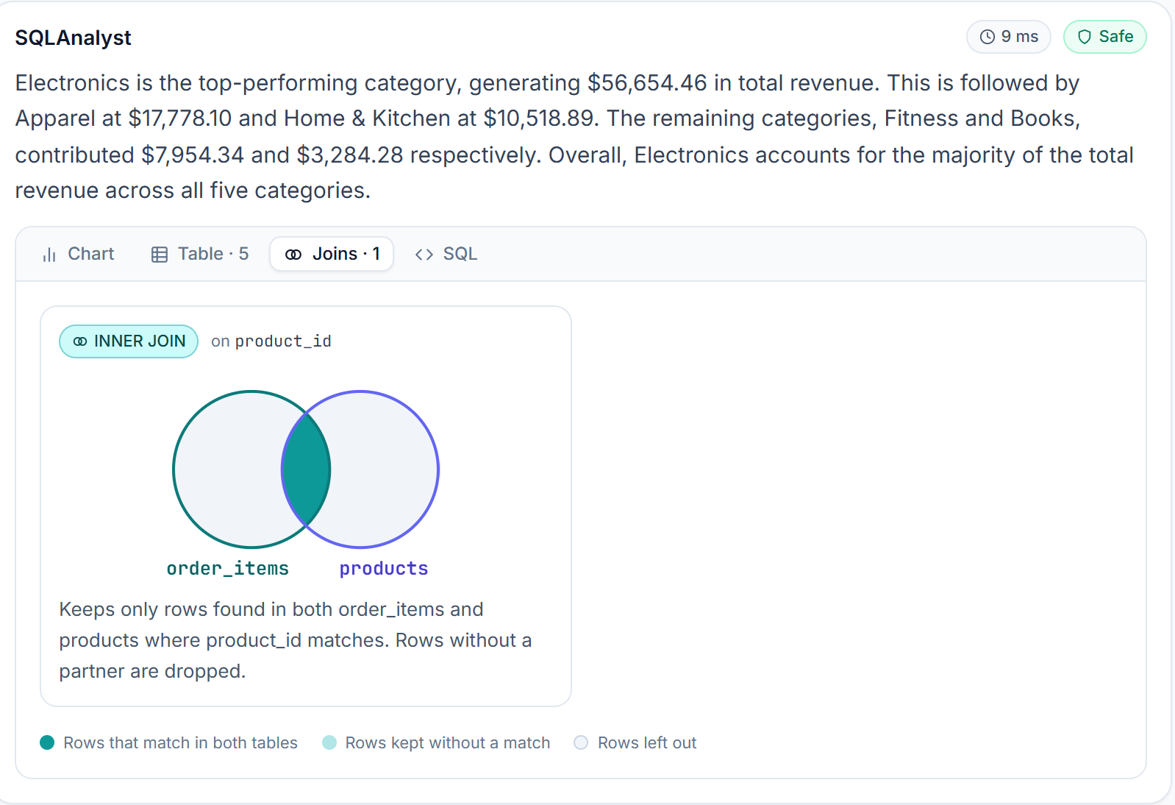
See how tables connect — and how joins work
Schema diagram
Answer · Joins tab
Interactive schema diagram
Every table, key and foreign-key link. Drag, zoom, and click a table to trace what it connects to.
Joins drawn as circles
The dark middle is the matching rows. A sentence explains the join in plain words.
Notes:
Two features help non-technical users understand their data. On the left, the schema diagram: one click in the sidebar opens every table with its columns, primary keys and foreign keys, and the lines show how tables connect. Clicking orders highlights its links to customers and order_items. On the right, when an answer uses a JOIN, a Joins tab draws it as two circles: the dark middle is the rows found in both tables, and the sentence explains it, here an inner join of order_items and products on product_id.

Slide 7
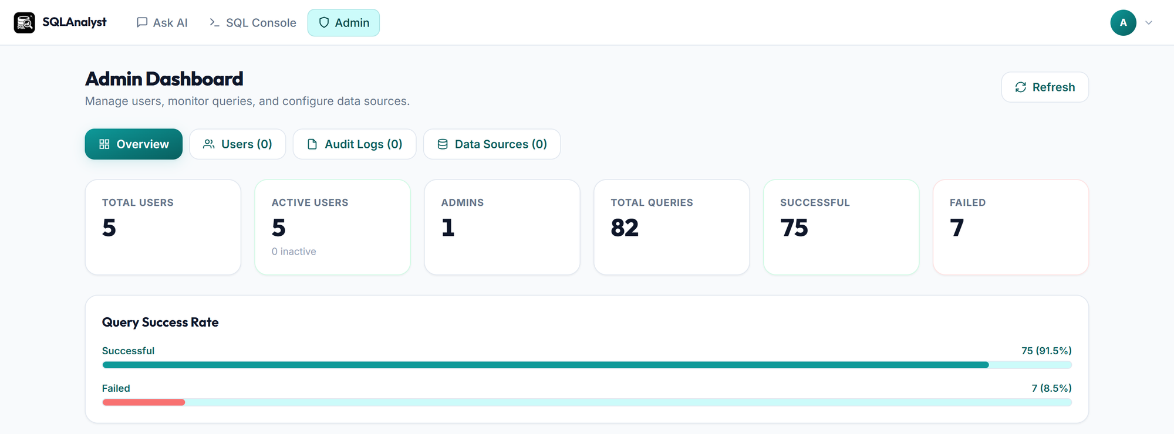


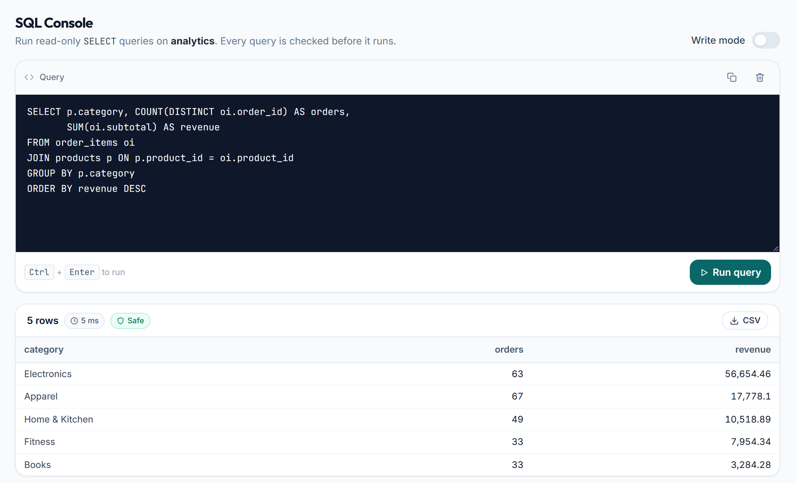



Admins stay in control, with every action logged
localhost:3000/admin
Verified accounts
bcrypt passwords and a 6-digit email code (5 tries)
Short sessions
15-minute tokens; logout ends every session
Rate limits
5 to 30 requests a minute on sign-in routes
localhost:3000/dashboard/sql
Encrypted credentials
Data-source passwords stored with Fernet
Confirmed changes
One click for a change, two for a whole table
Full audit log
Every question, its SQL, row count and errors
Notes:
Admins get an admin panel with usage numbers, user management, the audit log and data-source management, where they can connect PostgreSQL, MySQL, SQL Server, Oracle or SQLite databases and test the connection first. In front is the SQL console with a safe read-only result. On the right are the security measures: verified accounts with bcrypt and email codes, short-lived tokens that logout revokes everywhere, rate limits against password guessing, encrypted data-source passwords, confirmed admin changes, and a full audit log.

Slide 8

Delivered, tested and ready to grow
39
API endpoints
68
automated tests
11
SQL safety checks
5
database types
Next steps
Alembic migrations for database changes
Keep chat memory in Redis or a vector database
Send the AI only the relevant tables of large databases
End-to-end UI tests with Playwright
Thank you — questions?
Kapil Sen
Notes:
To sum up: SQLAnalyst is working end to end, with 39 API endpoints, 68 automated backend tests, an 11-check SQL safety engine and support for five database types. The next steps I would take are proper database migrations with Alembic, keeping chat memory outside server RAM, sending the AI only the tables relevant to a question so very large databases fit, and end-to-end UI tests. Thank you, I am happy to take questions or show a live demo.

