Slide 1


Deep dive in Data Build Tool
June 29, 2023

Slide 2
Agenda
Introduction to DBT
Available data-adapters
Installation
Creating DBT project
Setting up Profiles
Different DBT operations
Working with Macros & Packages
Model Materialization
Testing models
Generate docs
Demo on Control-Quality check
Capabilities of DBT
Relevant links

Slide 3
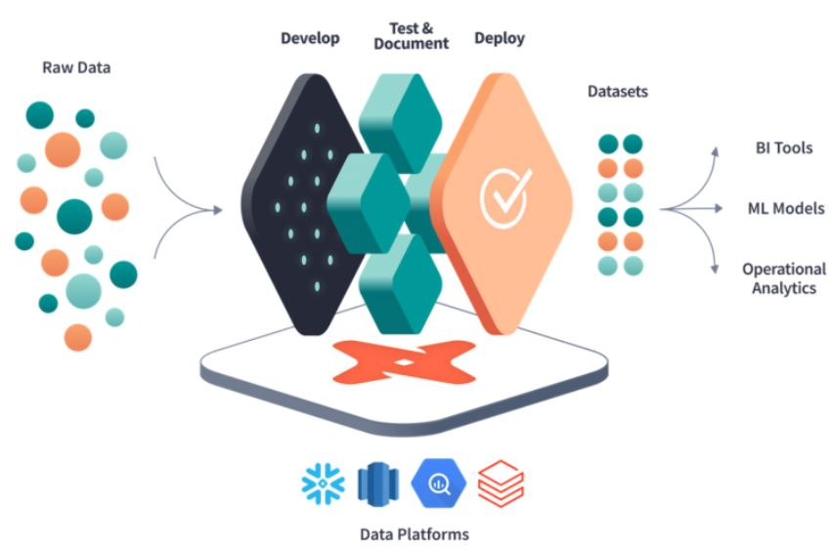
Introduction to dbt
dbt (data build tool) is an open-source command-line tool that facilitates the development and management transformation workflows for data in data warehouse.
"transformations as code" providing a repeatable and modular approach to data transformations.
It integrates well with popular data warehouses, including BigQuery.
dbt leverages the power of SQL to perform complex data manipulations, aggregations, and joins, enabling feature engineering tasks.
dbt supports testing through SQL-based tests.
valuable tool for data teams to build, manage, and document data transformations, making it an excellent choice for feature engineering in ML pipelines, including in conjunction with BigQuery.

Slide 4
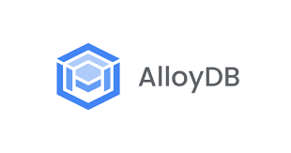


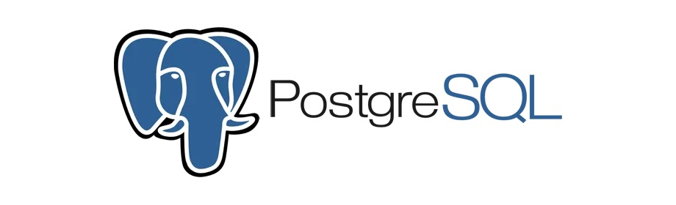




Available Data Adapters

Slide 5
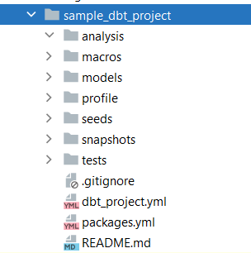
Installation
Creating dbt-project
Enter following command in terminal with desired project-name at the working directory. dbt init <project-name> This command will create basic project-structure required for dbt.
For windows & linux, use pip to install.
For MacOS, use pip or homebrew to install.
Once data-adapter is decided, we can install it using dbt-<adapter> plugin. For example, in case of Big Query
pip install dbt-bigquery
This will install dbt-core and dbt-bigquery.

Slide 6
Different DBT operations
dbt clean
dbt deps
dbt compile
dbt seed
dbt run
dbt test
dbt snapshot
dbt run-operation
dbt docs

Slide 7
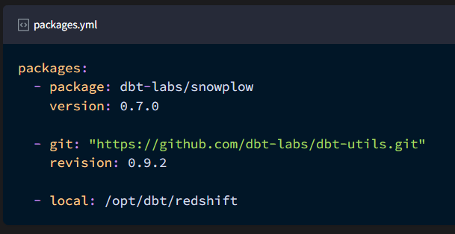
Working with Macros & Packages
Just like any other programming language, macros and snippets can be modularized into libraries which are referenced as packages in dbt.
dbt packages are in fact standalone projects focussing on a particular problem-area. We define them in packages.yml file and install them using dbt deps command.
Below are the different ways to define a package.
In dbt, you can combine SQL with Jinja, a templating language.
Jinja along with control structures, environment-variables and data manipulation logic results into reusable snippets of code called macros. Macros can be used within models or executed individually using
dbt run-operation command.

Slide 8
Model Materialization
View
Table
Incremental
Ephemeral
(Fresh insert)
(Upsert operations)
(Common table expression)

Slide 9
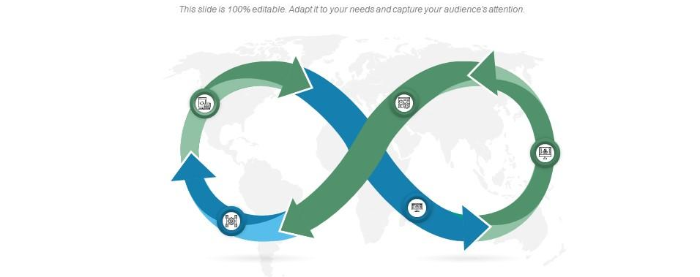
Demo on Control Quality Check Use case

Slide 10
Testing models
Using Generic Tests defined in schema.yml
Using dbt-unit-testing framework

Slide 11

Capabilities of DBT
Code compiler to detect and debug errors
Documentation to write, version-control, and share documentation for dbt models.
Logical data testing
Seed file loader for static data to be referenced
Data Snapshots for analysts to look into previous-data for mutable-objects
Package management for developers to publish public or private dbt repositories which can be referenced by others.

Slide 12

Relevant links
Installation https://docs.getdbt.com/docs/core/installation
Project Configuration https://docs.getdbt.com/reference/dbt_project.yml
Data adapters https://docs.getdbt.com/docs/supported-data-platforms
Materializations https://docs.getdbt.com/docs/build/materializations
Unit testing framework https://github.com/EqualExperts/dbt-unit-testing
DBT sample project https://pscode.lioncloud.net/nidsingh3/dbt-espresso

Slide 13

thank you

