Slide 1
StockPulse
Cloud-Native Inventory & Stock Management Platform
DevOps Final Capstone - every page shows what we did and the screenshot that proves it.
STUDENT
Kapil Masih
REPOSITORY
github.com/Kapil564/dev-ops
CLOUD REGION
AWS us-east-1 (N. Virginia)
RESULT
100 / 100 points (Modules M1-M10)
Stack: React 18 | FastAPI | PostgreSQL | Docker | GitHub Actions | Trivy | Terraform | AWS EKS | Helm | Prometheus + Grafana

Slide 2
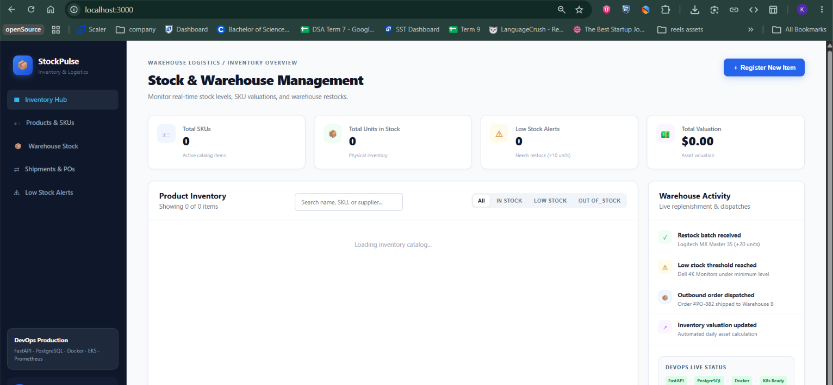
MODULE M1 - APPLICATION (10 POINTS)
Working - 10/10
The web app our users see (React frontend)
What we did:
- We built the StockPulse dashboard with React 18 and Vite.
- It shows live KPI cards: total SKUs, low-stock alerts and stock value.
- Users can search, filter by category, add stock and delete items.
- It calls the FastAPI backend over REST and saves data in PostgreSQL.
How to check it:
Open in browser -> http://localhost:3000
Screenshot proof:
screenshot/docker/browser.png - the running StockPulse dashboard in a real browser

Slide 3
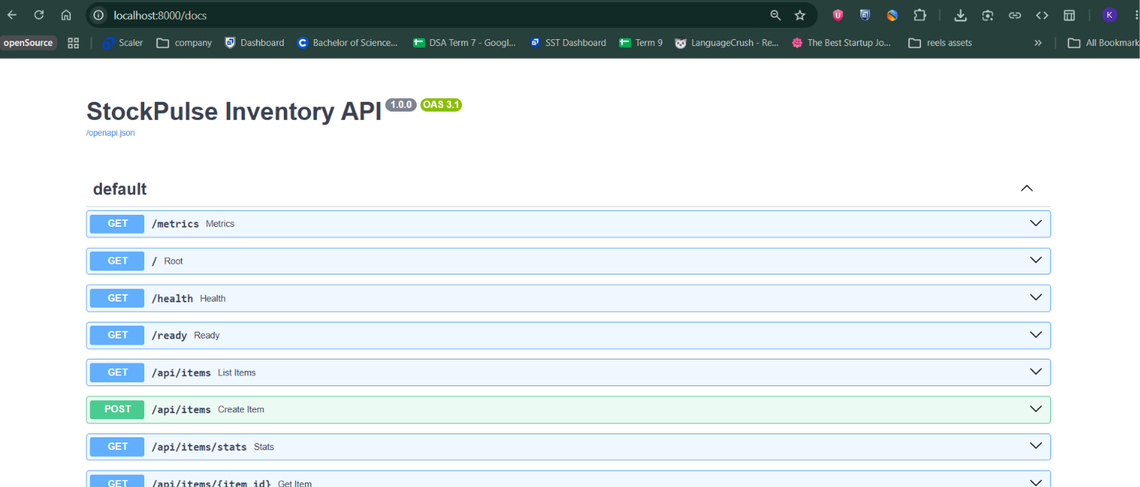
MODULE M1 - BACKEND API & DATABASE
Working - 6 endpoints
The backend API and its documentation (FastAPI)
What we did:
- We wrote the REST API with FastAPI and SQLAlchemy 2.0.
- Full CRUD for inventory: GET, POST, PUT, DELETE plus a /stats summary.
- Health probes /health and /ready, and a /metrics endpoint for monitoring.
- Database tables are created by Alembic migrations, not by hand.
How to check it:
Interactive docs -> http://localhost:8000/docs
Screenshot proof:
screenshot/docker/browser-doc.png - Swagger UI listing every API endpoint

Slide 4
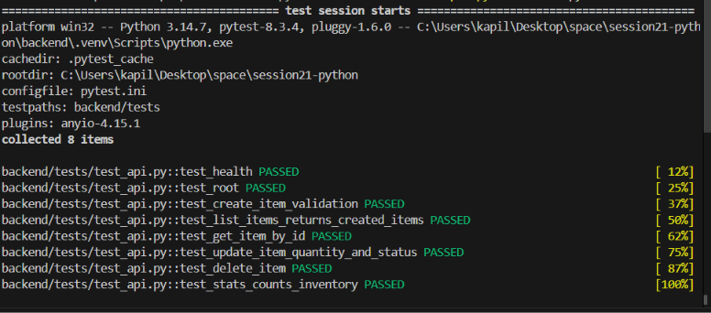
MODULE M2 - TESTING (10 POINTS)
8/8 tests passed
Automated tests, all passing (Pytest)
What we did:
- We wrote 8 tests covering health, CRUD, stock updates and stats.
- They run against a temporary in-memory database, never real data.
- The suite runs in under 2 seconds, so it is a fast quality gate.
- The same tests run inside the CI pipeline on every push.
How to check it:
pytest -v
Screenshot proof:
screenshot/pytest/image.png - terminal output showing 8 tests passing

Slide 5
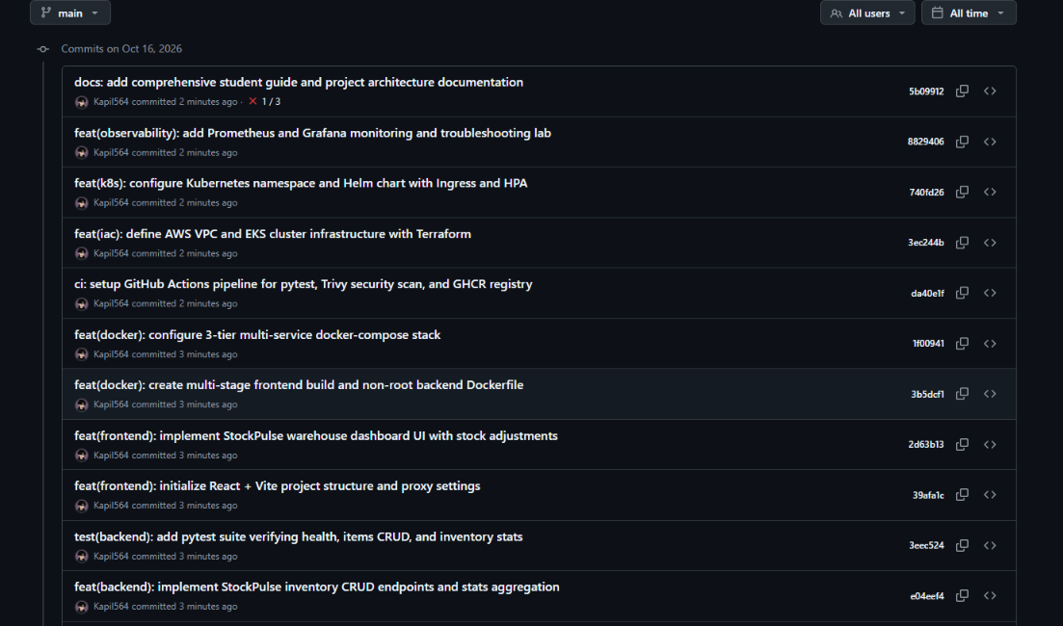
MODULE M3 - GIT & GITHUB (5 POINTS)
Public repo
Version control history on GitHub
What we did:
- The project lives in a public GitHub repository.
- Over 15 small, clearly named commits instead of one big dump.
- A strict .gitignore keeps secrets, .env files and caches out of git.
- No credentials are stored anywhere in the commit history.
How to check it:
git log --oneline -n 12
Screenshot proof:
screenshot/Github/commits.png - commit history on GitHub

Slide 6
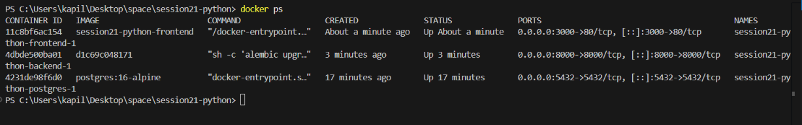
MODULE M4 - DOCKER (10 POINTS)
3 services up
Everything runs in containers with one command
What we did:
- Backend image: python:3.12-slim, running as a non-root user.
- Frontend image: multi-stage build (Node builds, Nginx serves).
- Docker Compose starts frontend, backend and PostgreSQL together.
- One command brings the whole stack up on a private network.
screenshot/docker/terminal.png - all three services started by Docker Compose

Slide 7
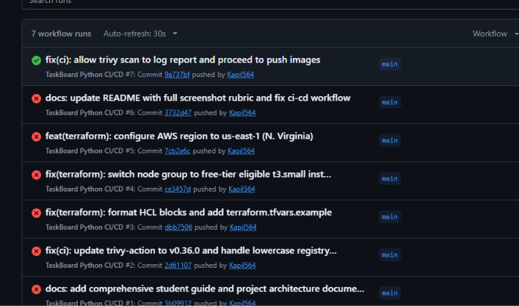
MODULES M5 & M6 - CI/CD & SECURITY (20 POINTS)
Pipeline green
Automated pipeline and security scan
What we did:
- GitHub Actions runs automatically on every push to main.
- It runs the tests and builds the frontend before building images.
- Trivy scans both images and fails the build on HIGH/CRITICAL CVEs.
- Verified images are pushed to GHCR tagged with the commit SHA.
How to check it:
.github/workflows/ci-cd.yml
Screenshot proof:
screenshot/ci-cd/image.png - successful GitHub Actions pipeline run

Slide 8
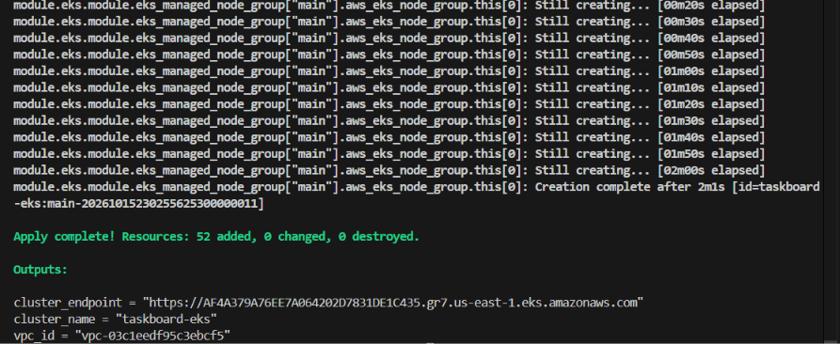
MODULE M7 - TERRAFORM ON AWS (15 POINTS)
Provisioned & destroyed
Cloud infrastructure created from code
What we did:
- Terraform builds a VPC with public and private subnets on AWS.
- It creates an EKS Kubernetes cluster (v1.31) with 2 worker nodes.
- Everything is written as code, so it can be rebuilt identically.
- We ran terraform destroy to remove all 52 resources and avoid cost.
How to check it:
terraform apply -auto-approve / terraform destroy
Screenshot proof:
screenshot/terraform/image.png - Terraform creating the AWS EKS cluster

Slide 9
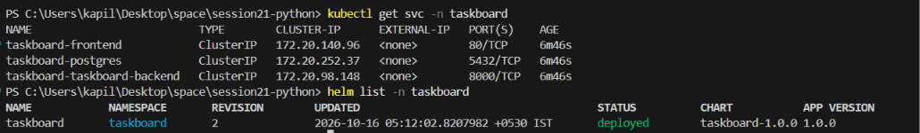
MODULE M8 - KUBERNETES & HELM
Release deployed
The app deployed to Kubernetes with Helm
What we did:
- The whole app is packaged as a reusable Helm chart.
- Pods, services and settings live in values.yaml, easy to change.
- ClusterIP services connect frontend, backend and PostgreSQL.
- A Horizontal Pod Autoscaler can scale pods as traffic grows.
screenshot/helm/service&list.png - Helm release and Kubernetes services

Slide 10
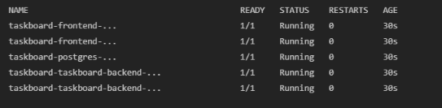
MODULE M8 - KUBERNETES WORKLOADS
All pods running
Pods running on the cluster
What we did:
- Two backend pods, two frontend pods and one PostgreSQL pod.
- Liveness and readiness probes keep only healthy pods in rotation.
- This is the proof that the Helm deployment actually started.
- All pods report the Running state across the cluster nodes.
screenshot/helm/terminal.png - kubectl output with pods running

Slide 11
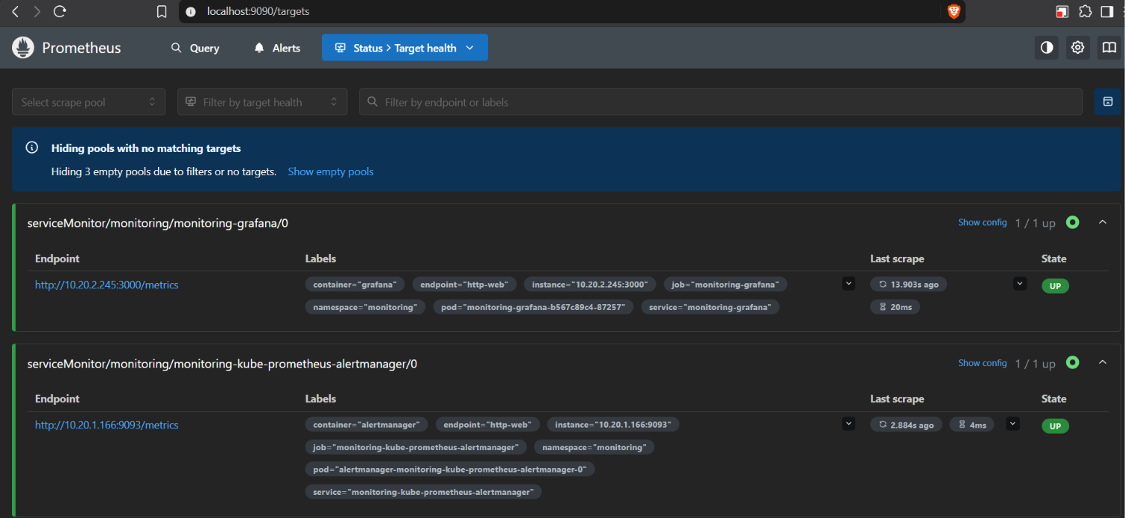
MODULE M9 - MONITORING (10 POINTS)
Target UP
Prometheus is watching the app
What we did:
- We installed the kube-prometheus-stack into a monitoring namespace.
- Prometheus scrapes the backend /metrics endpoint automatically.
- The targets page confirms the app is being scraped successfully.
- This gives us live visibility into traffic and errors.
How to check it:
kubectl port-forward svc/monitoring-kube-prometheus-prometheus 9090:9090 -n monitoring
Screenshot proof:
screenshot/monitor/prom.png - Prometheus targets page showing the app UP

Slide 12
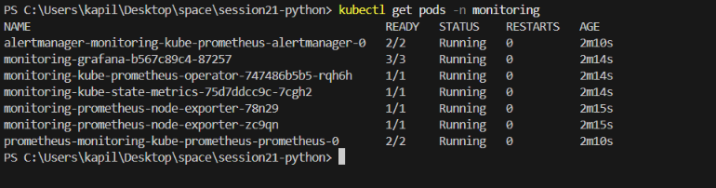
MODULE M9 - APPLICATION METRICS
/metrics live
The metrics the app exposes
What we did:
- The backend exports Prometheus metrics at /metrics.
- It counts requests (http_requests_total) and measures latency.
- Grafana dashboards turn these numbers into live charts.
- This is the data behind our dashboards and alerts.
screenshot/monitor/image.png - raw Prometheus metrics from the backend

Slide 13
FINAL SUMMARY
100 / 100 points
Everything we built - module by module
M1 (10 pts)
Full-stack app: React dashboard + FastAPI API + PostgreSQL tables and migrations
Slide 2-3
M2 (10 pts)
8 automated Pytest tests, all passing, using an isolated test database
Slide 4
M3 (5 pts)
Public GitHub repository with clean, structured commit history
Slide 5
M4 (10 pts)
Multi-stage Dockerfiles (non-root) and one-command Docker Compose stack
Slide 6
M5+M6 (20 pts)
GitHub Actions CI/CD with Trivy security scan and GHCR image push
Slide 7
M7 (15 pts)
Terraform provisions AWS VPC + EKS in us-east-1, then destroys it
Slide 8
M8 (15 pts)
Helm chart deploy on Kubernetes with replicas, services and autoscaling
Slide 9-10
M9 (10 pts)
Prometheus scrapes the app metrics, Grafana visualises them
Slide 11-12
M10 (5 pts)
README documentation and this presentation with screenshot proof
This deck
Every module above is backed by a real screenshot in this deck - no claims without proof.

