Slide 1
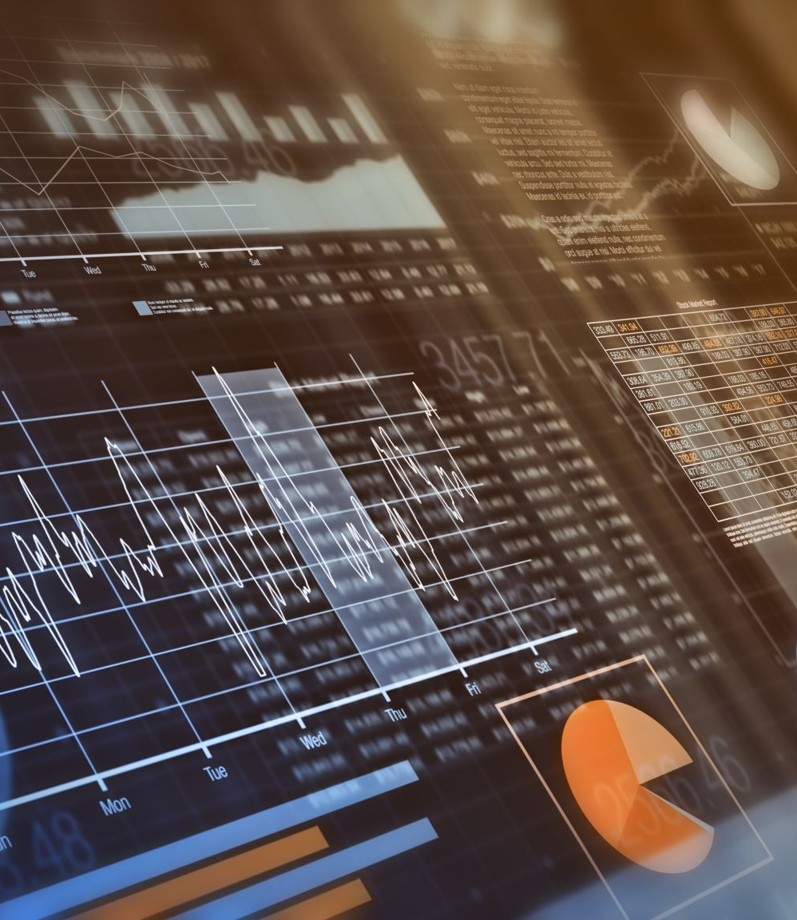
Myntra Social Media Performance Analysis
Data-driven insights & strategic recommendations

Slide 2
Business Objective
• Analyze social media performance
• Identify top platforms, campaigns & content
• Recommend data-backed strategies

Slide 3
Hashtag Performance Insights
• Highest avg clicks: #MyntraTrend
• Most used Hashtag: #StyleWithMyntra
• Hashtag with highest engagement : #MyntraSale

Slide 4
Platform Performance Overview
• Highest engagement rate: Instagram
• Highest follower growth: Twitter
• Best ROI: Instagram & Twitter
• Instagram shows recent follower surge

Slide 5

Content Type Performance
• Instagram: Videos & Stories
• Twitter: Stories
• YouTube: Carousel posts
• Facebook: Stories
• Short-form content performs best

Slide 6
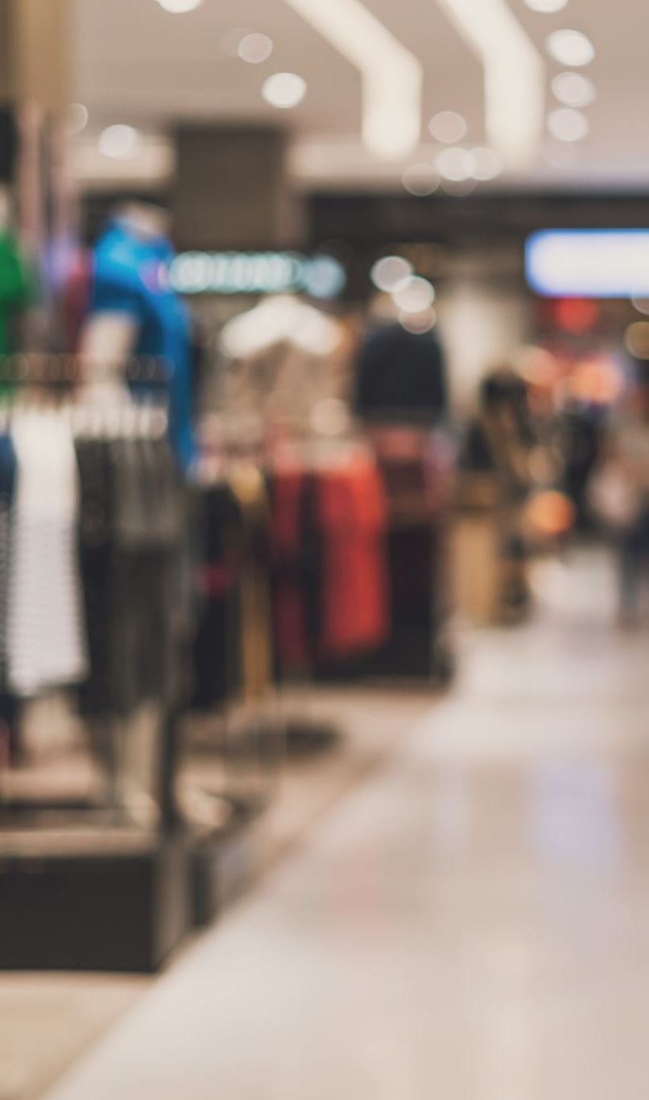
Campaign Performance – Engagement
• Highest total likes: End of Season Sale
• Highest avg likes: FashionUpgrade
• Highest impressions: End of Season Sale
• Highest avg impressions: FashionUpgrade

Slide 7
Campaign Performance – Clicks & ROI
• Highest total & avg clicks: MyntraFestiveEdit
• Highest ROI: FashionUpgrade
• Strongest follower growth: StyleRevolution

Slide 8
Key Strategic Insights
• Different campaigns serve different funnel stages
• Instagram drives highest engagement & ROI
• Twitter accelerates follower growth

Slide 9
Recommendations – Platform Strategy
• Increase spend on Instagram & Twitter
• Use YouTube & Facebook for awareness
• Allocate budget based on ROI

Slide 10
Recommendations – Content Strategy
• Shift 60%+ content to videos & stories
• Reduce static posts
• Platform-specific formats

Slide 11
Recommendations – Hashtag Strategy
• Use hashtag clusters:
– 1 Trend hashtag - #MyntraTrend
– 1 Sale hashtag - #StylewithMyntra
– 1 Brand hashtag - #MyntraSale

Slide 12
Final Business Impact
• Higher ROI through focused platforms
• Improved engagement via content optimization
• Scalable, funnel-based campaign planning

