Slide 1
Airbnb Case Study
BY -: Kapil Parmar
Presented to:
Data Analysis Managers
Lead Data Analyst

Slide 2
Problem Statement
In the past few months, Airbnb has seen a major decline in revenue. Now that the covid restrictions have started lifting and people have started to travel more, Airbnb wants to make sure that it is fully prepared for this change.
Working as a data analyst at Airbnb, we have gathered some important insights based on various attributes that can help to increase the revenue.

Slide 3

Objective
Provide a deep dive into the data analysis, highlighting trends, patterns, and actionable insights to inform strategic decisions.
Refer Appendix for detailed python codes used for data cleaning.

Slide 4
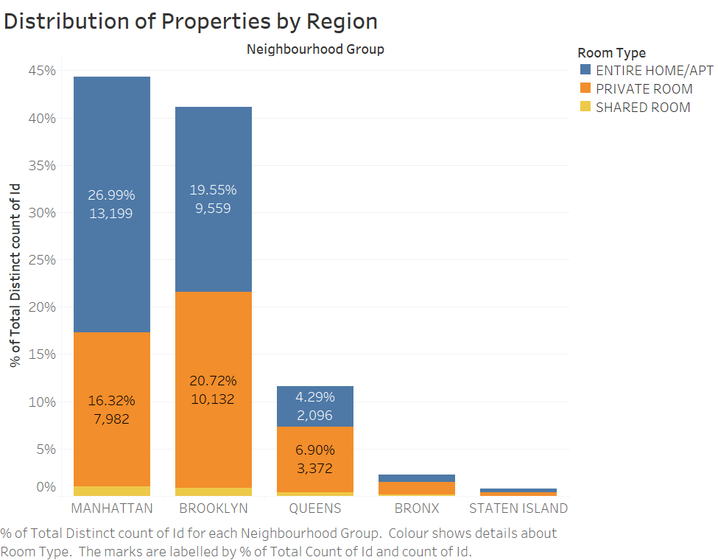
Distribution of Properties by Region
Insights:
We can see Manhattan has the highest percentage of Properties with 26.99% Entire Home/Apt Type and 16.32% Private Room Type.
Next, Brooklyn is second with 20.72% Private Room Type and 19.55% Entire Home/Apt Type.
We can also see, Staten Island and Bronx has least number of Properties

Slide 5
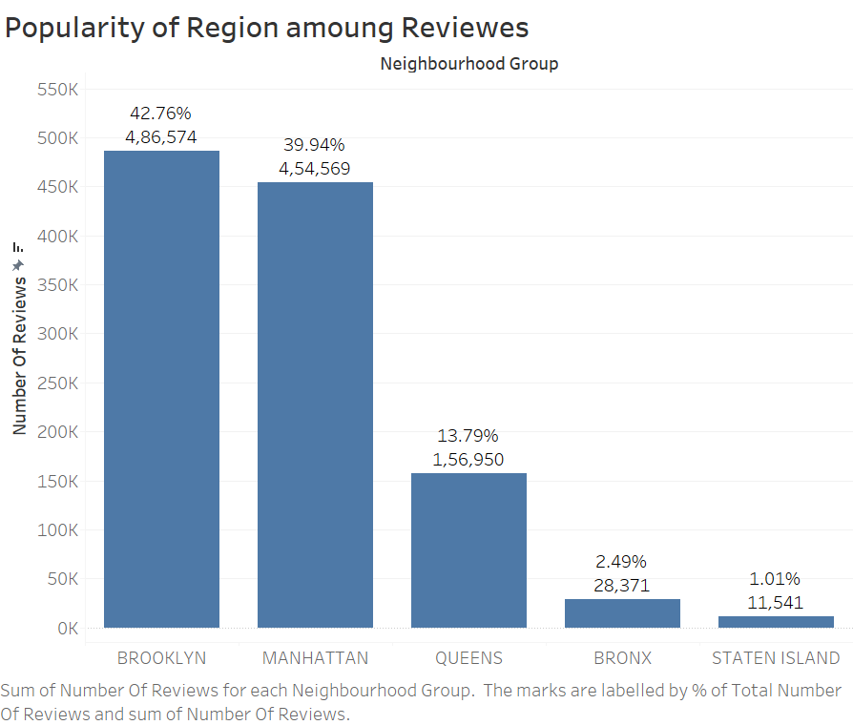
Popular Regions as per Reviews
Insights:
Brooklyn is the most Popular Region with 42.76% of booking reviews.
Second is Manhattan with 39.94% of booking reviews.
And Staten Island is the least popular region as it only has 1.01% of Booking reviews.

Slide 6
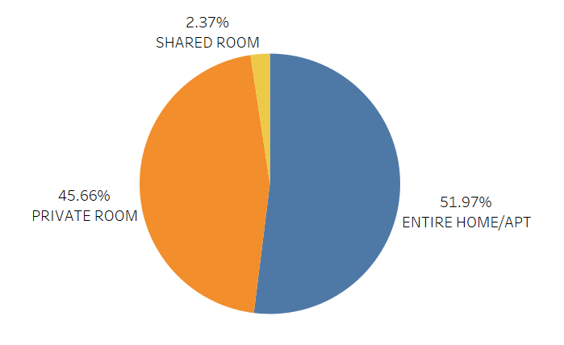
Distribution of Room Type
Insights:
We can see Most of the people prefer to book the Entire Home/Apt.
Shared Room Type are least popular choose with only 2.37% booking.

Slide 7
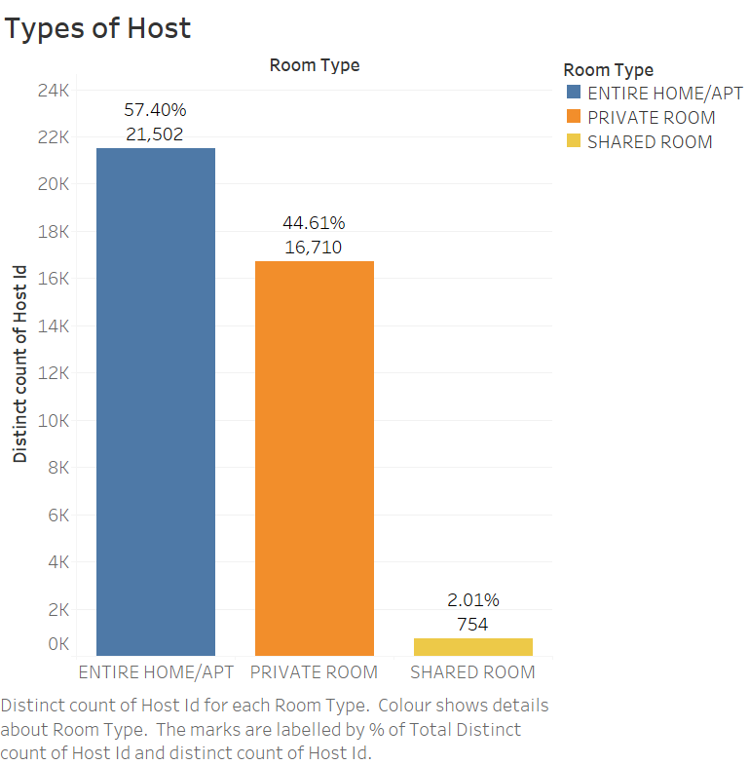
Popular Room Type Listings by Hosts
Insights:
We can see most of the Hosts (around 21.5K) are listing Entire Home/Apt on Airbnb.
And only 754 Shared Rooms are listed by Hosts.

Slide 8
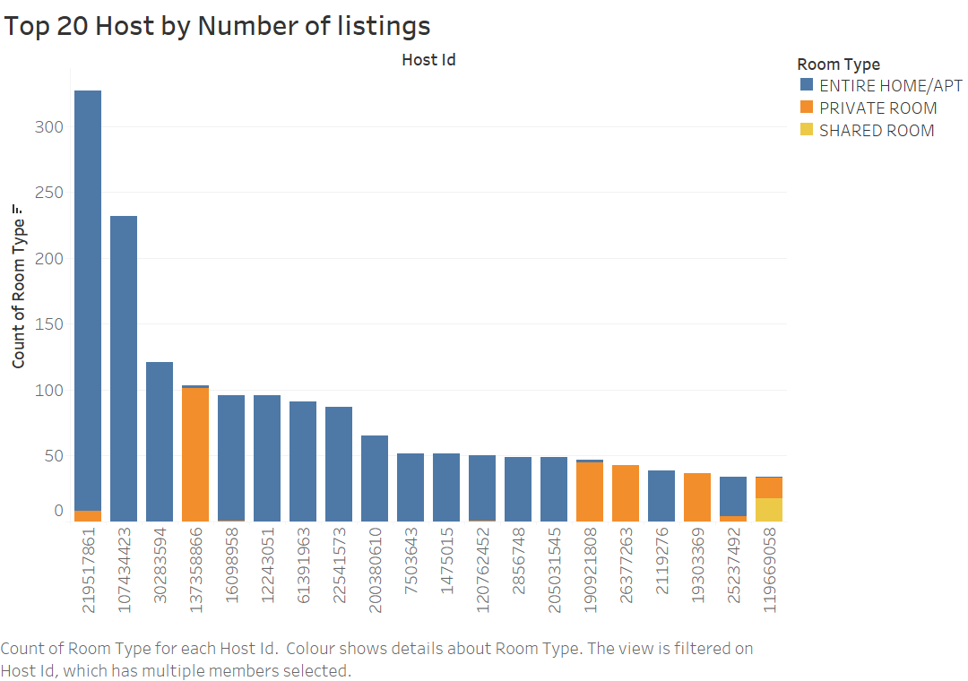
Top 20 Hosts by Number of Listings

Slide 9
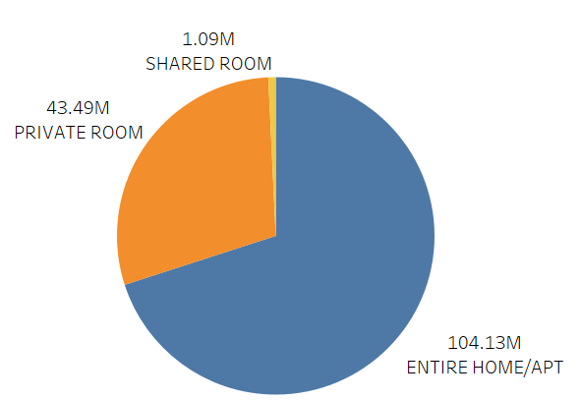
Total Revenue by Room Types
Insights:
Entire Home/Apt Room Type has generated highest Total revenue of $ 104.13 Million.
And only $ 1.09 Million is generated by Shared Room.

Slide 10
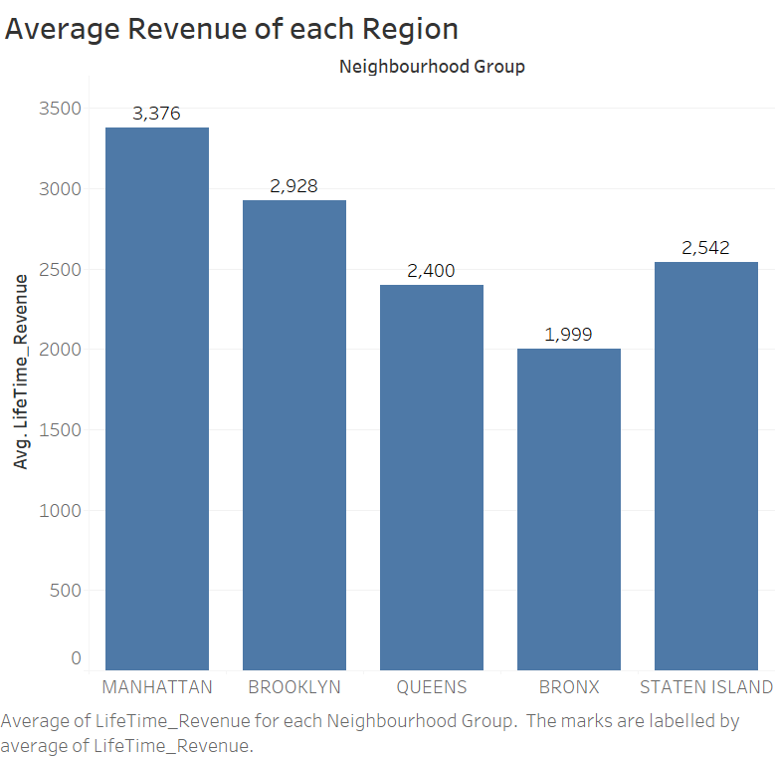
Average Revenue of Each Region
Insights:
Manhattan has the highest Average Revenue of $ 3376.

Slide 11
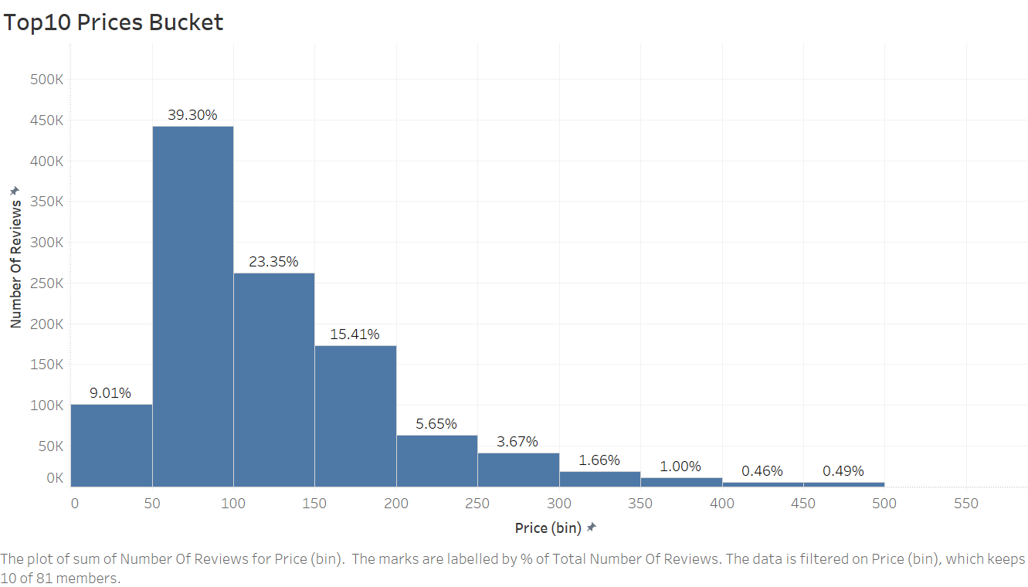
Top 10 Price Bucket
Insights:
$50 –S100 is the most popular price bucket.
Most of the booking are made between the price range of $0-$400, with less than 1% bookings are higher than $400 price.

Slide 12
Conclusion
Manhattan has the highest number of Properties.
Brooklyn is the most popular region with highest number of bookings and Manhattan is the second popular region in term of bookings.
Most of the people prefer to book the Entire Home/Apt. and use to choose property with $50 –$100 price point.
Thus, Entire Home/Apt Room Type has generated highest Total revenue of $104.13 Million.
We also saw that properties with best river side views are costliest with around $10K booking price.
Thus we can focus on these area to increase Airbnb revenue.

Slide 13

Appendix - Key Findings and Recommendations
Key Findings and Trends:
High Prices in Manhattan:
Opportunities in Brooklyn and Queens, Insights shows growth potential in more affordable areas.
Targeted Marketing: Importance of focusing on top neighbourhoods.
Recommendations:
Price Optimization: We would suggest dynamic pricing strategies based on neighbourhood demand.
Targeted Growth: Explore expansion in Brooklyn and Queens to attract different traveller segments.
Data-Driven Decision Making: We can utilize data insights to forecast trends and adjust strategies accordingly.

