Slide 1
Airbnb Case Study
By:
Kapil Parmar
Presented to:
Head of Acquisitions and Operations, NYC
Head of User Experience, NYC

Slide 2
Problem Statement
In the past few months, Airbnb has seen a major decline in revenue. Now that the covid restrictions have started lifting and people have started to travel more, Airbnb wants to make sure that it is fully prepared for this change.
Working as a data analyst at Airbnb, we have gathered some important insights based on various attributes that can help to increase the revenue.

Slide 3

Objective
Translate data-driven insights into actionable business strategies for market expansion, operations, and user experience improvements.
Refer Appendix for detailed methodology used and Recommendations

Slide 4
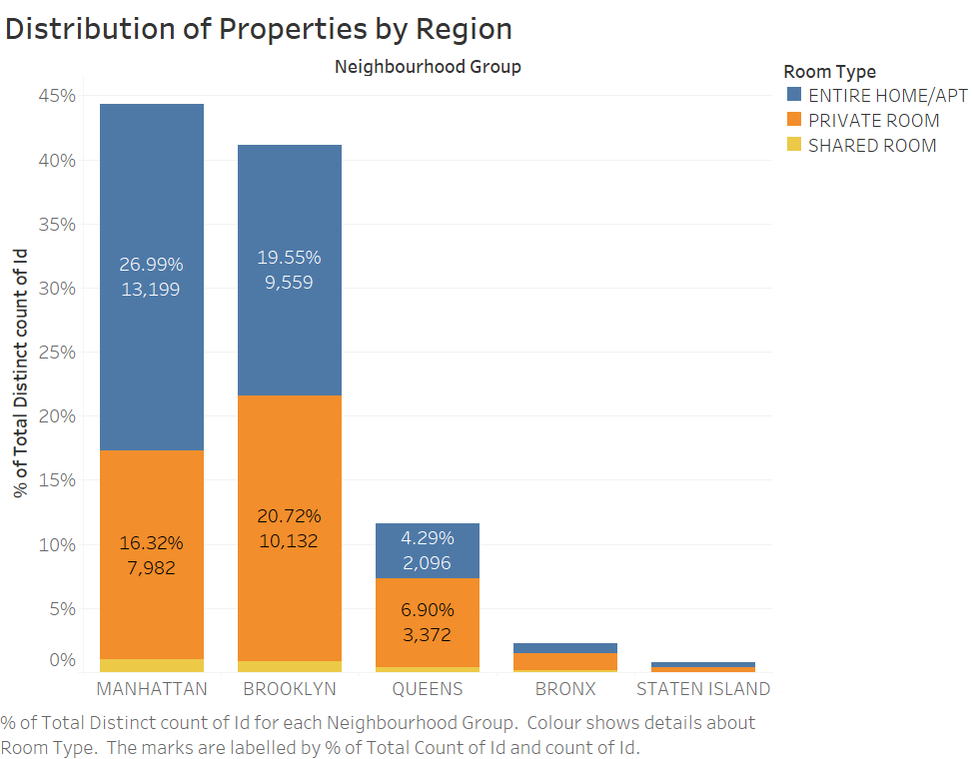
Distribution of Properties by Region
Insights:
We can see Manhattan has the highest percentage of Properties with 26.99% Entire Home/Apt Type and 16.32% Private Room Type.
And potential growth in Brooklyn and Queens.
We can also see, Staten Island and Bronx has least number of Properties

Slide 5
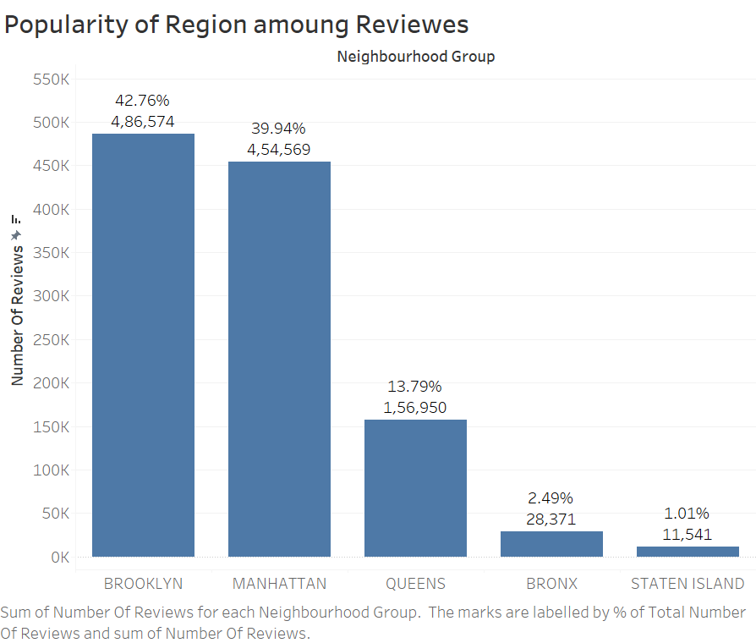
Popular Regions as per Reviews
Insights:
Brooklyn is the most Popular Region with 42.76% of booking reviews.
Second is Manhattan with 39.94% of booking reviews.
And Staten Island is the least popular region as it only has 1.01% of Booking reviews.

Slide 6
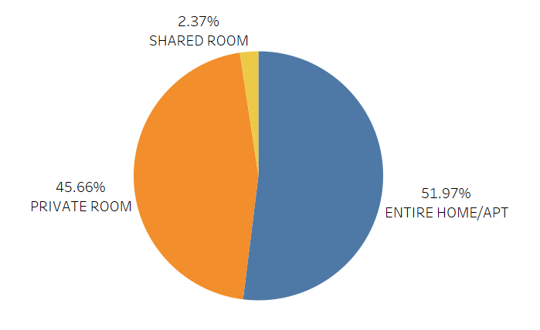
Distribution of Room Type
Insights:
We can see Most of the people prefer to book the Entire Home/Apt.
Shared Room Type are least popular choose with only 2.37% booking.

Slide 7
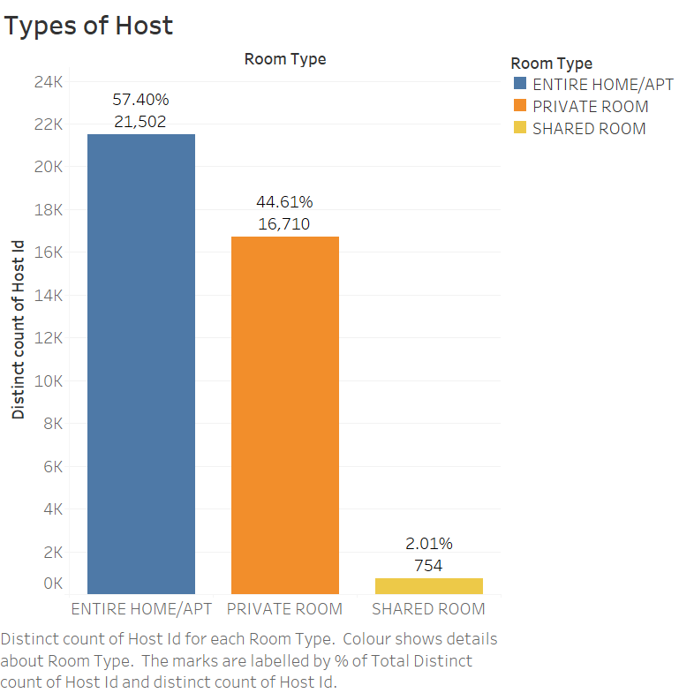
Popular Room Type Listings by Hosts
Insights:
We can see most of the Hosts (around 21.5K) are listing Entire Home/Apt on Airbnb.
And only 754 Shared Rooms are listed by Hosts.

Slide 8
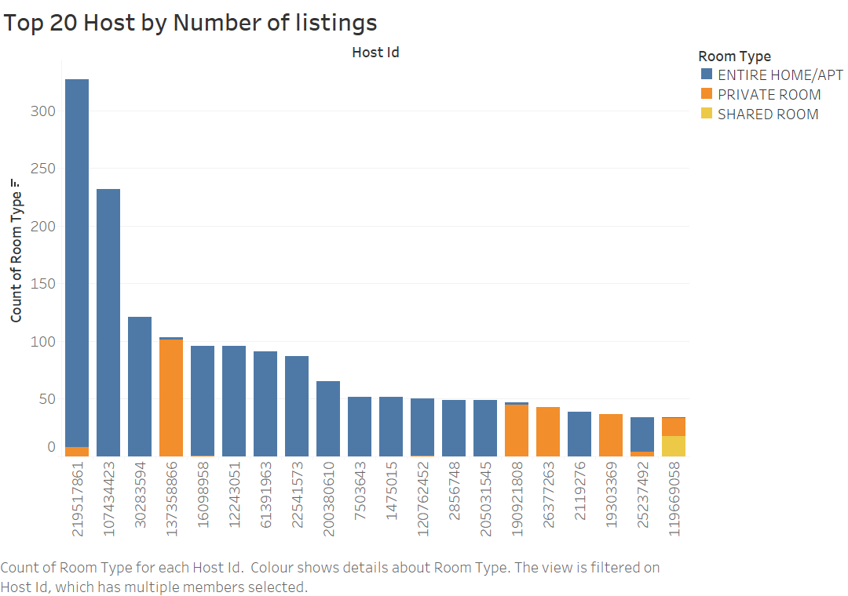
Top 20 Hosts by Number of Listings

Slide 9
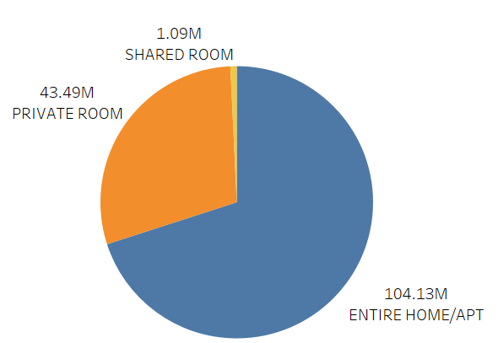
Total Revenue by Room Types
Insights:
Entire Home/Apt Room Type has generated highest Total revenue of $ 104.13 Million.
And only $ 1.09 Million is generated by Shared Room.

Slide 10
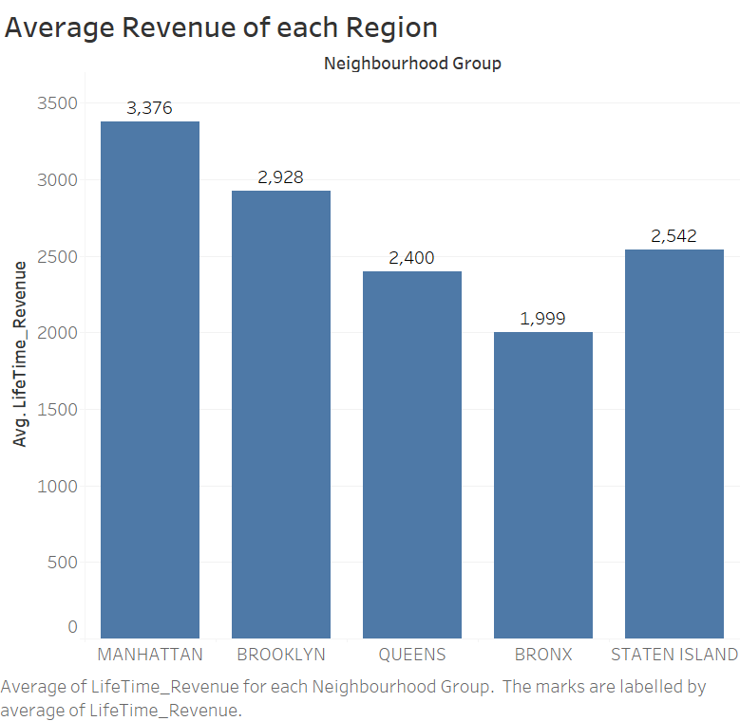
Average Revenue of Each Region
Insights:
Manhattan has the highest Average Revenue of $ 3376.

Slide 11
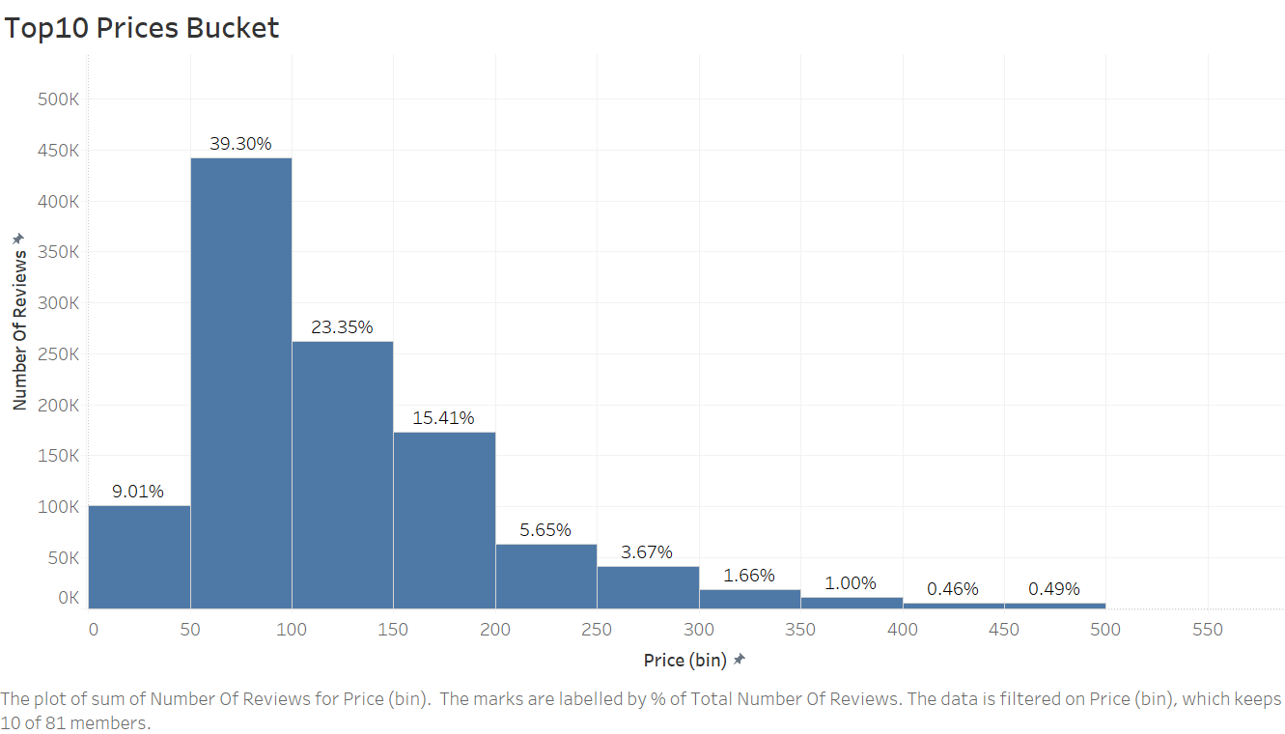
Top 10 Price Bucket
Insights:
$50 –S100 is the most popular price bucket.
Most of the booking are made between the price range of $0-$400, with less than 1% bookings are higher than $400 price.
There is potential to attract a broader audience by focusing on lower-cost listings.

Slide 12
Conclusion
Manhattan has the highest number of Properties.
Brooklyn and Queens offers opportunities for attracting budget-conscious travellers. Targeted marketing and possibly adjusting minimum stay requirements could boost bookings.
Most of the people prefer to book the Entire Home/Apt. and use to choose property with $50 –$100 price point.
Thus, Entire Home/Apt Room Type has generated highest Total revenue of $104.13 Million.
We also saw that properties with best river side views are costliest with around $10K booking price.
Thus we can focus on these area to increase Airbnb revenue.

Slide 13
Appendix
Firstly, before starting our analysis on Raw data, we must clean it on Jupiter Notebook by performing Data Cleaning, EDA.
After, cleaning the data, we export the cleaned dataset for visualization.

Slide 14
Appendix - Methodology Used
Firstly, we have performed Market Overview Analysis:
By checking listings Distribution: Highlight the concentration in Manhattan and potential growth in Brooklyn and Queens.
Checking Distribution of Room Types: Emphasize user preferences for Entire Homes/Apartments.
Then, we have done Pricing Analysis:
By checking price disparity and discussing the variation in prices across neighborhoods and room types.
Finding opportunities in affordable areas and potential to attract a broader audience by focusing on lower-cost listings.

Slide 15

Appendix - Methodology Used
User Experience Insights:
High-Demand Areas: Focus on enhancing user experience in neighbourhoods like Williamsburg and Harlem.
Minimum Stay Adjustments: Consider revising minimum stay requirements to cater to short-term travellers.
Operational Strategies:
Focus on Premium Services in Manhattan: Maintain high standards to justify premium pricing.
Expand in Brooklyn and Queens: Increase marketing efforts and potentially adjust service offerings to attract more bookings in these areas

Slide 16
Appendix - Recommendations
Recommendations to improve Revenue:
Neighbourhood-Specific Campaigns: Target marketing and promotional efforts in high-demand neighbourhoods.
Enhance User Experience: Invest in improving the user experience in areas with high listing concentrations.
Operational Efficiency: Streamline operations in Manhattan while exploring new opportunities in less saturated areas.

