Slide 1
Calibrating RP DAC and ADC
Calibration Branch

Slide 2
Python Scripts in tools/
Keithley Script to set and get voltage
Gain-/Offset Parameters
• adc_calibration.py
• dac_calibration.py
• rp_dac_adc_test.py
• Keithley260X.py in py_src/rp/devices
• c_src/rp_calib_parameters.h
• py_src/rp/calib_parameters.py

Slide 3
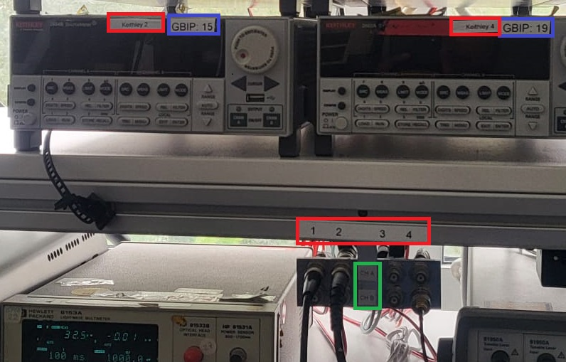
Running the Scripts
Get IP Address of the RP from DHCP Server
Set the IP Address in the Script and connect to the server using command terminal
ssh root@RP_IP
Initialising Keithley:
• Power ON the SMU
• Set GPIB in Python Script
• Set Slot (1 for CH A, 2 for CH B)
Set the Boolean Variables:
• Debug_mode
• Plot_graph
• Write_new_coeffs
* Both ADC Channels can be calibrated at once within ±20V.
* Only a single DAC Channel is calibrated at once within ±1V.

Slide 4
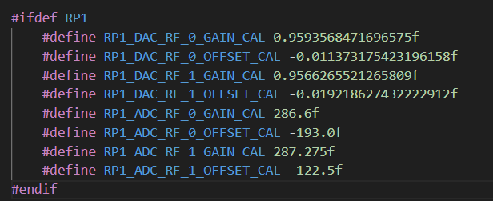
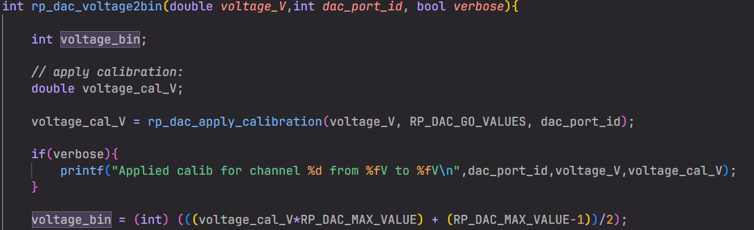
Implementating G/O parameters - During the compilation of C source code, RP ID is obtained from tools/getRPID.sh and a compiler flag is created. - Only the gain/offset-parameters defined for the connected RP are used while giving out or measuring the voltage - rp_dac_set_voltage: voltage is adjusted using the parameters , voltage_cal = voltage * gain + offset - get_voltage_fast: similar to rp_dac_set_voltage

Slide 5
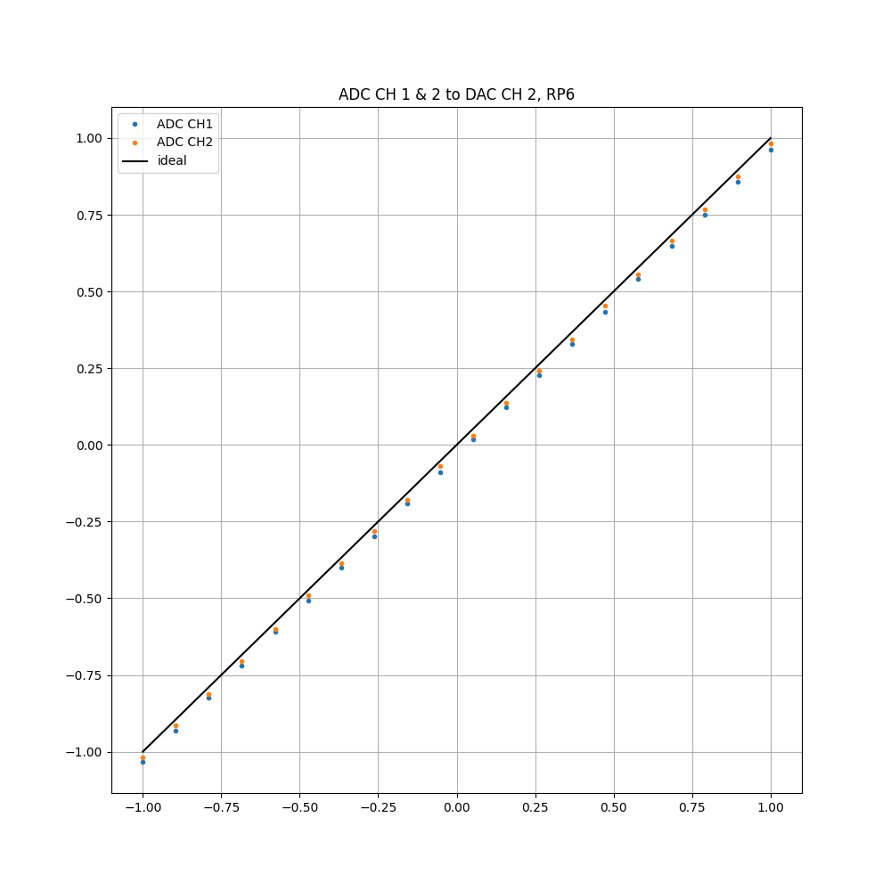
Test RP DAC and ADC
- After calibrating both ADC and DAC channels, rp_dac_adc_test.py
was executed by giving voltage out of DAC and measuring it with
ADC of RP.
- Connect both ADC Channels with PORT0 of DAC
- Run the script
- Test on a channel can either be executed by pressing „Enter“
or be skipped by pressing „X“.

Slide 6
Vielen Dank für eure Aufmerksamkeit !!

