Slide 1

KIET GROUP OF INSTITUTIONS
Department of Computer Applications

Slide 2
Chat2Talk
Android based Chatting Application
MENTOR : Mr. Vipin Kumar
Project By : Amit Kumar
Harshika Srivastava
(4th Semester)

Slide 3
Objective:
Our Project Chat2Talk is an Android based Messaging Application,
which is designed and kept under the huge scope of the audience i.e. students and faculty of KIET Group of Institute . In this era of social platforms having a medium of communication like Chat2Talk helps in sharing thoughts on status, quick chats wherein people can communicate initiating a chat to convert in Talks. We have curated Chat2Talk to share messages, videos, stickers, that make Chat2Talk the most user-friendly and simple to use App.
We have used FIREBASE for Authentication of Phone Number and REAL TIME

Slide 4
Project Scope:
Phone Number Authentication.
Setting Profile Name.
Uploading Profile Image.
Real Time Chatting.
Uploading Status.
Reaction on Messages.
Sharing Files & Images.

Slide 5
Why we developed Chat2Talk for our major Project ?
The idea behind building this App was to understand how Android work and to learn FIREBASE and for this we thought it is best to build a chatting application
On daily basis we use social media apps for connecting with each other, so we were curious to see how this app works, that’s why we started building this app.

Slide 6
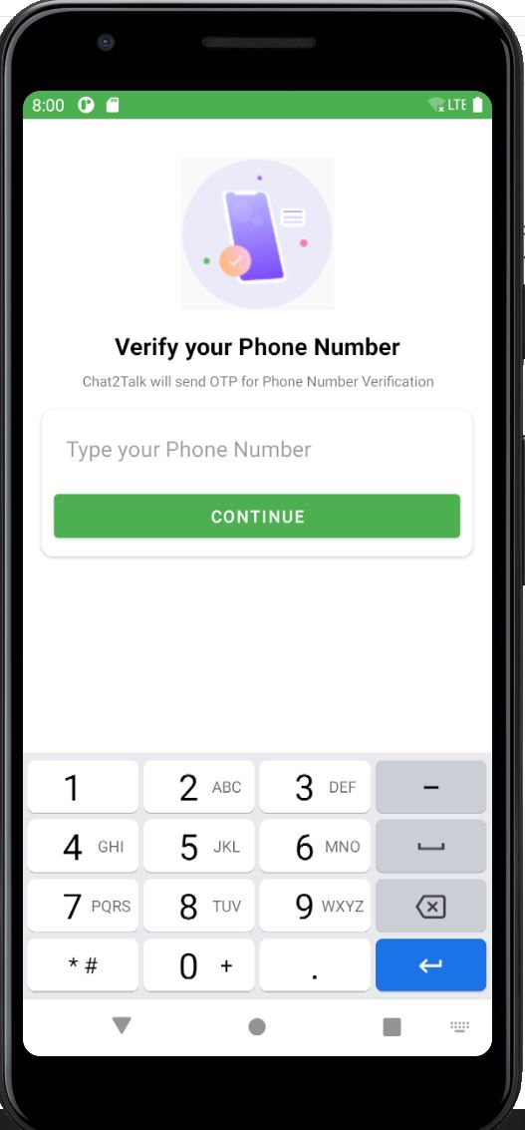
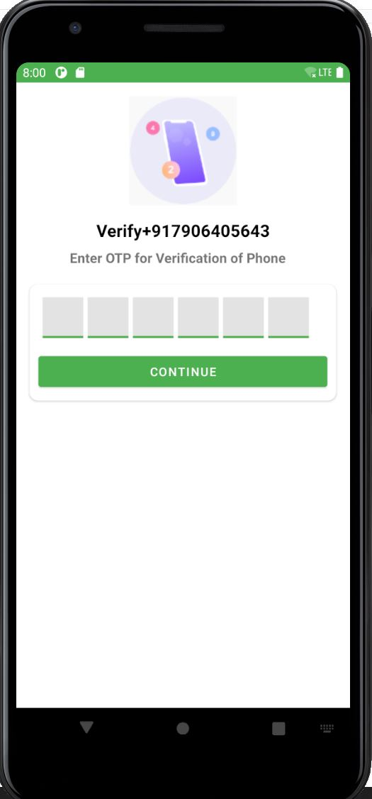
Project View :
Activity One
Activity Two

Slide 7
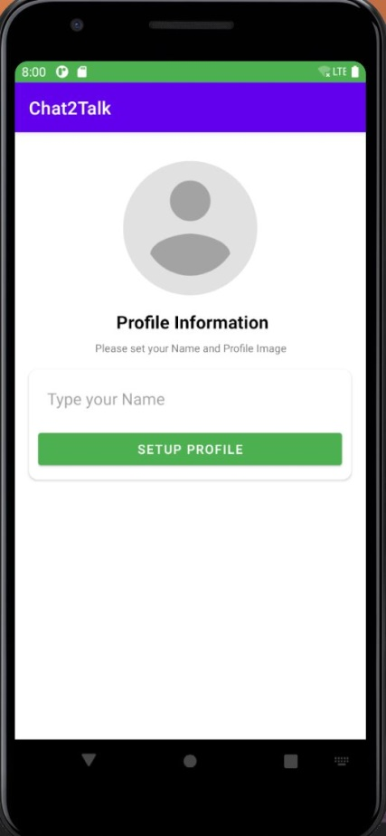
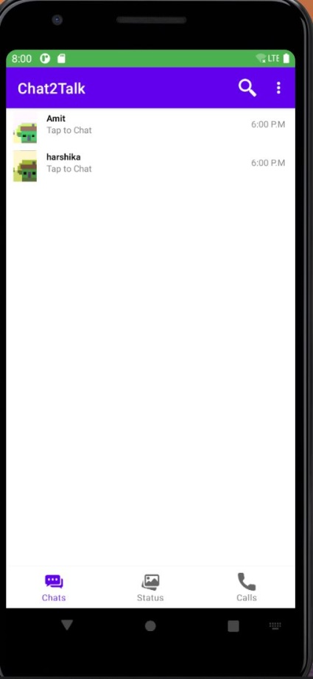
Project View :
Activity Three
Activity Four:

Slide 8
Future Scope:
Sharing of Files.
Voice Calling.
Video Calling.

Slide 9
THANK YOU.

