Slide 1


EDA : Racism and Fatal Police Shooting in the US
Kapil Dadlani
Data Science
The Bridge

Slide 2
Hypothesis
The percentage of Fatal police Shooting in the US is higher within black population in comparison with other races

Slide 3
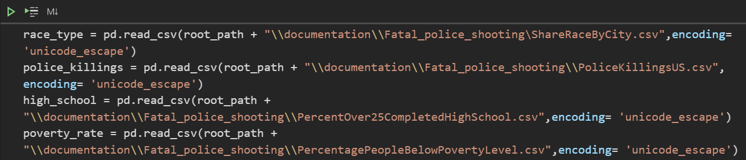
Data Source
Kaggle: Fatal Police Shooting in the US
Data Wrangling
Transforming data from .csv to pandas dataframes

Slide 4
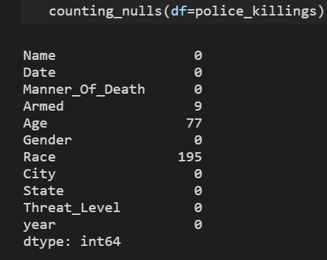
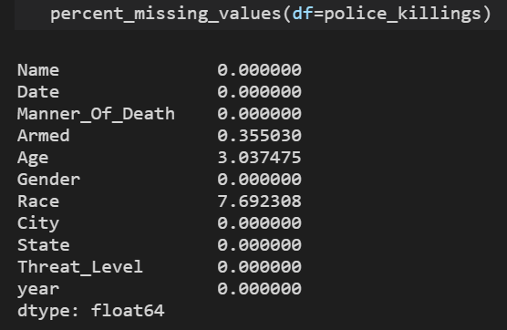
Data Cleaning
Transformed all column titles to the same format to be able to merge the dataframes
Renamed Columns
Dropped unnecessary columns (columns that were not going to be used in my analysis)
Identified missing values
Dropped rows where values were NaN

Slide 5
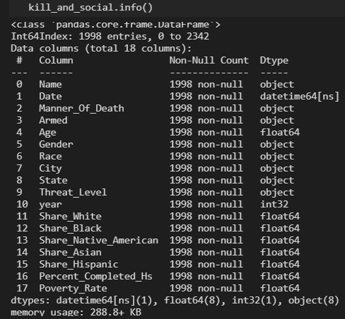
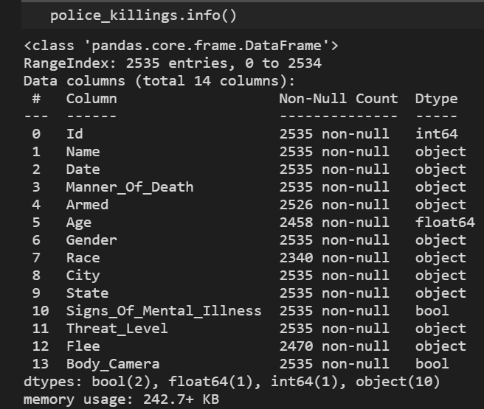
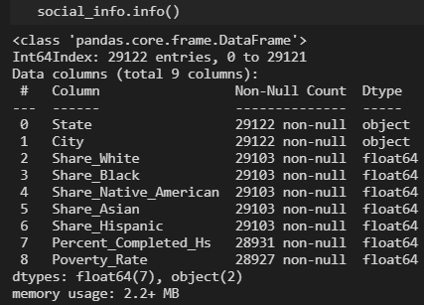
Completed missing values in the age column with it´s mean value
Deleted rare values ( “(X)”, “(-)”, etc.) and transformed numeric columns to float type
Transformed Date column type to datatime, extracted the year and added it as a new column type(int)

Slide 6
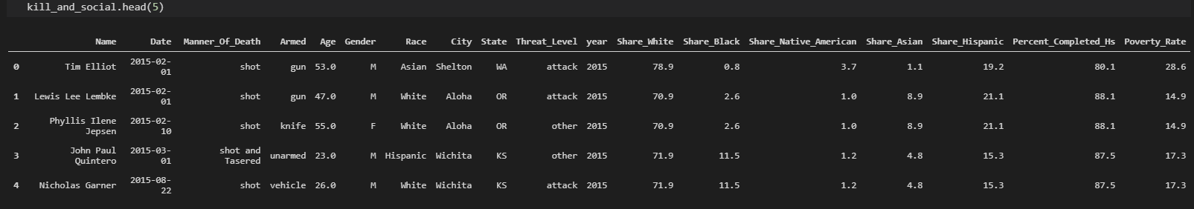
Merged Dataframes

Slide 7
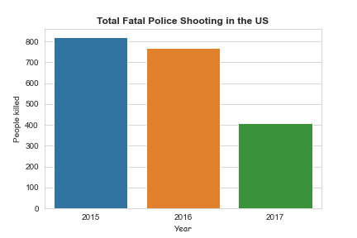
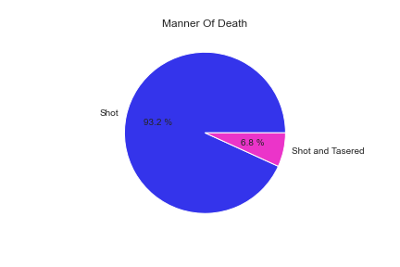
Data Visualization
Showing the information and tendency of the columns in my dataframe
Showing charts focused on my hypothesis

Slide 8
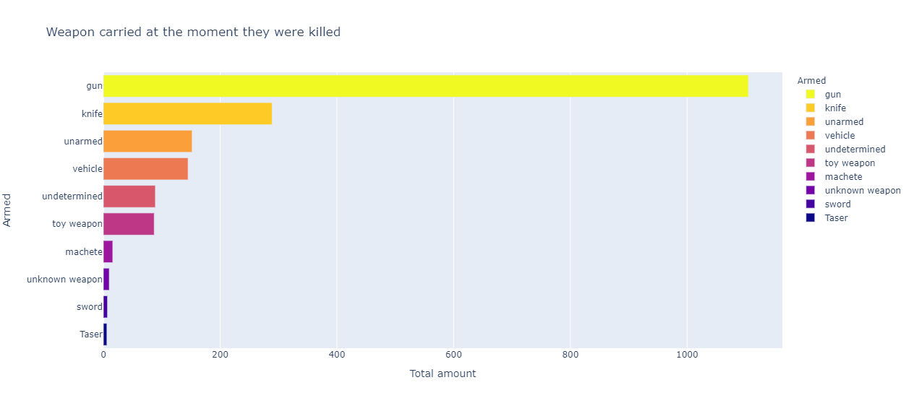

Slide 9
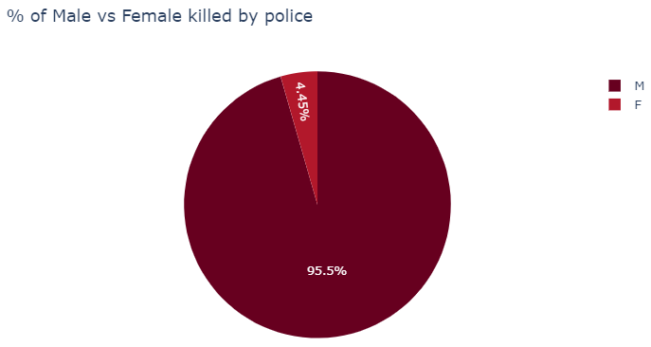
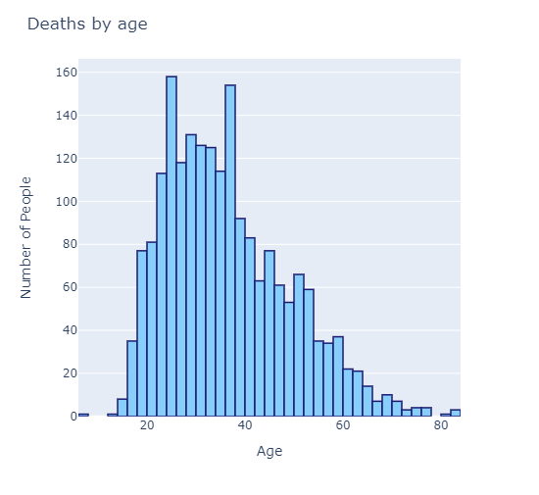
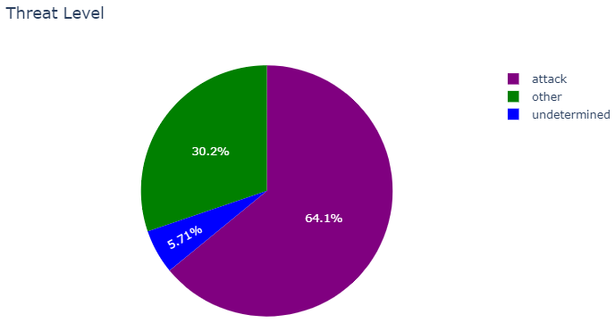

Slide 10
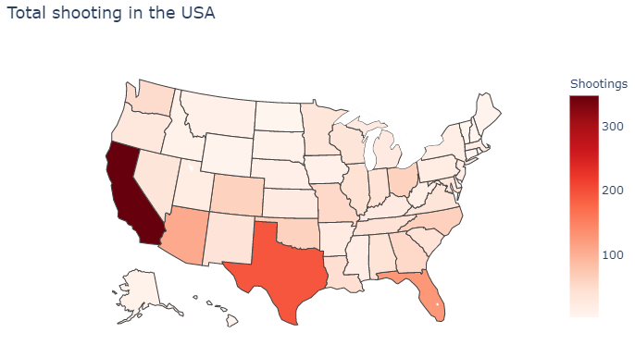
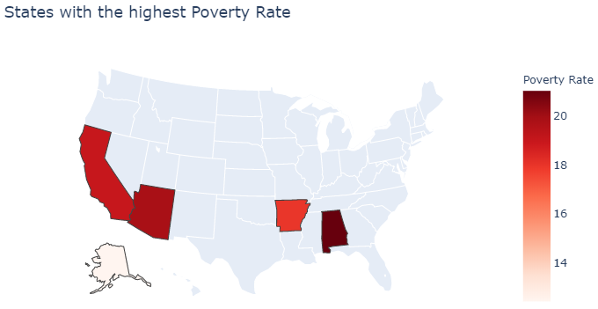
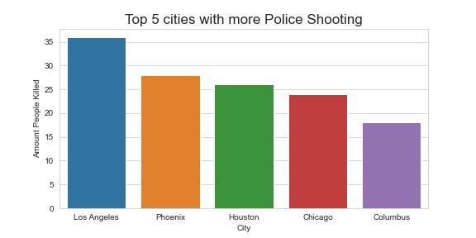

Slide 11
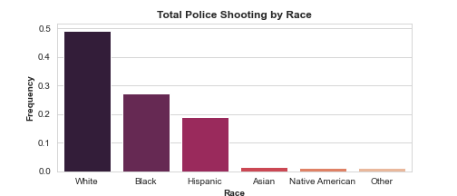
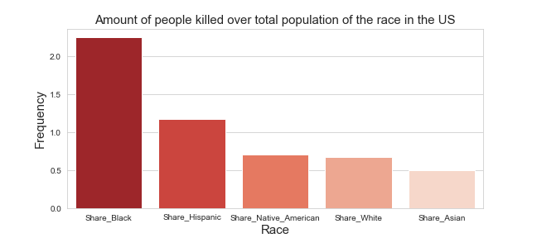

Slide 12
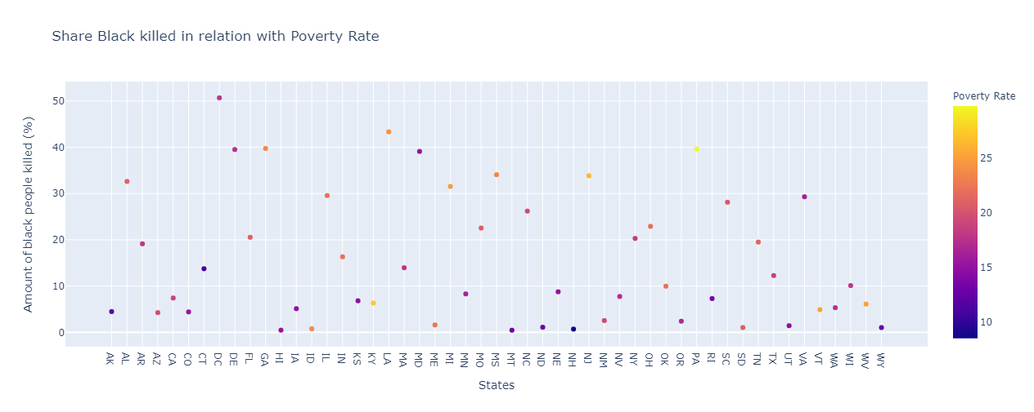

Slide 13
Conclusion
We can conclude that there is a tendency for Fatal Police Shooting in the US towards black people
Future Steps
Find more information related with this topic to further analyse racism in the US.
Apply all the new concepts I will be acquiring during the bootcamp in this project.

Slide 14
Thank You!

