Slide 1
Correlation VS. Causation
Correlation does not imply causation
Nilima Pandey

Slide 2
What is Correlation?
association between variable quantities
Measures how variables are related

Slide 3
Correlation Coefficient
Pearson correlation coefficient
denoted by ‘r’
value ranges between -1 to 1
0 means no relationship
1 means perfect positive correlation
-1 means perfect negative correlation

Slide 4
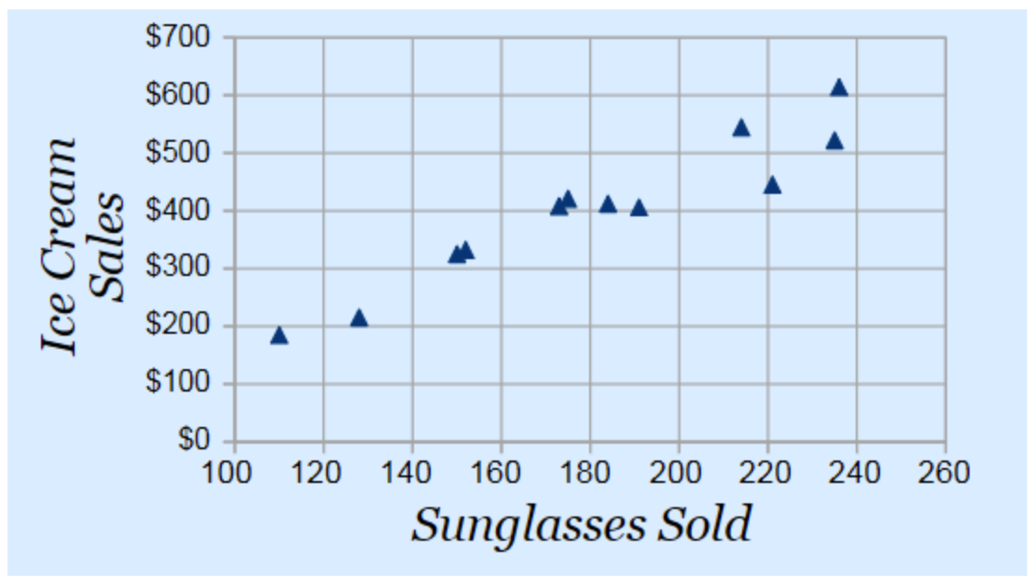
Example: Correlation between Ice cream sales and sunglasses sold
Sale of ice cream increasing as the sale of sunglasses is increasing
Sale of ice cream and sale of sunglasses is correlated
Does not mean sale of sunglasses causes sale of ice cream

Slide 5
What is Causation?
one event is 100 percent certain to cause something else

Slide 6
Correlation VS Causation
High correlation can indicate causation
Correlation does not imply causation
Presence of a third variable?

Slide 7
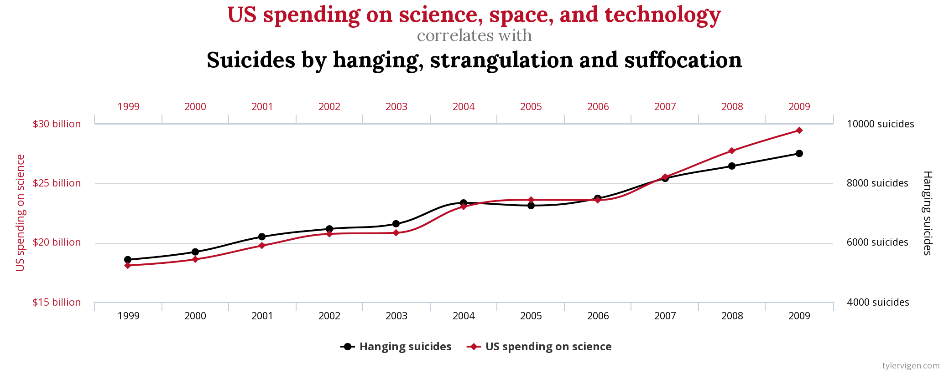

Slide 8
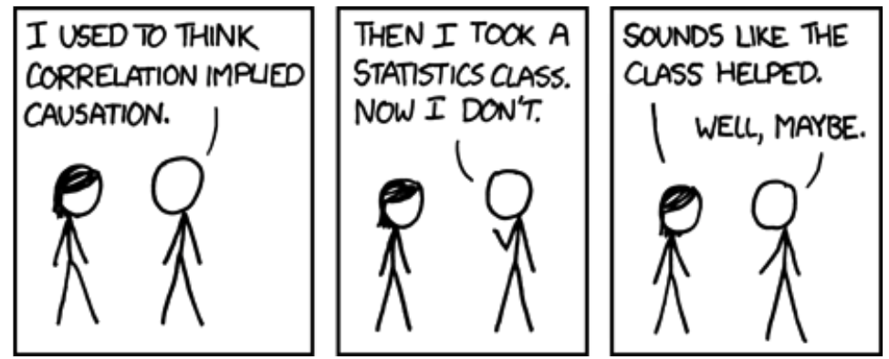
Questions??

