Slide 1
Customer
shopping
behavior
What 3,900 purchases reveal about revenue, loyalty, subscriptions, and the next commercial moves.

Slide 2
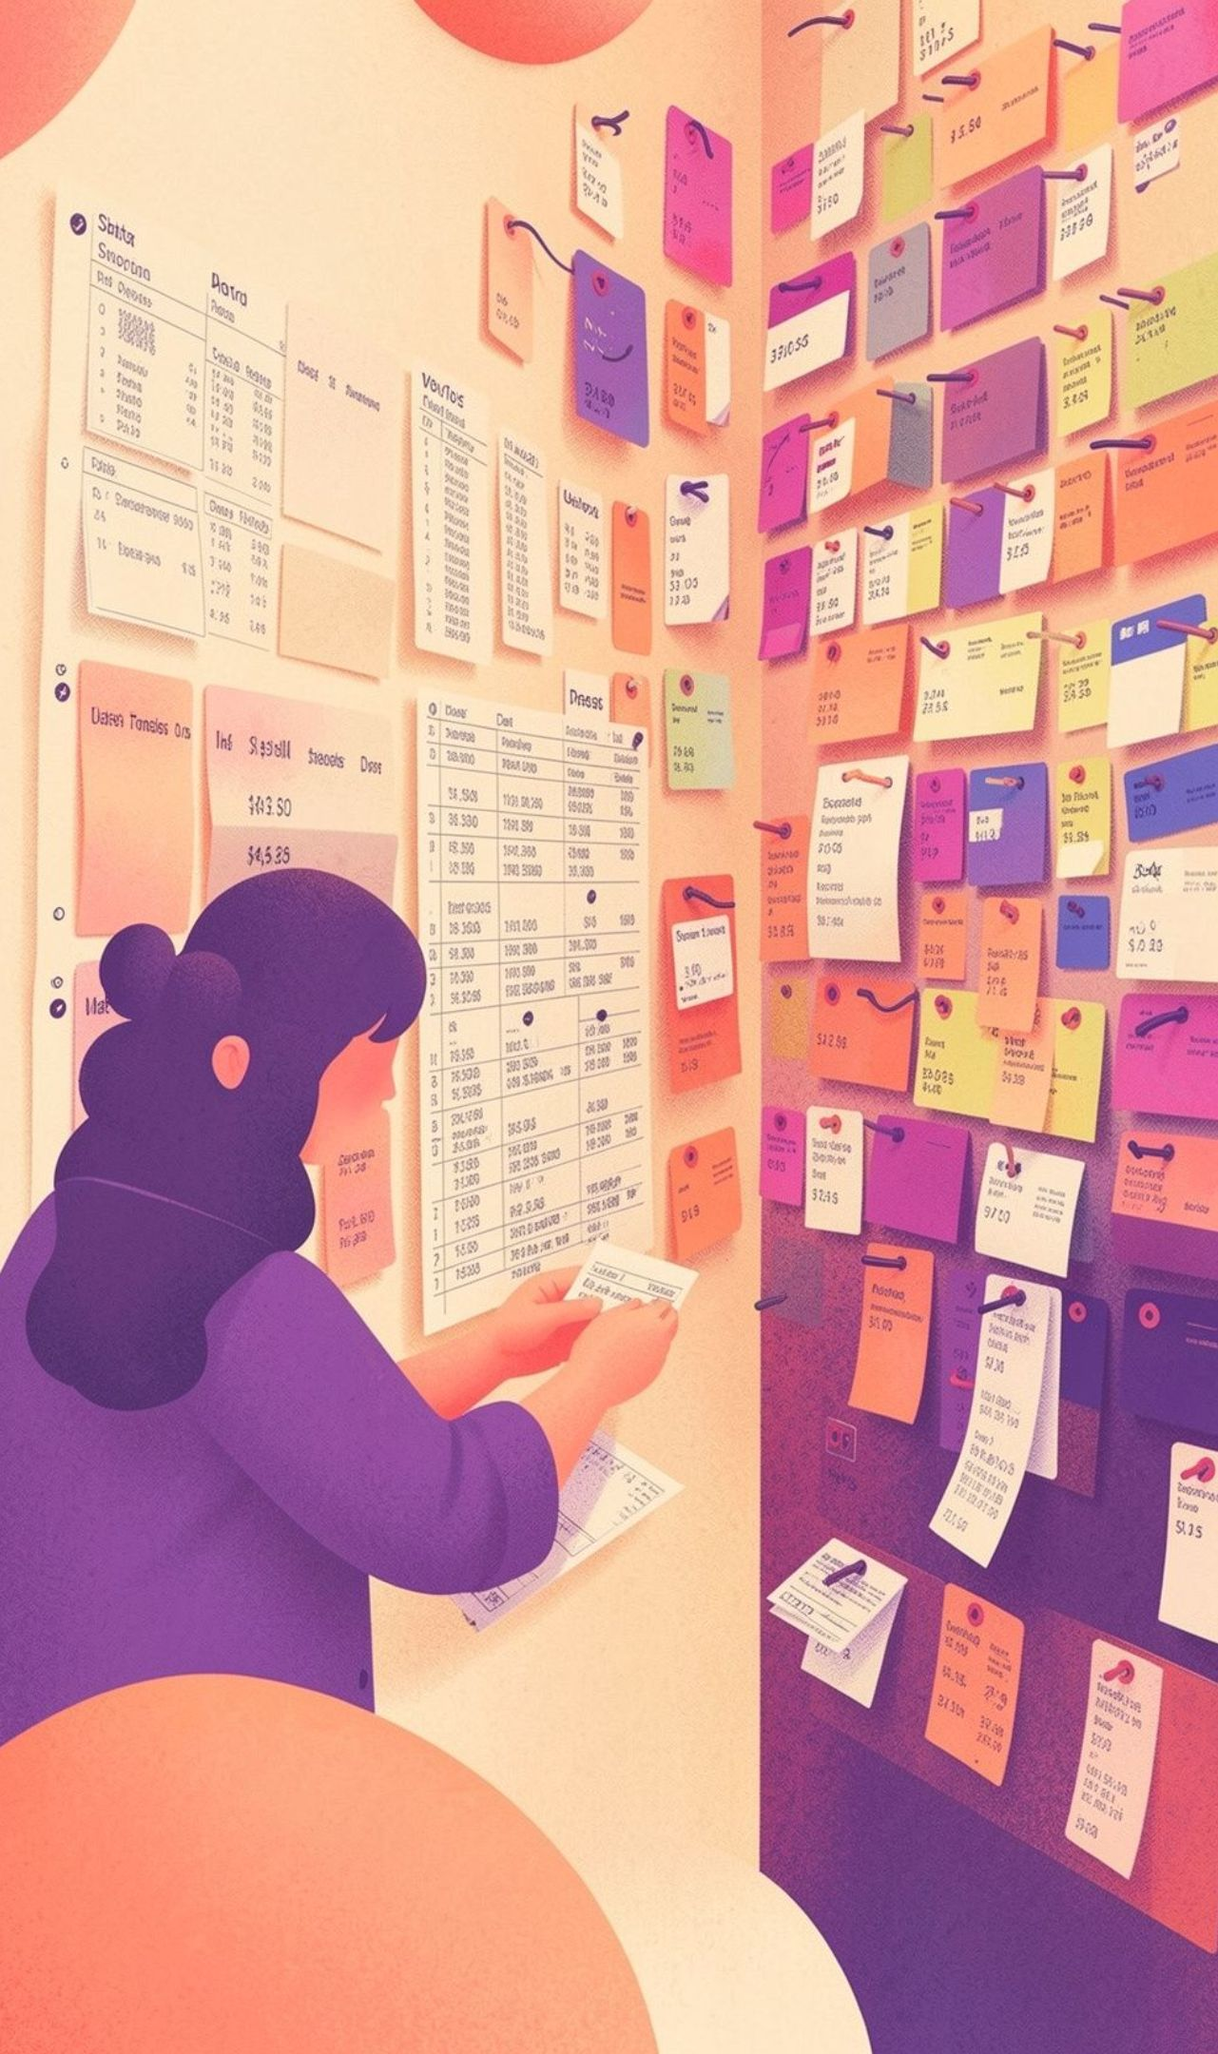



The dataset is broad enough to connect behavior to action
3,900 purchases
18 fields
Demographics, products, promotions, reviews, frequency, shipping and etc.
One cleanup gap
37 missing review ratings, imputed with the median.
Cleaned in Excell, loaded for SQL analysis, and visualized in Power BI.
01
02
03
Clean Data
Analyze Transactions
Activate Insights

Slide 3
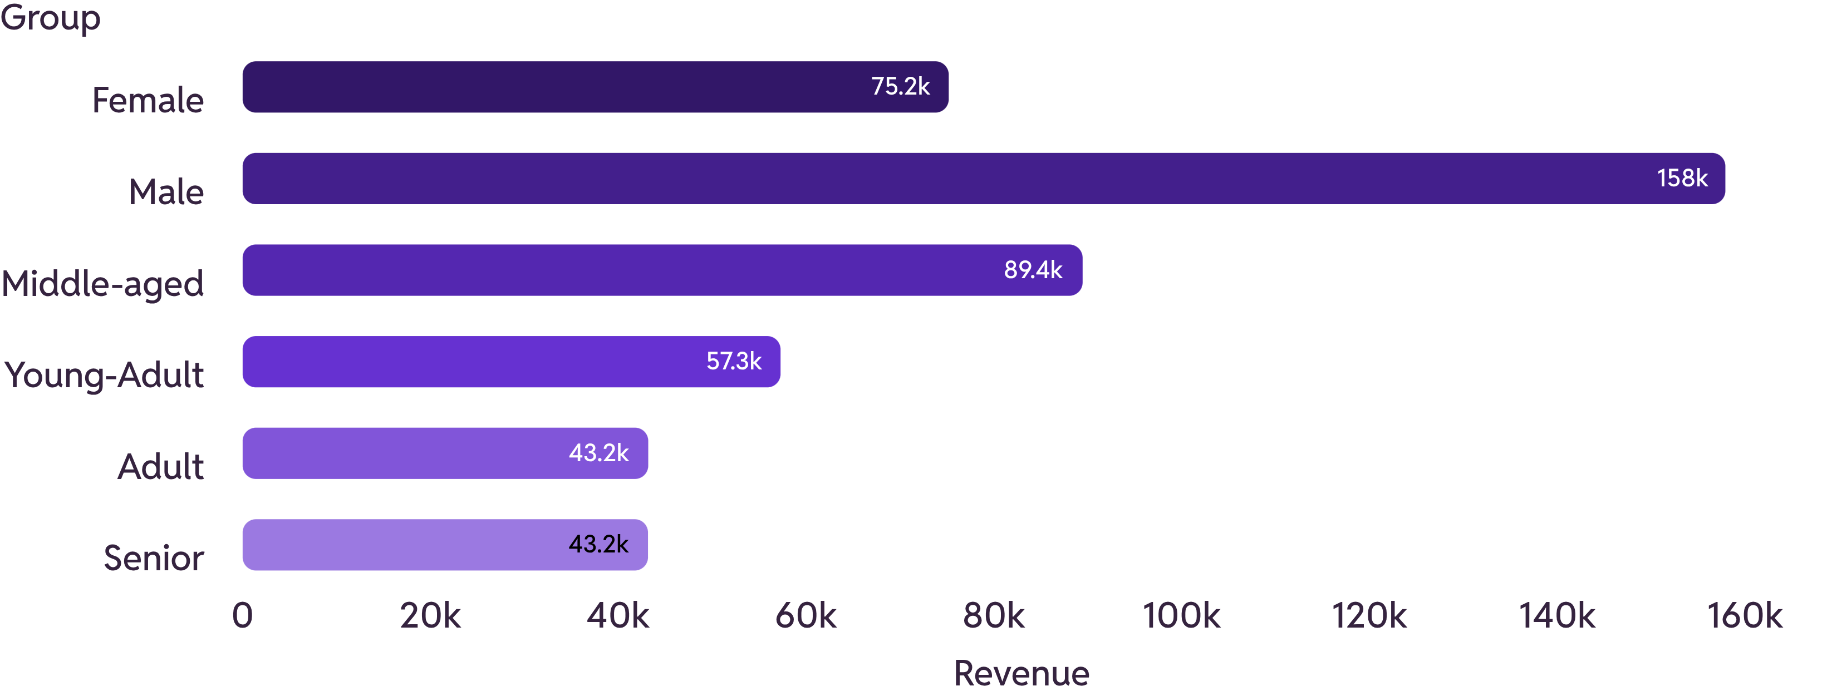
Revenue is concentrated in male customers and the middle-aged segment
Gender and age point to two distinct targeting signals.

Slide 4


Loyal customers already anchor the business
Loyal: 3,116 customers
Returning: 701 customers
New: 83 customers
Launch
Research
Idea
Design
Build
The growth question is less about finding loyalty from scratch and more about protecting, rewarding, and extending it.

Slide 5

Subscription is an opportunity, not yet a spend advantage
Average spend
59.49 subscribers · 59.87 non-subscribers
Total revenue
62,645 subscribers · 170,436 non-subscribers
Customer base
1,053 subscribers · 2,847 non-subscribers
Recommendation: make the membership promise more compelling before pushing harder on enrollment.

Slide 6
Repeat buying is widespread, but subscription conversion lags
958
2,518
Repeat buyers among subscribers
Repeat buyers among non-subscribers
Practical test: use loyalty moments and repeat-purchase triggers to introduce exclusive subscription benefits.

Slide 7


Discounts can lift conversion without guaranteeing value
Discount signal
Margin check
Campaign action
Identify customers who used discounts yet still spent above the average purchase amount.
Flag the five products with the highest share of discounted purchases.
Review discount depth and product dependence together to protect margin.
Use discounts as a targeted lever, not a default growth strategy.

Slide 8

Express shipping is a small but actionable value signal
A modest difference gives the team a focused test.
60.48
58.46
2.02
Express average purchase
Standard average purchase
Difference in favor of Express
Recommendation: test whether speed, urgency, or convenience messaging can raise basket value.

Slide 9



Product and review signals can sharpen campaigns
Use top-rated products
Improve category storytelling
Pair product and audience
Make them proof points in merchandising and campaign creative.
Position products with the age and loyalty segments most likely to respond.
Use the top three products in each category to improve navigation and category storytelling.

Slide 10


Three moves turn the analysis into action
Boost Subscriptions
Reward Loyalty
Target Precisely
Decision lens: protect the loyal base, test the membership promise, and focus campaigns where the evidence is strongest.

