Slide 1
Fraud Account Detection System
Group Members:
Kapil Surve | (21106018)
Harshal Deshmukh | (22206008)
Mihir Bhave | (21106051)
Tanisha Chitnis | (21106003)

Slide 2
INTRODUCTION
In this project, we implemented two key methods for fraud detection: Account Fraud and Transaction Fraud.
Account Fraud: Focuses on identifying fraudulent accounts involved in illegal activities, such as money laundering, scam accounts, and dummy accounts.
Transaction Fraud: Involves real-time log detection to evaluate transaction risks, distinguishing between legitimate and fraudulent accounts.
To enhance our detection accuracy, we utilized machine learning models including Artificial Neural Networks (ANN), Logistic Regression (LR), and K-Nearest Neighbors (KNN). Random Forest (RF) was used for classification.

Slide 3
OBJECTIVE
The primary objective of this project is to implement machine learning algorithms for detecting fraud based on transaction time and amount. The system aims to identify suspicious activities benefiting both banks and cardholders by enhancing security and reducing financial losses.
    Real-Time Fraud Detection: Detect fraud instantly during transactions.
    Enhance Detection Process: Improve fraud detection accuracy and efficiency.
    Compare Multiple Machine Learning Models: Evaluate and select the best-performing fraud detection model.

Slide 4
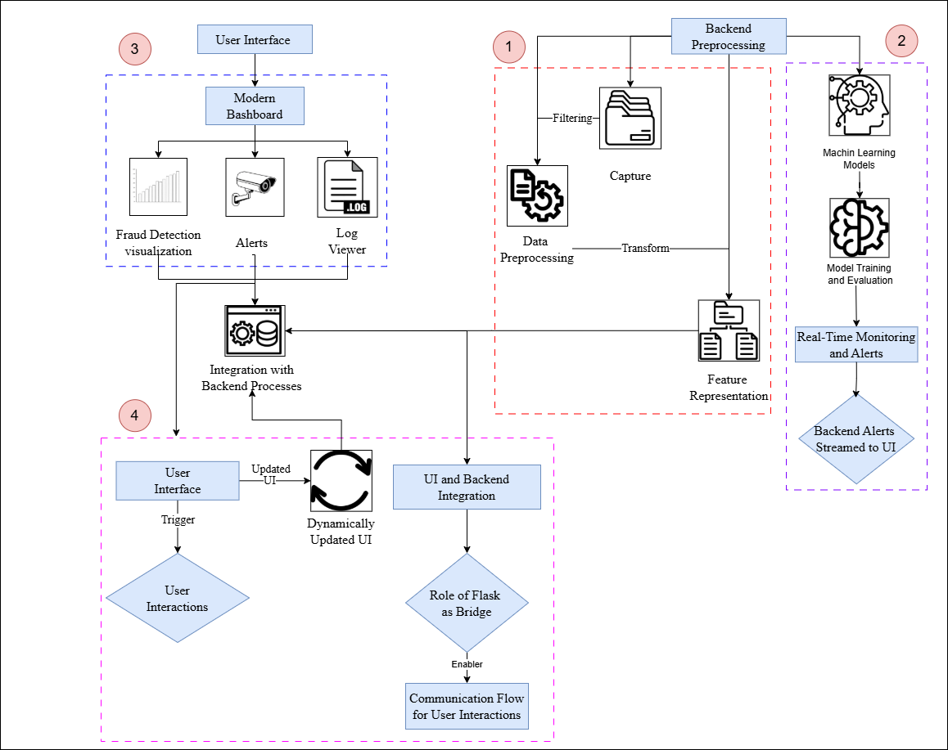
PROPOSED SYSTEM

Slide 5
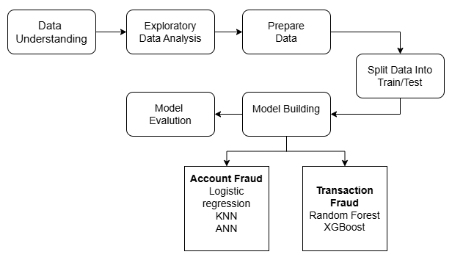
IMPLEMENTATION STEPS

Slide 6
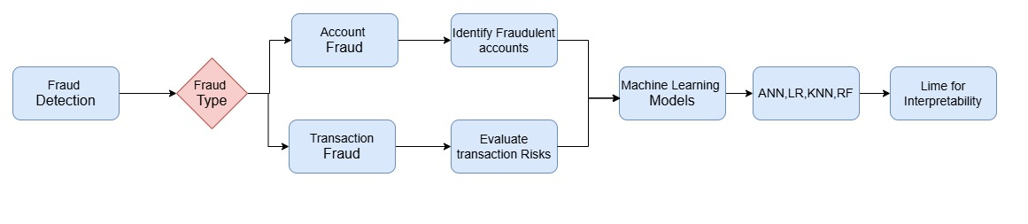
FRAMEWORK

Slide 7
INPUT TO THE SYSTEM
To model our fraud detection task, we use the Bank Transaction Fraud Detection and Account Fraud Detection datasets. These are among the most widely used datasets for fraud detection, providing both normal and fraudulent account and transaction data.
The Bank Transaction Fraud Detection dataset includes labeled transaction data and features 12 attributes, while the Account Fraud Detection dataset focuses on account data with 7 key features. These datasets allow us to analyze transaction activities and account behaviors to identify fraudulent patterns.

Slide 8
FEASIBILITY AND VIABILITY
Technical Feasibility:
The project uses widely available datasets (Bank Transaction Fraud Detection and Account Fraud Detection from Kaggle). These datasets provide labeled transaction data, making supervised learning feasible.
The project compares multiple models to select the best-performing one, ensuring adaptability to fraud detection scenarios.
Implementing real-time fraud detection is challenging but achievable with optimized models. Implementing real-time fraud detection is challenging but achievable with optimized models.
Challenges & Mitigation:
Hyperparameter tuning, threshold adjustment, and ensemble methods can help reduce false positives.
Using lightweight models or GPU-accelerated computing can help.

Slide 9
IMPACT AND BENEFITS
IMPACT:
Reduces fraudulent transactions by identifying suspicious activities more accurately than traditional rule-based systems
Enables instant transaction monitoring and fraud detection, preventing fraudulent transactions before they are processed.
By using machine learning models like Random Forest and ANN, the system can distinguish between legitimate and fraudulent transactions more effectively.
BENEFITS:
Helps banks and financial institutions minimize financial losses due to fraud.
Protects customers and financial institutions from financial threats in real-time.
Improves customer experience by preventing unnecessary transaction blocks.

Slide 10
CONCLUSION
We successfully implemented account fraud detection and transaction fraud detection partially
we use ml models and achieve higher accuracy for logistic regression 86 % , for random forest 94 %, for KNN 98 %, for ANN 98 %.

Slide 11
11
REFERENCES
Useful links:
Account Fraud: https://www.kaggle.com/datasets/sgpjesus/bank-account-fraud-dataset-neurips-2022
Transaction Fraud: https://www.kaggle.com/code/marusagar/bank-transaction-fraud-detection-accuracy-95/notebook
Journal used
[1] Vashistha, Astha, and Anoop Kumar Tiwari. "Building Resilience in Banking Against Fraud with Hyper Ensemble Machine Learning and Anomaly Detection Strategies." SN Computer Science 5, no. 5 (2024): 556.
[2] Sivanantham, S., S. R. Dhinagar, P. Kawin, and J. Amarnath. "Hybrid approach using machine learning techniques in Account Fraud Detection." In Advances in Smart System Technologies: Select Proceedings of ICFSST 2019, pp. 243-251. Springer Singapore, 2021.
[3] Talukder, Md Alamin, Majdi Khalid, and Md Ashraf Uddin. "An integrated multistage ensemble machine learning model for fraudulent transaction detection." Journal of Big Data 11, no. 1 (2024): 168.

Slide 12

THANK YOU !

