Slide 1
LITTLE BLOSSOMS • WEBSITE • 2026
Play today.
Blossom tomorrow.
A warm, colourful playschool website for little ones from 8 months to 6 years
Designed with real photos, WhatsApp-first booking, an age quiz, and a garden of playful details
Little Blossoms Play School

Slide 2
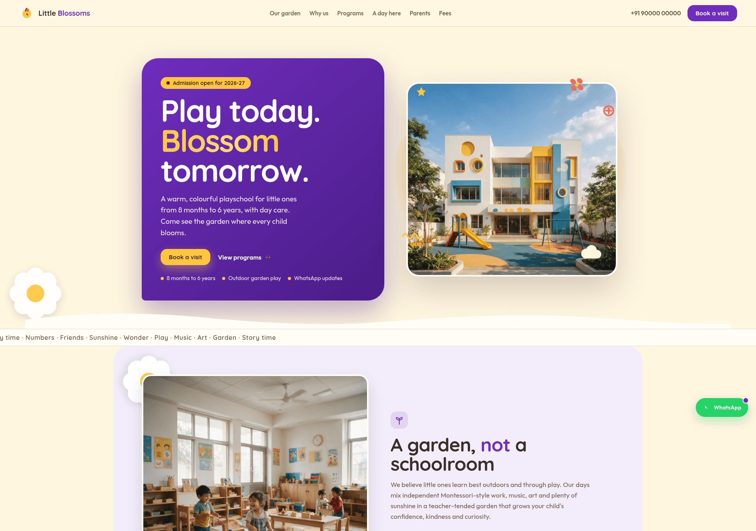
Our website today
A single-page site that feels like the school: warm, playful and easy for parents
What makes it special
✓
WhatsApp-first booking
All enquiries land in one WhatsApp chat with details pre-filled
✓
Age quiz → auto-fill
Parents answer 2 questions; the form pre-fills program + age
✓
Real photos
Your playschool photos across hero, About, day cards and gallery
✓
Interactive scroll
Scroll progress, spinning corner flowers, gentle reveals
✓
Address + Google Map
Find-us bubble with directions link below the form
✓
Fully responsive
Tested on a 360px mobile viewport — clean on every screen

Slide 3
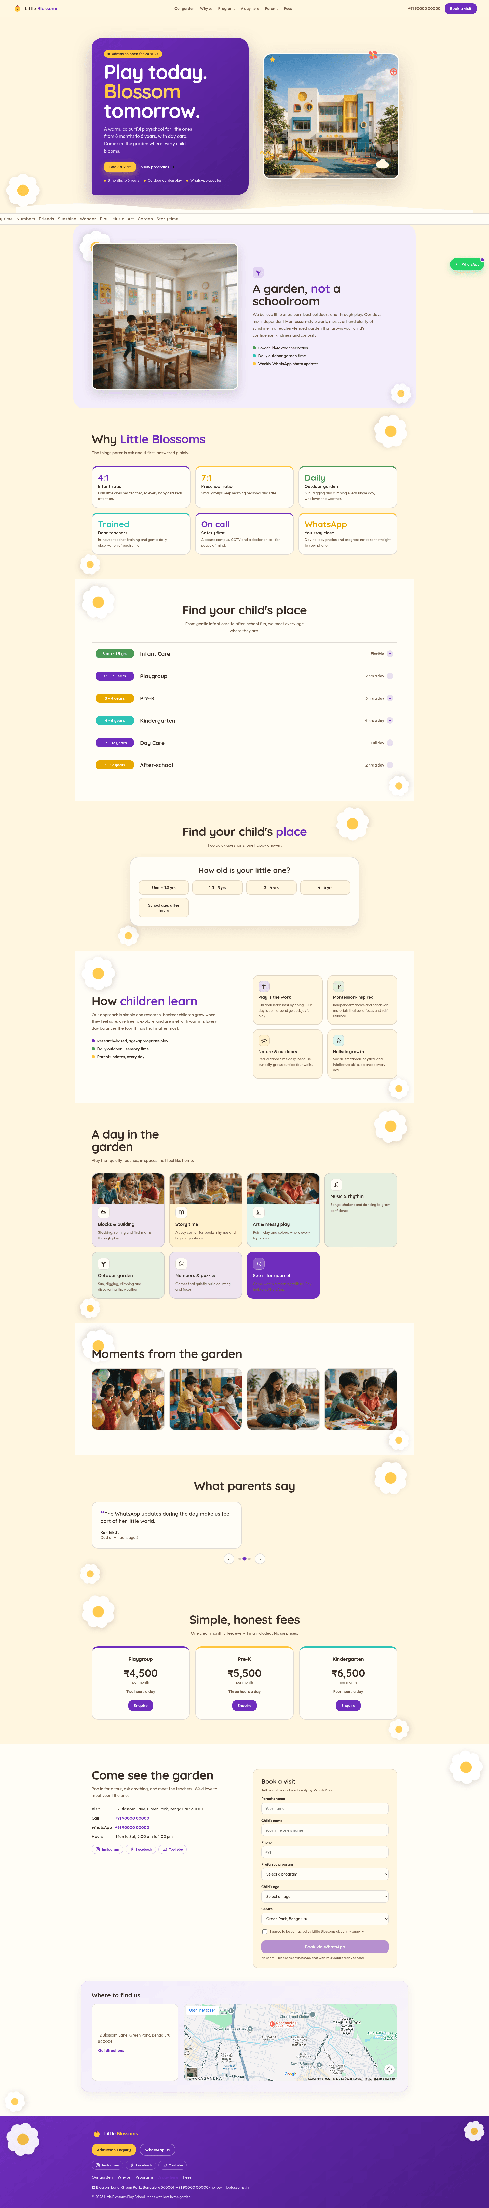
Reference 1 — roughout.in (agency demo)
A playful, modular, rounded landing page in the same spirit as ours
What to borrow
Big friendly headline inside a bold rounded card
Custom icons to explain trust points simply
Interactive age-selector personalises the journey
Warm cream + lavender + sunny yellow palette
Floating flower / organic shapes for charm

Slide 4
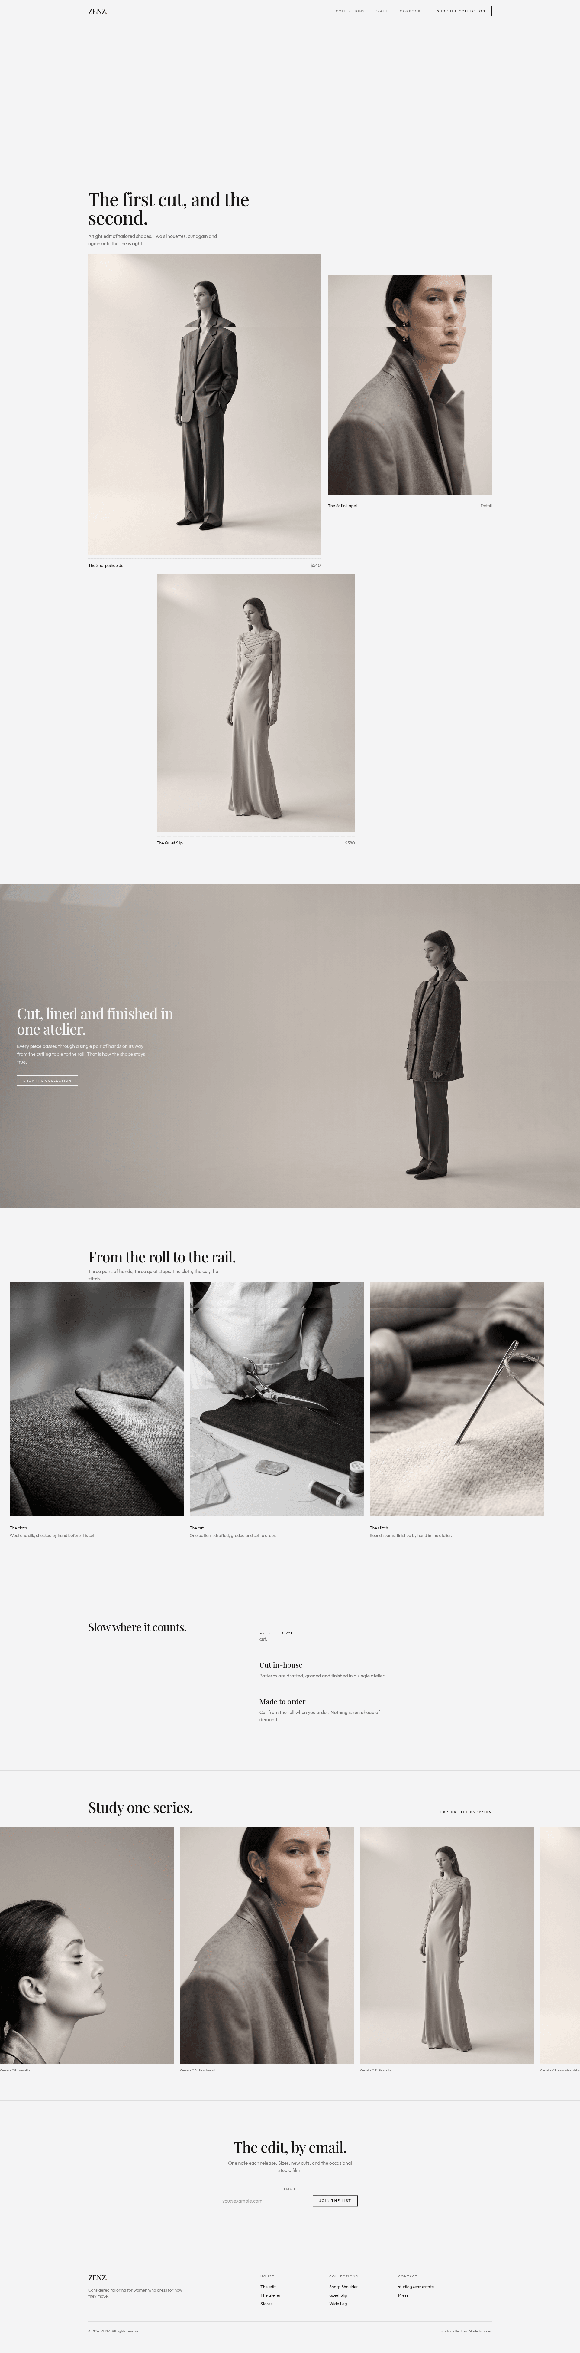
Reference 2 — ZENZ (fashion / editorial)
A minimalist, editorial look built on white space and strong photography
What to borrow
Generous white space — let content breathe
High-quality real photos carry the page
Asymmetric, editorial image placement
One confident accent against a neutral base
Craft markers that build trust step-by-step

Slide 5
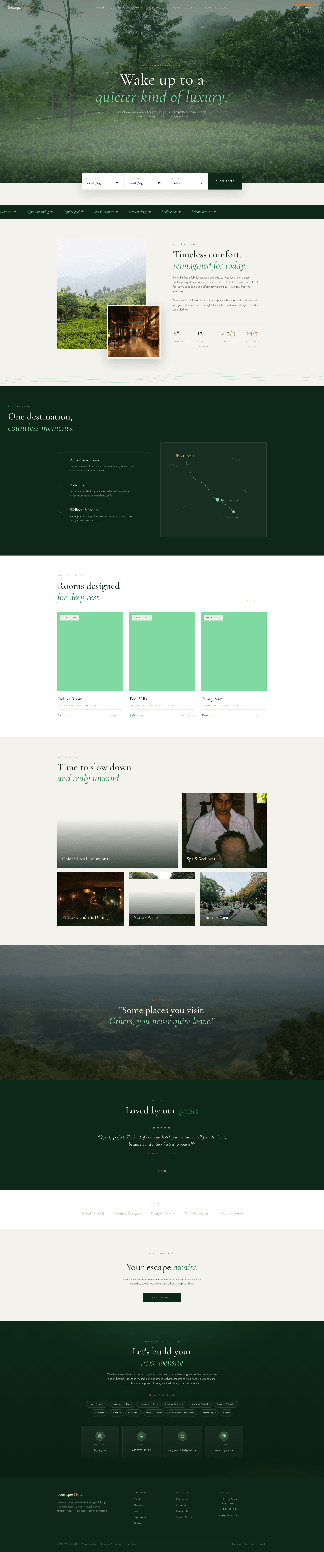
Reference 3 — Boutique Hotel (hospitality)
Full-bleed atmosphere + a conversion bar that is always in reach
What to borrow
Immersive full-bleed hero sets the mood
A sticky booking bar keeps the key action visible
Elegant serif + calm nature palette
Alternate big images with clean info blocks
A stylised map / journey graphic to guide visitors

Slide 6
The parent’s journey
1
Discover
2
Match
3
Book
Scroll a playful hero, see real kids and the outdoor playground
Answer 2 quick questions — the quiz recommends the right program
Tap Book a visit — program and age are already filled in
4
Connect
5
Visit
Add name, phone, centre and consent — one tap opens WhatsApp
Find the address and map, then get directions — done

Slide 7
Design system
Brand palette
Motifs
White daisy with a sunny centre — in the corners, spinning gently on scroll
Grape — primary
Sun — accent
Aqua — pop
Rounded cards, pill buttons and soft cloud-like shapes
Flower-divider language replaced by clean rounded sections
Leaf — pop
Cream — ground
Ink — text
Typography
Quicksand
Photos framed with a cream border, like polaroids
Friendly rounded display for headlines
Outfit
Clean legible body for parent-facing text

Slide 8
Why this design works
1
Trust first
Real photos + honest fees + concrete ratios (4:1, 7:1) answer parent worries
2
Zero-friction enquiries
WhatsApp is the inbox: pre-filled details, one tap to send
3
Parents finish fast
The quiz pre-fills the form, so booking takes seconds, not retyping
4
Looks alive
Scroll progress, spinning flowers and reveals keep the scroll delightful
5
Mobile-perfect
Verified on a 360px viewport — no overlaps, no horizontal scroll

Slide 9
Where it lives & what’s next
Live now
little-blossoms.higgsfield.app — the main site
Live now
Website repository — deployed and version-controlled
Next
Custom domain — littleblossoms.in
Next
Final content: real address, fees and WhatsApp number
Next
Optional cover video for the feed card

Slide 10
Thank you!
Play today. Blossom tomorrow.
Little Blossoms Play School — 12 Blossom Lane, Green Park, Bengaluru
WhatsApp +91 90000 00000 | hello@littleblossoms.in

