Slide 1
Information Retrieval Final Project Presentation
TOPIC : Query processing and data extraction using word embedding technique and VSM.
Group Members :
Kapil Bhargava - MT20088
Purudewa Pawar - MT20053

Slide 2
MOTIVATION
Since the start of the course, we have been learning various techniques related to information retrieval domain.
We got insights about various methodology such as boolean query search retrieval , phrase query search retrieval.
We got to know about few models such as VSM, BM25, Elastic BM25 used in retrieving the relevant data pertaining to a particular query.
Various metric used to measure the performance of model used in information retrieval.

Slide 3
After gathering above knowledge, we decided to build upon a data retrieval system using the above baseline models and evaluating the models performance on MAP metric.
After getting the working of baseline models, we tried upon how could we improve the MAP metric using some other techniques.

Slide 4
PROBLEM STATEMENT
Consider situation where user would like to retrieve information for a particular product or if user wants to extract information from a restricted content of data.
This scenario can be related to when user would like to retrieve information from a particular document or suppose there is an e-commerce website and user would like to search for a product which pertains to their need.
In such cases, a general solution would be to simply google.
But it doesn’t sound much great to search for a solution’s problem which is restricted to a particular domain.
Google will be giving generalized result.

Slide 5
LITERATURE REVIEW
During our analysis on existing models, we got to know about various existing techniques used in retrieving the relevant documents w.r.t. query.
Existing models such as VSM (VECTOR SPACE MODEL), BM25 MODEL, ELASTIC BM25 MODEL. There were other mathematical model which simply used some similarity metric in order to find the relevant document w.r.t query.
A fixed evaluation metric was not known for the above models since the performance of model may vary depending on the type of dataset present.

Slide 6
VECTOR SPACE MODEL
Our first baseline model is VSM model.
In Vector Space Model, each document and query is a N-dimensional
vector where N is the number of distinct terms over all the documents and queries.
Value present at i-th index in vector represent the TF-IDF score for the i-th term in vector.
We have used Term-Frequency (tf) and Inverse-Document- Frequency(idf) to evaluate the score.

Slide 7
Now we are ready with our vector space model, we can fetch the relevant documents to our query using the cosine similarity measure.
Then we have sorted the retrieved documents in decreasing order of similarity.

Slide 8
EVALUATION ON VSM
We have used Mean Average Precision(MAP) value as
our metric for evaluating the IR model.
We are having the relevancy list of documents w.r.t query obtained from VSM.
We are having the ground truth values for our query.
We have evaluated the average precision value for each query.
After getting the average precision value for each query, then we have evaluated the Mean Average Precision(MAP) value for the whole IR model.
MAP value reported for VSM model is 67%.

Slide 9
BM25 MODEL
Our second baseline model is BM25 technique.
BM25 model tries to overcome the TF-IDF model by mapping the
relevance as a probability problem .
A probability score for a particular document indicates the relevance score of document for a given query.
For a given particular query, using our BM25 model, we can evaluate the relevance score for documents.
Now we have sorted the documents in decreasing order of their relevance score.

Slide 10
EVALUATION ON BM25
As we had evaluated VSM model on MAP metric, similarly BM25 model is also evaluated on MAP.
MAP value reported for BM25 model is 59%.

Slide 11
PROPOSED METHODOLOGY
In baseline models, we had created the unique vocabulary and then evaluated the scores for the documents.
We didn’t gave a thought about word embedding technique in our baseline models.
Various word embedding technique such as BagOfWords, Word2Vec are available.
We had then done comparative analysis of both word embedding technique and explored few papers which gave insights about which word embedding technique has proven to be better.

Slide 12
We have implemented these two word embedding technique in VSM model and accordingly the MAP value is reported.
We arrived at the conclusion that the Word2Vec word embedding technique gave good results as compared to BagOfWords technique.
MAP value reported using Word2Vec embedding technique is 74% which is improvised over baseline models.

Slide 13
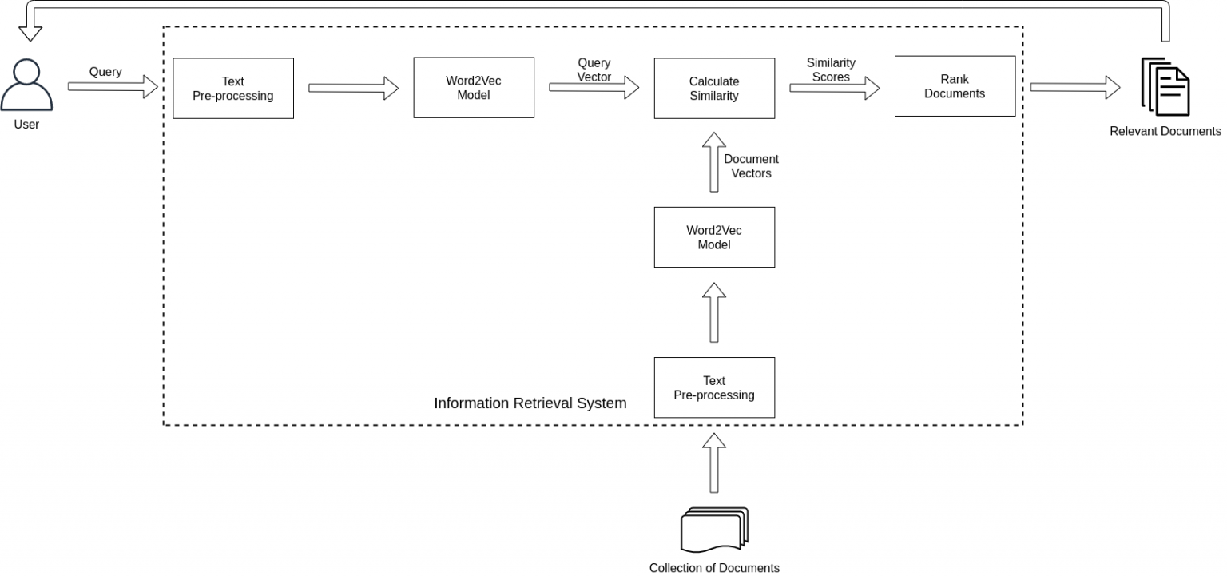

Slide 14
WORD2VEC EMBEDDING TECHNIQUE
”WORD2VEC” model converts words to vectors.
Reason behind good performance of Word2Vec technique is it’s capability to capture the contextual properties of words and represent them using vectors.
Word2Vec embedding technique is able to maintain the semantic and syntactic relationship between words.

Slide 15
There are two types of Word2Vec model, one is our own user-defined Word2Vec model and other is pre-trained Word2Vec model.
For user-defined model, we need millions of documents and the processing power of CPU has to be large otherwise the executing CODE gets crashed.
Therefore, in our final working model, we have used pre-trained Word2Vec model.
This model is provided by GOOGLE for performing various experiments in information retrieval field.

Slide 16
Google’s pre-trained Word2Vec model is trained on 100 billion words.
This model provides 300 dimensional vectors for around 3 million words and phrases.

Slide 17
INTERESTING PROPERTIES OF WORD2VEC
Word2Vec model has the property of capturing linguistic regularities between words.
Example. vector(‘king’) - vector(‘man’) + vector(‘women’) is very close to the vector(‘queen’).
Similarly, vector(‘Paris’) - vector(‘France’) + vector(‘Italy’) is very close to the vector(‘Rome’).

Slide 18
COMPARISON BETWEEN WORD2VEC AND BAGOFWORD MODEL
BagOfWord
Main advantage of BagOfWord model is it doesn’t need a huge corpus in order to get good results.
Computationally, BagOfWord is not very complex.
Major drawback of this model is it creates huge vectors with lots of empty spaces (sparsity) problem leading to large memory consumption.
Another drawback is that it doesn’t capture the context of information.
Word2Vec
Word2Vec retains the semantic and contextual relationship between words.
Size of the embedding vectors is very small.
Each embedding vector w.r.t word contains information about one aspect of word.
Sparsity problem is not present in Word2Vec model.

Slide 19
Thank You !!!

