Slide 1
Omegalib Tutorial
Alessandro Febretti

Slide 2
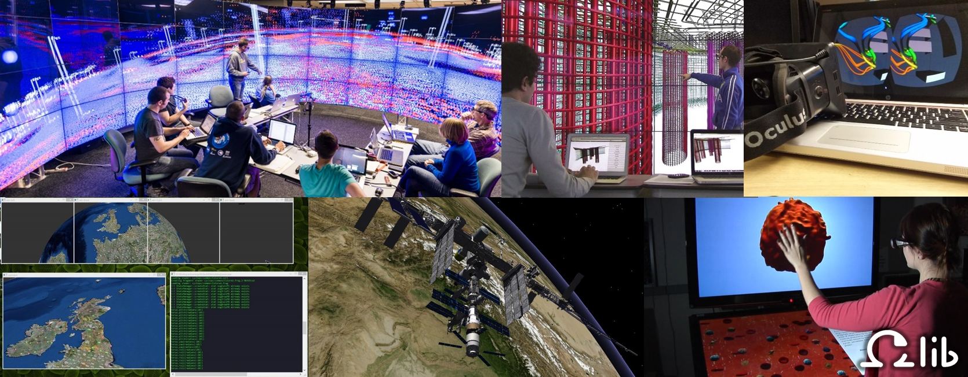
What is Omegalib
Framework for 2D/3D applications on heterogeneous systems
Platforms: Laptops, HMDs, Cluster-based displays
Immersion support: stereo rendering, head tracking, panoptic stereo
Positional audio through Supercollider
Input: Gamepads, tracked devices, touch surfaces, ...
OS: Windows, OSX 10.7+, Linux (various distros)
Languages: C++, Python

Slide 3

Requirements
Omegalib distributed as source
Requirements to build
Git
Cmake
OSX/Linux: Python 2.7 (should be pre-installed)
Build Environment for your OS
Windows: Visual Studio 2012/2013 (free editions fine)
OSX: Xcode + (possibly) Xcode command line tools (gcc/clang)
Linux: standard build tools (gcc/make)
possibly flex & bison

Slide 4
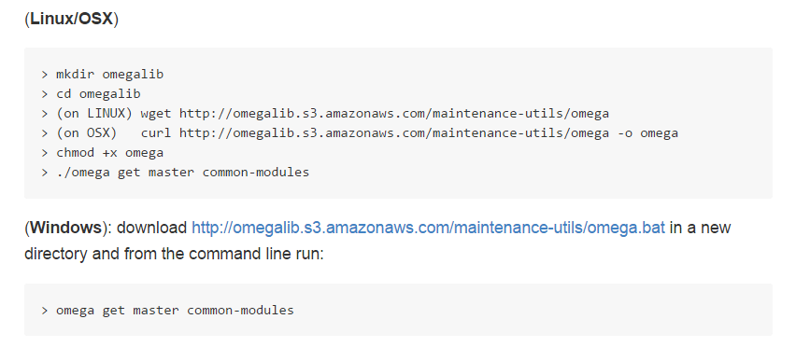
Build omegalib
See instructions on https://github.com/uic-evl/omegalib/

Slide 5
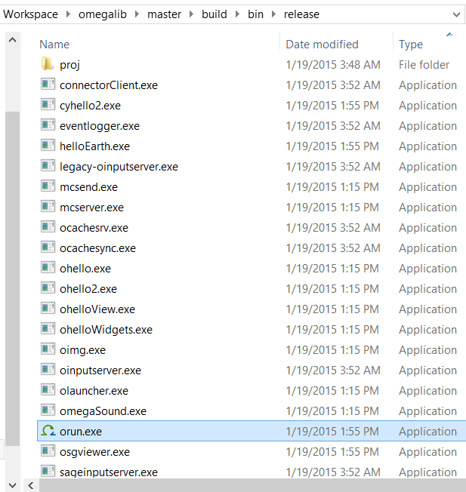
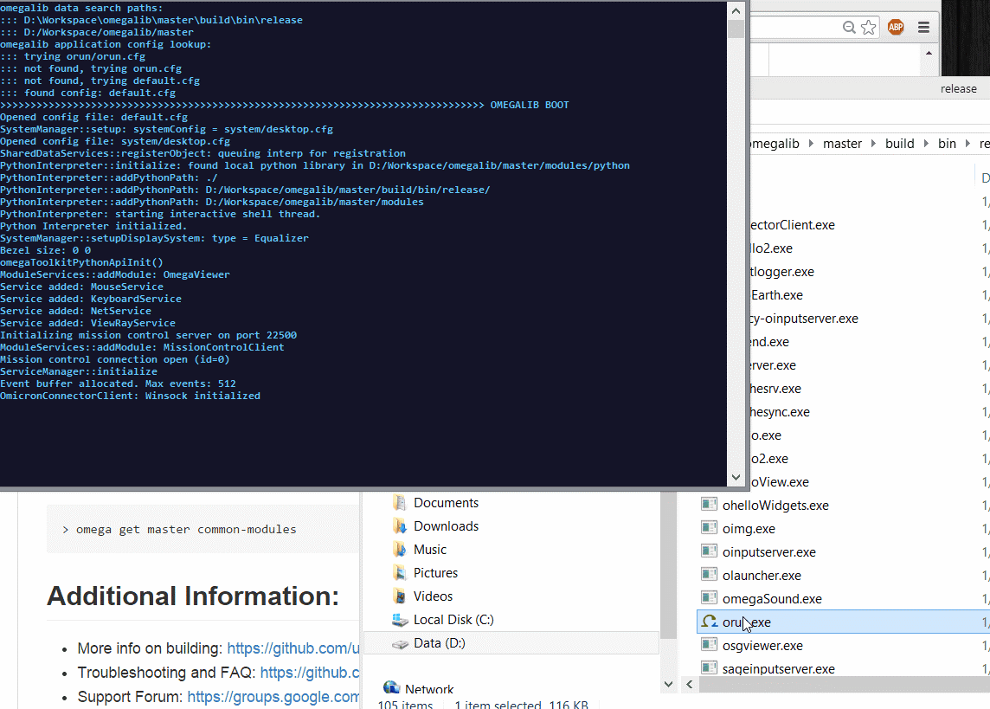
Test it

Slide 6
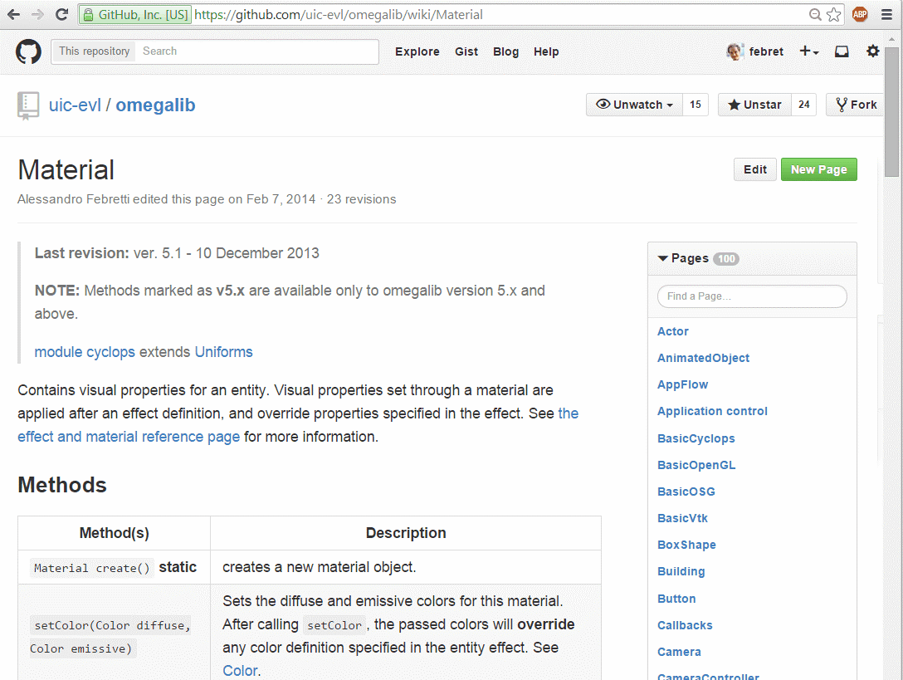
Where to look for info
Wiki: https://github.com/uic-evl/omegalib/wiki
Forum: https://groups.google.com/forum/#!forum/omegalib

Slide 7
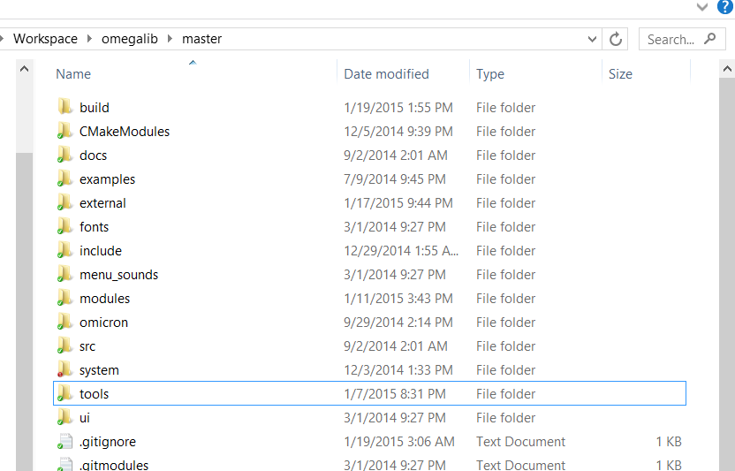
Running a script
Command line in bin directory:
orun –s [path to script]
Script search path:
inside main source dir
in modules

Slide 8
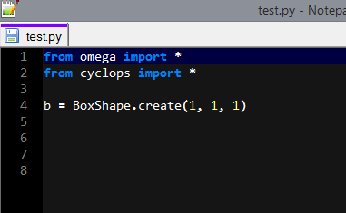
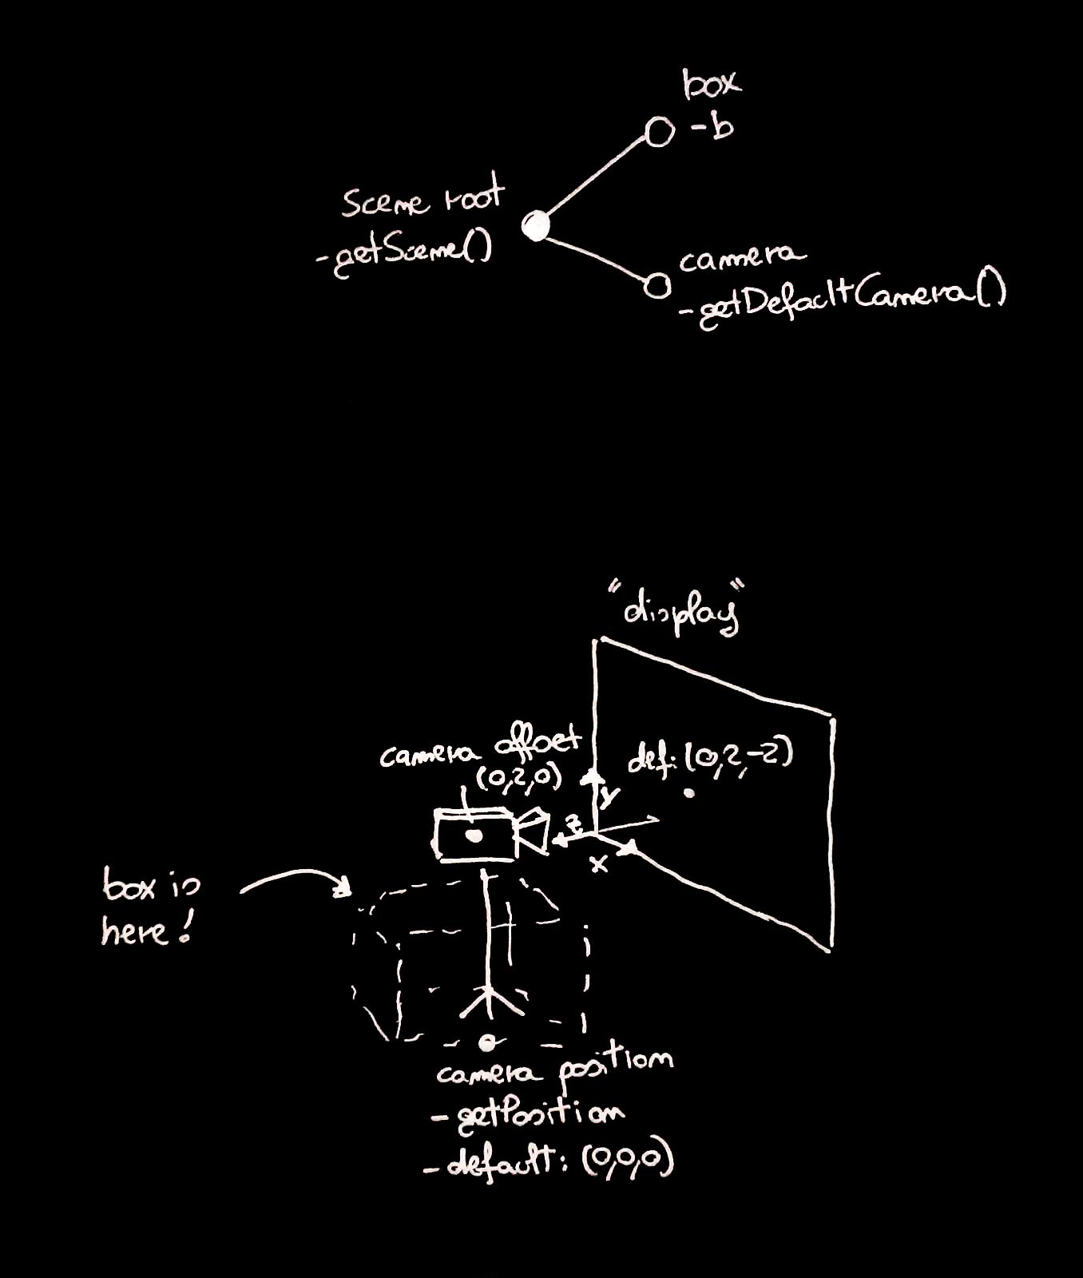
Basic example
Reference frame: origin is your feet!
Units: meters
Objects are in a scene tree

Slide 9
Controls
Left mouse button = freelook
WASD: move
RF: fly up/down
Ctrl: free rotation
Esc: exit
Console: python interactive + special ‘quick commands’
:c [s] – toggle console/statistics
:q exit
:? [.|var] [prefix]
:? . B = list all global objs/functions starting with B
:? Foo set = list all members of object Foo stat start with set

Slide 10
Effects, Materials, Lights
Material = visual properties of an object
Effect = same as material but as a short string
Box.setEffect(‘colored –d #0000ff’) = Set box diffuse color to blue
Light: positional/directional/spot
Diffuse & ambient colors, attenuation, shadow
Lights are SceneNodes

Slide 11
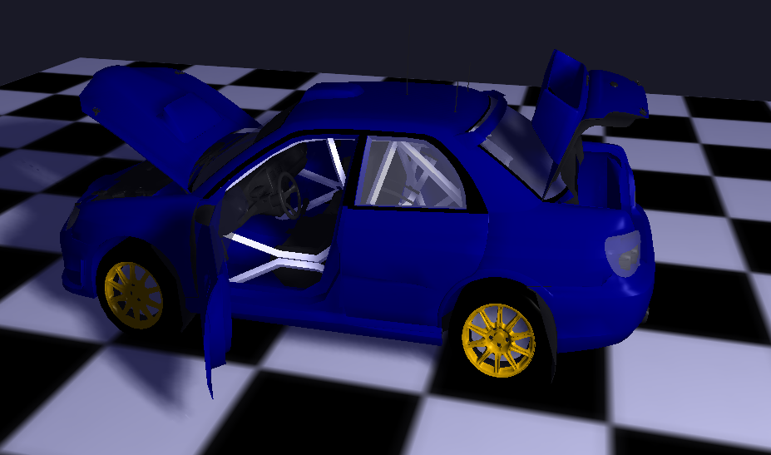
Loading Models
Preferred format: Autodesk FBX (supports static & animated objects)
Two steps:
Load a model
Create one (or more) objects using that model
Sketchup FBX export demo

Slide 12
Callbacks
Update callback
Runs each frame, you get frame, time, dt
Event callback
Runs once for each input event received
Use getEvent() to obtain event data. Event has
isKeyUp / isKeyDown – check for keyboard press
isButtonUp / isButtonDown – check for mouse/gamepad/wand buttons
getPosition – get mouse position (x,y) or wand (x,y,z)
getServiceType – what type of device generated this input (Keyboard, Pointer, Wand, ...)

Slide 13
Menu System
Demo – colorChooser.py

Slide 14
Cross-Platform Considerations
CAVE2 – scripts run on a cluster
Oculus – FPS are important, keep close to 60,
check with :s or :c s

