Slide 1
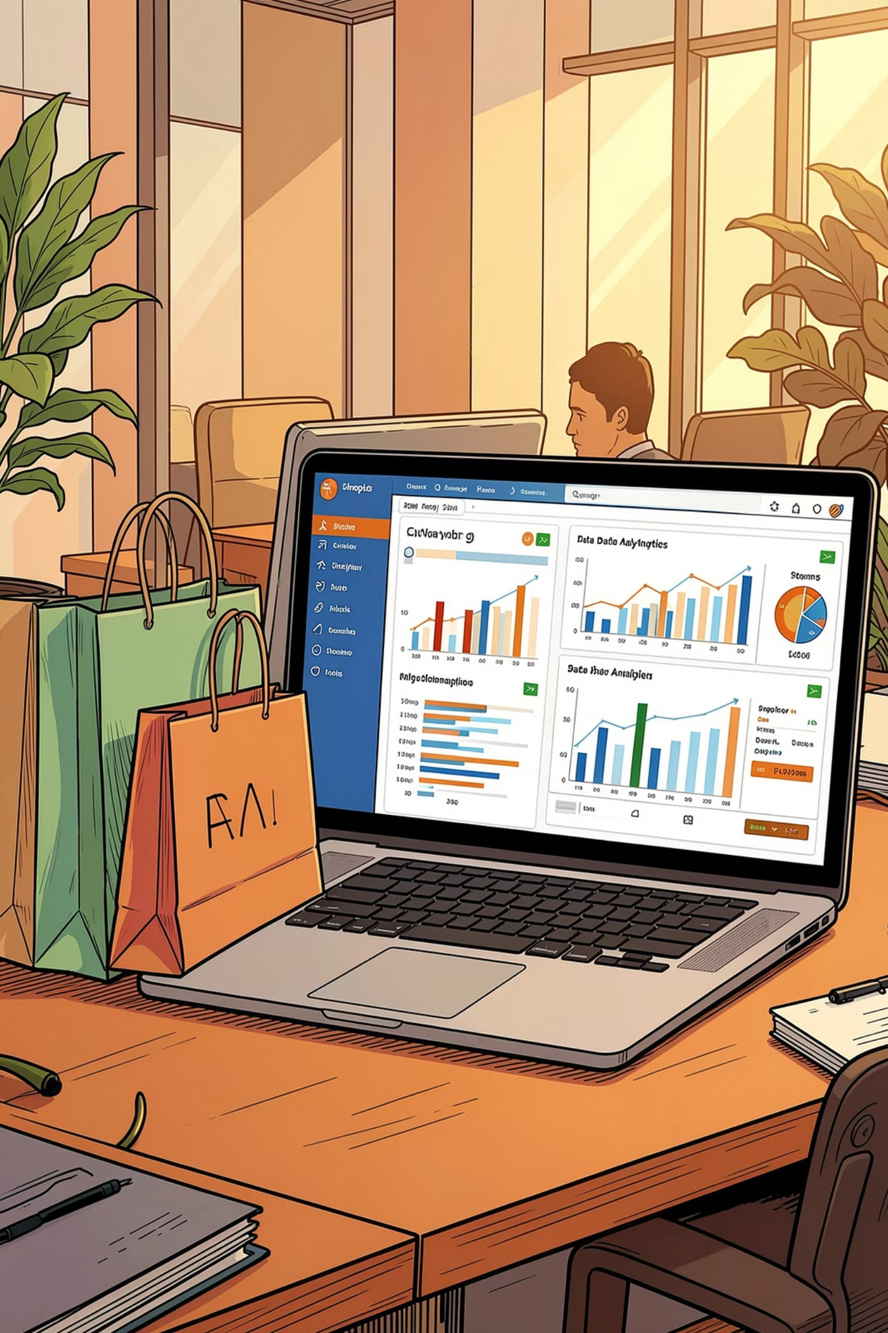
Customer Shopping Behavior Analysis
End-to-End Data Analytics Project · 3,900 purchases across multiple product categories
PYTHON
SQL
POWER BI
Prepared by: Kapil

Slide 2
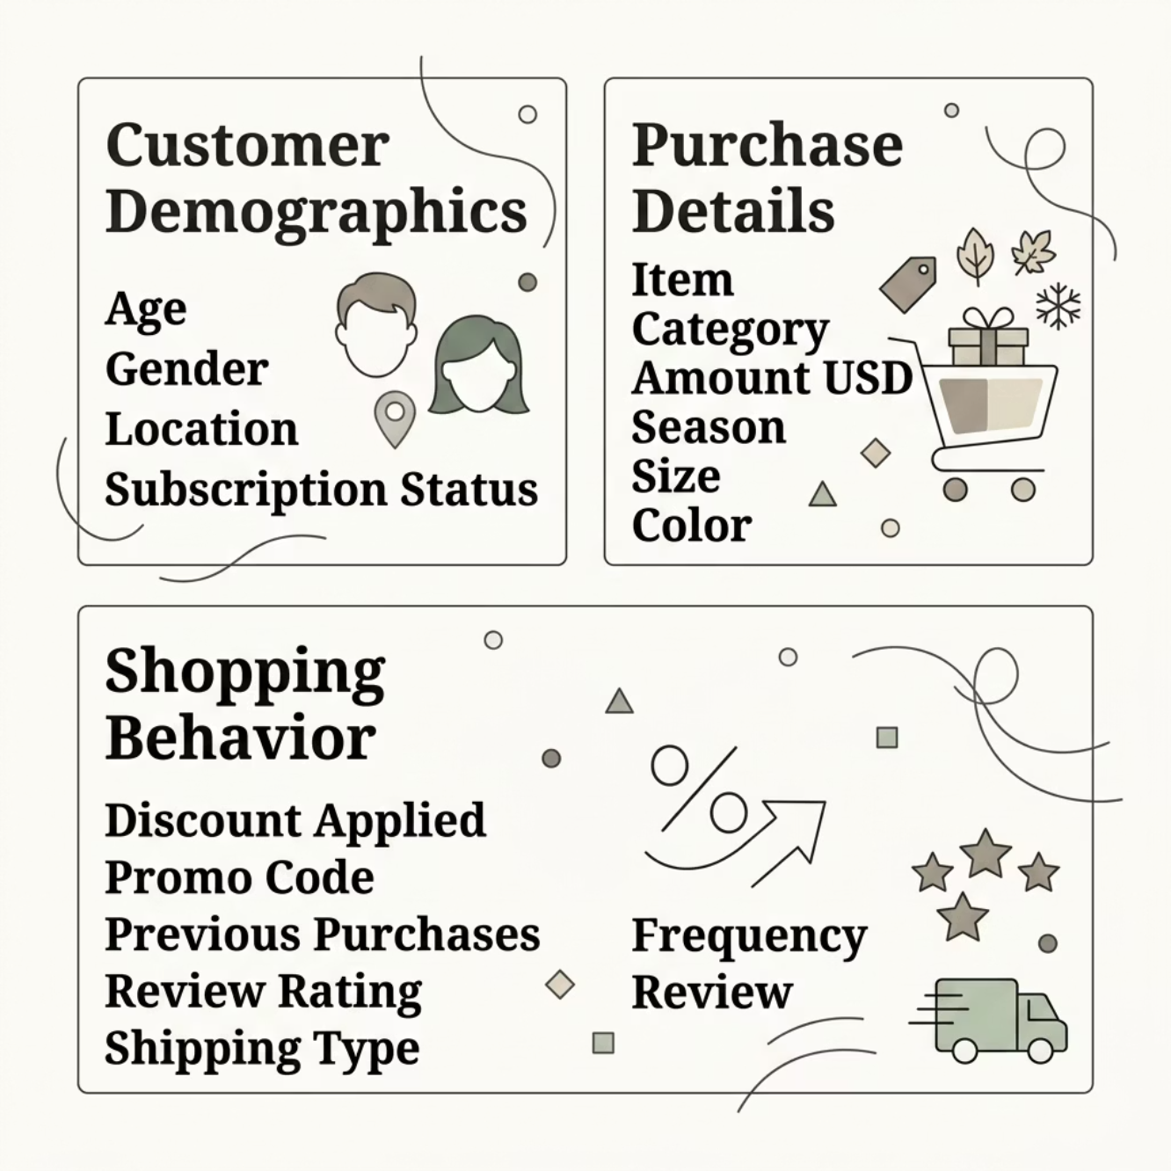
Dataset at a Glance
3,900
18
37
Total Records
Features / Columns
Missing Values
Review Rating column
Feature Groups
Customer Demographics · Purchase Details · Shopping Behavior

Slide 3

Exploratory Data Analysis — Python
Data Loading
Imported via pandas, verified shape, dtypes, samples
Missing Data
37 nulls in review_rating — imputed by median per category
Feature Engineering
Created age_group bins and purchase_frequency_days
Database Integration
Loaded cleaned DataFrame into MySQL via SQLAlchemy

Slide 4
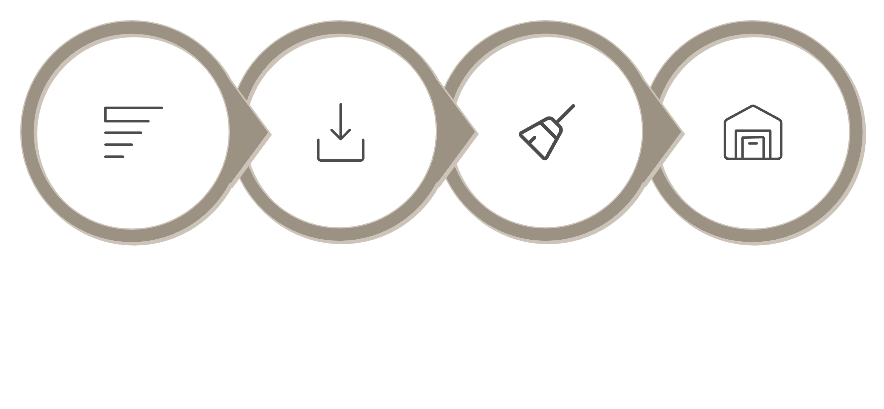
Data Cleaning Pipeline
Drop Redundant Column
Standardize Columns
Impute Ratings
Load to MySQL
Columns renamed to snake_case for SQL compatibility. Redundant promo_code_used dropped — fully correlated with discount_applied.

Slide 5
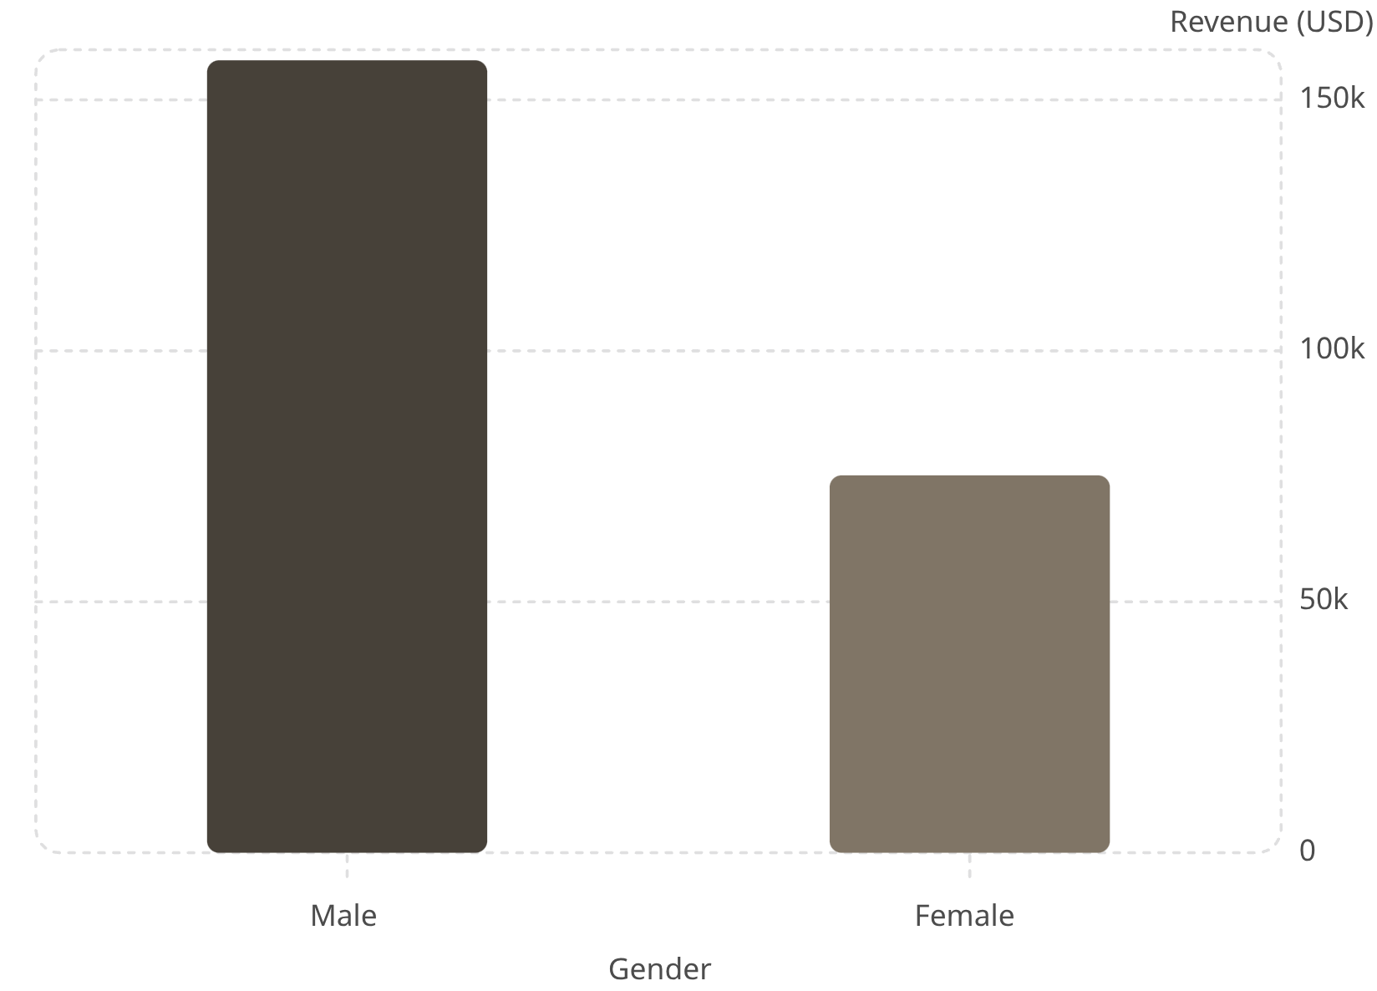
SQL Analysis — Revenue & Spending
Key Findings
Gender Revenue Gap
Male: $157,890 vs Female: $75,191
Discount Users
839 customers used discounts yet spent above average (~$60)
Shipping Spend
Express avg: $60.48 vs Standard avg: $58.46

Slide 6
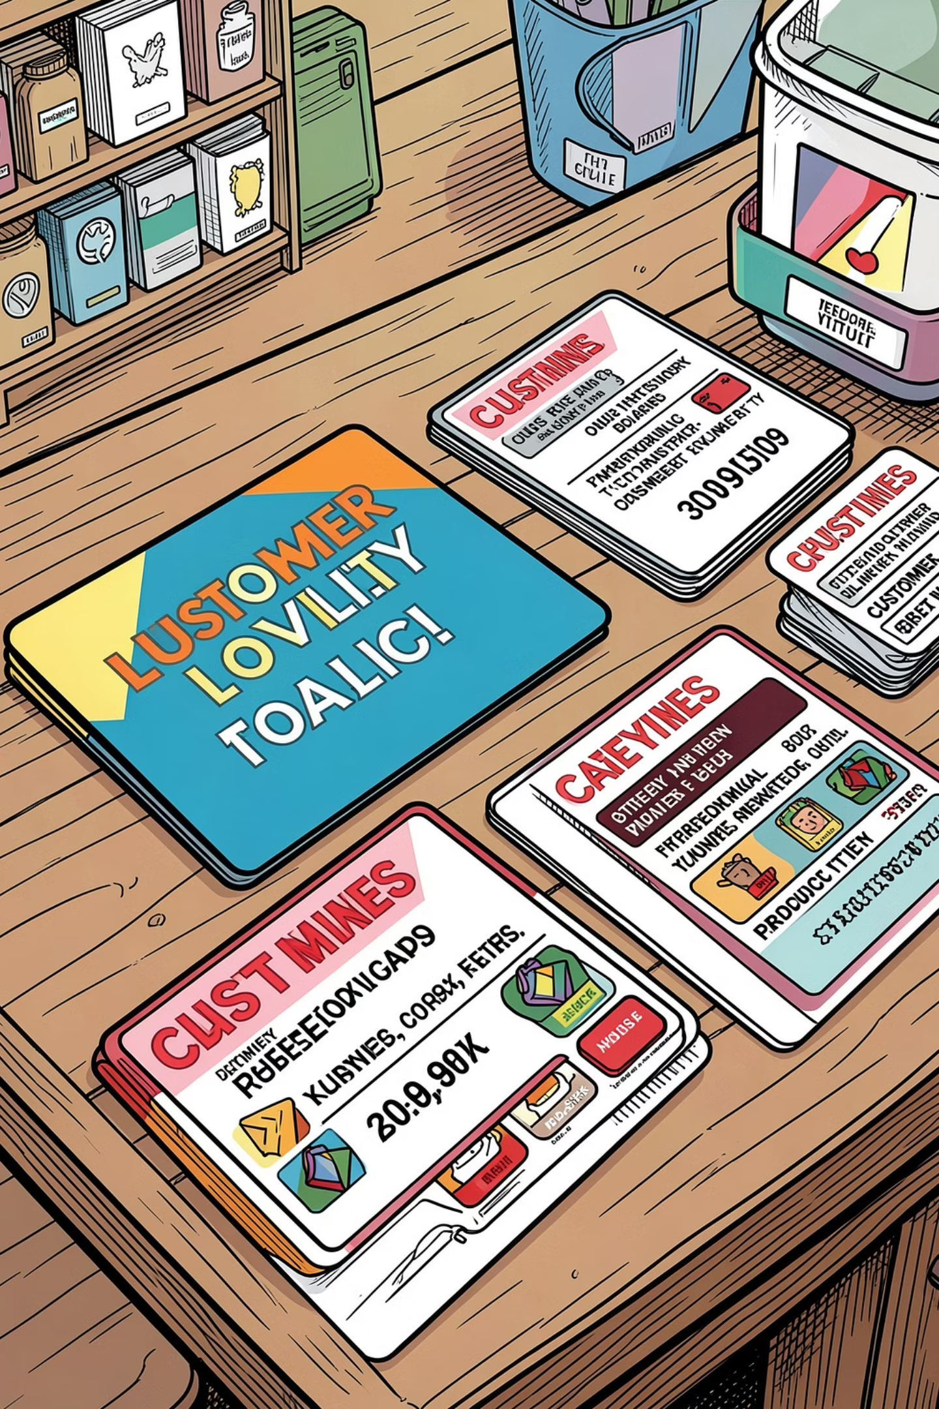
SQL Analysis — Products & Segments
Top Rated Products
Gloves (3.86) › Sandals (3.84) › Boots (3.82) › Hat (3.80) › Skirt (3.78)
Discount Dependency
Hat 50% · Sneakers 49.66% · Coat 49.07% discount rate
Customer Segments
Loyal: 3,116 · Returning: 701 · New: 83
Repeat Buyers
Of >5 purchases: 2,518 not subscribed vs 958 subscribed

Slide 7
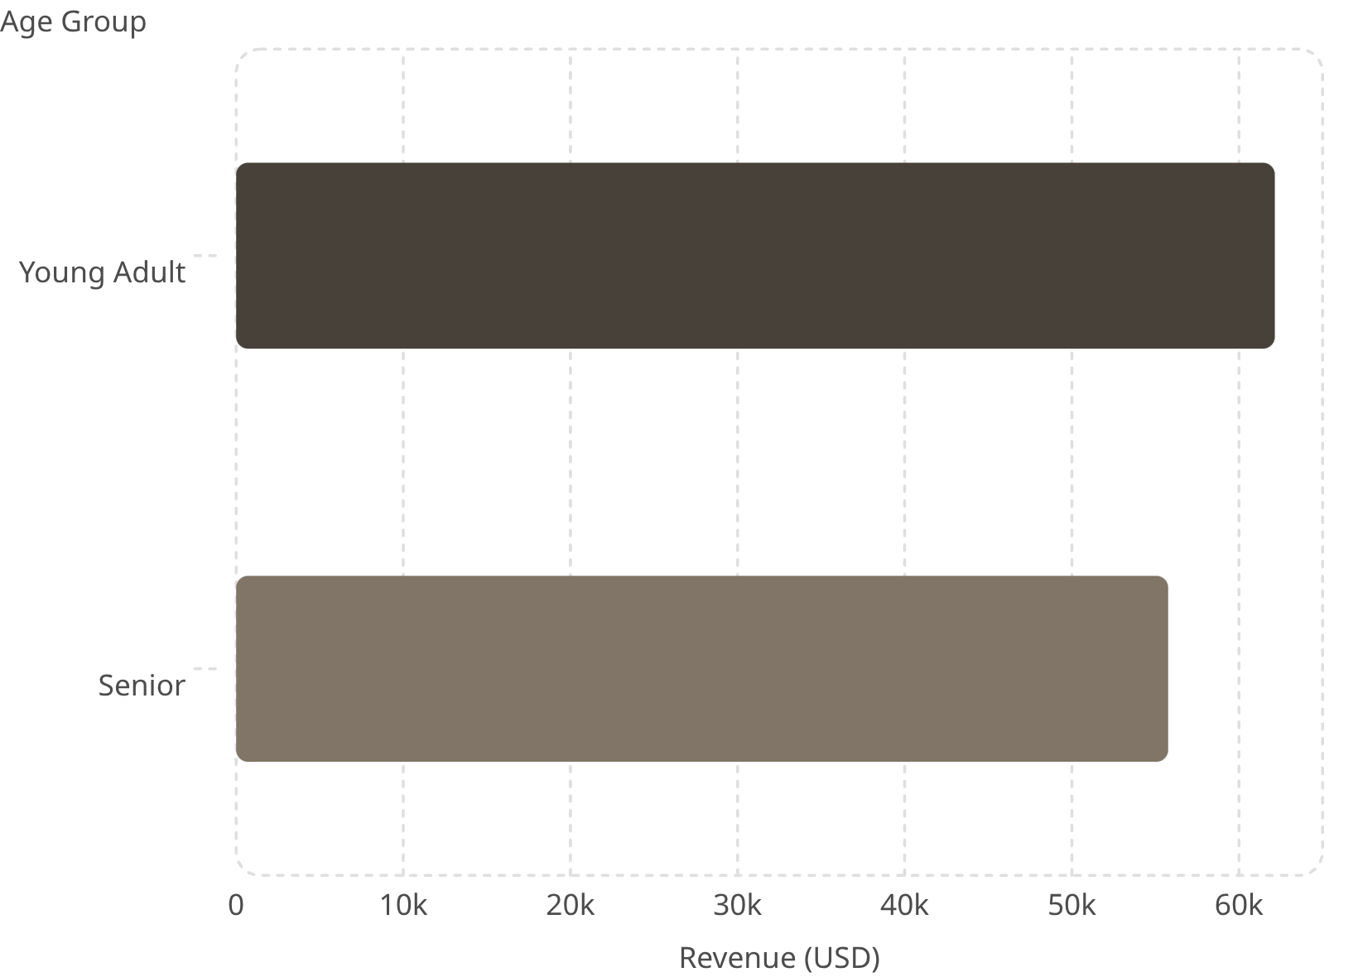
Revenue by Age Group
Subscriber Spend
Subscribers: $59.49 avg
Non-subscribers: $59.87 avg — nearly identical
Top Products by Category
Clothing: Blouse, Pants, Shirt
Footwear: Sandals, Shoes, Sneakers

Slide 8
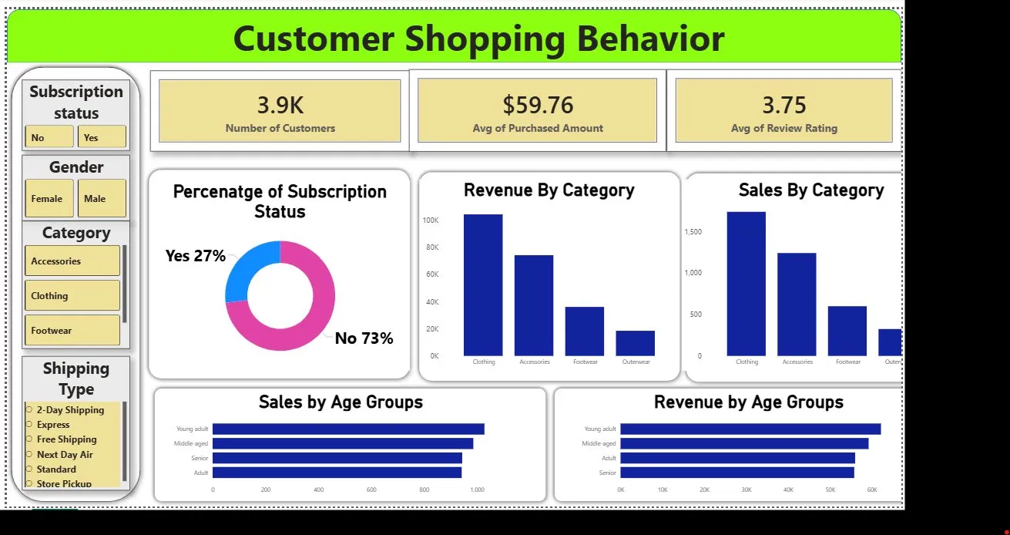
Power BI Dashboard
Dashboard Highlights
KPI Cards
3.9K customers · $59.76 avg purchase · 3.75 avg rating
Subscription Split
27% subscribed vs 73% not subscribed
Category Leader
Clothing leads both Revenue and Sales
Age Segment
Young Adults drive highest revenue & sales

Slide 9
Strategic Recommendations
1
Boost Subscriptions
Only 27% subscribed — add exclusive perks to drive conversion
2
Loyalty Program
80% are 'Loyal' — formalize tiered rewards to reduce churn
3
Optimize Discounts
Hat & Sneakers at ~50% discount rate — test lower thresholds
4
Target Young Adults
Highest revenue segment ($62,143) — allocate digital marketing budget
5
Product Positioning
Highlight top-rated items; promote Clothing with cross-sell opportunities
6
Express Shipping Upsell
Express users spend $60.48 avg — target Standard users with promotions

Slide 10
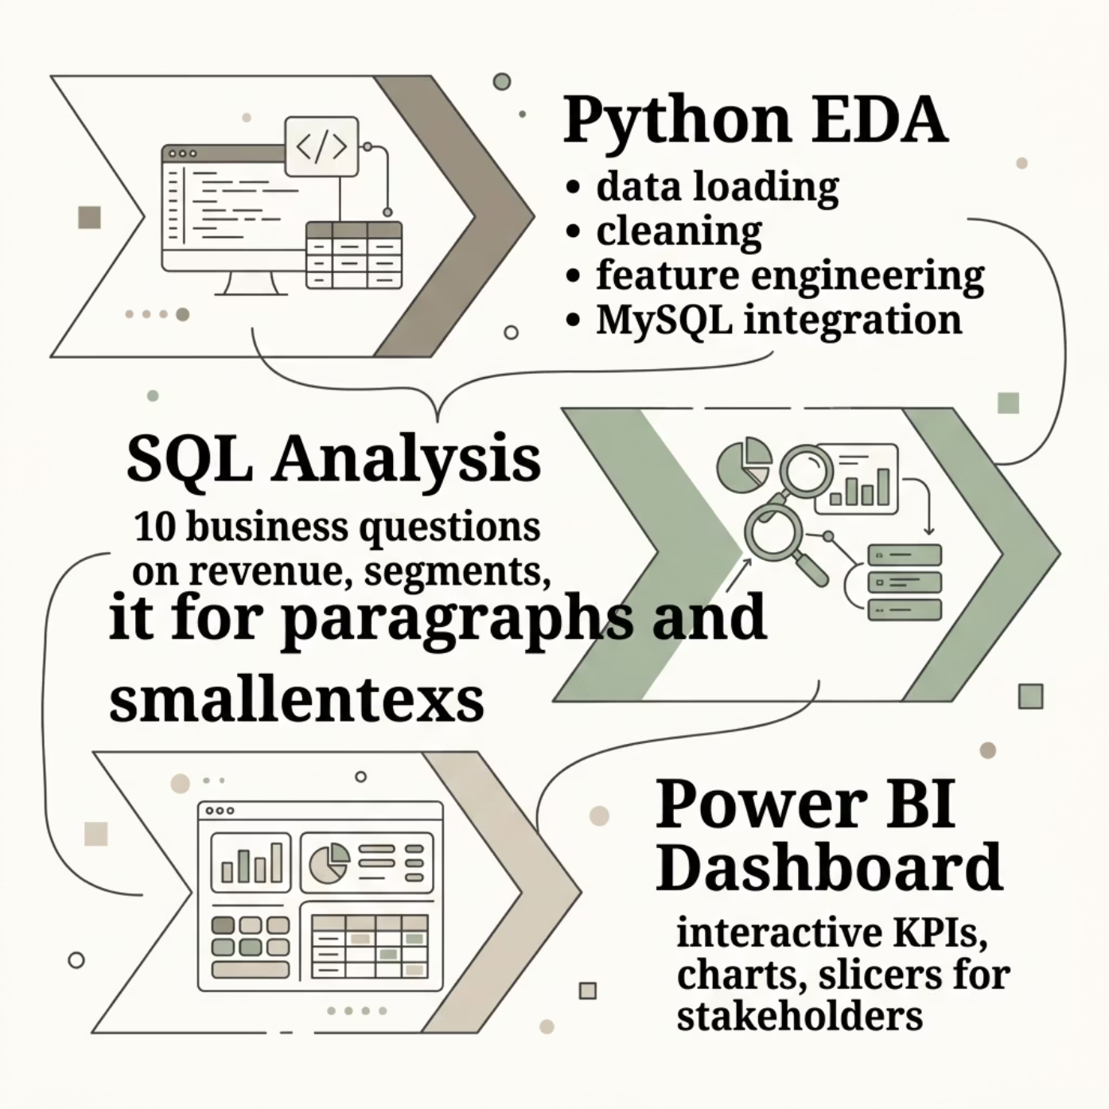
Project Summary
End-to-End Pipeline
From raw data to actionable insights — Python, SQL, and Power BI working in concert.
3,900
10
6
Transactions analyzed
Business questions answered
Strategic recommendations

