Slide 1

SQL Case Study Portfolio
Relational Database Design + Business Query Solving
MYSQL 8.4
Kapil Mali
github.com/Kapilmali07

Slide 2
Two Case Studies
Case 1
Case 2
Owner–Car Relationship
1:N · 4 queries
Corporate Employee–Manager
4 tables · 2 queries + 3 bonus

Slide 3
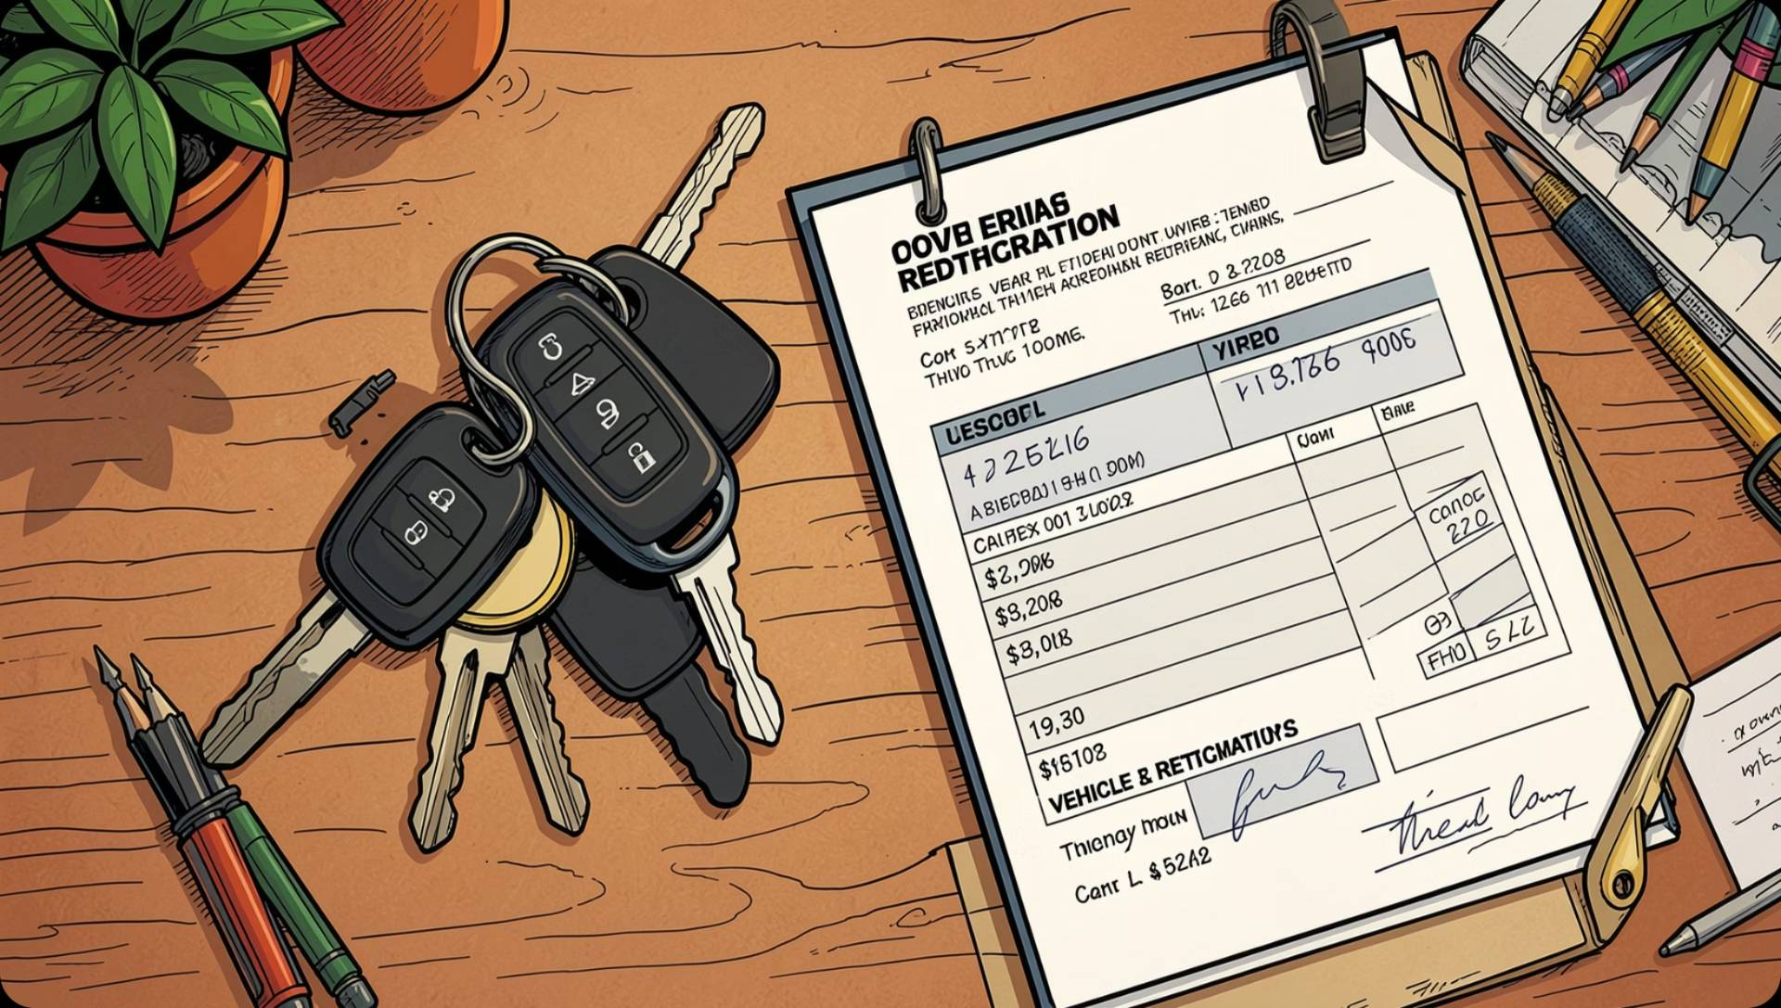

CASE STUDY 1
Owner–Car Schema
OWNER
Licence_No PK · Name · Address · Phone
CAR
Car_No PK · Model · Color · Licence_No FK
Relationship: One Owner → Many Cars (1:N)

Slide 4
CASE STUDY 1
Q1 & Q2 — Owner Lookup & Insert
Q1 — Zen & Indica Owners
Q2 — Insert New Car
INNER JOIN + IN · DISTINCT
INSERT INTO CAR · Car_No 119

Slide 5
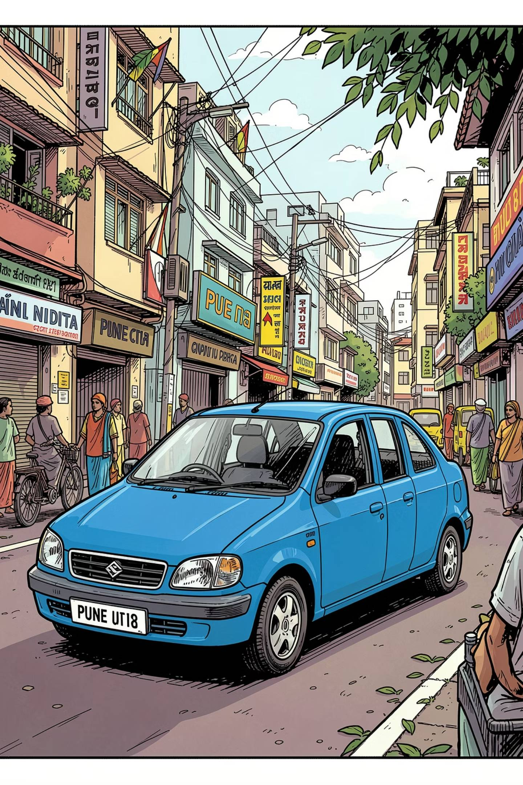
CASE STUDY 1
Q3 & Q4 — Filters & Location
Q3 — Mr. Shah's Blue Cars
JOIN vs. correlated subquery
Q4 — Pune Registrations
WHERE Address = 'Pune'

Slide 6
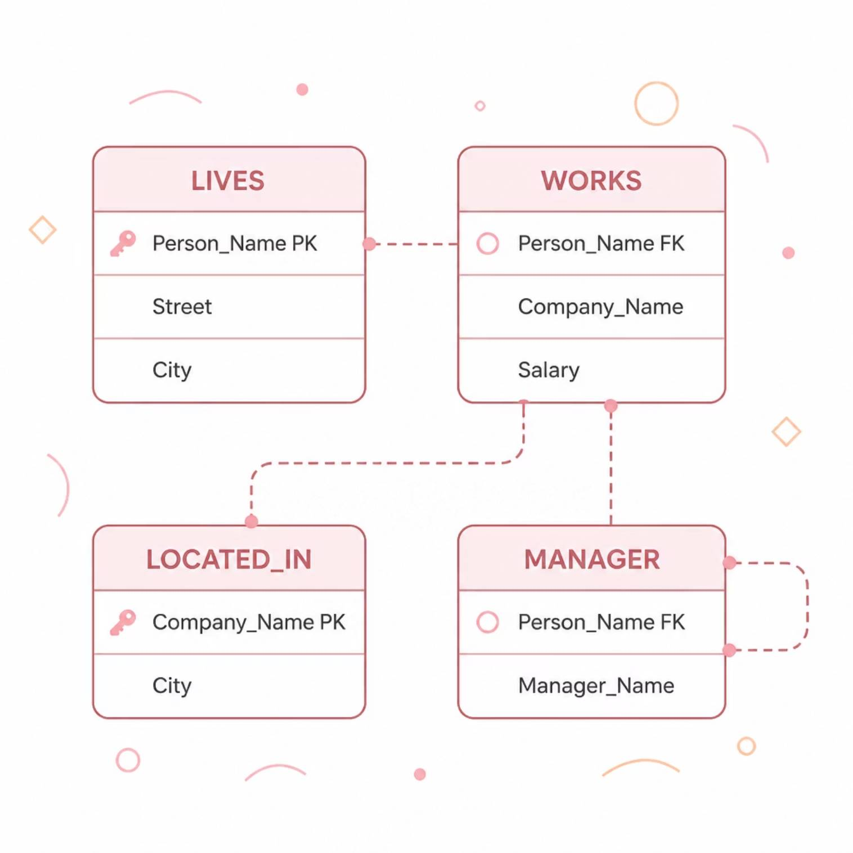
CASE STUDY 2
Corporate Employee–Manager Schema
Four tables linked by foreign keys modeling a corporate environment.

Slide 7


CASE STUDY 2
Q1 — Above-Average Earners
Approach
Self-join WORKS with per-company AVG subquery
WHERE Salary > Company_Avg_Salary

Slide 8

CASE STUDY 2
Q2 — Smallest Company
GROUP BY Company
COUNT Employees
ORDER BY Count
LIMIT 1
Uses GROUP BY + ORDER BY + LIMIT 1 to identify the company with the fewest employees.

Slide 9

BONUS QUERIES
Advanced SQL Techniques
B1 — Salary Rank
RANK() OVER per company
B2 — City Match
Employee city = Company HQ
B3 — Manager Team Size
HAVING COUNT(*) > 1

Slide 10

Key Takeaways
Relational Design
Query Techniques
PK/FK · 1:N · 4-table schema
JOIN · Subquery · GROUP BY · Window
MySQL 8.4
DDL · DML · DQL · 9 queries
https://github.com/Kapilmali07/sql-case-study

