Slide 1
PORTFOLIO THEME BUILDER
Group - 5
Submitted To:
-Vikas Patel
Submitted By:
-Kapish Aggarwal: 2210990476
-Kanishk Kharbanda :2210990472
-Lokesh Garg: 2210990544
-Jaspreet Sandhu: 2210990453
Notes:
1

Slide 2
Table of Contents
Introduction
Problem Statement
Technical Details
Key Features
Project Highlights
Bonus Feature(optional)
Conclusion
References/Links used
Notes:
2

Slide 3
Introduction
In this project, we will be creating a Portfolio Theme Builder. This will have a set of questions, and the user will have answer the questions to make his/her portfolio.
The project is made by using different technical details such as HTML, CSS, and Javascript.
Notes:
3

Slide 4
Problem Statement
The primary objective is to develop a portfolio theme builder that empowers users to easily create, customize, and maintain an online portfolio without the need for extensive technical knowledge or significant financial investment. While building a portfolio theme from scratch is not without its challenges and requires a significant investment of time and effort, the benefits—ranging from complete customization and skill demonstration to cost savings and personal growth—make it a worthwhile endeavor for many professionals.
Notes:
4

Slide 5
Technical Details
The project will use HTML, CSS, and Javascript to create the portfolio theme builder. HTML will be used for the layout and structure of the quiz, while CSS will be used for styling and making the portfolio theme builder visually appealing. Javascript will be used to implement the functionality, including the questions, answers, and portfolio builder.
Notes:
5

Slide 6
Key Features
Customization and Originality
Skill Demonstration
Learning and Growth
Adaptability and Scalability
Personal Satisfaction and Professional Pride
Notes:
6

Slide 7
Project Highlights
The project will showcase how to use Javascript to create an interactive portfolio builder.
The project will demonstrate how to use CSS to make the portfolio buildder visually appealing.
The project will highlight how to use HTML to structure and layout the project.
The project will showcase how to implement the information given by the user in the main portfolio theme builder.
Notes:
7

Slide 8
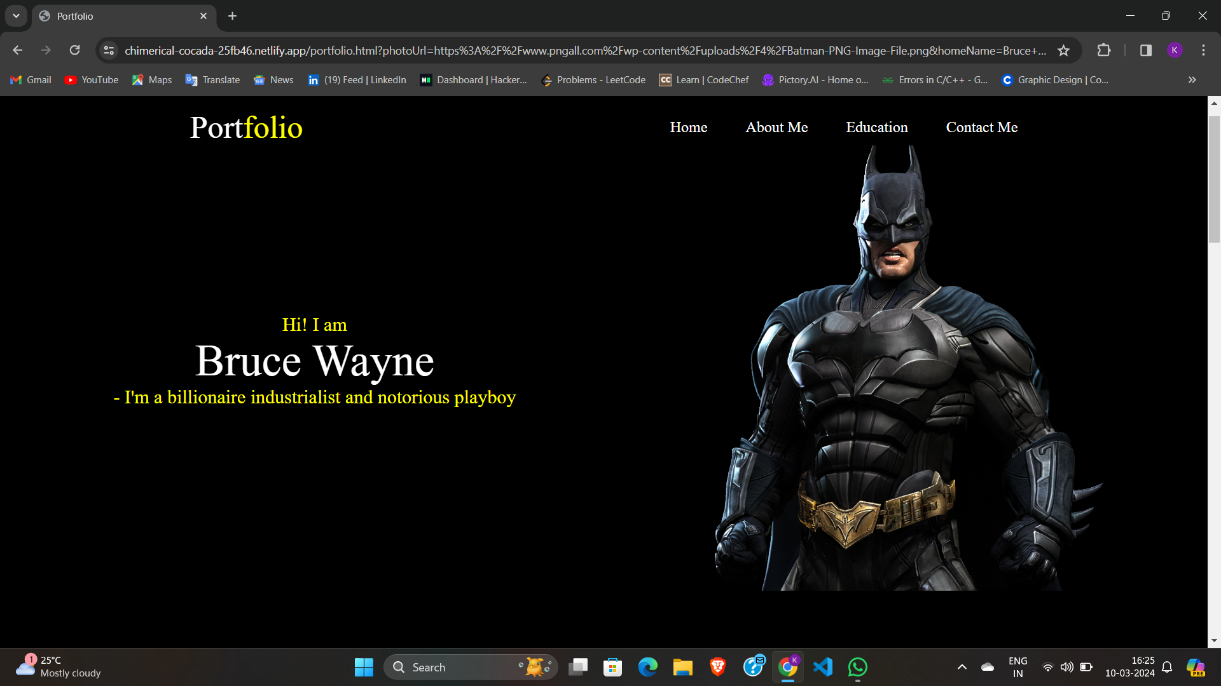
SOME SNIPPETS!

Slide 9
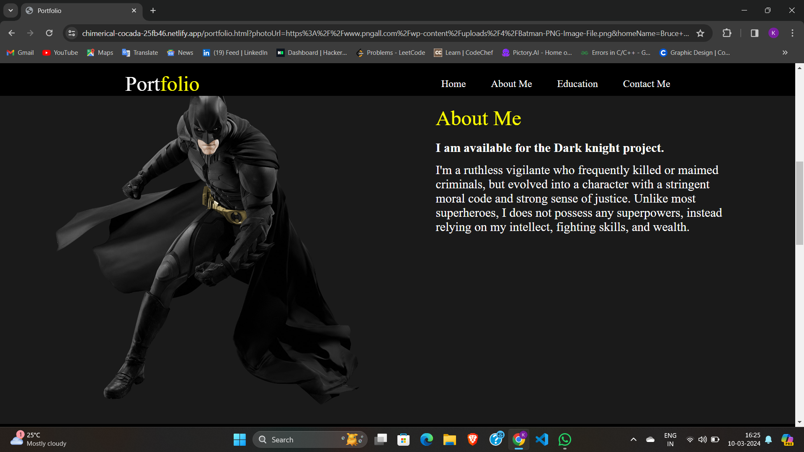
SOME SNIPPETS!

Slide 10
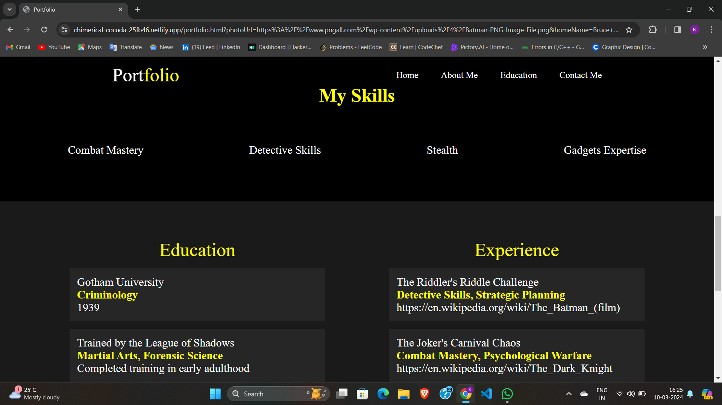
SOME SNIPPETS!

Slide 11
Conclusion
Developing a portfolio theme builder is an impressive way to demonstrate your own skills in web development, design, and user experience. It serves as a testament to your ability to conceive, design, and execute a complex project. This can enhance your professional reputation, open up job opportunities, or attract freelance clients.
Notes:
11

Slide 12
Conclusion
Creating a portfolio theme builder is not a small undertaking, but the potential rewards—both personal and professional—can be significant. Whether driven by a desire to innovate, help others, demonstrate your skills, or even create a new revenue stream, it's a project that offers a multitude of benefits and opportunities for growth.
Notes:
12

Slide 13
References/Links used
MDN Web Docs - https://developer.mozilla.org/en-US/docs/Web
W3Schools - https://www.w3schools.com/
CSS-Tricks - https://css-tricks.com/
Stack Overflow - https://stackoverflow.com/
Notes:
13

Slide 14

Notes:
14

