Slide 1
Proactive, Predictive, Preventive!
Data-Driven Techniques for
Predictive Machine Maintenance
Group members:
Mandeep Burdak
Kapish Krishna Bodapati
Morgan Tucker
Kehl Li

Slide 2
Table of contents
01
02
03
Introduction
The Data
EDA
04
05
Models
Conclusion
Setting the Scope and Defining Objectives
A Comprehensive Breakdown of Our Dataset
Data Preprocessing and Initial Insights
Supervised & Unsupervised Techniques; Findings
Summary, Implications, and Future Work

Slide 3
01
Introduction

Slide 4
Planning a roadtrip?
Got a car?
When did you last use it?
How about maintenance?

Slide 5
An Overview: Predictive Machine Maintenance
Utilizing Telemetry & Historical Data for Proactive Machine Health Monitoring
Predictive Maintenance in an Industrial Context
Inefficiency of Traditional Reactive Maintenance
Purpose
Predict failures such that when they occur they can be fixed as soon as possible.
Save money by cutting downtime for machines.
Better preventive maintenance schedules.
We use an endless number of machines in our industry.
In a large site with hundreds of machines, it is crucial to find machine failures in time.
Predicting failures can reduce down-time.
Failures take time to be noticed.
Waiting for mechanics and parts leads to down times.
Down times lead to sub optimal production at the site.

Slide 6
02
The Data

Slide 7





Our Data
Errors
Failures
Machine Conditions
Maintenance Records
Telemetry
Log of machines exhibiting any of the 5 Types of Errors
Logs of machine exhibiting any of the 4 types of failures
Hourly readings of Voltage, Rotation, Pressure, Vibration for machines
Info about 100 machines of
4 models with
age ranging from 1 to 20
Logs of the 4 types of maintenance done on the machines
Notes:
Looking to answer these questions:
What are the top-selling products and their sales trends?
How do sales vary by location and time of year?
Can you identify patterns in customer purchasing behavior?
A little more information regarding our data:
From Kaggle, from ominous turkish retail company. That is all we know?? For some reason?
Sales Data Attriubutes:
Product ID: Unique identifiers for each product, linking to product-related data.
Store ID: Identifiers for each store location, enabling location-based analysis.
Date: Transactional timestamps crucial for trend and time series analysis.
Sales: Quantities sold, vital for understanding product performance.
Revenue: Generated income, reflecting the financial success of product sales.
Stock: Inventory levels, important for assessing supply chain efficiency.
Price: Selling price of products, which interacts with sales and promotions.

Slide 8
03
EDA

Slide 9
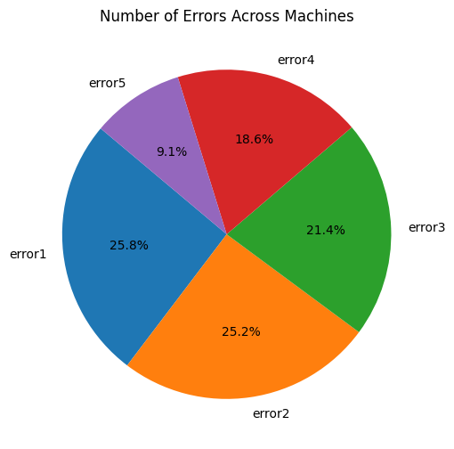
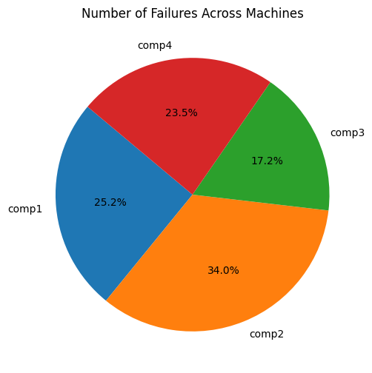
Exploratory Data Analysis
Total data points - 876100
Number of Errors - 3919
Number of Failures - 761
Maintenance - 3286
EDA 1
EDA 2
DESC VIZ
DESC VIZ
EDA 3
EDA 4
DESC VIZ
DESC VIZ

Slide 10
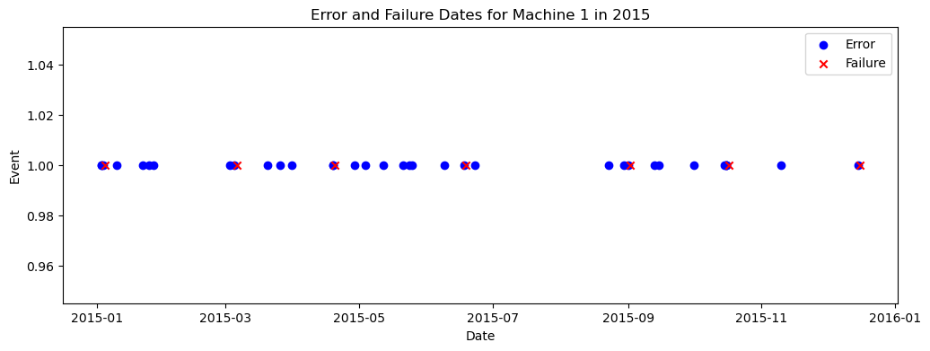
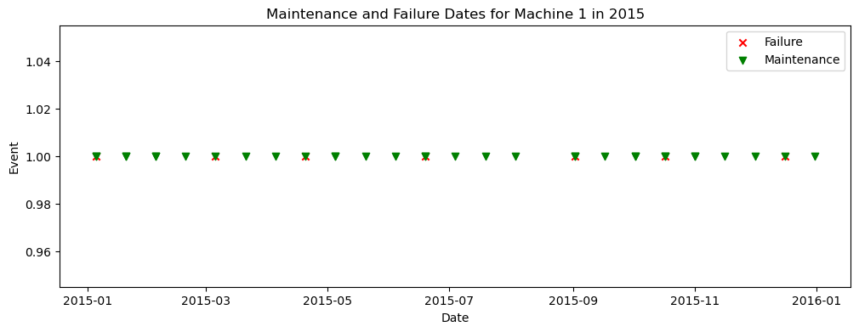
EDA: Error, Failure & Maintenance dates for Machine1

Slide 11
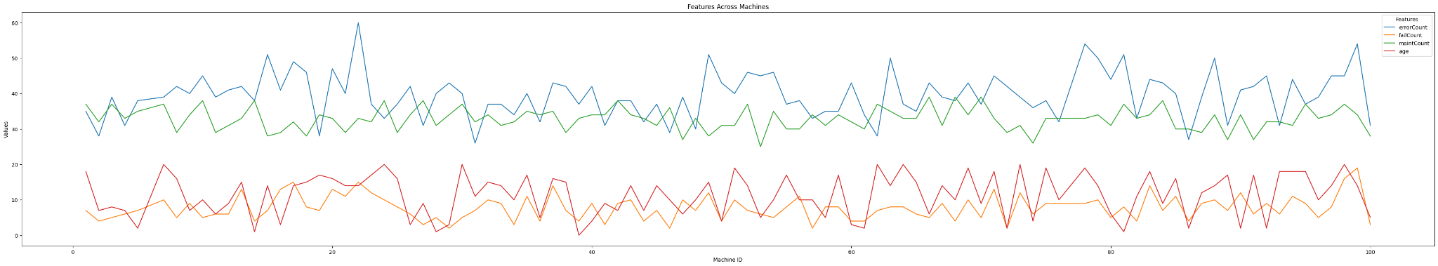
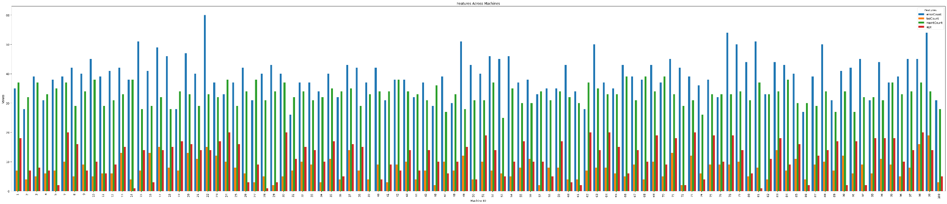
EDA: Error, Failure, Maintenance, and Age Correlation
~ Error ~ Failure ~ Maintenance ~ Age

Slide 12
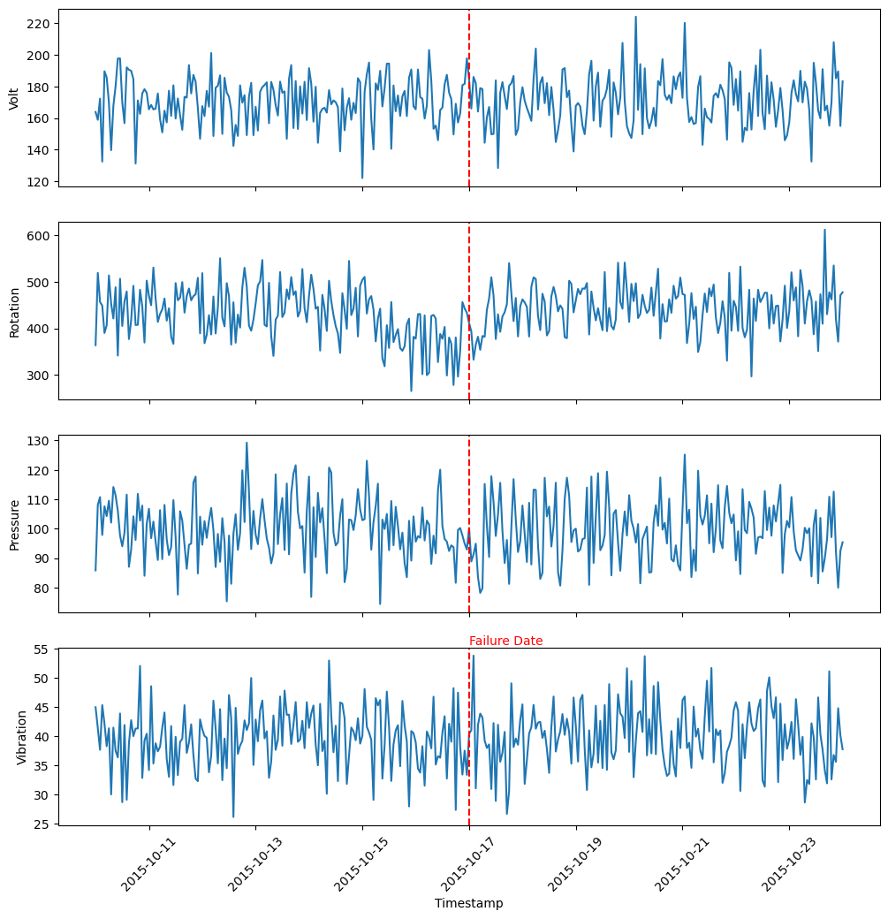
Telemetry Readings
Analysis of Viz
Variation in telemetry readings one week before and after a failure event

Slide 13
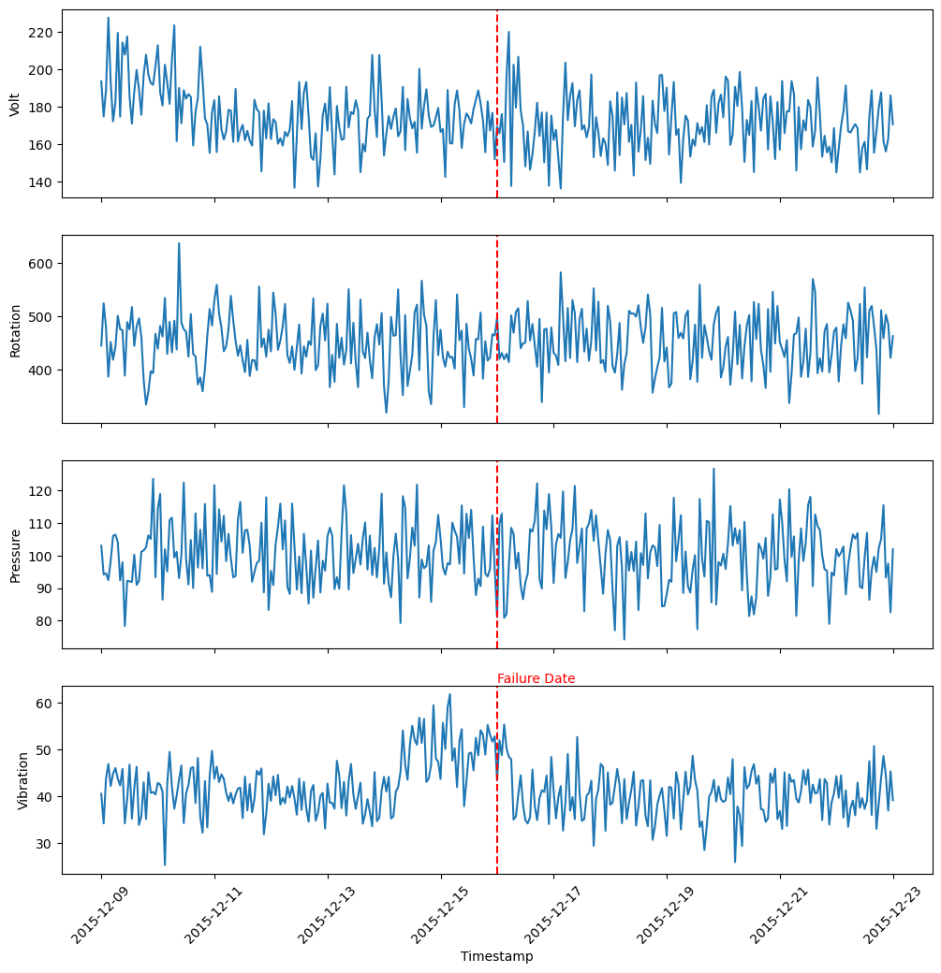
Telemetry Readings
Analysis of Viz
Variation in telemetry readings one week before and after a failure event

Slide 14
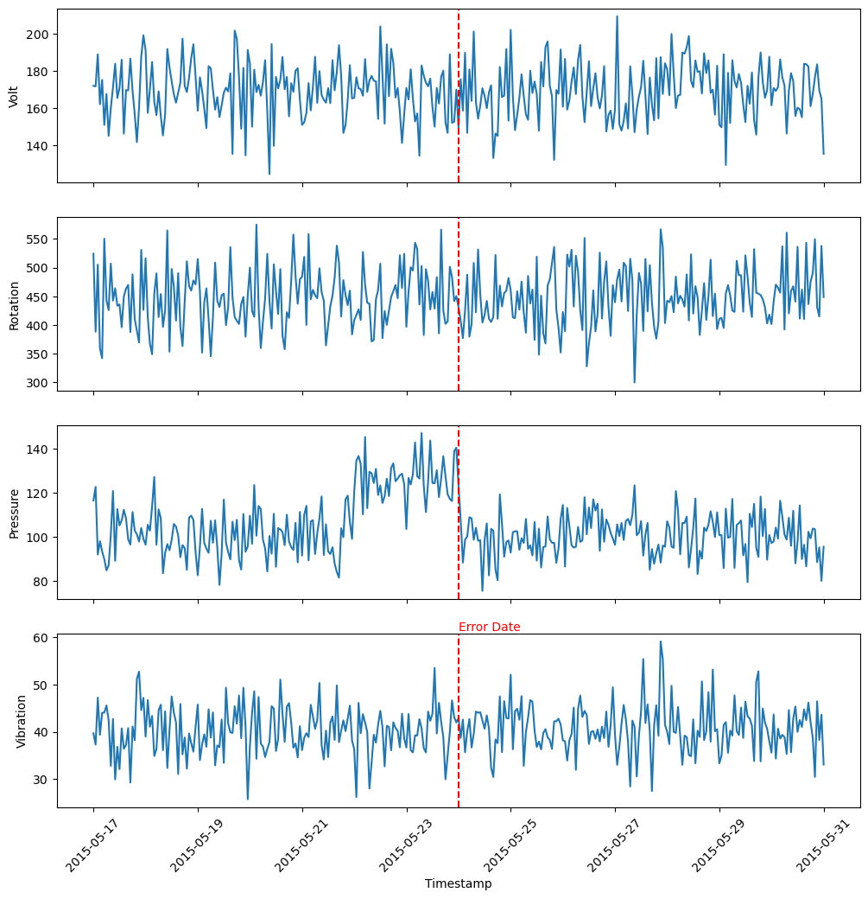
Telemetry Readings
Analysis of Viz
Variation in telemetry readings one week before and after an error

Slide 15
04
Models

Slide 16
Supervised and Unsupervised Techniques
Supervised Methods
Failure
Prediction
Binary Classification
Multi-class Classification
Time Series Forecasting
Unsupervised Methods
Uncovering Latent Structures and Anomaly Detection
K-Means Clustering
Notes:
This section delves into the analytical backbone of our project, highlighting the complexities and challenges inherent in predictive machine maintenance. We will discuss the specific obstacles we encountered, such as imbalanced datasets, high-dimensional feature spaces, and the intricacies of temporal data. A comprehensive exploration of the machine learning models employed will be provided, detailing how both supervised and unsupervised techniques have been harnessed to decipher the patterns hidden within our data. Supervised methods will be outlined in the context of failure prediction, while unsupervised approaches, such as clustering, will be showcased for their utility in uncovering latent structures and anomaly detection. This fusion of methodologies aims to create a robust predictive framework, adaptable to the nuanced demands of machine maintenance and fault prevention.

Slide 17
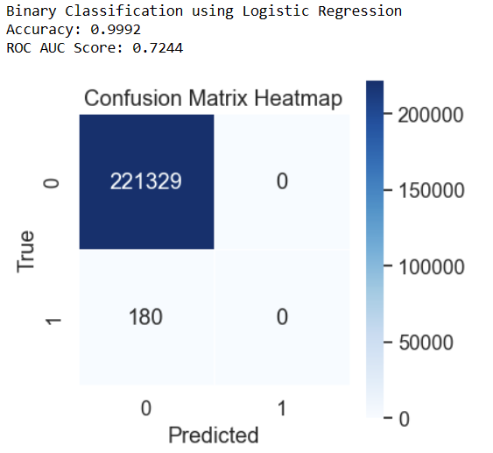
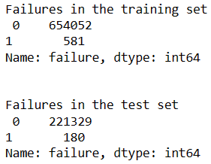
Logistic Regression: Binary Classification
Features: Telemetry Readings, Machine Model & Age, Errors
Target: Binary - Failure or No Failure
Train - 9 months data
Test - 3 months data

Slide 18
Different Approaches
Binary Classification of failures
Binary classification of anomalies (errors + failures)
Binary classification using Daily data
Over sampling the positive class
Binary classification of failures using daily data
Multi-class classification using daily data
Multi-class classification using hourly data

Slide 19
Model Comparison: Multi-class Classification
Model | Accuracy | AUC_ROC
Logistic Regression | 0.6038 | 0.8597
Decision Tree | 0.9962 | 0.9976
Bagging | 0.9974 | 0.9998
Gradient Boosting | 0.8167 | 0.9593
XGBoost | 0.9736 | 0.9988

Slide 20

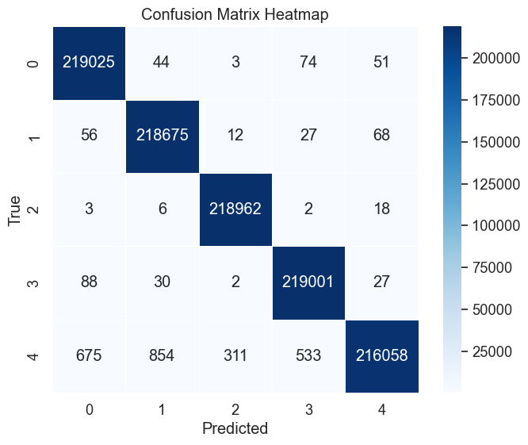
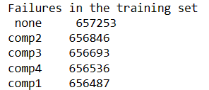
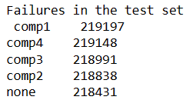
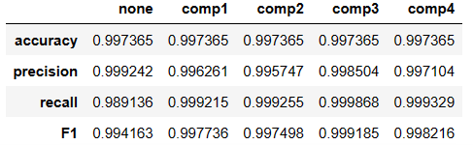
Bagging : Multi-class Classification
Over-Sampling the positive class
Using SMOTE package
Target: Multi-class
4 types of Failures and No Failure

Slide 21
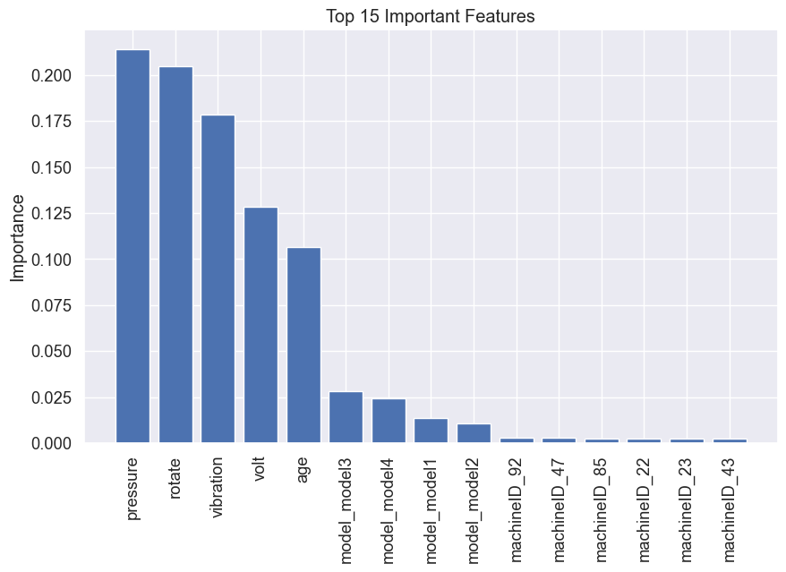
Feature Importance: Decision Tree

Slide 22
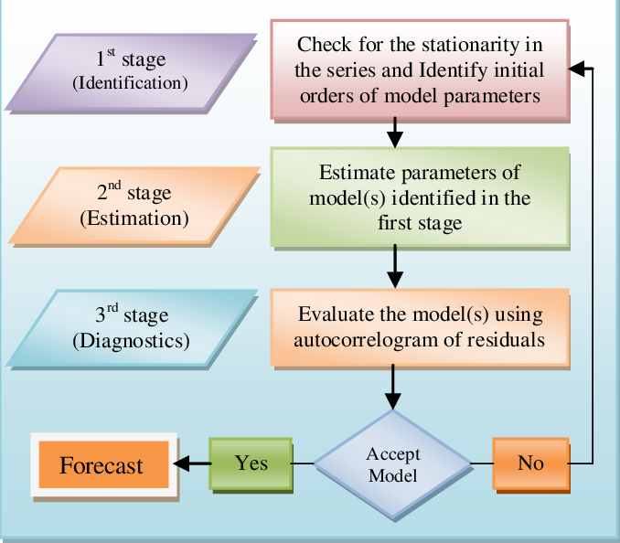
Time Series Forecasting: ARIMA
Predicts the patterns within the data
Forecast the telemetry readings
Check the stationarity of time series
Look at ACF, PACF plots
Auto_arima function
Split the data - train and test sets
Plot the actual vs predicted values
Forecast the future values

Slide 23
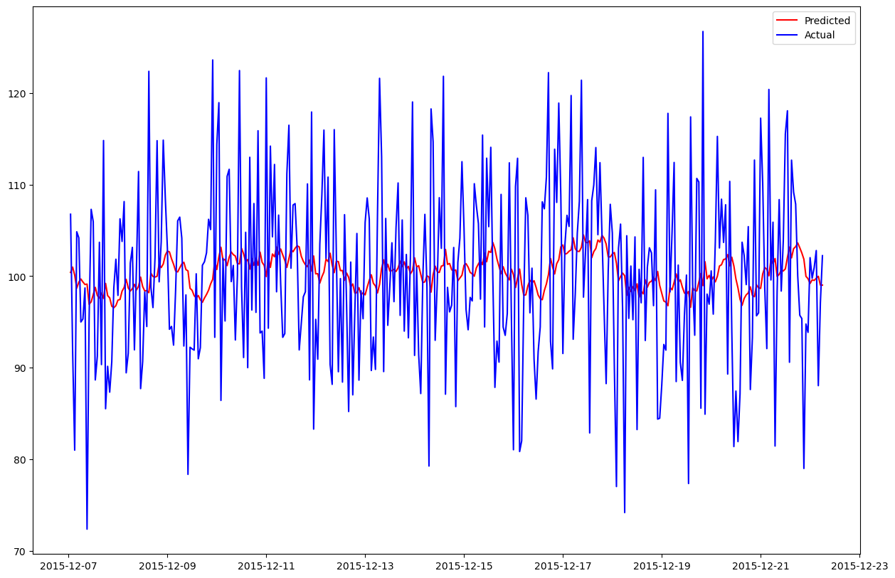
Forecast of pressure readings - Machine 1
Supervised Methods
Method 1
f
Method 2
f
Method 3
f

Slide 24
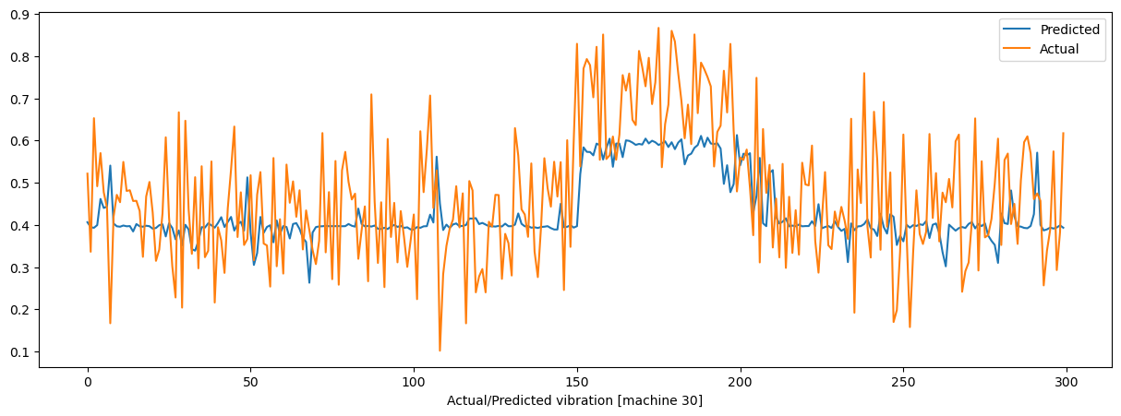
Forecast of Vibration readings - Machine 30
Supervised Methods
Method 1
f
Method 2
f
Method 3
f

Slide 25
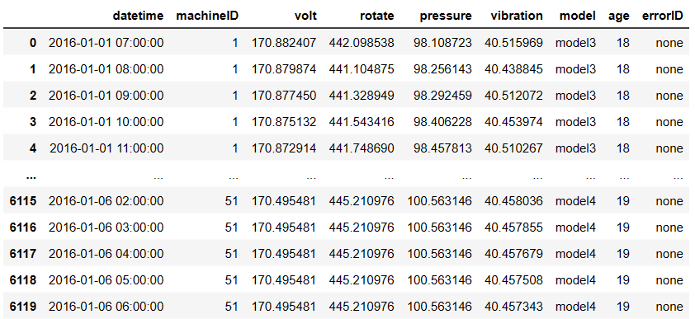
Forecast data

Slide 26
K-Means Clustering
Goal: Uncover Latent Structures, Patterns, and Anomalies amongst both the machines with Failures and Non-Failures
Pre-Processing
Merging Dataframes: Telemetry, Age, and Failures based on machineID
Failure Binary Encoding
Drop irrelevant columns, featuring engineering, & coerce data types to numerical.
Scale readings ('volt', 'rotate', 'pressure', 'vibration')
Separate into 2 Dataframes: Failures and Non-failures

Slide 27
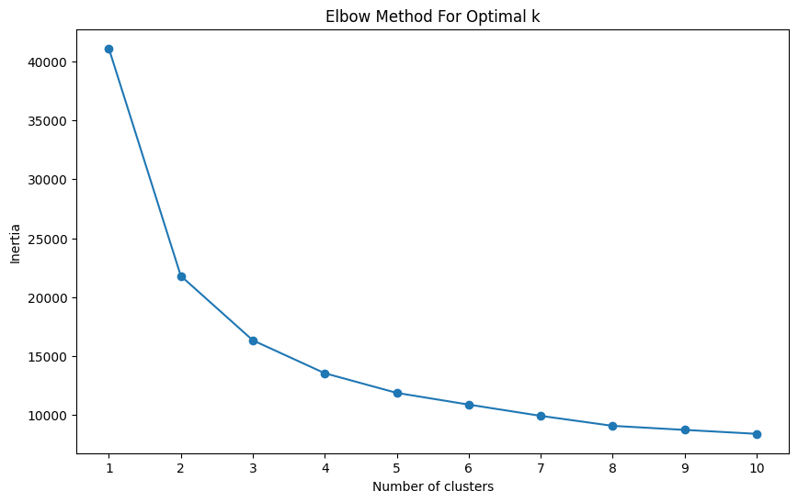
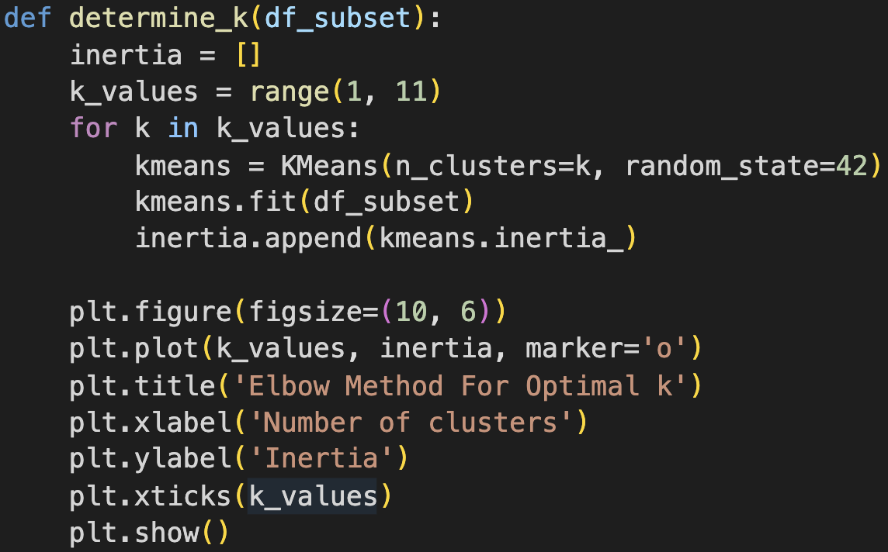
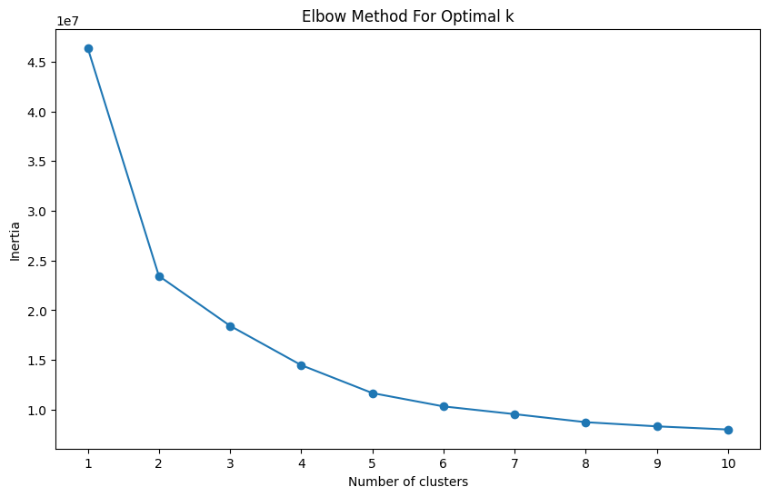
K-Means Clustering
Finding k: Elbow Plot (k = 4)

Slide 28
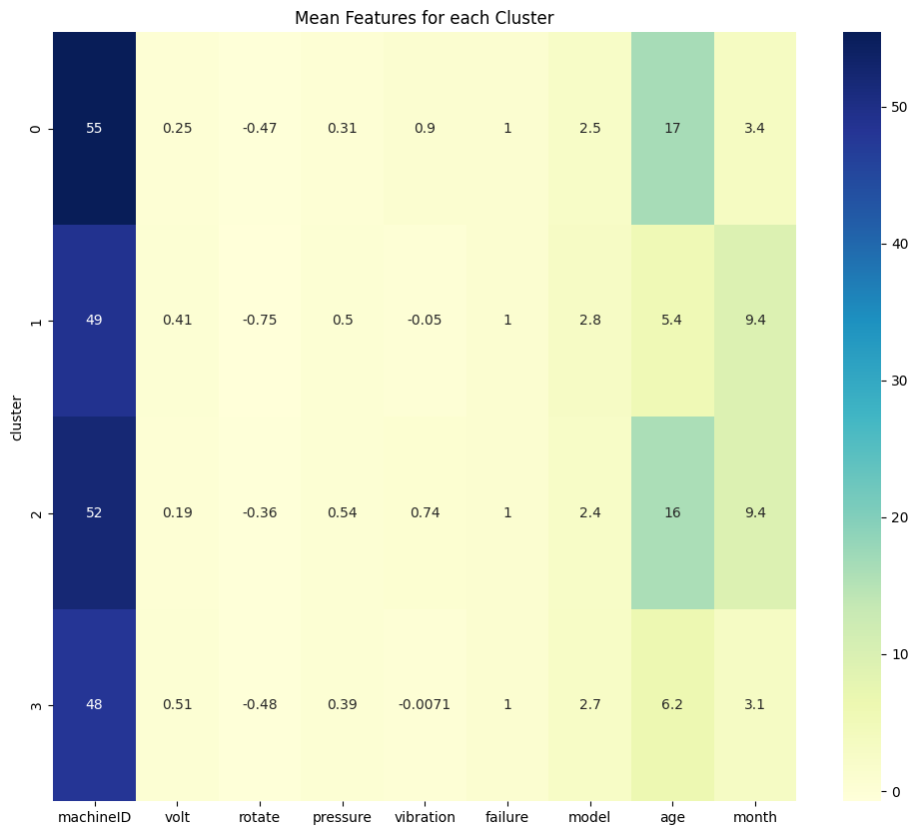
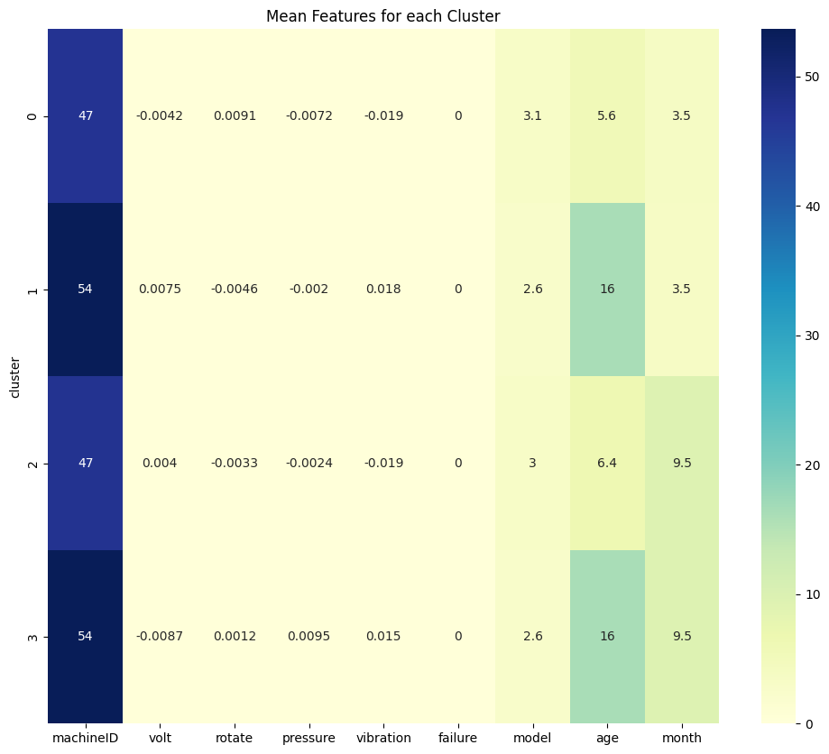
Nf’s
Cluster | 0 | 1 | 2 | 3
Count | 204324 | 229558 | 216500 | 224999
F’s
Cluster | 0 | 1 | 2 | 3
Count | 251 | 135 | 241 | 134
Notes:
The operational metrics Voltage, Rotation, Pressure, and Vibration exhibit different mean values across clusters for both failing and non-failing machines. This variability suggests that these features are potential indicators of machine health or stress, offering predictive power for machine failure. A higher mean in these metrics might correlate with failure likelihood and as such, we should monitor significant deviations from the non-failures operational norms in real time in order to predict and prevent failures.
Now looking forward the feature ‘model’, the mean feature for ‘model’ within our failures is far closer to 2 than it is within our non-failures (which is closer to 3 more often than not). As such, we can draw some careful observations. The 'model' feature shows a discernible pattern where failing machines are more commonly associated with a specific model, possibly model 2, while non-failing machines tend to be associated with another, likely model 3. This observation could signal intrinsic differences in design or function between the models that affect their reliability. A deeper dive into the operational differences, design changes, and enhancements from model 2 to model 3 could uncover critical factors contributing to machine resilience.
Conversely, the age of the machines and the month of operation do not significantly differ between the failing and non-failing clusters. Though we initially thought the ‘month’ could be indicative of the effects of temperature changes on the machines, this suggests that the likelihood of failure is less influenced by these factors, or that their effects are uniform across models. While this might imply that machine maintenance and reliability are not strongly age-dependent within the timespan observed, it's worth noting that other external factors not captured by the month alone, such as usage patterns or maintenance schedules, could still play a role.
Additional Considerations:
While the heatmaps offer a snapshot of mean cluster characteristics, it's important to consider the broader context. Factors such as usage intensity, maintenance practices, and environmental conditions could all interplay with the observed data. Furthermore, the absence of significant variation in age and month does not rule out their importance; instead, it may indicate that the effects are subtler or require more nuanced analysis, possibly at a higher resolution of time or in conjunction with other operational parameters.

Slide 29
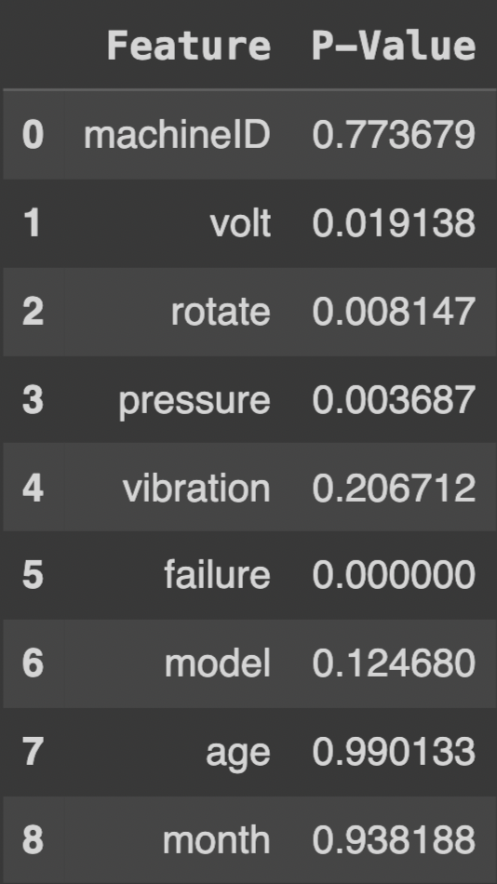
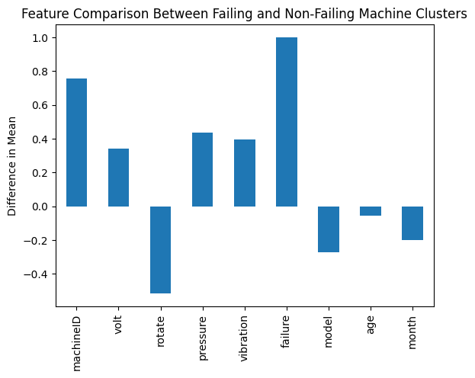
Feature Comparison
Significant features:
volt, rotate, and pressure
Not-significant features:
vibration, model,
age, and month

Slide 30
05
Conclusion

Slide 31




Final Insights and Conclusion
Preventing unplanned downtime
Improve machine reliability
Increase Operational Efficiency
Notes:
This fusion of our supervised and unsupervised methodologies aims to create a robust predictive framework, adaptable to the nuanced demands of machine maintenance and fault prevention, so that we can ultimately achieve these goals

Slide 32
Questions?
References (Hyperlinks):
Dataset: Microsoft Azure Predictive Maintenance (kaggle.com)

Slide 33
Data Cleaning
Clean 1
desc
Clean 2
desc
Data Preparation
Clean 3
desc
Clean 4
desc

