Slide 1
BLUESTOCK FINTECH | DATA ANALYST INTERNSHIP
Bluestock Mutual Fund
Analytics Capstone
End-to-End ETL, SQL Database Design, Performance & Risk Analytics, and a Power BI Dashboard for the Indian Mutual Fund Industry
Final Project Review Presentation
Kapish
Data Analyst Intern, Bluestock Fintech
2026

Slide 2

INTRODUCTION
Project Overview
Simulates a real-world fintech analytics workflow: raw data to business-ready insight
Covers 40 mutual fund schemes across 10 major Indian AMCs
Built end-to-end in Python, SQL (SQLite) and Power BI
Executed across 5 structured stages over the internship
Final deliverable: an interactive Power BI dashboard for stakeholders
40
10
Mutual Fund Schemes
Fund Houses (AMCs)
46K+
32,778
NAV History Records
Investor Transactions
Project Stages
Data Ingestion
>
Cleaning & DB Design
>
EDA
>
Performance Analytics
>
Advanced Analytics
Bluestock Mutual Fund Analytics Capstone
02

Slide 3

PROJECT GOALS
Objectives
1
Build a clean, validated mutual fund dataset
2
Design a relational database
Ingest & validate 10 raw datasets covering funds, NAV, AUM, SIP, transactions and holdings
Normalize data into a SQLite schema with dimension and fact tables
3
Deliver SQL-driven business insights
4
Perform Exploratory Data Analysis
Write analytical queries for AUM, returns, expense ratio and transaction patterns
Study NAV trends, AUM growth, SIP inflows, demographics and correlation
5
Compute performance & risk metrics
6
Apply advanced risk & behaviour analytics
CAGR, Sharpe, Sortino, Alpha, Beta, Drawdown and a composite Fund Scorecard
VaR/CVaR, cohort analysis, SIP continuity and a fund recommendation engine
Bluestock Mutual Fund Analytics Capstone
03

Slide 4

DATA FOUNDATION
Dataset
Dataset | File | Rows
Fund Master | 01_fund_master.csv | 40
NAV History | 02_nav_history.csv | ~46,000
AUM by Fund House | 03_aum_by_fund_house.csv | 170+
SIP Inflows / Category Inflows | 04, 05_*.csv | 120+
Scheme Performance | 07_scheme_performance.csv | 40
Investor Transactions | 08_investor_transactions.csv | 32,778
Portfolio Holdings | 09_portfolio_holdings.csv | 300+
Benchmark Indices (NIFTY50/100) | 10_benchmark_indices.csv | 1,000+
Category Split
10 Fund Houses Covered
SBI · HDFC · ICICI Prudential · Nippon India · Kotak Mahindra · Axis · Aditya Birla Sun Life · UTI · Mirae Asset · DSP
Bluestock Mutual Fund Analytics Capstone
04

Slide 5

DATA ENGINEERING
ETL Pipeline
1
2
3
EXTRACT
TRANSFORM
LOAD
Raw CSVs: fund master, NAV, AUM, transactions, holdings
Live NAV pulled via mfapi.in public API
>
Type casting, deduplication, null handling
Outlier flags on expense ratio & NAV; KYC & type standardization
>
Cleaned CSVs loaded to SQLite via SQLAlchemy
to_sql() into dim_fund & 3 fact tables
Deliverables: nav_history_clean.csv · scheme_performance_clean.csv · investor_transactions_clean.csv · bluestock_mf.db · data_quality_report.txt
Bluestock Mutual Fund Analytics Capstone
05

Slide 6

DATA ARCHITECTURE
Database Design
SQLite database: bluestock_mf.db
1 dimension table + 3 fact tables, joined on amfi_code
Loaded via SQLAlchemy to_sql()
Supports fast, repeatable analytical querying
dim_fund
amfi_code (PK) · scheme_name
fund_house · category
fact_nav
amfi_code · date · nav
fact_transactions
investor_id · amfi_code
txn_date · type · amount_inr
40
46K
dim_fund rows
fact_nav rows
fact_performance
amfi_code · return_1/3/5yr
expense_ratio_pct
Bluestock Mutual Fund Analytics Capstone
06

Slide 7


UNDERSTANDING THE DATA
Exploratory Data Analysis
NAV trends analysed for top 10 schemes (2022-2026)
AUM by fund house: SBI Mutual Fund leads
SIP inflows show consistent month-on-month growth
T30 cities contribute ~66% of transaction value
26-35 age group is the most active investor segment
Strong positive NAV correlation among equity peers
Chart: Daily NAV Trend (2022–2026)
Chart: AUM by Fund House
Chart: Monthly SIP Inflow Trend
Chart: NAV Return Correlation Heatmap
Bluestock Mutual Fund Analytics Capstone
07

Slide 8

FUND EVALUATION
Performance Analytics
Metric | What It Measures
CAGR | Annualized compounded return
Sharpe Ratio | Return per unit of total risk
Sortino Ratio | Return per unit of downside risk
Alpha / Beta | Excess return & market sensitivity vs. NIFTY100
Max Drawdown | Largest peak-to-trough NAV decline
Fund Scorecard | Composite 0–100 weighted rank score
Sample Sharpe Ratio — Top 5 Schemes
Avg. 1-Yr Return: 14.4% Avg. Sharpe: 1.36 Avg. Expense Ratio: 1.24%
Weights → Return 30% · Sharpe 25% · Alpha 20% · Expense 15% · Drawdown 10%
Benchmarked against NIFTY50 and NIFTY100
Chart: Top 5 Funds vs. NIFTY50/NIFTY100 (Normalized Performance)
Bluestock Mutual Fund Analytics Capstone
08

Slide 9


RISK & BEHAVIOUR
Advanced Analytics
VaR & CVaR
Rolling Sharpe Ratio
Investor Cohort Analysis
Historical 95% Value at Risk and Expected Shortfall per scheme
90-day rolling window, annualized, tracks risk-adjusted trend
Grouped by first-investment year: avg SIP, total invested, top fund
SIP Continuity
Recommendation Engine
Portfolio Concentration (HHI)
Investors classified Healthy vs. At-Risk (avg. gap > 35 days)
Rule-based: top 3 funds by risk appetite & Sharpe Ratio
Sector-weight concentration index for equity schemes
All advanced-analytics outputs are exported to /reports for direct Power BI ingestion.
Bluestock Mutual Fund Analytics Capstone
09

Slide 10

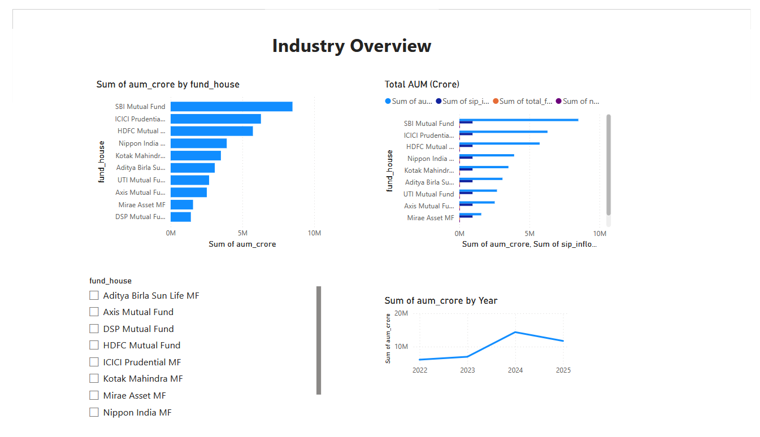
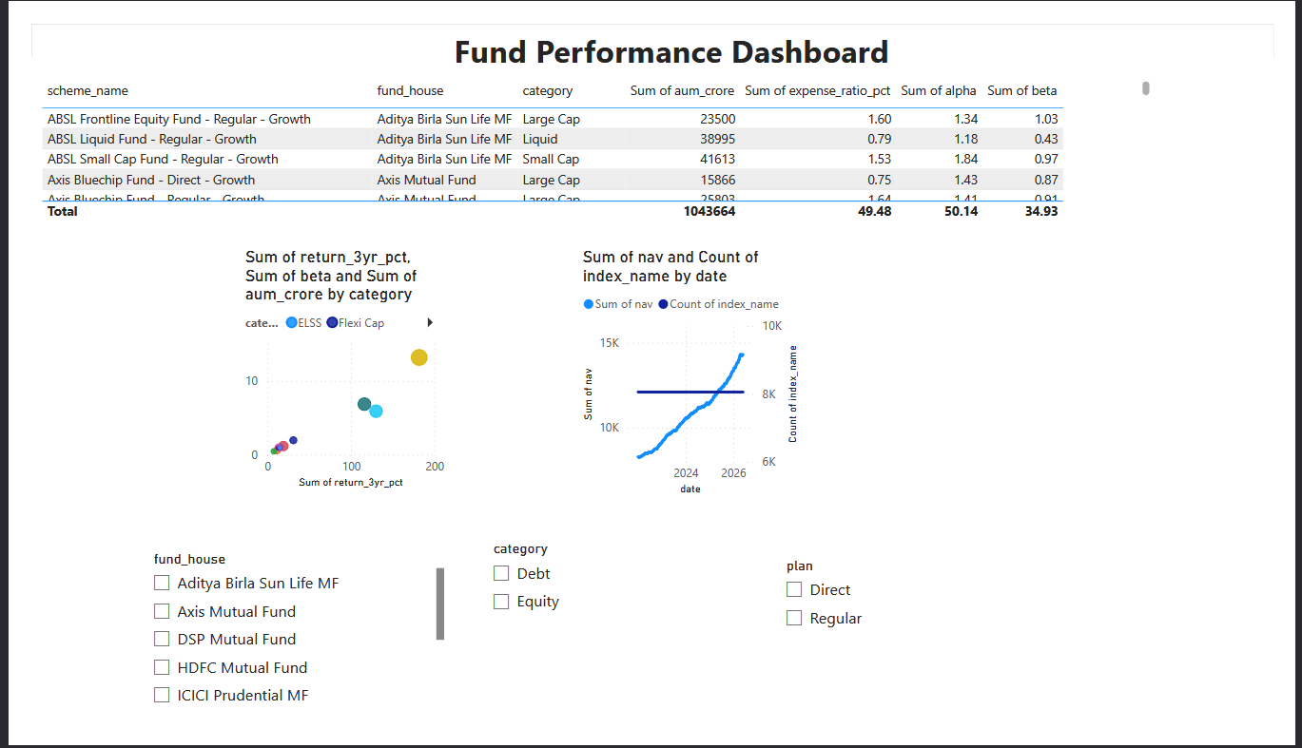
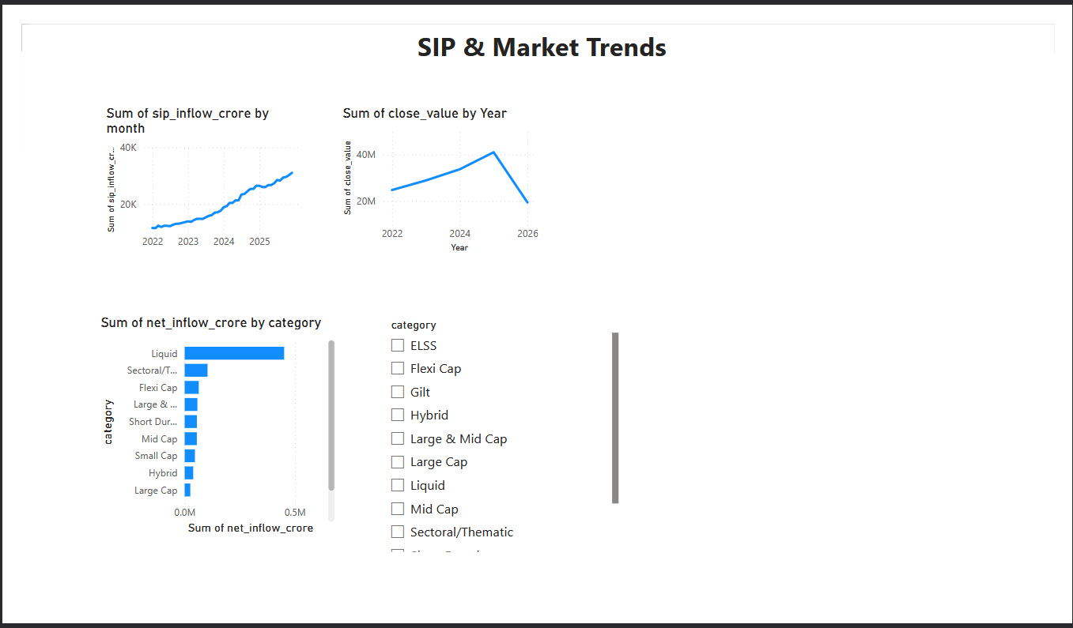
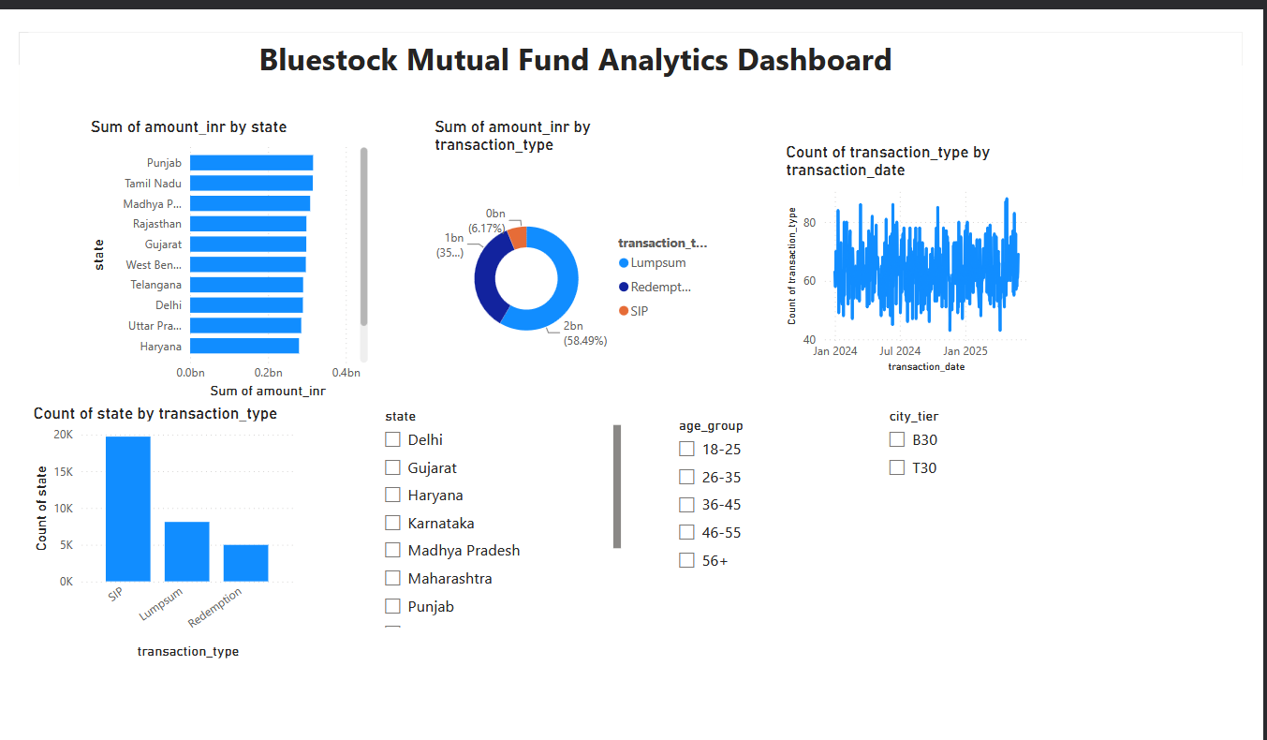
BUSINESS INTELLIGENCE
Power BI Dashboard
Single source of truth: SQLite DB + processed CSV reports
Slicers: fund house, category, risk grade, date range
Cross-filtering enables stakeholder drill-down
Dashboard Screenshot: Fund Overview (AUM & Category Split)
Dashboard Screenshot: Performance & Fund Scorecard
Dashboard Screenshot: Risk Analytics (VaR/CVaR, Drawdown)
Dashboard Screenshot: Investor Insights & SIP Continuity
Bluestock Mutual Fund Analytics Capstone
10

Slide 11



FINDINGS
Business Insights
Fund Performance
Investor Behaviour
Equity schemes: higher CAGR, higher drawdown risk
Liquid/debt funds post the highest Sharpe ratios
Fund Scorecard gives a holistic, multi-factor ranking
Rolling Sharpe shows risk-adjusted rank shifts over time
SIP transactions dominate (~60% of all transactions)
Age group 26-35 is the most active investor segment
T30 cities drive ~66% of transaction value; B30 has headroom
A meaningful share of SIP investors are flagged ‘At-Risk’
Bluestock Mutual Fund Analytics Capstone
11

Slide 12

Conclusion
Delivered a complete analytics lifecycle: raw data → ETL → SQL database → EDA → performance & risk analytics → Power BI dashboard
Analysed 40 schemes, ~46,000 NAV records, and 32,778 investor transactions
Applied industry-standard financial metrics: CAGR, Sharpe, Sortino, Alpha/Beta, VaR/CVaR, HHI
Translated analysis into actionable insights on fund performance, investor retention and diversification
Strengthened practical skills in Python, SQL, financial analytics and Power BI — directly applicable to a Data Analyst role in fintech
Thank you
Kapish · Data Analyst Intern · Bluestock Fintech

