Slide 1
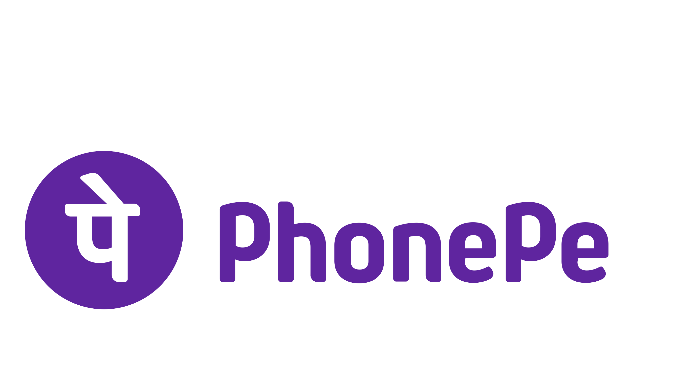
PhonePe Transaction Insights
Visual Analysis of PhonePe Usage in India

Slide 2
🔍 Problem Statement
With the rise of digital payment platforms like PhonePe, understanding user behavior, regional performance, and financial engagement is key to informed decision-making. This project uncovers insights using real transaction data from PhonePe Pulse.

Slide 3
🎯 Project Goals
- Analyze transaction patterns across states and districts
- Identify most used device brands
- Explore app engagement and insurance adoption
- Build an interactive dashboard for real-time data insights

Slide 4
🛠 Tools & Technologies Used
- Python (pandas, json, os)
- MySQL (database & queries)
- Streamlit (dashboard)
- Plotly (data visualization)
- Git & GitHub (version control)
- Source: PhonePe Pulse GitHub (JSON data)

Slide 5
📁 Data Extraction
Extracted JSON files from PhonePe Pulse GitHub and converted them into structured CSVs using Python. Each category (transactions, users, insurance) was loaded into MySQL.

Slide 6
🏗️ SQL Table Structure
Created 9 relational tables in MySQL:
- aggregated_user, aggregated_transaction, aggregated_insurance
- map_user, map_transaction, map_insurance
- top_user, top_transaction, top_insurance
Each table captured values by year, state, district, and quarter.

Slide 7
🔍 Data Analysis with SQL
Executed SQL queries to analyze:
- Top states by transaction amount
- Top brands by user base
- App usage by districts
- Insurance transactions by state
- Transaction volume by district

Slide 8
🐍 Python & Streamlit Integration
- Connected Python to MySQL using `mysql.connector`
- Used pandas to fetch and clean data
- Visualized data using plotly.express
- Built sidebar and charts in Streamlit app

Slide 9
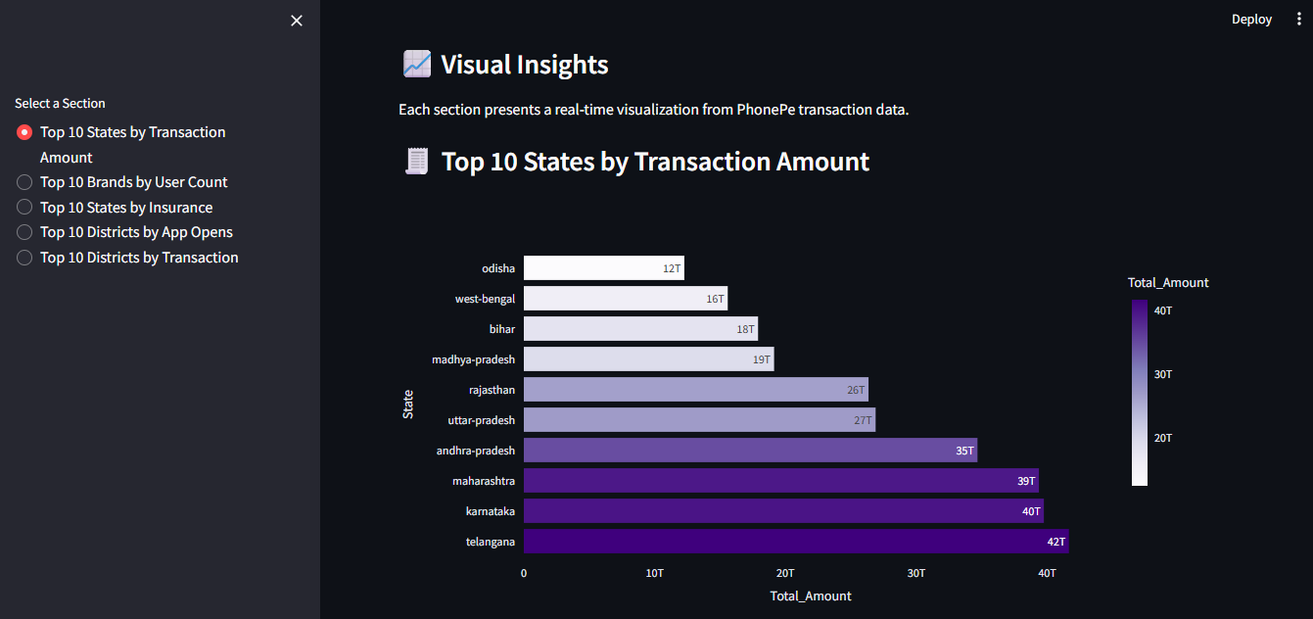
📊 Streamlit Dashboard Overview

Slide 10
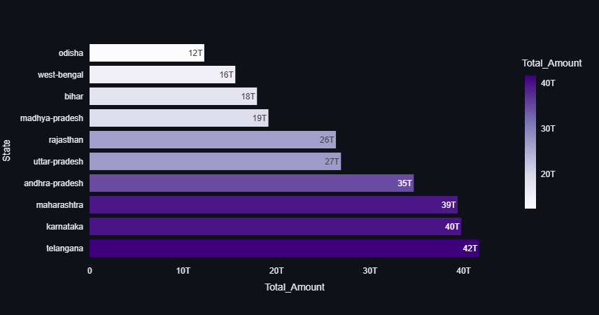
📊 Top 10 States by Transaction Amount
🧠 Insight: Maharashtra, Karnataka, and Telangana lead in total transaction volume.

Slide 11
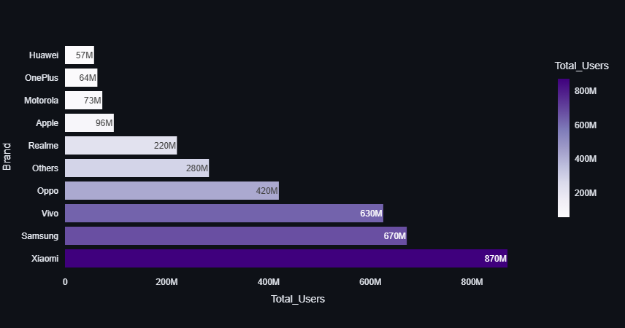
📊 Top 10 Brands by User Count
🧠 Insight: Xiaomi and Samsung are the most popular brands among PhonePe users.

Slide 12
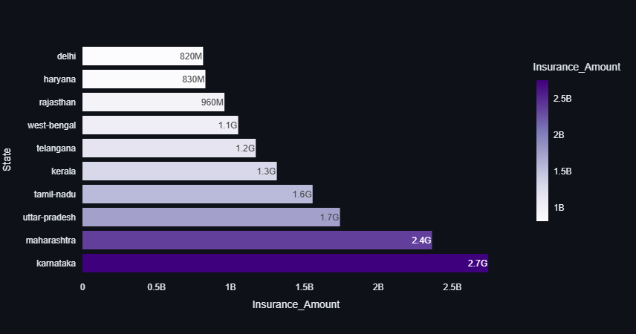
📊 Top States by Insurance Transactions
🧠 Insight: Karnataka and Maharashtra show high fintech and insurance adoption.

Slide 13
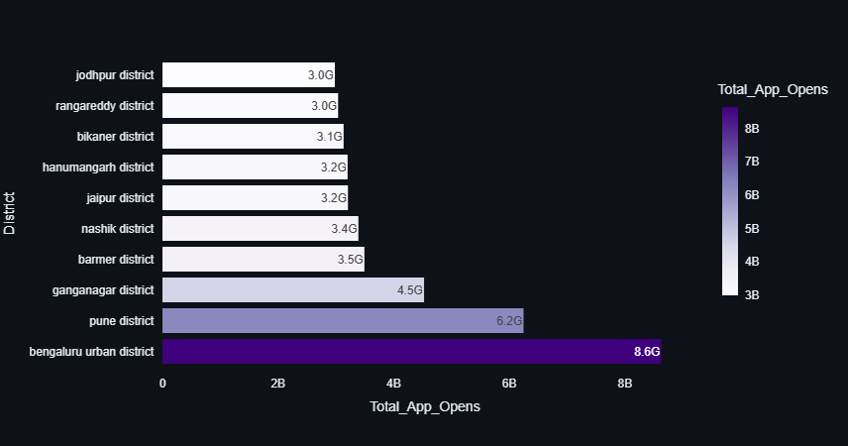
📊 App Opens by District
🧠 Insight: Bengaluru Urban, Pune, and Ganganagar are the most engaged districts.

Slide 14
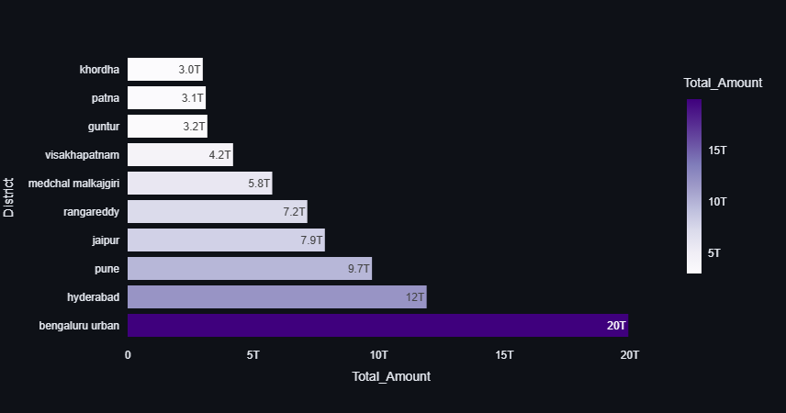
📊 Districts by Transaction Amount
🧠 Insight: Bengaluru and Hyderabad dominate district-level digital payments.

Slide 15
📌 Summary of Key Findings
- South & West India dominate digital payments
- Android mid-range phones are most common
- Urban areas show highest engagement
- Insurance is growing in tech-savvy states
- Tier-2 cities show emerging potential

Slide 16
💡 Business Recommendations
- Expand in Tier-2 cities with high engagement
- Partner with Xiaomi & Samsung
- Focus fintech campaigns in mature states
- Encourage insurance in underrepresented regions

Slide 17
✅ Conclusion & Learnings
This project helped me explore the full data pipeline:
- Extracting raw data
- Cleaning and organizing in SQL
- Querying for insights
- Visualizing through Streamlit
Result: A real-time, meaningful dashboard to support business decisions.

Slide 18
🙏 Thank You
Project by Kapish
GitHub: github.com/Kapish196258/Phone_pay_project_files
PhonePe Pulse Data Visualization

