Slide 1
“Calendar w/ Temperature & Binary Clock“
By: Doding

Slide 2
Overview
Requirements
Requirement Key Points
Hardware
Software
Software modules
Software Framework
State Machine (FSM)
Event Handling
Serial Console Event Handling
Command Set
Command Parsing
UART Buffering
Storage Module
One way of storing information in physical memories.
Application Tick
Temperature Sensing
Display Manager
Calendar and Clock Module
Button
System Priorities
Software – All Together
Notes:
1.) In requirement slides will discuss about
- one way of doing requirement capture is by using UML
- using UML to analyze use cases
- I will show you an actual UML models
- basically, will talk about what are the things I did before I start thinking about What Software modules I need and What Software Framework is best fit for the job.
2.) In Hardware will talk about its high level diagram.

Slide 3
What you need:
PIC24FJ128GA010 MCU PIM
http://www.microchip.com/wwwproducts/en/PIC24FJ128GA010
XC16 Compiler
http://www.microchip.com/mplab/compilers
PIC24/dsPIC Peripheral Libraries v2.00 – Windows
http://www.microchip.com/mymicrochip/filehandler.aspx?ddocname=en574967
Explorer 16 Board
ICD-3
MCP2200
Serial Terminal such as Real Term

Slide 4
Requirements
The Date, Day and Ambient Temperature will be displayed on the LCD.
The Time will be displayed using LEDs (Binary Clock). This will be on a 24-hour format.
The LEDs will display the hour for 2.5 seconds. D8-D7 for the tens, D6 to D3 for the one. D10 is always ON to identify that it is hours.
The LEDs will then display the minutes for 2.5 seconds. D9-D7 for the tens, D6 to D3 for the one. D10 is always OFF to identify that it is minutes.
RS232 Menus:
Update Date
Update Time
Set Alarm
Save Time/Date to Internal EEPROM
Save Time/Date to External EEPROM
View Time/Date from Internal EEPROM
View Time/Date from External EEPROM
Feel free to design the Sub Menus for the items on (3).
The Internal EEPROM should be simulated (refer to Data EEPROM Emulation Application Note).
The LEDs will blink (250mS ON/OFF) during an Alarm. A push button switch will cancel the Alarm and will return to the normal display of the Binary Clock.
Let us target a 1sec +/- 100uS accuracy for the clock.
Notes:
1.) This slide is not the best as it has many information in it but we will take it slow to capture what we need here.

Slide 5
Requirement Key Points
Events
Human generated events such as serial console commands and button events.
Human generated events are not super fast.
Alarm Event generated by the RTCC.
Fastest alarm event is every 0.5 seconds.
Human Interface
No animation is required.
Display info are in fixed positions.
Serial Console.
Buttons.
LED for the binary clock
Buffering
No data streaming.
Fifo based buffer is enough.
We have enough memory to avoid dynamic memory allocation.
The entire requirement have fixed number of states.
Hierarchical State Machine is not needed.
Single level state machine is enough to support all functionalities.
Notes:
1.) After requirement capture I normally write down some key points where I can based my design.

Slide 6
Hardware
MCU
GPIO
LEDs
PMP
LCD
CONSOLE
UART
iEEPROM
SPI
xEEPROM
TEMP_SENSE
ADC
TIMER
RTCC
BUTTONS
INT0
Notes:
1.) 16bit MCU
2.) GPIO to control LED
3.) Parallel Master Port is used to control the LCD display
4.) UART to receive commands and show text into serial console.
5.) iEEPROM, this is an Emulated EEPROM
6.) SPI to write and read with an external EEPROM.
7.) ADC to monitor ambient temperature.
8.) 1 Timer is used as the application tick. But not used in clock and calendar.
9.) RTCC for calendar, binary clock and Alarm
10.) INT0 to detect button events.

Slide 7
Software Framework
Event handler 1
FIFO
State Machine
Engine
External Events
Event handler 2
event
Internal Events
Event handler 3
LUT
Event handler 4
sys_info
Event handler etc..
temp_sense
tick
display
Notes:
1.) From left to right
2.) Event are 2 types:
- external events like button press, console commands.
- all external events are from ISR.
- internal events are for example Alarm and Internal Errors like while accessing eeprom, etc..
3.) All events are queued to make sure that nothing is missed.
- first in first out
4.) the state machine is running in infinite loop always checking if there is an item in the fifo.
- when the state machine detects an item in the queue it will query the LUT to determine which event handler to execute.
5.) the look up table will decide which handler to execute based on the FSM State and the Event.
6.) sys_info
- is a shared data structure containing:
- time
- date
- temperature
7.) the tick is a timer ISR running in background that keeps on updating LCD and LED based on sys_info

Slide 8
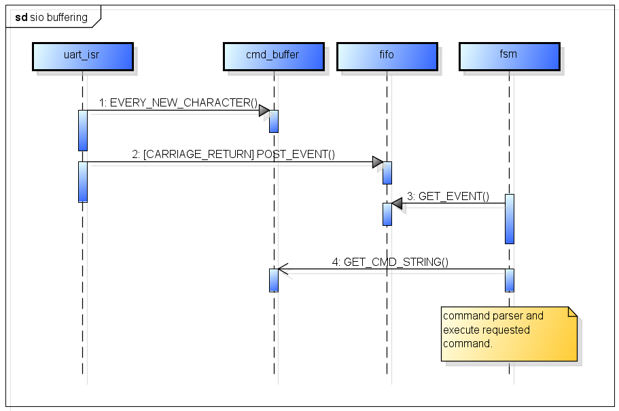
Serial IO Buffering

Slide 9
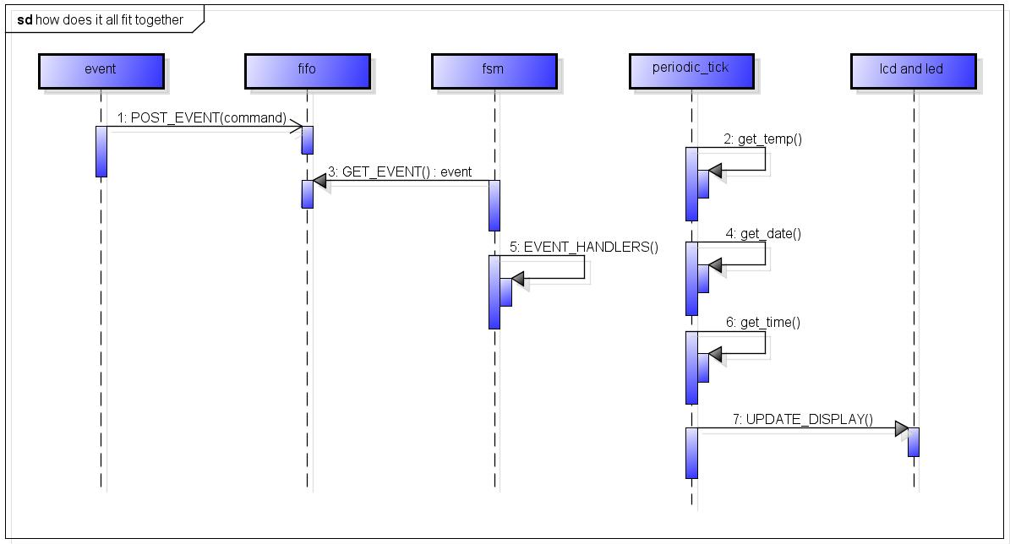
How does it all fit together?

Slide 10
End
Thank You!!

