Slide 1

CLAASP
Halil İbrahim Kaplan
TDD / Kripto Analiz Laboratuvarı
halil.kaplan@tubitak.gov.tr
2024

Slide 2

Overview
General Review
Some Test Results
Conclusions
Halil İbrahim Kaplan
CLAASP

Slide 3
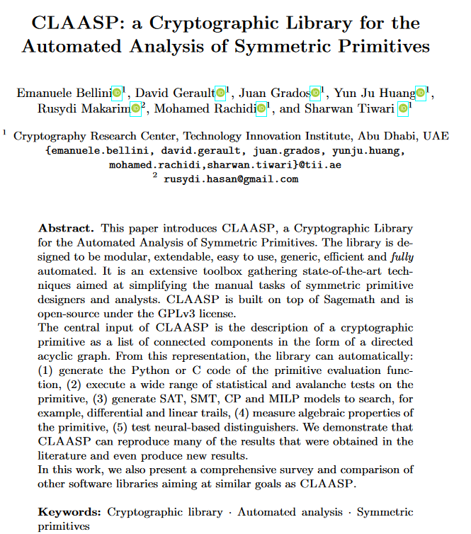

Slide 4
General Review
The basic block of CLAASP is the description of a cryptographic primitives in the form of a list of connected components (S-Box, LinearLayer, Constants, Input/Output, etc.).
Halil İbrahim Kaplan
CLAASP

Slide 5
General Review
The basic block of CLAASP is the description of a cryptographic primitives in the form of a list of connected components (S-Box, LinearLayer, Constants, Input/Output, etc.).
From this representation, the library can:
generate the Python or C code of the encryption function,
execute a wide range of statistical and avalanche tests on the primitive,
automatically generate SAT, SMT, CP and MILP models to search, for example, differential and linear trails,
measure algebraic properties of the cipher,
test neural-based distinguishers.
Halil İbrahim Kaplan
CLAASP

Slide 6
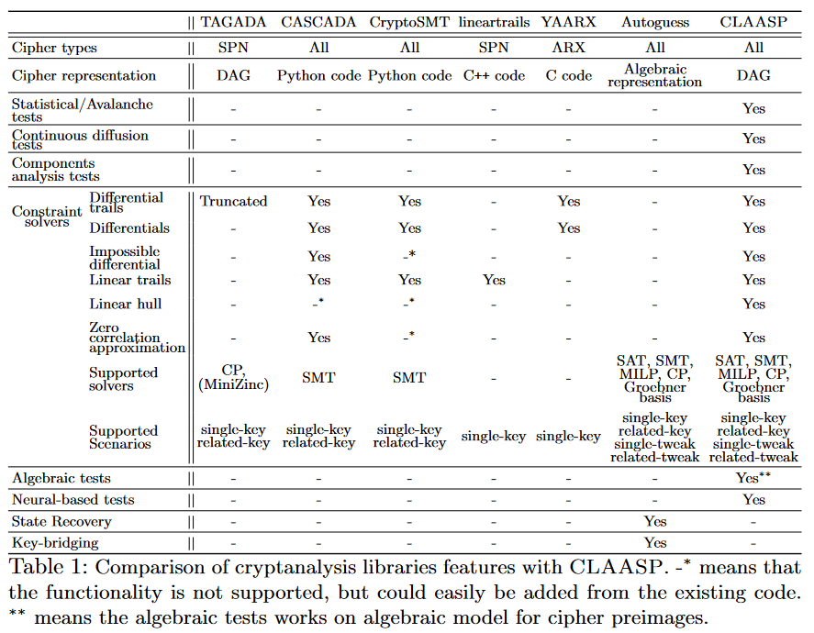
General Review
Halil İbrahim Kaplan
CLAASP

Slide 7
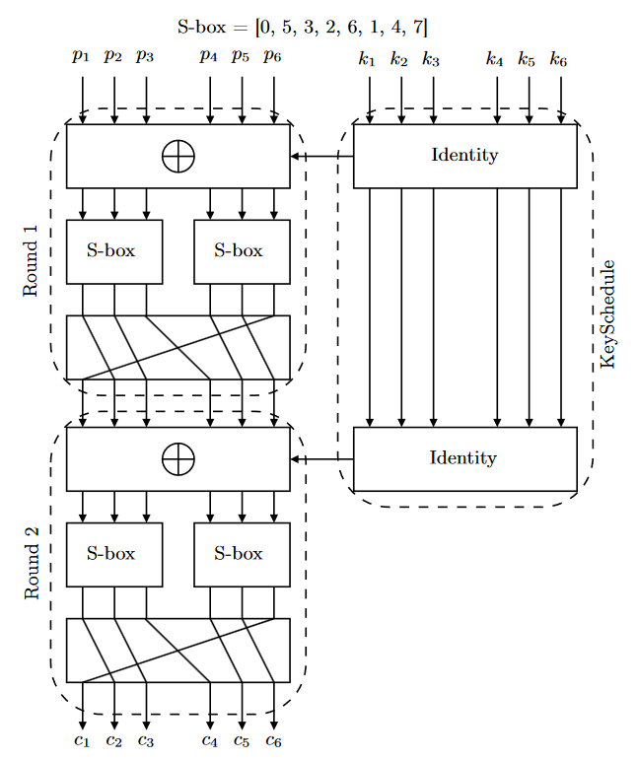
General Review
Halil İbrahim Kaplan
CLAASP

Slide 8
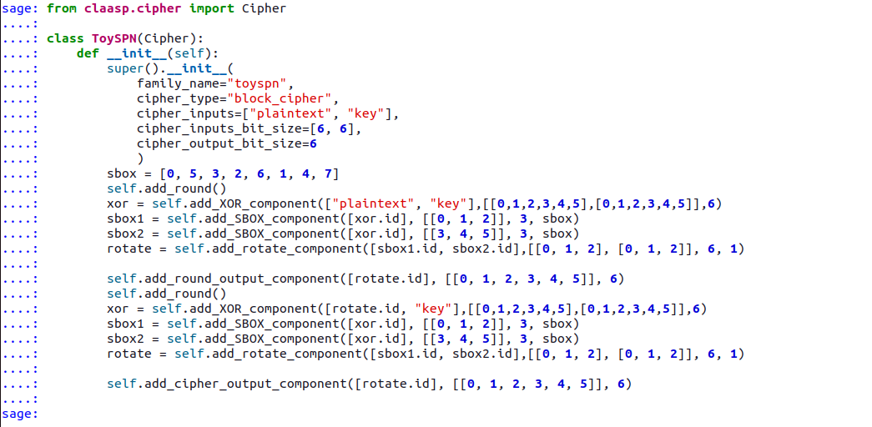
General Review
Halil İbrahim Kaplan
CLAASP

Slide 9
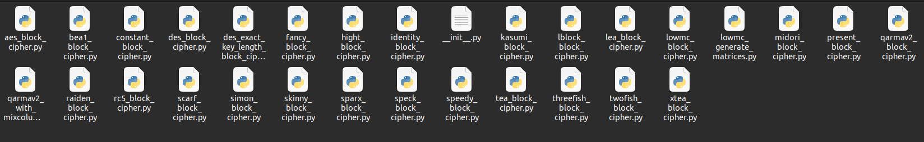
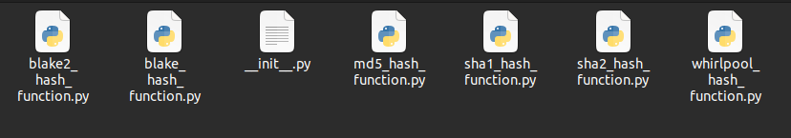
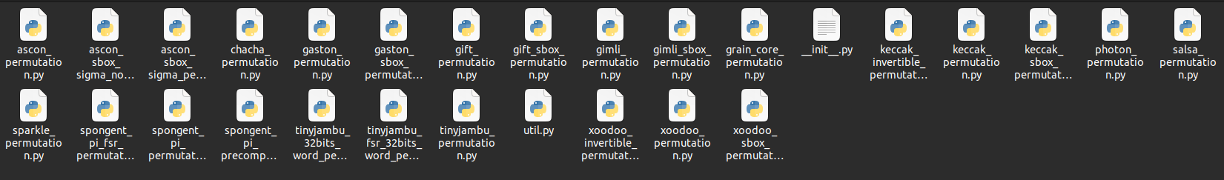
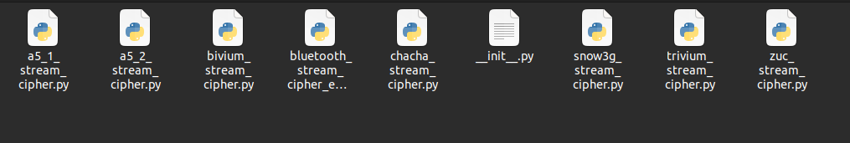
General Review
Halil İbrahim Kaplan
CLAASP

Slide 10
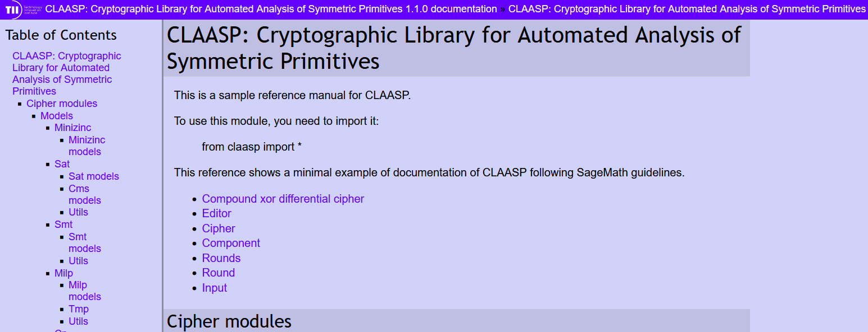
General Review
Halil İbrahim Kaplan
CLAASP

Slide 11
Some Test Results

Slide 12
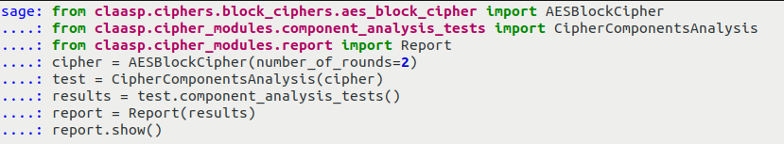
Some Test Results
Halil İbrahim Kaplan
CLAASP

Slide 13
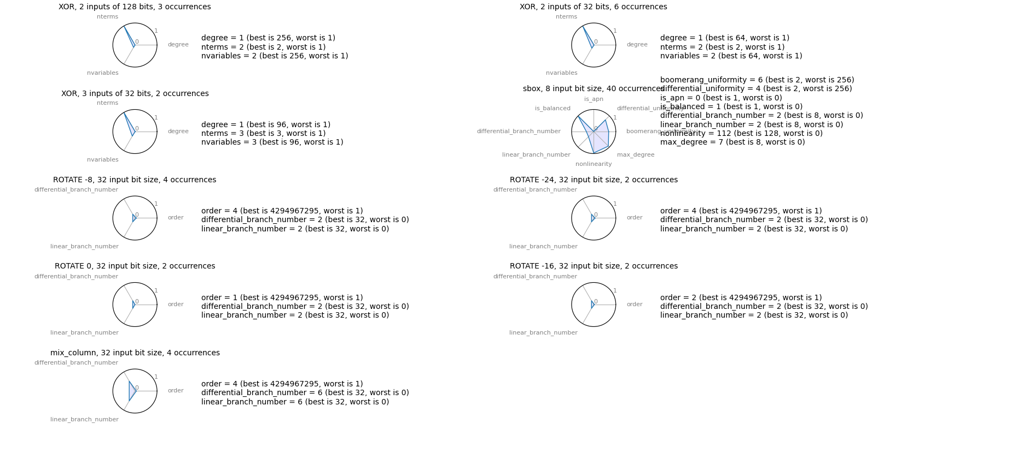
Some Test Results
Halil İbrahim Kaplan
CLAASP

Slide 14
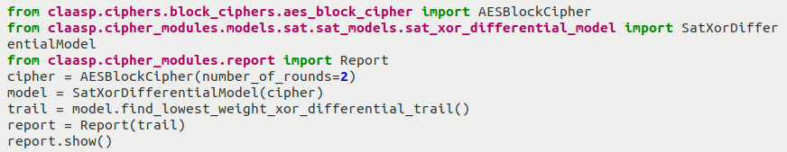
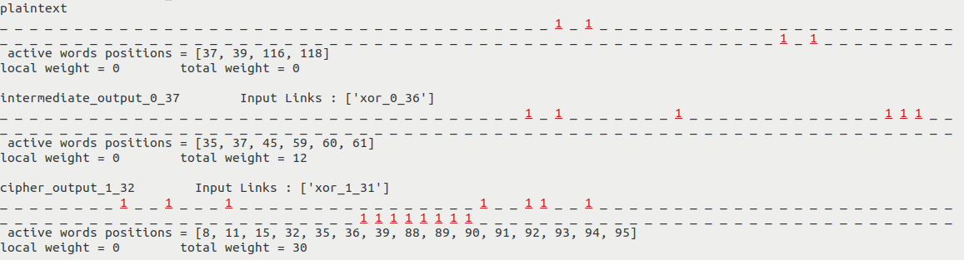
Some Test Results
Halil İbrahim Kaplan
CLAASP

Slide 15
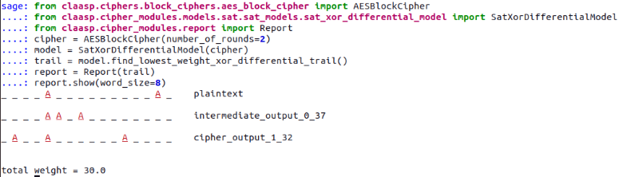
Some Test Results
Halil İbrahim Kaplan
CLAASP

Slide 16
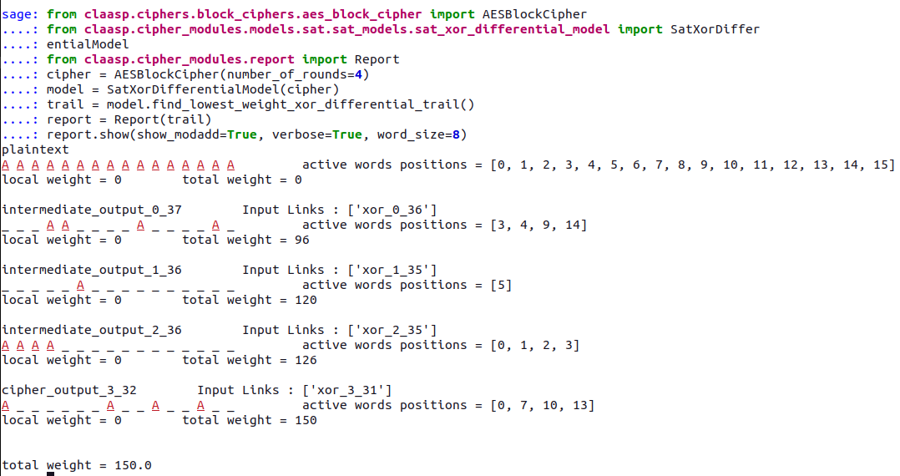
Some Test Results
Halil İbrahim Kaplan
CLAASP

Slide 17
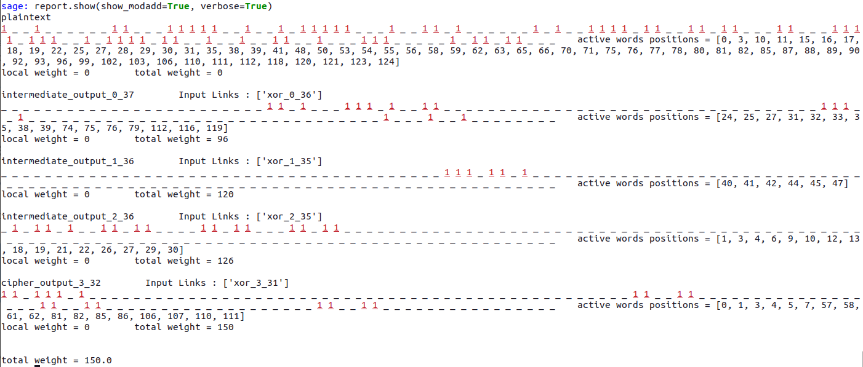
Some Test Results
Halil İbrahim Kaplan
CLAASP

Slide 18
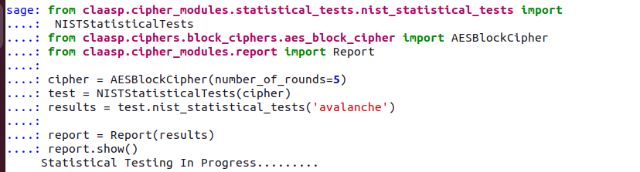
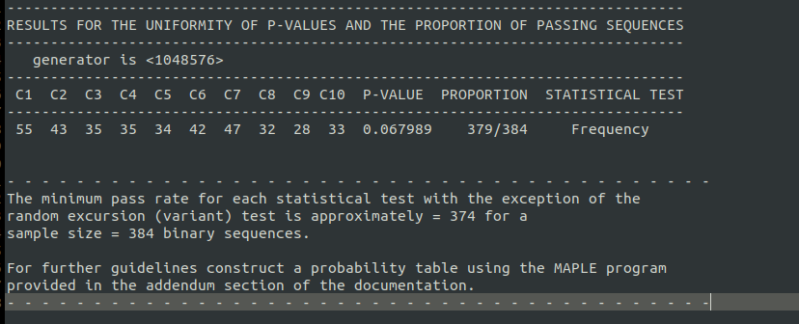
Some Test Results
Halil İbrahim Kaplan
CLAASP

Slide 19
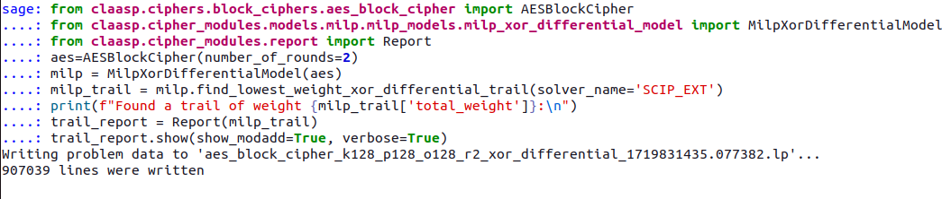
Some Test Results
Halil İbrahim Kaplan
CLAASP

Slide 20
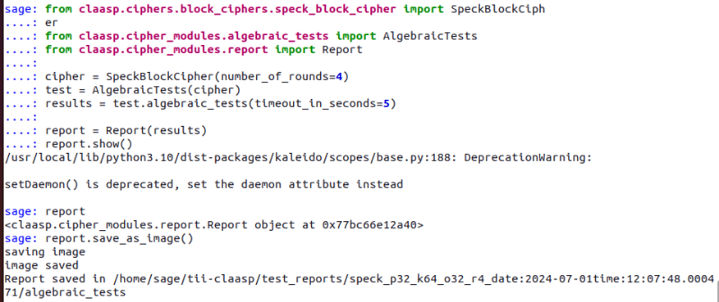
Some Test Results
Halil İbrahim Kaplan
CLAASP

Slide 21
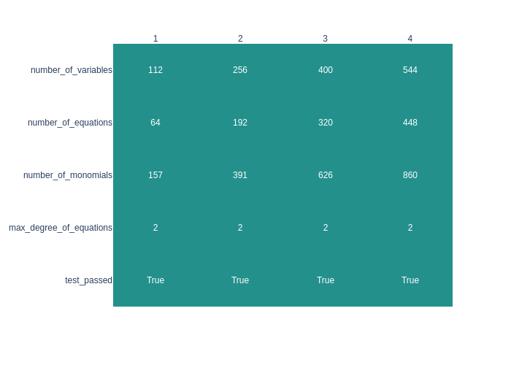
Some Test Results
Halil İbrahim Kaplan
CLAASP

Slide 22
Conclusions

Slide 23
Conclusions
PROS | CONS
Still in development process. Implementation of the algorithm is easy. To make all the tests. Only implementation of the algorithm is enough. Searching best linear and differential trails are easy | Only uses 1 processor. Documentation is not correct. Some functions are not working. Some tests works fine with basic ciphers like Speck but have problem with working AES MILP generates too many equations. Makes bitwise testing not bytewise.
Halil İbrahim Kaplan
CLAASP

Slide 24
References
Bellini, E., Gerault, D., Grados, J., Huang, Y. J., Makarim, R., Rachidi, M., & Tiwari, S. (2023, August). CLAASP: a cryptographic library for the automated analysis of symmetric primitives. In International Conference on Selected Areas in Cryptography (pp. 387-408). Cham: Springer Nature Switzerland.
Halil İbrahim Kaplan
CLAASP

