Slide 1


Online auction
Kaplin Sergey

Slide 2

Project objective
For this project my main objectives are to build an auction site that allows user to be able to browse through the list of lots, find lots by name and buy lots. The website would also allow users to register, create new lots and edit/delete existing lots.

Slide 3
User use case diagram

Slide 4
Administrator use case diagram

Slide 5
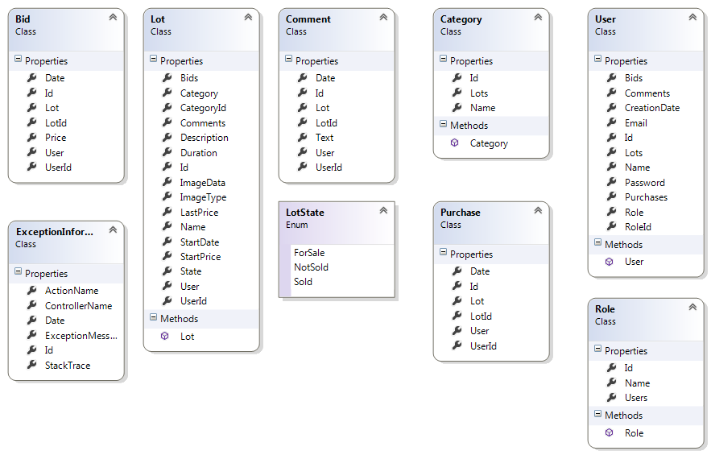
Class diagram

Slide 6
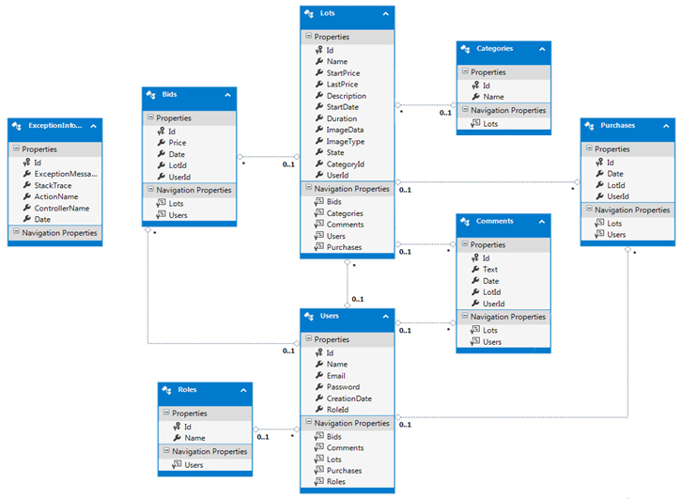
Database diagram

Slide 7
CONCLUSION
This project was made using a multilayered architecture, that can promote the development, extension and change of its functionality without extensive manual work from the programmer.
2017

