Slide 1

Frontend Backend Database
Kaponyi Benedek Péter Kerepesi Áron Katona Roland

Slide 2


The idea
Pharmaceutical webshop
What we offer:
Customer-first natural solutions
Health advice

Slide 3

Where did it come from?
Solving an everyday problem
Other websites offer less useful and less regulated products
Offering things what people often don’t benefit from

Slide 4









TEchnologies

Slide 5
Database structure

Slide 6
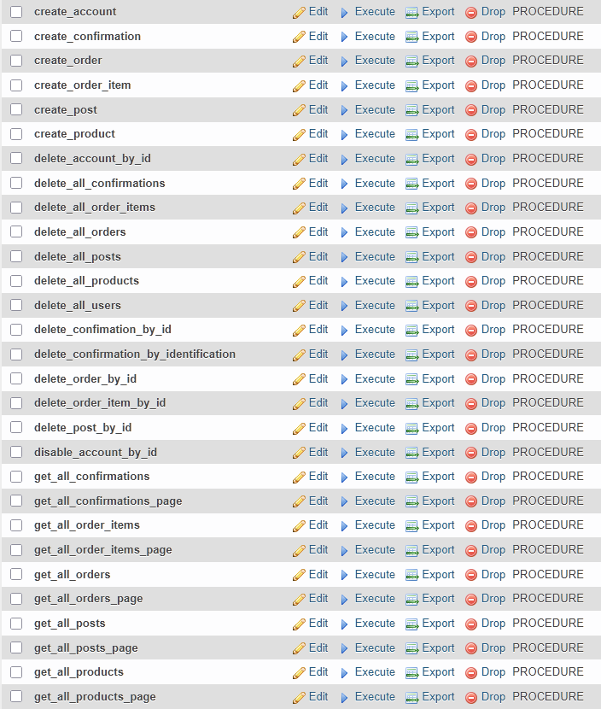
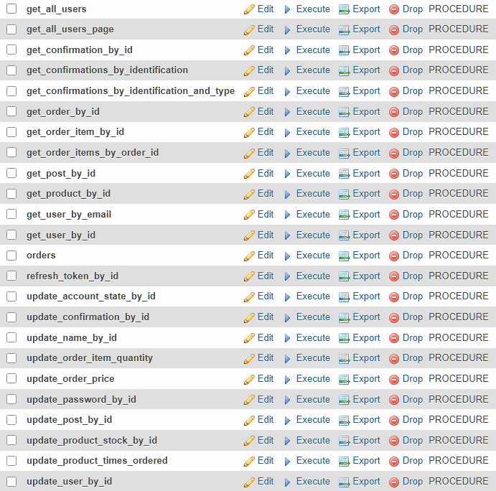
Database routines

Slide 7
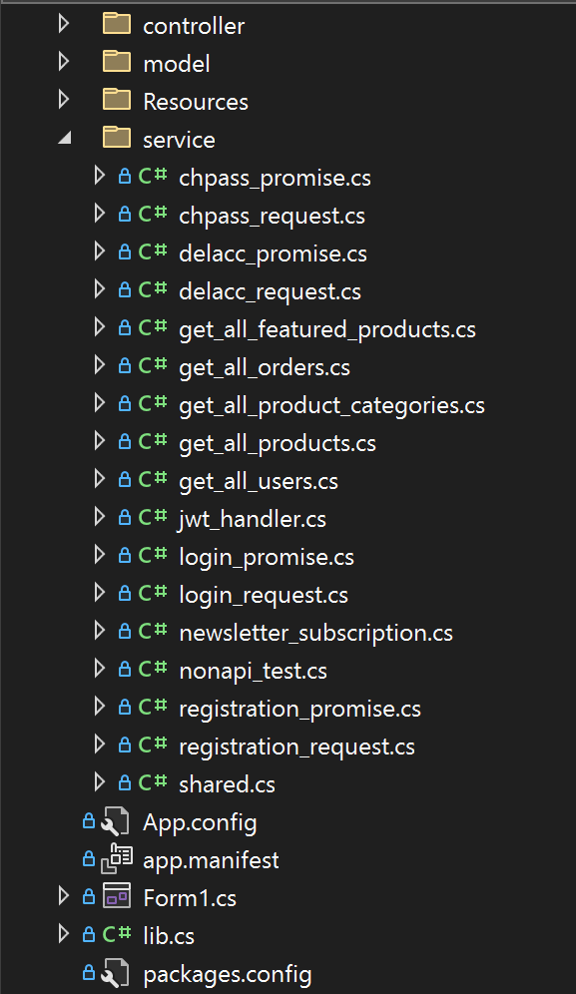
Backend
Backend checks the credentials
User clicks the magic link in the email
User clicks login
Backend checks the temporary confirmation token
Backend creates a login confirmation, sends an email with the temporary token
Backend sends the user all its credentials thru a TLS secured tunnel

Slide 8
Frontend
Made with Angular framework
Component based structure
API calls

Slide 9

Design ideas
Clean UI
User-friendly UI
Responsive design

Slide 10
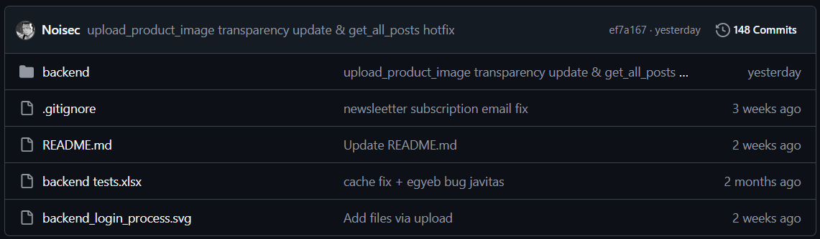
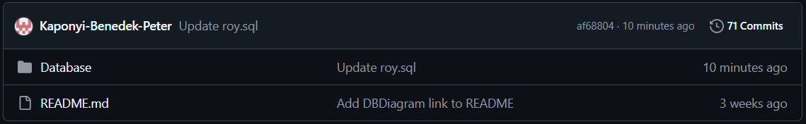
Teamwork + Work time

Slide 11
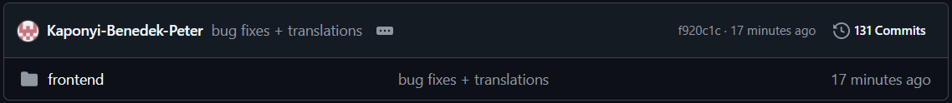
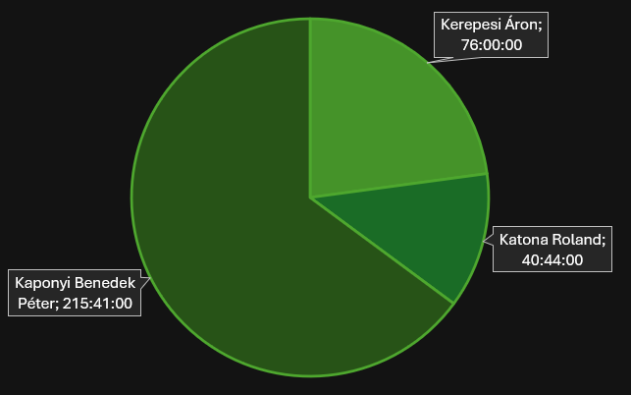

Slide 12


Work progress/status
Basic funtions working
Development still in progress
Design need some adjustments

Slide 13
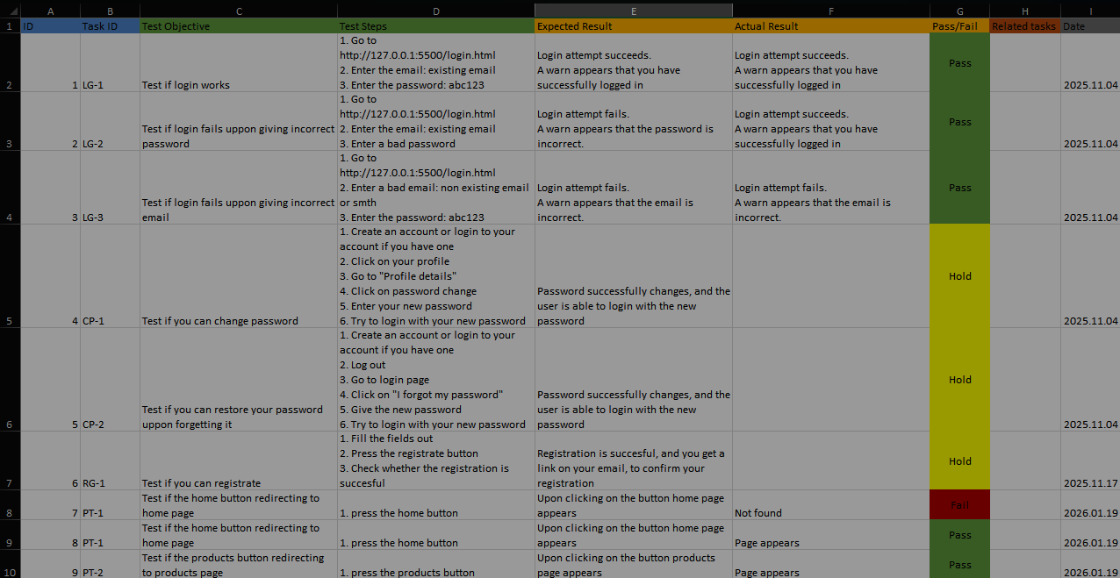
Tests

Slide 14

Future plans
OTP Simple pay integration
AI health advisor
Effective dosage/price calculator

Slide 15
The demo

Slide 16

Thank you for your attention!
Sources:
https://unsplash.com/ https://www.cypress.io/#create
https://icons8.com/

