Slide 1
DELIVERY ANALYTICS(BLINKIT)
Dashboard Review — Analysis, Insights & Strategic Recommendations
Quick Commerce | Customer Experience | Operational Intelligence
17.04 min
42.50%
Avg Delivery
On-Time Rate
63.03
₹951.91K
CSAT Score
Revenue
Prepared for Interview Presentation

Slide 2
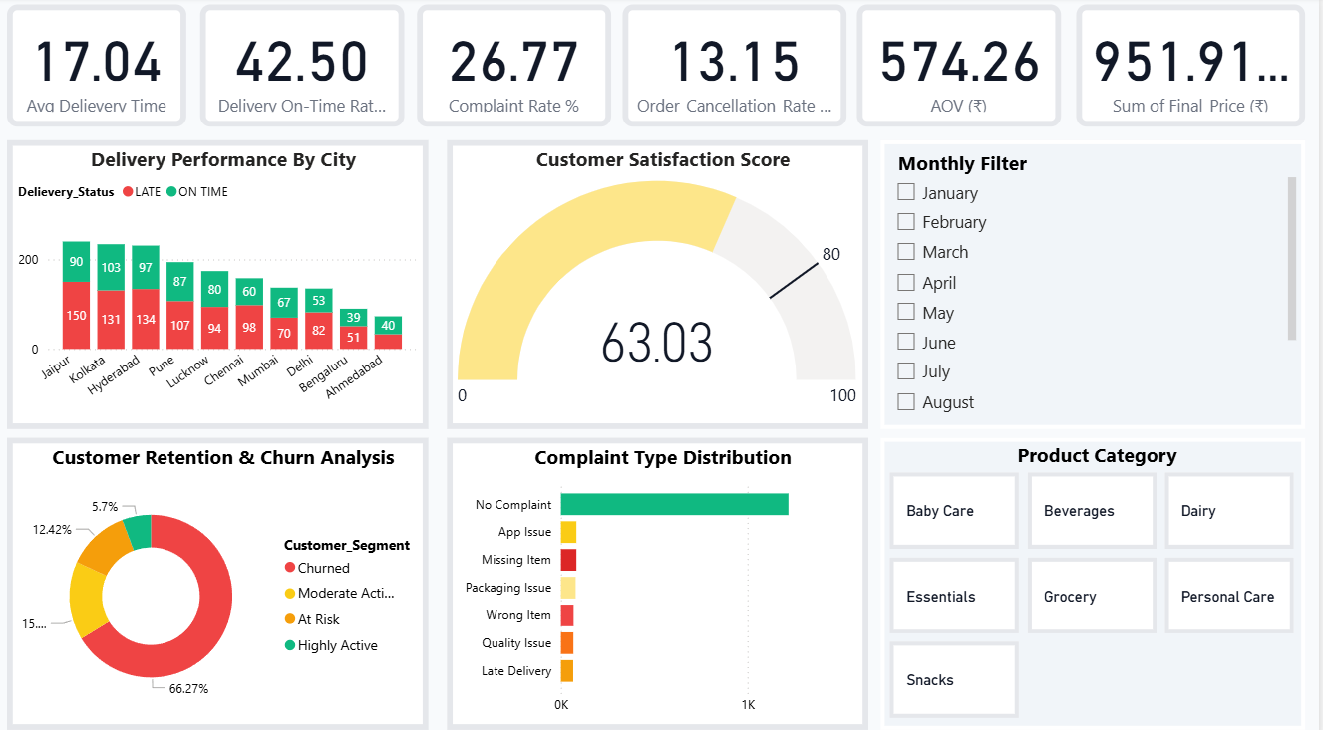
Dashboard

Slide 3
DASHBOARD AT A GLANCE
Key Performance Indicators — What the numbers tell us
17.04 min
42.50%
26.77%
Avg Delivery Time
On-Time Rate
Complaint Rate
Industry standard is 20-30 min. Performing well.
Only 4 in 10 orders arrive on time. Critical gap.
1 in 4 customers raise a complaint. Too high.
13.15%
₹574.26
₹951.91K
Cancellation Rate
AOV
Total Revenue
Above 10% threshold. Needs attention.
Healthy average order value. Good monetization.
Strong revenue base across all cities.

Slide 4
ANALYSIS & INTERPRETATION
Reading the story behind the numbers
Delivery Performance
The business delivers in 17 minutes on average, faster than most competitors. But only 42.5% of orders are on time, meaning the speed average is being pulled up by a minority of fast deliveries while the majority are delayed. This gap between speed and reliability is the central operational challenge.
Customer Complaints
A 26.77% complaint rate is a serious signal. App issues and missing items (83 each) top the list, these are both tech and fulfillment problems happening simultaneously. Packaging and wrong items add to the pile. Together, these aren't random incidents; they point to broken SOPs at the packing and dispatch stage.
Churn & Retention
The most alarming finding: 66.27% of customers are churned. Only 5.7% are highly active. The majority of the customer base has already walked away. This isn't just a retention problem, it's a sign that first-time buyers aren't being converted into loyal users, likely due to bad early experiences.

Slide 5
ANALYSIS & INTERPRETATION (CONT.)
City-level patterns, CSAT, and order categories
On-Time vs Late - City Breakdown
CSAT Score - 63.03 / 100
Jaipur leads with the worst on-time performance (90 late vs 150 on-time). Ahmedabad and Bengaluru show better ratios. Larger metros like Kolkata, Hyderabad and Pune have high absolute late volumes. City-wise SLA breaches suggest logistics infrastructure isn't scaling uniformly across markets.
A score of 63 out of 100 is a passing grade “barely". In the quick commerce space, leading players like Blinkit and Zepto consistently target CSAT above 80. A score below 70 typically correlates with high churn, which the 66% churn rate confirms. The CSAT score is a lagging indicator, the real damage has already happened.
🛒 Order Categories - Revenue Diversification
Baby Care
Beverages & Dairy
Grocery & Essentials
High-trust, repeat purchase. Demands near-perfect reliability. Any complaint here is deeply damaging.
Freshness-sensitive. Late delivery directly impacts quality. Temperature control is implicit SLA.
Highest frequency category. Most likely source of missing-item complaints. Inventory accuracy critical.

Slide 6
✅ WHAT'S WORKING — STRENGTHS
Genuine competitive advantages worth protecting
Fast Delivery Speed
17.04 min avg
Healthy Average Order Value
AOV ₹574.26
17 minutes average delivery is genuinely impressive. This speed, if made consistent, becomes the brand's strongest marketing claim. Speed is a hard thing to build, you already have it.
An AOV of ₹574 means customers are not just buying one item per order. This is healthy basket behavior, suggesting cross-category discovery is working. Strong foundation for upsell and subscription models.
Wide City Coverage
10 Cities
Diversified Category Mix
7 Categories
Operating across Jaipur, Kolkata, Hyderabad, Pune, Lucknow, Chennai, Mumbai, Delhi, Bengaluru, Ahmedabad shows strong geographic ambition. Multi-city presence creates network scale and data diversity.
Covering Baby Care, Beverages, Dairy, Grocery, Essentials, Personal Care and Snacks reduces revenue concentration risk. No single category failure can sink the business.
Revenue Base
₹951.91K
₹951.91K in total final price shows a real, active business. This is a working revenue engine — the challenge is making it more efficient and customer-friendly, not building from scratch.

Slide 7
❌ WHAT'S BROKEN — CRITICAL ISSUES
Honest assessment of the gaps that are costing customers and revenue
Only 42.5% On-Time Rate
High Impact
26.77% Complaint Rate
High Impact
Fewer than half of all orders reach customers on time. This is not an edge case, it's the norm. The fast average speed is misleading; it masks widespread late deliveries across most cities.
More than 1 in 4 customers is unhappy enough to raise a complaint. Top drivers are App Issues, Missing Items, Packaging — all point to execution failures, not external factors.
66.27% Churn Rate
Critical
App Issues = #1 Complaint
High Impact
Two-thirds of customers have already churned. This is the most dangerous metric. Acquiring a customer costs 5–7x more than retaining them. The leaky bucket is losing faster than it's filling.
App problems tied with missing items at 83 complaints each. A broken app in a digital-first business is a fundamental trust breach, customers who can't track or reorder simply don't come back.
13.15% Cancellation Rate
Medium Impact
CSAT Below 70
High Impact
1 in 8 orders is cancelled before delivery. Whether customer-initiated or platform-side, each cancellation is lost revenue plus wasted logistics cost. At scale, this is a significant margin leak.
A CSAT of 63 means 37% of customers had an experience they wouldn't call satisfying. Combined with high churn, this confirms that unhappy experiences aren't isolated, they're the standard experience for a large segment.

Slide 8
💡 STRATEGIC RECOMMENDATIONS
Targeted fixes for real problems — not generic advice
Fix App Before Running More Ads
'Delivery Promise' Visible at Checkout
App issues are the #1 complaint. Before spending on customer acquisition, run a dedicated 2-week app stability sprint. Every new customer acquired to a broken app just accelerates churn. Fix the funnel first.
Show the real estimated delivery window at cart stage and not the best-case 17 min. Under-promise and over-deliver. Customers who get accurate ETAs don't feel cheated even if delivery takes 25 min.
Addresses: App Issues, Churn
Addresses: On-Time Rate, CSAT
City-Specific Delivery SLA Targets
Packing Checklist QR Scan Before Dispatch
Jaipur and other high-late cities need localized logistics fixes, better dark store placement, more delivery partners, or adjusted radius. One-size-fits-all SLA doesn't work across 10 cities.
Missing items and wrong items account for 151 complaints. Introduce a mandatory QR scan of each item against the order before sealing the bag. Costs 30 seconds per order. Eliminates a category of complaints entirely.
Addresses: Late Deliveries by City
Addresses: Missing/Wrong Items
Win-Back Campaign for At-Risk Segment
Monthly NPS Pulse After Every Order
15% of users are classified 'At Risk’ as they haven't churned yet. A personalized push (free delivery, small discount, or 'We missed you') sent at the right moment costs very little and can pull them back before they go cold.
Replace periodic CSAT surveys with a simple 1-question NPS prompt post-delivery. This creates a real-time feedback loop. When CSAT drops in a city, you know within days and not months.
Addresses: 66% Churn Rate
Addresses: CSAT Below 70, Complaint Rate

Slide 9
PRIORITY ACTION MATRIX
Do this now vs. plan for later — ranked by impact and effort
DO FIRST
PLAN & INVEST
High Impact · Low Effort
High Impact · Needs Resources
✓ Launch app stability sprint for 2 weeks, zero new features
→ City-specific dark store placement review (Jaipur priority)
✓ Add packing QR scan before bag seal
→ Hire dedicated CX ops lead per zone
✓ Show real ETA at checkout, not best-case
→ Build ML-based delivery time predictor per city/time-slot
✓ Send Win-Back push to 'At Risk' 15% segment
→ Loyalty program for Highly Active 5.7%
✓ Post-delivery NPS prompt within 30 min of order
→ Category-specific SLA: Baby Care = guaranteed 20 min

Slide 10
THE BOTTOM LINE
This business has real speed and real revenue, the two things that take years to build. But it's losing customers faster than it's winning them. The 66% churn rate, 26% complaint rate, and 42% on-time delivery are all symptoms of the same root problem: execution doesn't match the promise. The good news? None of these are unsolvable. The app, the packing process, the delivery promise all these are operational fixes, not strategic pivots. The infrastructure exists. It just needs to be made reliable.
Speed
Trust
Retention
You have it. Now make it consistent.
Rebuild it through reliability, not campaigns.
Costs 7x less than acquisition. Prioritize it.

