Slide 1

INTERNAL MINI-COURSE · DEEP LEARNING FOR MEDICAL IMAGING
Fine-tuning nnU-Net with Pre-trained Models
A two-phase learning-rate schedule
Keishi Suzuki · University of Toronto · June 2026
synthetic CT phantom · lesion label
Six laptop-runnable notebooks · public GitHub repo
Notes:
[0:00] Hook in one line. By the end you will know why continuing nnU-Net training on a pretrained model at the default settings underperforms, and how a 50-epoch learning-rate ramp improves it, on a real medical-imaging foundation model. Mention it is hands-on: six notebooks, all runnable on a laptop.

Slide 2
OVERVIEW
What we'll cover
1
Background
why fine-tune, and the fix in one picture
2
Data preparation
match the checkpoint's preprocessing
3
Model architecture
transfer the body, re-initialize the heads
4
Training protocol
the two-phase learning-rate schedule (the main section)
5
Conclusion
recap, pitfalls, when to use it
Fine-tuning nnU-Net · two-phase LR schedule
2
Notes:
[0:45] Five sections. Background sets up why and the fix in one picture; then the three choices get a section each: data preparation, model architecture, and the training protocol. Training is the main section, the two-phase learning-rate schedule. We close with a recap and pitfalls.

Slide 3
Section 1
Background
Why fine-tune a foundation model, and the fix in one picture
3
Notes:
[1:15] Set the running example: FLARE pan-cancer lesion segmentation from a MultiTalent-style CT foundation model. This section ends with the whole talk on one slide.

Slide 4
BACKGROUND
The clinical task
Segment tumors in whole-body CT
Lesions are small and variable in shape
Labeled data is scarce
So you reach for a pretrained model, not training from scratch
FLARE pan-cancer Task-1 · lesion mask out
Fine-tuning nnU-Net · two-phase LR schedule
4
Notes:
[1:45] FLARE pan-cancer Task-1: whole CT in, lesion mask out. Lesions are small and varied, and labeled data is scarce. This is the setting where you reach for a pretrained model instead of training from scratch.

Slide 5
BACKGROUND
Why a foundation model
Reuse anatomy learned from many datasets
CT dataset A
Pretrained
ResEnc-L encoder
Your new task
(small tumor set)
CT dataset B
CT dataset C
MultiTalent-style ResEnc-L · Zenodo 13753413 · 4000 epochs · 192-cubed patches · 1 mm isotropic + Z-score
Fine-tuning nnU-Net · two-phase LR schedule
5
Notes:
[2:45] Instead of learning anatomy from your small tumor set, start from a network that already learned broad anatomy and pathology across many datasets. We use a MultiTalent-style ResEnc-L checkpoint (Zenodo 13753413): pretrained for 4000 epochs, 192-cubed patches, 1 mm isotropic with Z-score normalization, with a separate segmentation head per pretraining dataset.

Slide 6
BACKGROUND
What MultiTalent-style means
One body, many segmentation heads
seg head: dataset 1
Shared encoder
+ decoder body
Each dataset has its own label set, so each gets its own segmentation head
The shared body must learn anatomy useful across all of them
Fine-tune: drop the heads, keep the body, attach one fresh head
seg head: dataset 2
seg head: dataset N
MultiTalent: arXiv:2303.14444
Fine-tuning nnU-Net · two-phase LR schedule
6
Notes:
[3:45] MultiTalent trains one shared encoder and decoder body, with a separate segmentation output head per pretraining dataset. Why a head each? Each dataset labels different structures, so they cannot share one output layer. Forcing one body to serve all of them pushes it to learn anatomy that generalizes. When we fine-tune on a new task we drop those heads, keep the body, and attach one fresh head. That swap-the-head idea drives the architecture section.

Slide 7
BACKGROUND
Default fine-tuning can be sub-optimal
1. Preprocessing mismatch
2. Learning rate 0.01, no warm-up
Let nnU-Net re-plan with its own spacing and the pretrained encoder sees inputs unlike its training data.
The default LR moves the good pretrained weights too far, too early in fine-tuning.
Neither means fine-tuning is broken. Both are fixable recipe mistakes, and we fix both.
Fine-tuning nnU-Net · two-phase LR schedule
7
Notes:
[5:00] Two failure modes, both easy to miss. First, preprocessing mismatch: if you let nnU-Net re-plan your data with its own spacing and normalization, the pretrained encoder sees inputs unlike anything it trained on. Second, the default learning rate of 0.01 with no warm-up moves the good pretrained weights too far, too early. Neither means fine-tuning is broken; both are fixable recipe mistakes. We fix both.

Slide 8
BACKGROUND
The fix in one picture
This is the whole talk on one slide.
1
Match the preprocessing
Resample and normalize the way the pretraining did (1 mm isotropic + Z-score).
2
Transfer the body, re-initialize the heads
Load encoder + decoder body; randomly re-init all deep-supervision seg_layers.
3
Two-phase learning-rate schedule
Ease in with a linear warm-up, then decay. The whole network trains throughout.
Fine-tuning nnU-Net · two-phase LR schedule
8
Notes:
[6:30] This is the whole talk on one slide. Match the pretraining preprocessing, load the body and re-initialize the segmentation heads, and use a learning-rate schedule that eases in before decaying. Each gets its own section.

Slide 9
Section 2
Data preparation
Match the checkpoint's preprocessing · Notebook 01
9
Notes:
[7:15] The first of the three choices. The load-bearing idea: preprocess your data the way the pretrained checkpoint was preprocessed, not the way nnU-Net would choose by default.

Slide 10
DATA PREPARATION · NOTEBOOK 01
nnU-Net dataset format
NNU-NET RAW LAYOUT
Dataset999_Phantom/
├── imagesTr/
│ └── PHANTOM_001_0000.nii.gz
├── labelsTr/
│ └── PHANTOM_001.nii.gz
└── dataset.json
_0000 is the channel/modality suffix (first modality)
The label shares the case id, no suffix
dataset.json declares channel_names and labels
Our synthetic phantom follows this layout exactly.
Fine-tuning nnU-Net · two-phase LR schedule
10
Notes:
[7:30] nnU-Net expects a fixed layout. Image files carry a four-digit channel suffix (_0000 is the first modality); the label shares the case id with no suffix. dataset.json declares channel_names and labels. Our synthetic phantom follows this exactly. DEMO: switch to NB01, cell that loads the phantom and prints dataset.json.

Slide 11
DATA PREPARATION · NOTEBOOK 01
Match the preprocessing
Preprocess like the pretraining did
your spacing
1 mm isotropic
1 mm isotropic + Z-score normalization
The checkpoint trained on 1 mm isotropic, Z-score volumes
Preprocess differently and the pretrained features do not line up
Checkpoint-specific, not a universal nnU-Net rule
resample so voxels match the checkpoint
Why these two? The next two slides.
Fine-tuning nnU-Net · two-phase LR schedule
11
Notes:
[8:30] The most important data step. The checkpoint was trained on 1 mm isotropic, Z-score normalized volumes. If you preprocess differently, the pretrained features do not line up, which is the usual reason default fine-tuning fails. This is specific to the chosen checkpoint, not a general nnU-Net rule: nnU-Net normally derives spacing and normalization from your data; here you override to match the model. The next two slides say why each of the two matters.

Slide 12
DATA PREPARATION · NOTEBOOK 01
Why 1 mm isotropic
Filters expect a fixed physical scale
coarse spacing
1 mm isotropic
The encoder's 3D conv filters learned anatomy at 1 mm per voxel
At a different spacing, the same structure spans a different number of voxels, so the filters fire at the wrong scale
Isotropic means equal spacing on all three axes, matching how the pretraining sampled 3D context
Cost: forcing 1 mm can heavily upsample thick-slice scans (compute and memory) and is not ideal for very anisotropic data
same structure, more voxels: the filters see the scale they trained on
Fine-tuning nnU-Net · two-phase LR schedule
12
Notes:
[9:45] Convolutional filters are tied to a physical scale. The pretrained encoder learned its 3D filters on volumes sampled at 1 mm per voxel. If your data has a different spacing, the same anatomical structure covers a different number of voxels, so the learned filters respond at the wrong scale. Isotropic means the spacing is equal on all three axes, which is how the pretraining sampled 3D context. The cost is real: forcing 1 mm can heavily upsample thick-slice scans, using more compute and memory, and it is a poor fit for very anisotropic data. You match the checkpoint, but you know the trade-off.

Slide 13
DATA PREPARATION · NOTEBOOK 01
Why Z-score normalization
Weights expect a fixed intensity distribution
raw intensities
mean and scale vary
(scanner, protocol)
Z-scored
mean 0, std 1
(matches pretraining)
The network trained on inputs at roughly zero mean, unit variance
Its early-layer weights assume that input distribution
Feed raw HU or a different scaling and every activation shifts, pushing features outside the learned regime
Z-score reproduces the pretraining's intensity statistics
x = (x - mean) / std
Fine-tuning nnU-Net · two-phase LR schedule
13
Notes:
[11:00] Normalization matters for the same reason. The network was trained on inputs normalized to roughly zero mean and unit variance, and its weights, especially in the early layers, are calibrated to that distribution. If you feed raw Hounsfield units or a different scaling, every downstream activation is shifted and scaled away from what the pretrained weights expect, and the features degrade. Z-score normalization, subtract the mean and divide by the standard deviation, reproduces the intensity statistics the pretraining used.

Slide 14
DATA PREPARATION · NOTEBOOK 01
Move the plans across datasets
REAL COMMAND (READ-ONLY)
nnUNetv2_move_plans_between_datasets
-s <pretrain_dataset> -t <your_dataset>
The pretrained plans.json encodes architecture, spacing, and normalization
Move it onto your dataset, then preprocess with that plans, and now data and checkpoint match
Cost: forced 1 mm isotropic resampling uses more compute and memory, and can be wrong for very anisotropic scans
Fine-tuning nnU-Net · two-phase LR schedule
14
Notes:
[12:15] Mechanically, take the pretrained model's plans.json, which encodes architecture, spacing, and normalization, move it onto your dataset, and preprocess with that plans. Now your data and the checkpoint match on both of the things we just discussed.

Slide 15
DATA PREPARATION · NOTEBOOK 01
Sanity checks
After preprocessing, confirm the generated plans, not the nnU-Net defaults:
✓
spacing is [1, 1, 1] ?
✓
normalization is Z-score ?
✓
channels match the checkpoint ?
A 30-second check that prevents a multi-day mis-trained run.
Fine-tuning nnU-Net · two-phase LR schedule
15
Notes:
[13:30] After preprocessing, confirm the generated plans say 1 mm isotropic and Z-score, not the nnU-Net defaults. A 30-second check that prevents a multi-day mis-trained run. DEMO: NB01 cell that inspects the dataset and Z-score step.

Slide 16
Section 3
Model architecture
Transfer the body, re-initialize the heads · Notebook 02
16
Notes:
[14:15] The second choice. Which parts of the pretrained network do you keep, and which do you throw away and relearn?

Slide 17
MODEL ARCHITECTURE · NOTEBOOK 02
U-Net recap
skip connections
encoder
bottleneck
decoder
Encoder compresses to semantic features; decoder upsamples back to full resolution; skips carry spatial detail across
Segmentation is per-voxel classification at the output.
Fine-tuning nnU-Net · two-phase LR schedule
17
Notes:
[14:30] A short refresher: the encoder compresses to semantic features, the decoder upsamples back to a full-resolution map, and skip connections carry spatial detail across. Segmentation is per-voxel classification at the output.

Slide 18
MODEL ARCHITECTURE · NOTEBOOK 02
ResEnc-L, the backbone
Residual encoder, large preset
Vanilla nnU-Net uses plain conv blocks; ResEnc adds residual blocks in the encoder, so it trains deeper and more stably
The design is encoder-heavy: most of the capacity sits in the downsampling path
"L" is the large preset: more features and blocks, sized for large GPUs and big datasets (M / L / XL scale with VRAM)
We inherit it from the moved plans; patch size 192-cubed at 1 mm needs a large GPU, so the notebooks teach the logic on a tiny model
Fine-tuning nnU-Net · two-phase LR schedule
18
Notes:
[15:45] The checkpoint is an nnU-Net ResEnc-L U-Net. What is different from the vanilla nnU-Net U-Net? Vanilla uses plain convolution blocks; ResEnc adds residual connections in the encoder, which let it go deeper and train more stably. The design is deliberately encoder-heavy, with most of the capacity in the downsampling path. And L is the large preset: the ResEnc family comes in M, L, and XL, scaling features and blocks to the available GPU memory; L is sized for large GPUs and large multi-dataset training, which is exactly the pretraining setting. We inherit all of this from the plans we moved over. The 192-cubed patch at 1 mm is why real training needs a large GPU, and why the notebooks teach the logic on a tiny model.

Slide 19
MODEL ARCHITECTURE · NOTEBOOK 02
Encoder, decoder body, seg heads
Split the network into three parts. This split decides what transfers.
Encoder
Decoder body
Seg layers (heads)
Compresses input to features. General anatomy.
Upsamples back to resolution. General.
Map features to your class set. Task-specific.
Encoder and decoder body carry transferable anatomy. The seg layers are task-specific.
Fine-tuning nnU-Net · two-phase LR schedule
19
Notes:
[17:00] Split the network into three parts. The encoder and decoder body are general; they carry transferable anatomy. The segmentation layers are task specific; they map features to your class set. This split decides what transfers.

Slide 20
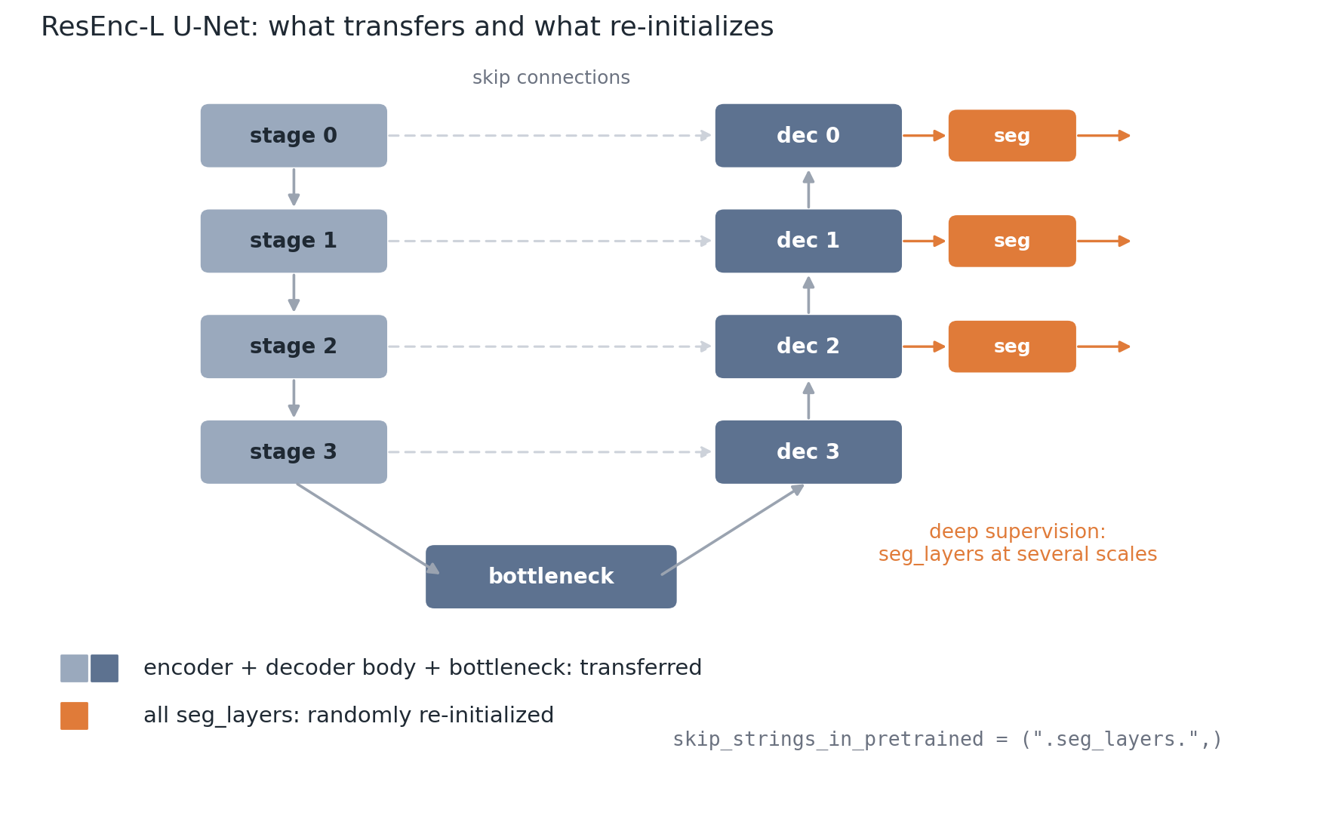
MODEL ARCHITECTURE · NOTEBOOK 02
What transfers versus what re-initializes
Load pretrained weights for every key except those containing .seg_layers.
Deep supervision puts seg_layers at several decoder scales; the substring match skips all of them, so every head re-inits
Caveat: if class counts match, nnU-Net may load the heads instead. Re-init follows from skipping the keys, it is not automatic
Fine-tuning nnU-Net · two-phase LR schedule
20
Notes:
[18:15] This is the figure to dwell on. nnU-Net loads pretrained weights for everything except keys whose name contains the substring .seg_layers. Because nnU-Net uses deep supervision, there are segmentation layers at several decoder scales, not a single final 1x1x1 conv, and the substring match skips all of them, so every head is randomly re-initialized. The official guidance is to load all layers except the segmentation layers. One caveat: if your class count matches the pretraining, nnU-Net may load the heads instead; the re-initialization follows from skipping those keys, it is not automatic. DEMO: NB02 builds a small network with deep-supervision heads and prints, per parameter, whether it transfers or re-initializes.

Slide 21
MODEL ARCHITECTURE · NOTEBOOK 02
Why re-initialize the heads
New task, new label meaning
Old heads
(N pretraining datasets)
One fresh head
(your lesion label)
Drop the pretraining heads, attach a fresh head, and let fine-tuning learn the new mapping on the transferred body. This is the MultiTalent swap-the-head idea from earlier.
Fine-tuning nnU-Net · two-phase LR schedule
21
Notes:
[20:00] The pretraining heads predict the pretraining datasets' classes, which mean nothing for your lesion label. Drop them, attach a fresh head, and let fine-tuning learn the new mapping on top of the transferred body. This is the swap-the-head idea from the MultiTalent slide.

Slide 22
Section 4
Training protocol
The two-phase learning-rate schedule · the main section · Notebook 03
22
Notes:
[21:00] The heart of the talk. We matched preprocessing and set up weight transfer. Now: how do we fine-tune so we improve the pretrained weights instead of damaging them?

Slide 23
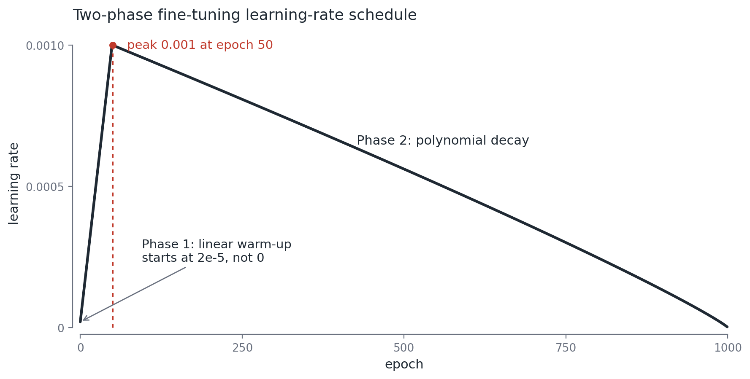
TRAINING PROTOCOL · NOTEBOOK 03
The schedule that makes it work
Control the learning rate over time.
Fine-tuning nnU-Net · two-phase LR schedule
23
Notes:
[21:15] We matched preprocessing and set up weight transfer. The question now is how to fine-tune so we improve the pretrained weights instead of damaging them. The answer is to control the learning rate over time.

Slide 24
TRAINING PROTOCOL · NOTEBOOK 03
The default: poly decay from 0.01
Strong from scratch
From scratch, nnU-Net uses SGD with polynomial decay starting at 0.01
A strong default for random initialization
On a pretrained model, starting at 0.01 takes large steps immediately and washes out the features you wanted to keep
Fine-tuning nnU-Net · two-phase LR schedule
24
Notes:
[22:15] From scratch, nnU-Net uses SGD with polynomial decay starting at a learning rate of 0.01. That is a strong default for random initialization. On a pretrained model, starting at 0.01 takes large steps immediately and washes out the features you wanted to keep.

Slide 25
TRAINING PROTOCOL · NOTEBOOK 03
Phase 1: linear warm-up
Ramp from ~2e-5 to 1e-3
lr = max_lr / 50 * (epoch + 1)
Epoch 0 is about 2e-5 (max_lr / 50), not zero
Small early steps let the fresh heads and the body settle together
Fine-tuning nnU-Net · two-phase LR schedule
25
Notes:
[23:30] Phase 1 ramps the learning rate linearly over 50 epochs, from about 2e-5, which is max_lr over 50 at epoch 0, not zero, up to the peak of 1e-3. Small early steps let the fresh heads and the transferred body settle together.

Slide 26
TRAINING PROTOCOL · NOTEBOOK 03
Phase 2: offset polynomial decay
Decay 1e-3 toward 0
lr = init * (1 - t/(T-50))**0.9
At epoch 50, switch to poly decay restarting at the 1e-3 peak
"Offset" means the decay clock starts at epoch 50, not 0
Same SGD optimizer continues, so momentum is preserved
Fine-tuning nnU-Net · two-phase LR schedule
26
Notes:
[25:00] At epoch 50 we switch to polynomial decay that restarts at the 1e-3 peak and decays over the remaining 950 epochs toward zero, without reaching it. "Offset" means the decay clock starts at epoch 50, not 0. The same SGD optimizer continues, so momentum is preserved across the switch.

Slide 27
TRAINING PROTOCOL · NOTEBOOK 03
The full two-phase curve
Ramp up, then decay, one peak at epoch 50. That is the entire two-phase idea.
Fine-tuning nnU-Net · two-phase LR schedule
27
Notes:
[26:30] Put them together: ramp up, then decay, one peak at epoch 50. That is the entire two-phase idea, a learning-rate trajectory. DEMO: NB03 drives the course_utils schedulers and plots this curve. It also checks epoch 0 is about 2e-5, epoch 49 is 1e-3, and epoch 50 is 1e-3.

Slide 28
TRAINING PROTOCOL · NOTEBOOK 03
How the trainer wires it
CUSTOM TRAINER (READ-ONLY)
Swap the scheduler at the right epoch, reuse the same optimizer
Two stage labels: "warmup_all" and "train"
"train" just names the post-warm-up decay phase; both phases train the whole network
def on_train_epoch_start(self):
if self.current_epoch == 0:
# build linear warm-up scheduler
self.lr_scheduler = LinearWarmup(peak=1e-3, dur=50)
elif self.current_epoch == warmup_duration_whole_net: # 50
# build offset-poly scheduler, same optimizer
self.lr_scheduler = OffsetPolyLR(init=1e-3, total=1000)
Fine-tuning nnU-Net · two-phase LR schedule
28
Notes:
[28:00] A custom trainer swaps the scheduler at the right epoch. At epoch 0 it builds the linear warm-up scheduler; at epoch warmup_duration_whole_net, which is 50, it builds the offset-poly scheduler, reusing the same optimizer. There are two stage labels, warmup_all and train, but both train the whole network. train just names the post-warm-up decay phase; it does not mean training starts there.

Slide 29
TRAINING PROTOCOL · NOTEBOOK 03
The evidence: TBI Table 2
fine-tuning schedule | 5-fold avg Dice
from scratch | 53.44
plain 1e-3 (no warm-up) | 53.80
warm-up → 1e-3 | 54.21 (best)
warm-up → 1e-2 | 53.28 (worse)
Pretraining + correct fine-tuning beats from-scratch
Among schedules, warm-up to 1e-3 beats plain 1e-3
Warm-up to 1e-2 is worse: the peak LR matters too
The warm-up gain over plain 1e-3 is +0.41 Dice: small but real
Source: TBI paper, Table 2 (arXiv:2504.06741).
Fine-tuning nnU-Net · two-phase LR schedule
29
Notes:
[30:00] Read the table carefully. Pretraining with correct fine-tuning beats from-scratch, 5-fold average Dice 53.44 to 54.21; the paper reports an improvement of up to about 2 Dice points in its headline setting. Among schedules, warm-up to 1e-3, 54.21, beats plain 1e-3, 53.80, while warm-up to 1e-2 is worse, 53.28. Two lessons: the schedule matters, and the peak learning rate matters, use 1e-3 not 1e-2. And keep it honest: the warm-up gain over the already-lowered plain 1e-3 is about 0.4 Dice, small but real; the larger gains come from getting off the default 1e-2 and from matching preprocessing. Deck note: the four headline numbers are shown here as a clean cited table. If you would rather show the paper's exact Table 2, paste a cropped screenshot over the table during the Google Slides pass.

Slide 30
TRAINING PROTOCOL · NOTEBOOK 03
PANTHER says: not always
TBI
PANTHER
arXiv:2504.06741 · brain, T1 MRI
arXiv:2508.21775 · pancreas, MRI
Warm-up to 1e-3 helped (+0.41 Dice).
Warm-up and cosine did not beat the default poly. Wins came from multi-stage transfer, augmentation, ensembling.
The warm-up trick is task dependent, not a general law. Run the small ablation yourself.
Fine-tuning nnU-Net · two-phase LR schedule
30
Notes:
[32:00] A related DKFZ paper, PANTHER, pancreas tumor, MRI, tried warm-up and cosine schedules and found they did not beat the default polynomial schedule for that task; its wins came from multi-stage transfer, augmentation, and ensembling. So the warm-up trick is task dependent, not a general law. Run the small ablation yourself. (Speaker: confirm PANTHER's exact schedule-ablation wording before presenting it as fact.)

Slide 31
TRAINING PROTOCOL · NOTEBOOK 03
See it on a real run
The schedule only matters once you train
NB03 plots this once you drop the exported CSV into assets/precomputed/
We do not fabricate a curve. The comparison is the point, and it needs the real runs
Real fine-tuning loss curves go here
default (1e-2) vs warm-up → 1e-3, with the epoch-50 switch marked
Fine-tuning nnU-Net · two-phase LR schedule
31
Notes:
[33:30] The schedule only matters once you train. Run the two fine-tuning jobs, export the loss curves, and show the comparison. The notebook has a cell that plots this once you drop the exported CSV into assets/precomputed/. We do not fabricate a curve; the comparison is the point and it needs the real runs. DEMO: NB03 cell that plots the real curves if the CSV is present.

Slide 32
AFTER FINE-TUNING · NOTEBOOKS 04 TO 06
The rest of the pipeline is standard nnU-Net
The two fine-tuning choices are done. Everything downstream is the usual nnU-Net, unchanged.
Inference
Post-processing
Evaluation
Sliding-window prediction + test-time mirroring.
Connected-component filtering, chosen per dataset from cross-validation.
Dice per label, nanmean over present classes, summary.json.
nnUNetv2_predict
a validated heuristic
your reported number
Notebooks 04 to 06 demo each on a laptop (CPU) using an illustrative prediction, so there is no GPU dependency.
Fine-tuning nnU-Net · two-phase LR schedule
32
Notes:
[35:00] A deliberate fast-forward. Once you have matched preprocessing, transferred the weights, and trained with the two-phase schedule, everything downstream is standard nnU-Net, unchanged by this recipe. Inference is sliding-window prediction with optional test-time mirroring, via nnUNetv2_predict. Post-processing is connected-component filtering, which nnU-Net selects per dataset from cross-validation, so treat it as a validated heuristic, not an automatic step; it can delete real multifocal or bilateral lesions. Evaluation is Dice per label, aggregated with nanmean over the classes that are present, written to summary.json, where the mean foreground Dice is usually your reported number. Notebooks 04 to 06 demonstrate each of these on a laptop, on CPU, using an illustrative prediction built from the ground truth, so none of it needs a GPU. If anyone wants detail, we can open those notebooks in the Q&A. DEMO: optional: open NB04 / NB05 / NB06 if the audience wants detail.

Slide 33
Section 5
Conclusion
Recap, pitfalls, and when to use this
33
Notes:
[36:30] Pull the three choices back together and give the practical guardrails.

Slide 34
CONCLUSION
Recap: three aligned choices
If you remember one slide, this is it. These three must agree.
1
Match the preprocessing
1 mm isotropic + Z-score, via the moved plans.
2
Transfer the body, re-initialize the heads
Encoder + decoder body load; all deep-supervision seg_layers re-init.
3
Two-phase learning-rate schedule
Linear warm-up to 1e-3, then poly decay.
Throughout, the whole network trains. No part is ever frozen.
Fine-tuning nnU-Net · two-phase LR schedule
34
Notes:
[36:45] If you remember one slide, this is it. These three choices must agree for fine-tuning a medical foundation model to pay off. And one clarification that often trips people: this two-phase schedule is a learning-rate trajectory inside one fine-tuning job; the whole network trains the entire time, no part is ever frozen.

Slide 35
CONCLUSION
Pitfalls and when to use this
When to use it: adapting a strong pretrained medical model to a new, small-data task.
✓
Peak LR 1e-3, not 1e-2
✓
Match preprocessing first
✓
Ablate warm-up per task (the gain is not guaranteed)
✓
Remember the deep-supervision heads (all seg_layers)
Pointers: TBI (arXiv:2504.06741), PANTHER (arXiv:2508.21775), MultiTalent (arXiv:2303.14444), the nnU-Net fine-tuning docs, and this repo's notebooks.
Fine-tuning nnU-Net · two-phase LR schedule
35
Notes:
[38:00] When to use this: adapting a strong pretrained medical model to a new, small-data task. What to watch: the peak learning rate, the preprocessing match, and a quick per-task ablation, since the gain is not guaranteed, as PANTHER showed. Pointers: the TBI, PANTHER, and MultiTalent papers, the nnU-Net fine-tuning docs, and this repo's notebooks.

Slide 36
Questions?
github.com/Kappapapa123/internal-mini-course
Notebooks runnable on a laptop · quiz in NotebookLM
the two-phase curve
Keishi Suzuki · University of Toronto · June 2026
Notes:
[39:30] Point people at the GitHub repo, runnable on a laptop, and the quiz. Open the floor. Buffer to about 45 minutes, then 10 minutes of Q&A.

