Slide 1

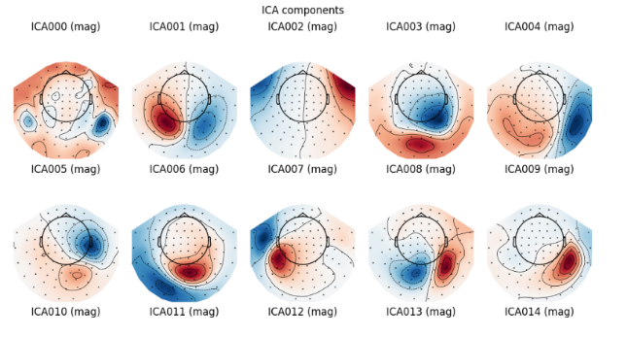
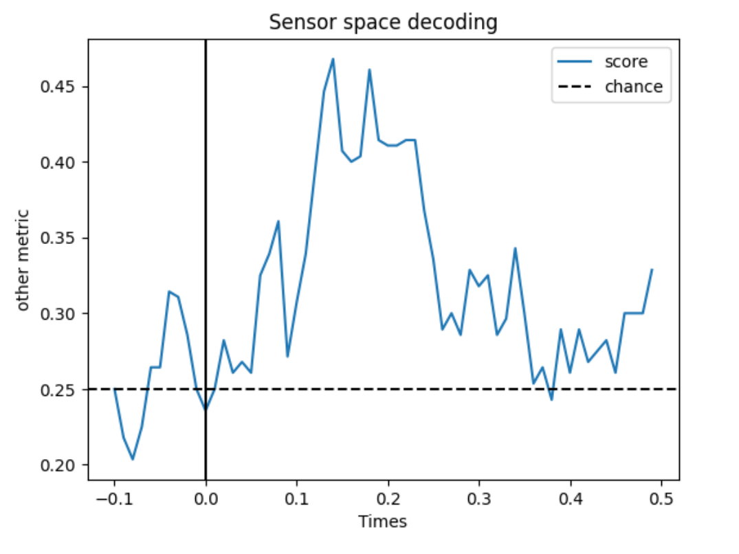
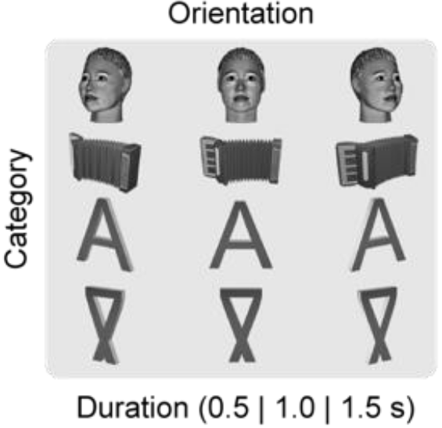

We Present a Method for Determining Visual Stimulus Based on Differences in Brain State
Fudan University
Institute of Science and Technology for Brain-Inspired Intellegence
Global Research Internship Progam at Fudan University
University of California Santa Cruz
University of Leeds
Singapore Management University
Key References:
Taulu,S. and Kajola, M. (2005) Presentation of electromagnetic multichannel data: the signal space separation method. Journal of Applied Physics, 97(12):124905 doi:10.1063/1.1935742.
Hyvärinen A, Oja E. (2002) Independent component analysis: algorithms and applications. Neural Netw. 13(4-5):411-30. doi: 10.1016/s0893-6080(00)00026-5.
Woodman G.F. (2010) A brief introduction to the use of event-related potentials in studies of perception and attention. Atten Percept Psychophys. 72(8):2031-46.
Melloni L, Mudrik L, Pitts M, Bendtz K, Ferrante O, Gorska U, et al. (2023) An adversarial collaboration protocol for testing contrasting predictions of global neuronal workspace and integrated information theory. PLoS ONE 18(2): e0268577. https://doi.org/10.1371/journal.pone.0268577
Decoding Visual Stimulus from MEG Signals
Mu Yangjiayi^{1,2,3} (22110850009@m.fudan.edu.cn), Mark Forbush^{2,3,4} (mforbush@ucsc.edu), Qiuhao Yin^{2,3,6} (qiuhao.yin.2022@scis.smu.edu.sg), Chun Yin Mou^{2,3,5} (chrismou2015@gmail.com)
Background
Magnetoencephalography (MEG) is a non-invasive neuroimaging technique that records the magnetic fields produced by neuronal activity. Magnetic fields are generated in the brain by electrical currents, primarily from postsynaptic potentials in pyramidal neurons.
MEG also has significant advantages over other neuroimaging techniques; such as better temporal resolution, improved signal quality, high spatial resolution, making it an ideal tool for understanding conscious and subconscious activity in the brain.
Objective
To accurately determine the category of visual stimulus based on state of the MEG sensor array.
Methods
MEG sensor array
Maxwell filtering (SSS)
Independent Component Analysis (ICA)
Event Related Field analysis
Multi-class SVM classification
Visual Stimulus
Subjects are presented a visual stimulus of a face, object, letter, or false letter for a period between 500ms and 1500ms.
Above, we can see examples of each category of stimulus, a well a variations of the orientation of each stimulus (Melloni, et al 2023).
Noise Filtering and ICA
Time series data is first denoised using Maxwell filtering (Taulu and Simola 2006), which attempts to remove artefacts based on our physical understanding of the MEG sensors. Then, we apply ICA (Hyvärinen and Oja 2002) and remove components that appear to related to muscle movement; such as eye movement and heartbeat.
Below we see a table of Independent Components. It’s likely ICA002 is related to eye movement.
Event Related Fields (ERFs)
Time series data (Woodman 2010) is broken up into windows of 600ms around stimulus (100ms before and 500ms after). We expect the prior 100ms to act as baseline activity for later comparison.
Classification of ERFs using Multi-class SVM Model
Using a multi-class support vector machine, we classify each time point in the sensor space, in order to determine the most likely category of visual stimulus.
From the graph above we see that the classifier performs significantly better than random chance, indicating our model is able to discern distinct neuronal activity for each visual stimulus, with accuracy of classification peaking at around 150ms post stimulus.
Classification of prior 100ms resembles random chance, indicating baseline activity in the subject.
Notes:
References:
Visual stimulus (Arc Cogitate paper) : https://www.biorxiv.org/content/10.1101/2023.06.23.546249v2.full.pdf
Arc Cogitate :
Noise filtering (Maxwell and ICA papers) :
Maxwell : Taulu,S. and Kajola, M. (2005) Presentation of electromagnetic multichannel data: the signal space separation method. Journal of Applied Physics, 97(12):124905 doi:10.1063/1.1935742.
ICA : Hyvärinen A, Oja E. (2002) Independent component analysis: algorithms and applications. Neural Netw. 13(4-5):411-30. doi: 10.1016/s0893-6080(00)00026-5.
Event Related Fields (ERF paper) :
ERFs : Woodman G.F. (2010) A brief introduction to the use of event-related potentials in studies of perception and attention. Atten Percept Psychophys. 72(8):2031-46.

