Slide 1
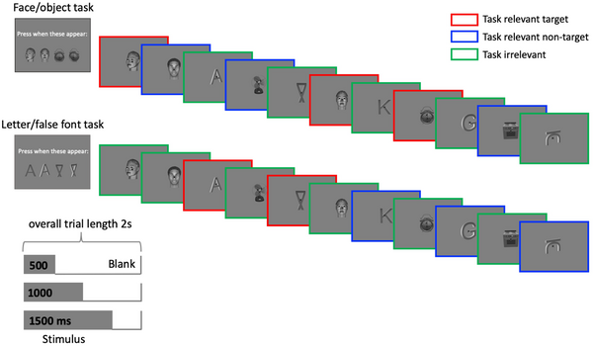

Fig 2.
Melloni L, Mudrik L, Pitts M, Bendtz K, Ferrante O, et al. (2023) An adversarial collaboration protocol for testing contrasting predictions of global neuronal workspace and integrated information theory. PLOS ONE 18(2): e0268577. https://doi.org/10.1371/journal.pone.0268577
https://journals.plos.org/plosone/article?id=10.1371/journal.pone.0268577

