Slide 1
CS 371 Project 2 Budget Application
Dylan Hoffman
Zachary Wichlacz

Slide 2

Why a Budget Tool?
Useful and Helpful
Some Past Experience
Known Object-Orientation

Slide 3
Budget Backend
C++ Language
Windows/Mac Compatible
MySQL User Database
Elements of OOP from this Semester

Slide 4
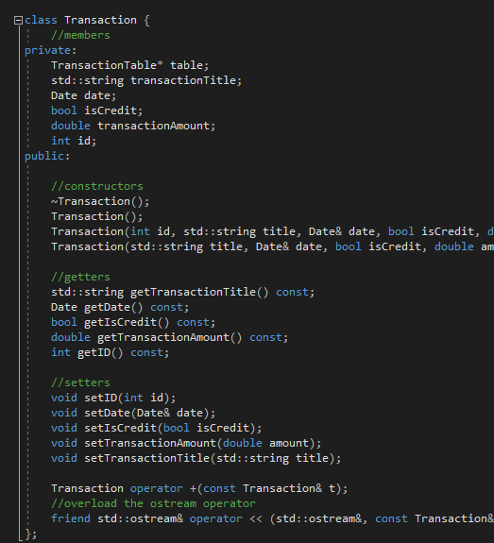
Elements of OOP
Encapsulation

Slide 5
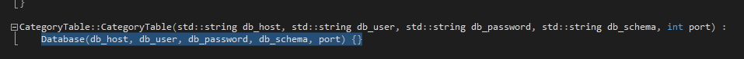
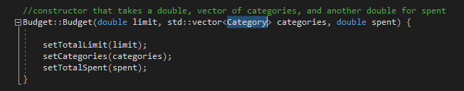
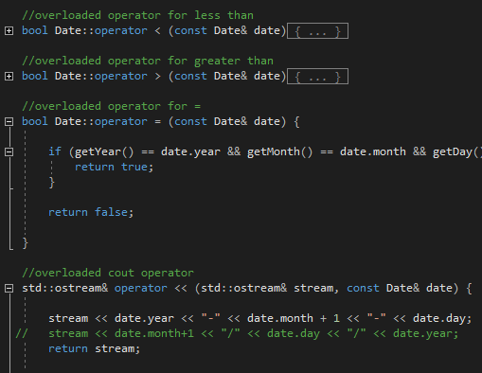
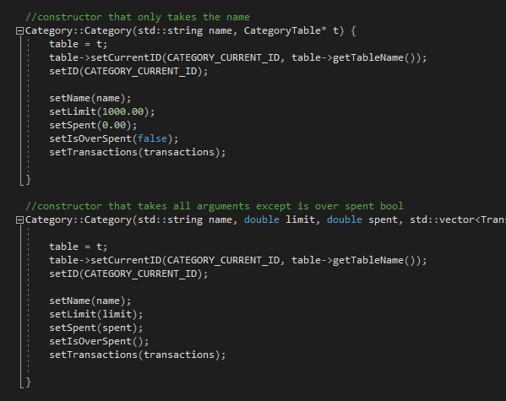
Elements of OOP (cont.)
Inheritance
Is A
Has A
More Polymorphism
Operator Overloading
Function Overloading

Slide 6

Budget Frontend
Login Page
Main Page or “Budget Page”
Set Categories
Add Transactions
Tracker per Category

Slide 7
DEMO…

Slide 8


