Slide 1

Szakikereső
Baranya Megyei SzC Radnóti Miklós Közgazdasági Technikum
Made by:
Dániel Pópé,
Benjámin Kapus
Pécs, Esztergár Lajos u. 6, 7633
Tel: (06 72) 257 859
OM code: 203049/014

Slide 2
The purpose of the project
Familiar problems:
can't find a specialist, scam, bad work (quality)
Simple platform
Easy browsing, communication
User-friendly functions

Slide 3




Teamwork, communication
Backend – Frontend separation
Simplest and shortest solution
Clean code
We helped each other
Trello, GitHub, Discord, Messenger

Slide 4
Functions
Registration/Login
Create, manage:
Users, Users data
Ads, Favorites
Jobs
Ratings
Search, browse

Slide 5
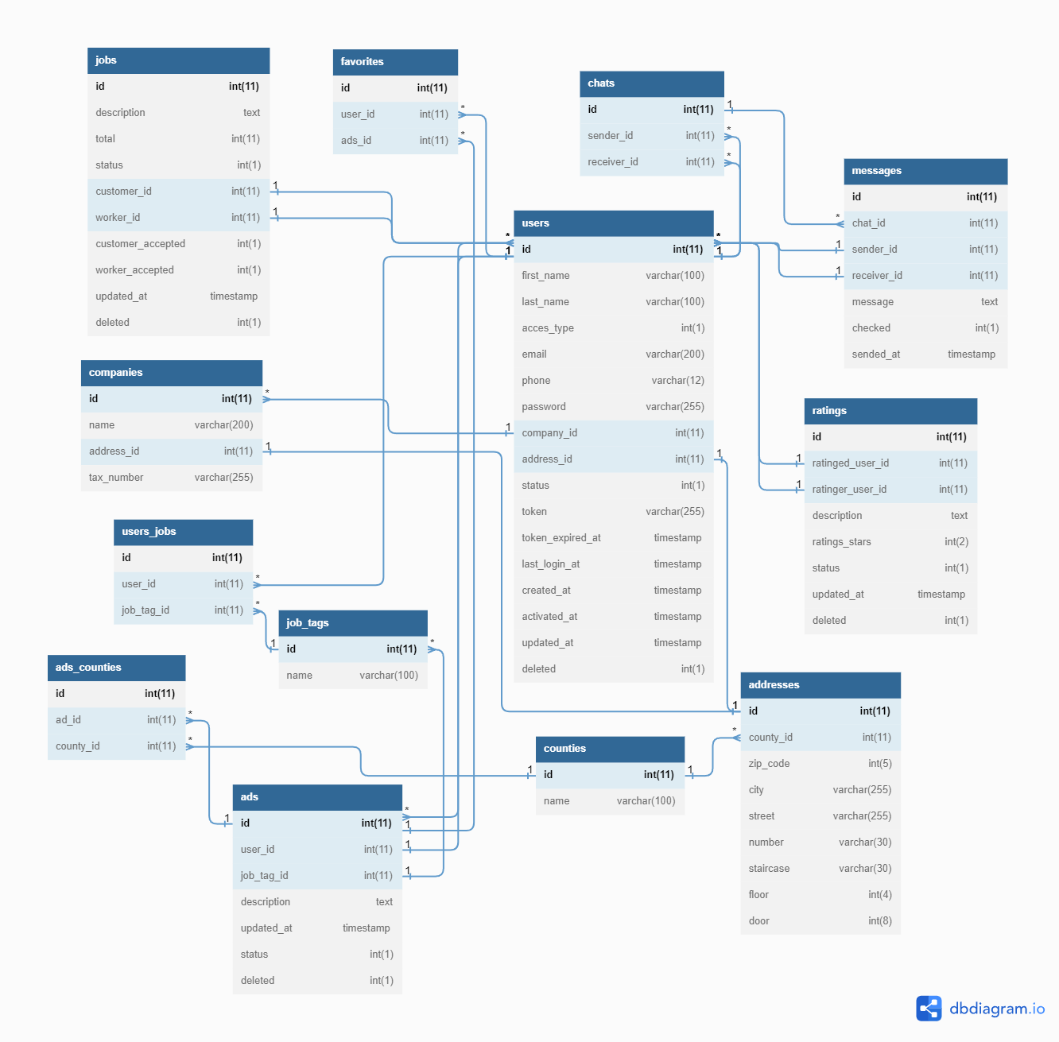

Database, Backend
MySql
Normal forms
Backend
Java – JaxRs
WildFly server

Slide 6
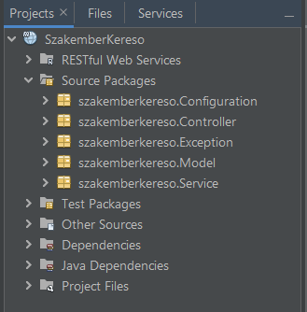
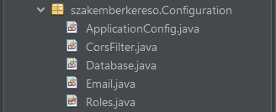

Backend
MVC framework
Own exceptions
Camel case naming
Email sending functions
Authentication
Roles
Token
WebAPI

Slide 7
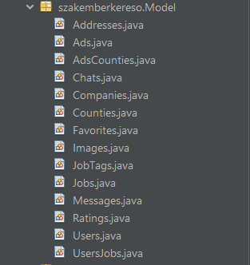
Backend
Model
Matching properties with database tables
Entity classes from database
Functions
Service
Business logic
Data validation
Controller
Endpoints
Unified response with JSON

Slide 8



Frontend
Angular
Material
Ng bootstrap
Lazy loading
Local Storage
VS code
Node.js

Slide 9
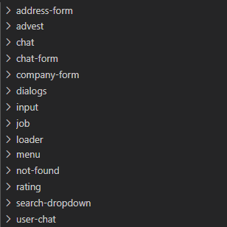
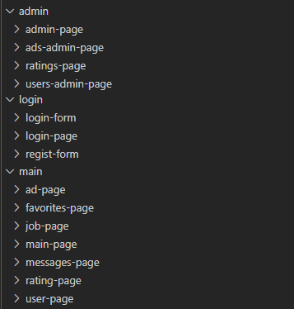
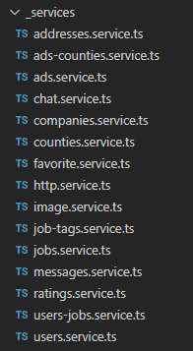
Frontend
Components
Pages
Other components
Services
Connect to backend API

Slide 10
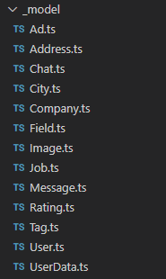


Frontend
Models
Data models
Roles (admin, worker, customer)
Validators
Password policy
Dropdown choose
Guards
Main page
Admin page

Slide 11

The future
Online payment for the Jobs
Mobile application
Reference images for workers
Hire professionals, for security, design, server operation…

