Slide 1

TD’s New AI Micro-Transaction Manager
Calen Siddall, Lauren Noble, Troy LaCoste, Rishi Kar, Moaaz Elsayed, Shabs

Slide 2
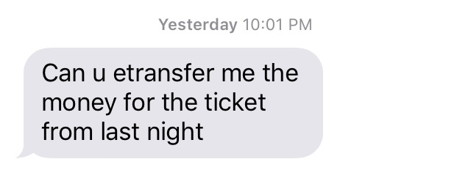
A Penny For Your Thoughts...

Slide 3

What is
?
TRUS

Slide 4
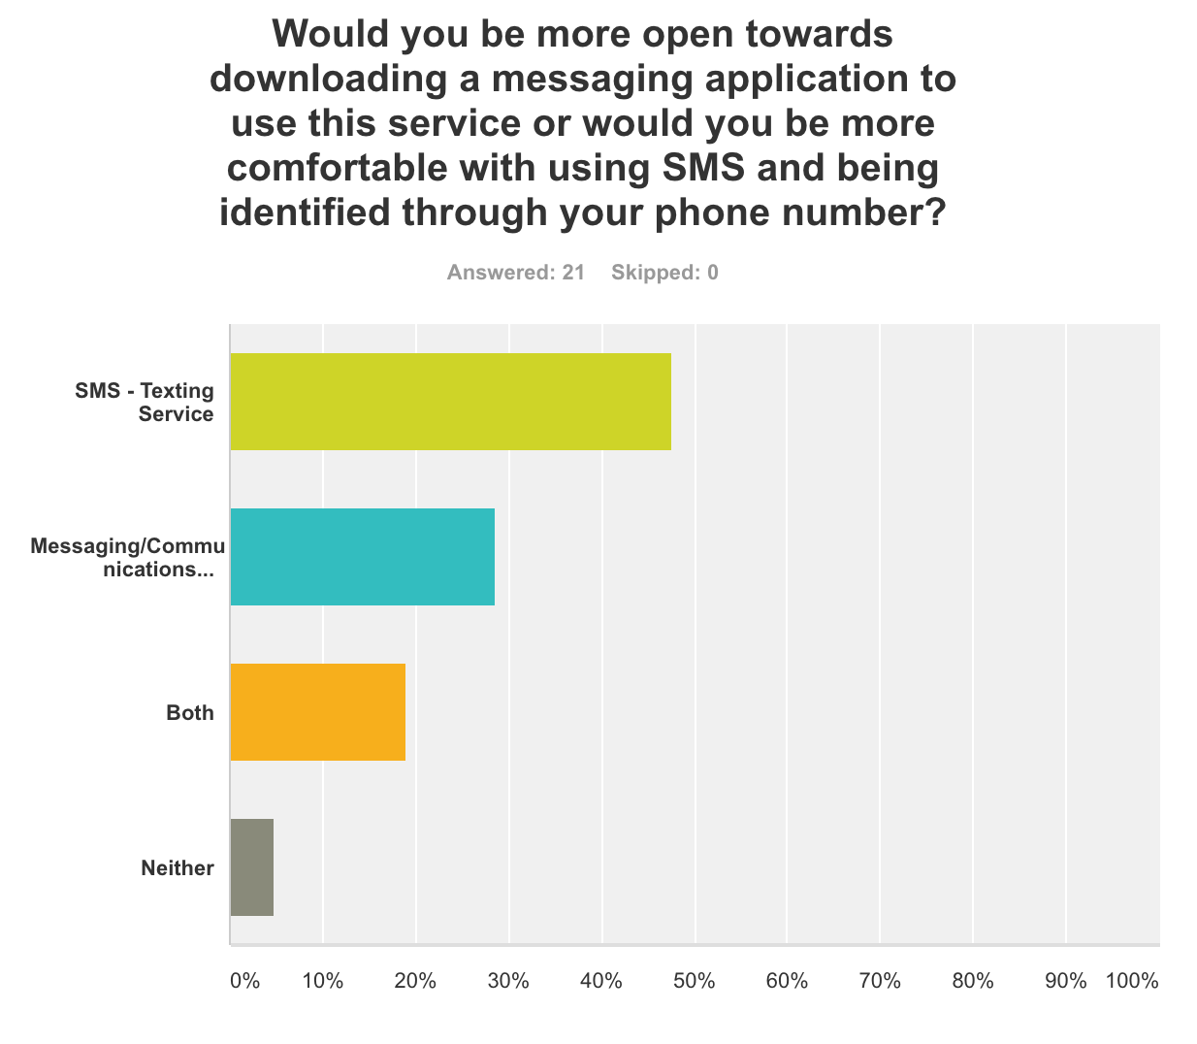
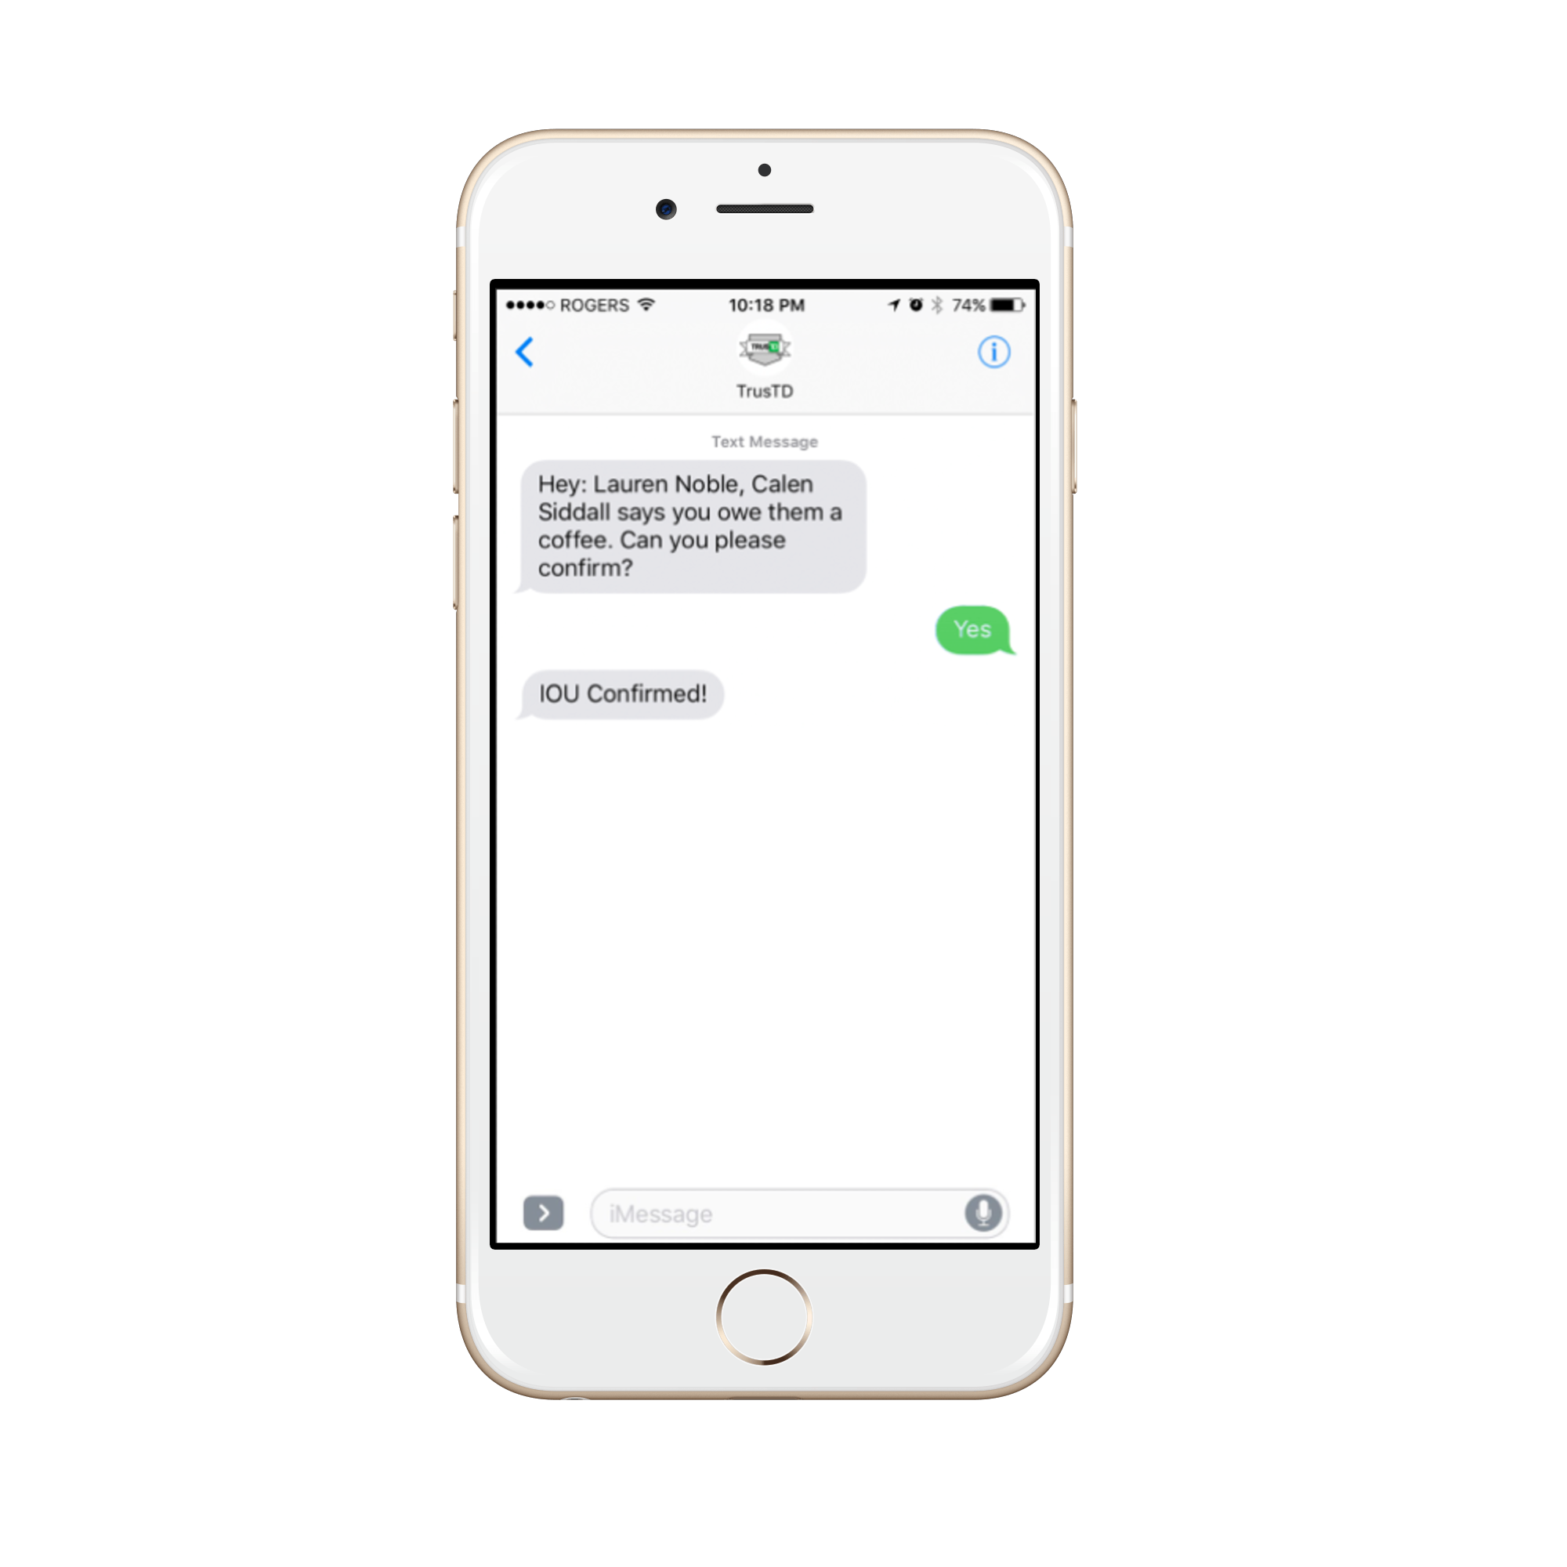

User Validation
Preference: an SMS or Mobile App?

Slide 5
Value Proposition
Organization tool - extension of TD’s mobile application
Reduce the pain of micro-transactions (e-transfers, loose change, etc)
Ubiquity of a simple text message
Able to reach the bot from multiple platforms

Slide 6
Value Proposition
Lack of awareness of current “credit” situation
Sends “smart” messages when within proximity of TD ATMs and Branches
Location Mobile Device TD Buildings or ATMs
Pushing you to settle your debt

Slide 7
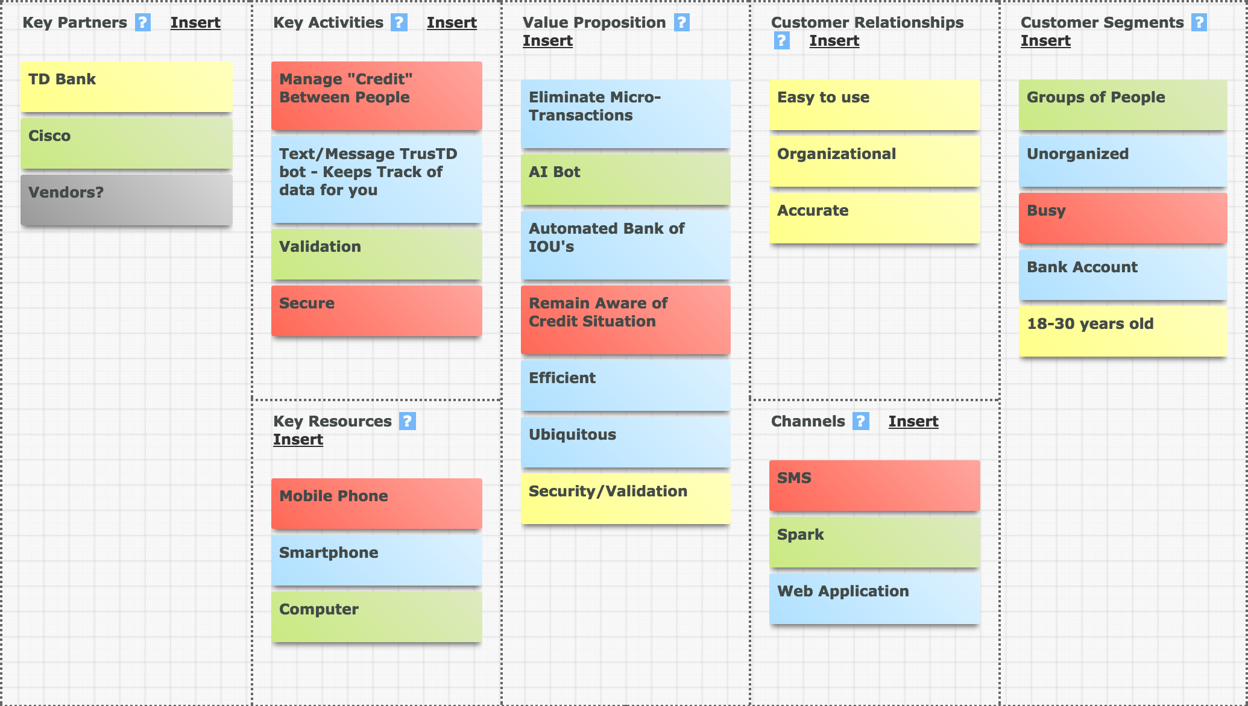
BMC Validation

Slide 8
Revenue Streams & Cost Structure
Implemented as an extension of TD’s mobile presence
Target Demographic: Unorganized, Aged 18-30 years old
Costs: Server costs, messaging service fee, website URL
What We Can Do for You:
Driving Cisco Spark Users
Providing TD customers with a great user experience
Data Driven Insights

