Slide 1
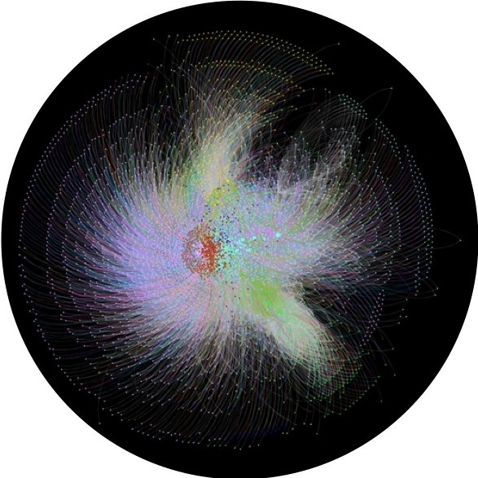
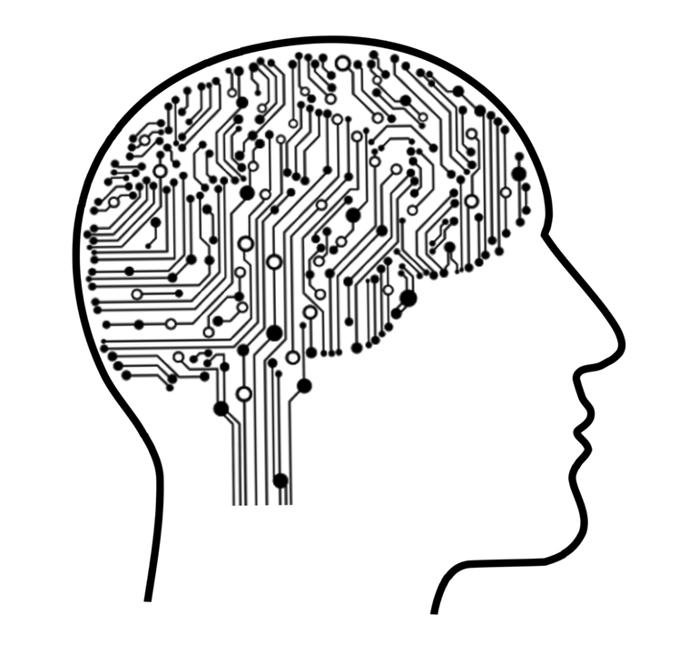

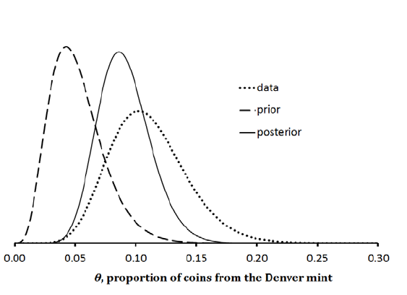

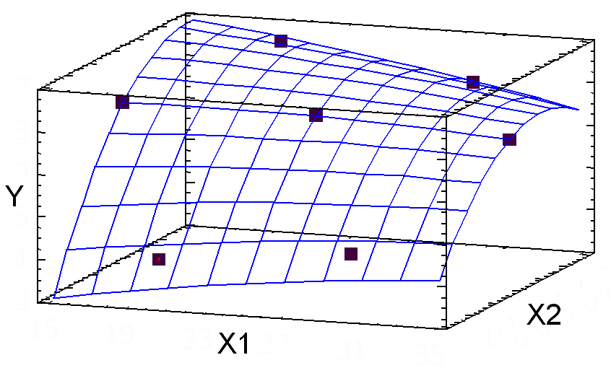
Analytics
Individual health and wellbeing
Network science
Machine learning
Digital health
Bayesian modeling
Classical approaches
Preventive care

Slide 2
Analytics
Individual health and wellbeing
Network science
Machine learning
Digital health
Bayesian modeling
Classical approaches
Preventive care

