Slide 1
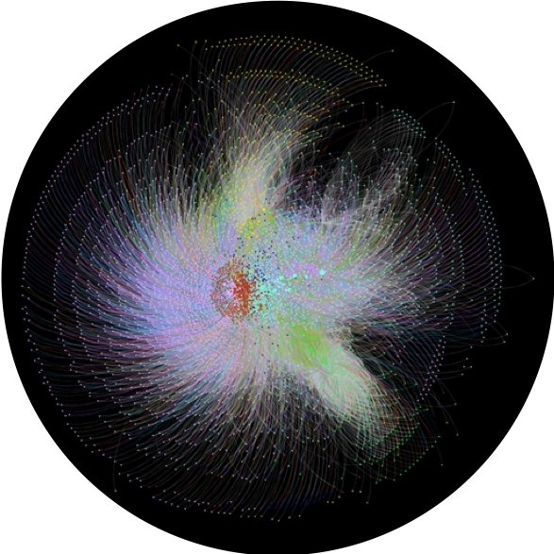
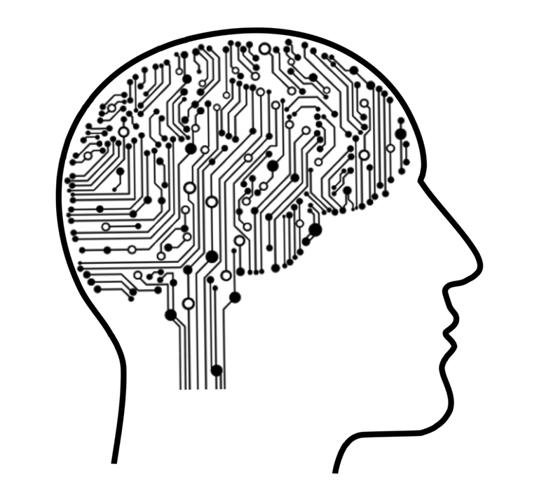

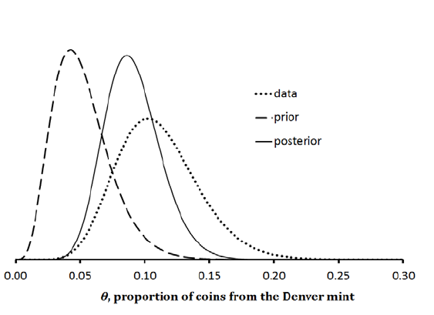

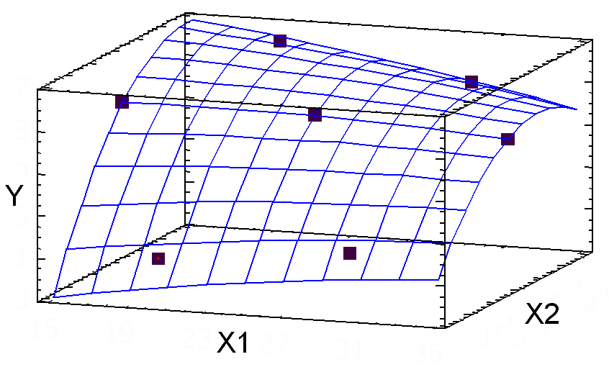
Analytics
Individual health and wellbeing
Network Science
Machine learning
Digital Health
Bayesian Modeling
Classical approaches
Preventive Care

Slide 2
Analytics
Individual health and wellbeing
Network Science
Machine learning
Digital Health
Bayesian Modeling
Classical approaches
Preventive Care

