Slide 1
Artificial Intelligence in Healthcare
Auto-generated Presentation

Slide 2

Introduction
• Overview of AI in healthcare
• Historical context and evolution
• Significance and potential impact
• Key stakeholders involved
• Challenges and opportunities

Slide 3

AI Applications
• Diagnostics and imaging
• Predictive analytics
• Personalized medicine
• Robotic surgery
• Virtual health assistants

Slide 4
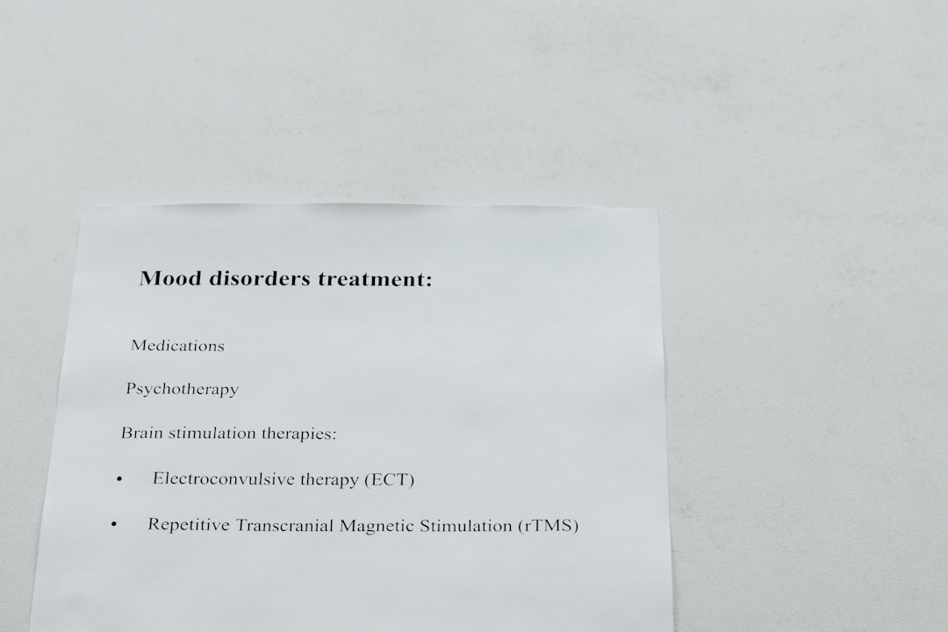
Diagnostics
• AI in radiology
• Pattern recognition for disease
• Improving accuracy and speed
• Reducing human error
• Case studies and examples

Slide 5
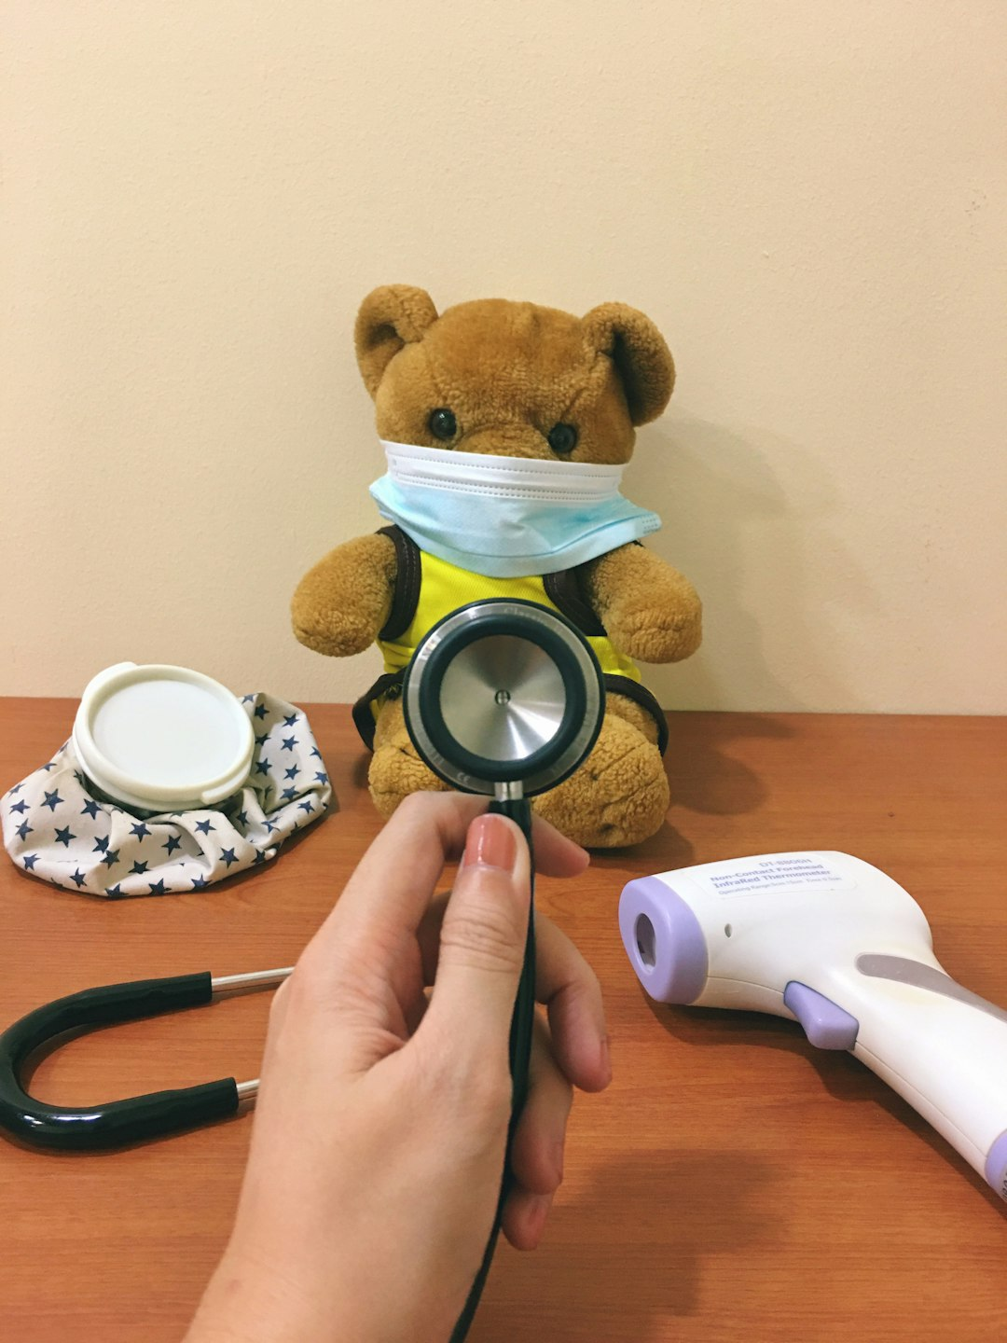
Patient Care
• Enhancing patient monitoring
• AI in treatment plans
• Improving patient outcomes
• Remote patient management
• AI-driven patient feedback

Slide 6
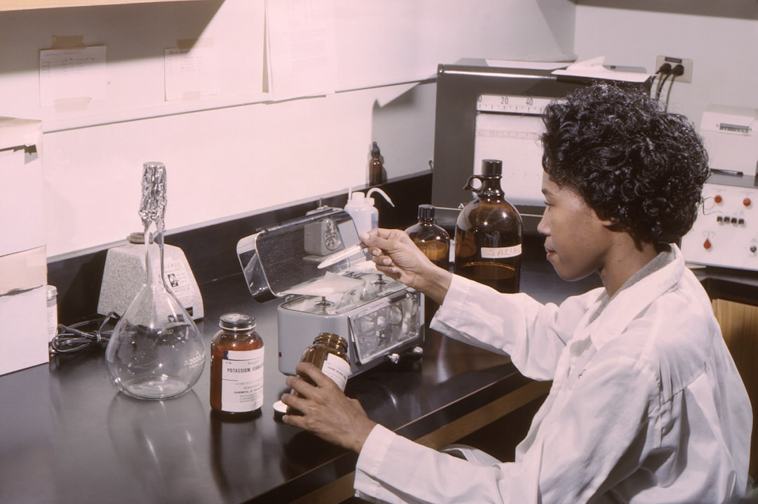
Drug Discovery
• Accelerating drug development
• AI in molecular modeling
• Reducing research costs
• Predicting drug interactions
• Success stories in AI drug discovery

Slide 7

Ethical Considerations
• AI in decision-making
• Patient privacy concerns
• Bias and fairness in AI
• Regulatory challenges
• Ensuring transparency and trust

Slide 8

AI and Big Data
• Role of big data in AI
• Data collection and analysis
• Improving clinical trials
• Challenges with data privacy
• Future of data-driven healthcare

Slide 9
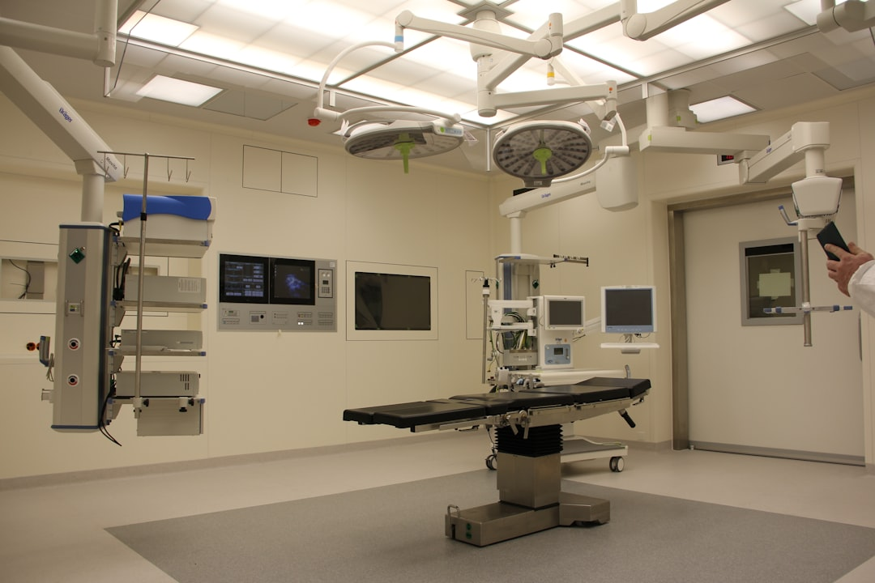
AI in Surgery
• Introduction to robotic surgery
• Enhancing precision and control
• Reducing surgical risks
• Training and simulation
• Future of AI-assisted surgery

Slide 10
Future Trends
• AI in preventive healthcare
• Integration with IoT devices
• Emerging technologies in AI
• Global impact and reach
• Predictions for the next decade

Slide 11
Conclusion
• Summary of key points
• Potential for AI to transform care
• Balancing innovation with ethics
• Steps for successful integration
• Call to action for stakeholders

