Slide 1
B.TECH • COMPUTER SCIENCE & ENGINEERING (AI & ML)
F1 RACE STRATEGY
& TELEMETRY PLATFORM
🏁 F1
FROM RAW TELEMETRY
TO RACE STRATEGY
A Unified Multi-Dataset Architecture for High-Performance Race Intelligence & Visual Analytics (14 Kaggle Repositories, 1950–2026)
PROJECT DOMAIN
Data Analytics & Visualization | Python • Streamlit • Pandas • Plotly Express
Project presentation | Team members: Member 1 • Member 2 • Member 3
01

Slide 2
[PART 1/3: DATA ENGINEERING] • WHY THIS PLATFORM WAS ENGINEERED
Problem Statement & Technical Challenges
Formula 1 generates high-velocity data (100 Hz car telemetry, pit lane timing, tyre life) that remains siloed across isolated sources.
14 HETEROGENEOUS REPOSITORIES
TIMING & ENTITY DRIFT
LATENT STRATEGY TRADE-OFFS
Data is scattered across 14 independent Kaggle archives spanning 77 seasons (1950–2026) with conflicting schemas, identifiers, and granularities.
Non-standardized timedelta strings ('1:23.456', ISO, ms), 70 years of team rebrands, and inconsistent driver codes make joint analysis failure-prone.
Tabular data hides critical trade-offs: tyre thermal degradation slopes, pit-lane transit vs stationary losses, and strategic undercut windows.
Our Solution: Engineered an end-to-end data pipeline uniting 14 Kaggle repositories into clean data lakes with real-time cascading filters and 20+ specialized charts.
02

Slide 3
[PART 1/3: DATA ENGINEERING] • ARCHITECTURAL GOALS & ENGINEERING SCOPE
Objectives of the Project
01 | UNIFY DATA
02 | EXPLORE HISTORY
03 | ANALYZE STRATEGY
Unify 14 Kaggle repositories (26k+ classifications, 107k+ laps, 12k+ pit stops) into relational in-memory lakes.
Support 77 historical seasons (1950–2026) with dual-direction year-wise sorting and cascading entity filters.
Model pit stop strategies, tyre degradation slopes (y = mx + c), and undercut/overcut windows statistically.
04 | VISUALIZE TELEMETRY
05 | ENABLE INTERACTION
06 | SUPPORT INSIGHTS
Process 100 Hz telemetry signals (Speed, Throttle, Brake, Gear) aligned with micro-distance track coordinates.
Engineer global cascading filters syncing Year, Constructor, Driver, Grand Prix, and Tyre Compound across views.
Provide 20+ visual types (Sitographs, Violins, Sunbursts, Radar, Waterfalls) and a Left Dashboard Custom Graph Studio.
03

Slide 4
[PART 1/3: DATA ENGINEERING] • HOW WE CLEANED & NORMALIZED KAGGLE DATASETS
Data Cleaning & Normalization Pipeline (data_cleaning.py)
1. TIME & DURATION PARSING
2. CONSTRUCTOR & DRIVER MAPPING
3. TYRE TAXONOMY & PIT SEGREGATION
Engineered parse_timedelta_to_seconds() regex engine resolving mixed formats ('1:23.456', ISO timedeltas, ms) into float seconds; nullifies '\N' anomalies.
Implemented canonical mappings (TEAM_NAME_MAP, DRIVER_MAP) resolving 70 years of team rebrands (Racing Point -> Aston Martin) and unifying driver codes.
Standardized historical tyres (clean_compound_name) into 5 classes with FIA hex colors; segregated stationary wheel-change time from pit-lane transit loss.
• Outlier Lap Filtering: Excludes in/out laps and Safety Car periods (>125% race pace) via IsOutlierLap to avoid skewing tyre degradation slopes.
• DNF & Classification Normalization: Harmonizes finishes, DNFs, DNS, DSQs, and laps down without dropping records.
• Type Coercion Engine: Enforces strict numeric types across 38 tables with robust error fallbacks to guarantee calculation integrity.
• Null Imputation: Imputes missing tyre life and stint numbers based on chronological lap index and pit event markers.
04

Slide 5
[PART 1/3: DATA ENGINEERING] • SYSTEM ARCHITECTURE & ANALYTICS PIPELINE
Technologies & Engineering Architecture
PYTHON
STREAMLIT
Python 3.13: Central computational backbone powering custom analytics algorithms and data pipelines.
Streamlit: Reactive web dashboard framework with zero-latency cascading state and custom dark pit-wall CSS.
PANDAS
CSV / EXCEL
Pandas & NumPy: High-speed vectorized data operations, grouping, pivots, and statistical transformations.
In-Memory Data Lakes: Cached parquet & arrow memory buffers via @st.cache_data eliminating disk I/O bottlenecks.
VISUALIZATION TOOLS
GIT & GITHUB
Plotly Express & Graph Objects: 20+ reactive motorsport visualizations with interactive tooltips and dark layout.
FastAPI & Uvicorn: Asynchronous REST backend API (/api/analytics, /api/health) powering multi-client data access.
Architecture: Raw Kaggle CSVs (14 Repos) -> data_cleaning.py -> In-Memory Unified Lakes -> apply_global_filters() -> Visual Views & Custom Graph Studio
05

Slide 6
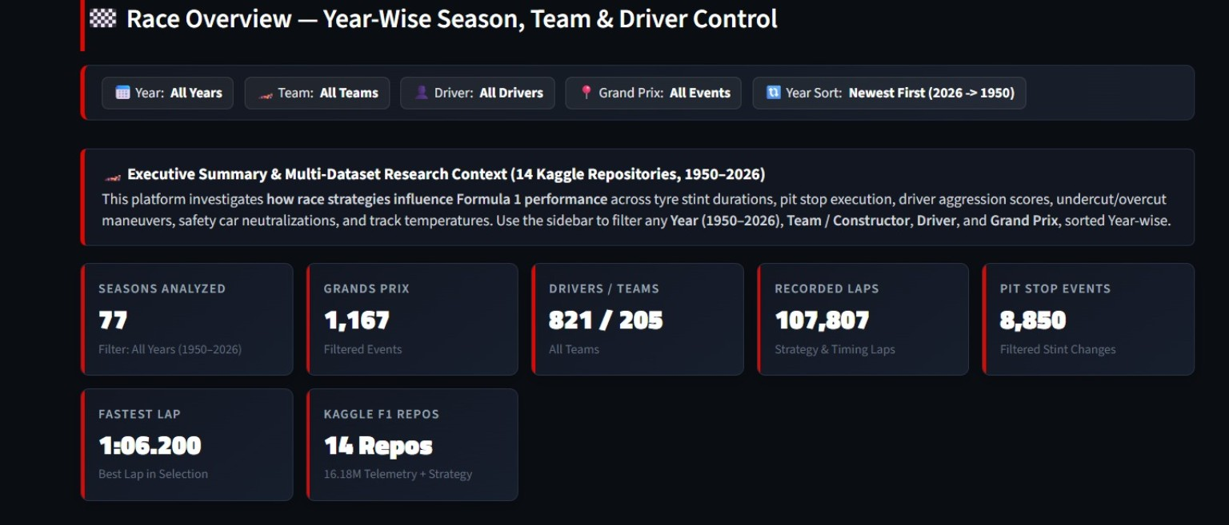
[PART 2/3: VISUAL ANALYTICS & STRATEGY] • EXECUTIVE RACE INTELLIGENCE & REAL-TIME KPI CONTROL
Race Overview — Unified Multi-Dataset Intelligence
• Unified 77-Season Data Lake: Merges Ergast, FastF1, and modern Kaggle archives to display live KPIs: 77 Seasons, 1,167 GPs, 821 Drivers, 205 Teams, 107,807 Laps.
• Single-Line HTML KPI Grid: Prevents markdown code-block parsing while delivering responsive metric cards with dynamic trend deltas.
• Constructor Points Donut: Visualizes team championship shares (hole=0.48) mapped to official constructor livery colors.
• Championship Sunburst: Hierarchical visualization (Constructor -> Driver -> Points) with interactive multi-layer zoom.
• Cumulative Points Area: Tracks multi-round championship momentum and lead shifts across the season.
• Driver Finish Heatmap: Categorical round-by-round matrix revealing driver consistency across Grand Prix circuits.
• Unified 77-Season Data Lake: Merges Ergast, FastF1, and modern Kaggle archives to display live KPIs: 77 Seasons, 1,167 GPs, 821 Drivers, 205 Teams, 107,807 Laps.
• Single-Line HTML KPI Grid: Prevents markdown code-block parsing while delivering responsive metric cards with dynamic trend deltas.
• Constructor Points Donut: Visualizes team championship shares (hole=0.48) mapped to official constructor livery colors.
• Championship Sunburst: Hierarchical visualization (Constructor -> Driver -> Points) with interactive multi-layer zoom.
• Cumulative Points Area: Tracks multi-round championship momentum and lead shifts across the season.
• Driver Finish Heatmap: Categorical round-by-round matrix revealing driver consistency across Grand Prix circuits.
06

Slide 7
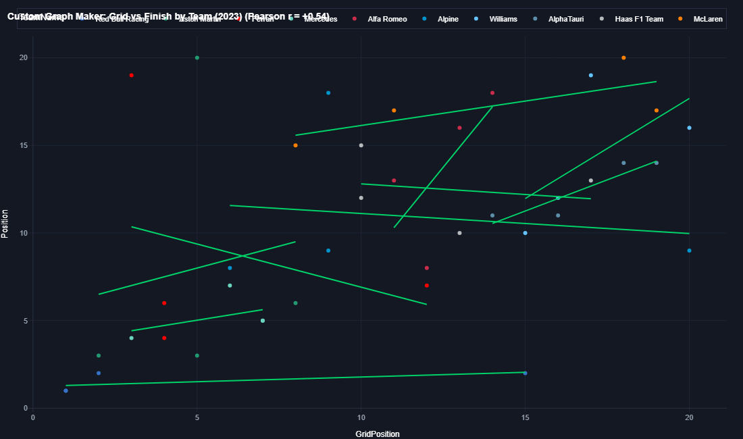
[PART 2/3: VISUAL ANALYTICS & STRATEGY] • ON-THE-FLY CUSTOM VISUALIZATION ENGINE
Custom Graph Studio for Selected Data (Left Dashboard)
• Embedded Sidebar Studio: Built directly into the Left Dashboard, enabling on-demand graph generation for any filtered slice.
• Real-Time Data Stream Selection: Dynamically queries Race Results, Lap Times & Pace, Pit Stops, Stints, or Career Standings.
• Live Filter-Coupled Row Counter: Instantly displays matching records (e.g. ⚡ 44 records in selection) as filters change.
• 8 Specialized Visual Types: Bar Chart, Line Chart, Sitograph (OLS Trendline + Pearson r), Pie/Donut, Histogram, Box Plot, Violin, and Area Chart.
• Custom Aggregations: Dynamic mathematical reductions (Sum, Mean, Count, Max, Min, or Raw data).
• Dual Display Architecture: Renders compact interactive preview in the sidebar + full-width high-resolution modal on the main dashboard.
07

Slide 8
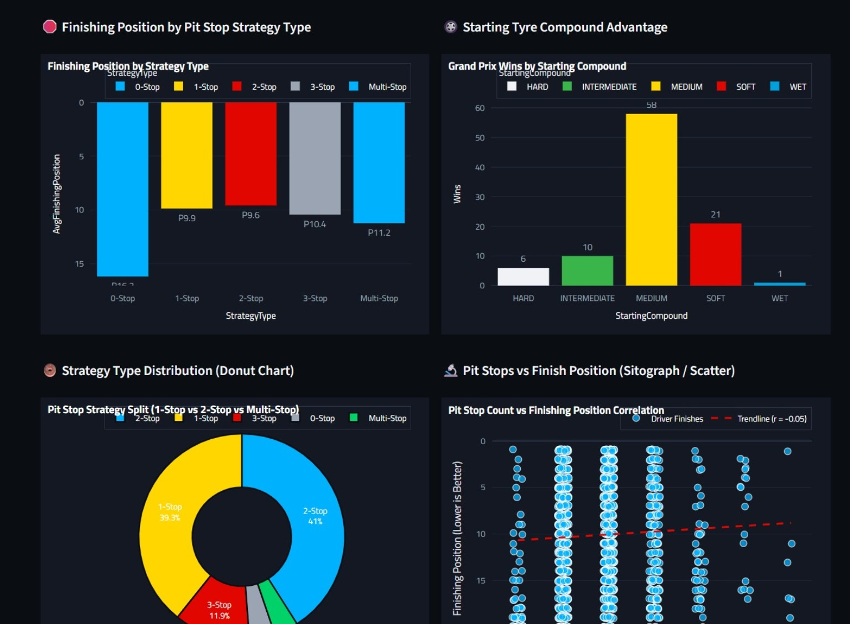
[PART 2/3: VISUAL ANALYTICS & STRATEGY] • STATISTICAL MODELING OF PIT DECIDERS & STINTS
Race Strategy Analysis — Pit Strategies & Correlations
• Stint Classification Algorithm: Evaluates pit stop records to segment race executions into 0-stop, 1-stop, 2-stop, 3-stop, and multi-stop groups.
• Finish by Strategy Type: Compares average finishing ranks across strategy categories to identify the mathematically optimal tactic.
• Starting Tyre Advantage: Cross-tabulates starting tyre compounds against GP wins (e.g. Medium compound accounting for 58 wins).
• Strategy Mix Donut Chart: Displays the strategic pit stop split across the field (1-stop: 39.3%, 2-stop: 41%, 3-stop: 11.9%).
• Sitograph (Scatter + Trendline): Computes Pearson correlation (r = -0.05) between pit stop count and finishing position to evaluate tactical penalty.
• Grid-to-Finish Waterfall: Diverging bar chart showing position delta from starting grid to chequered flag.
08

Slide 9
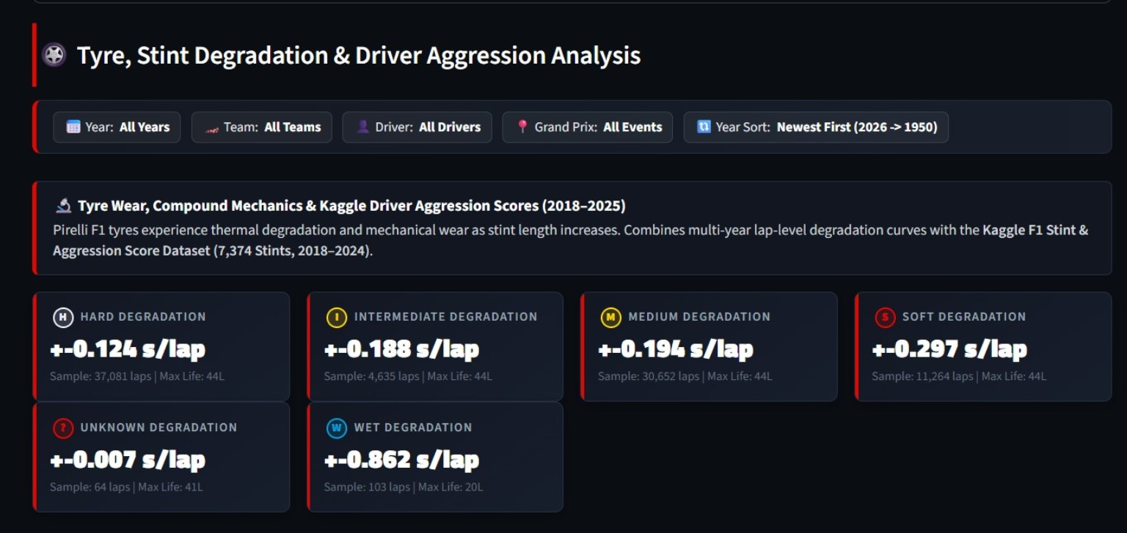
[PART 2/3: VISUAL ANALYTICS & STRATEGY] • MATHEMATICAL MODELING OF TYRE WEAR & DEGRADATION
Tyre and Stint Analysis — Thermal Wear & Stints
• Linear Regression Degradation Slopes (y = mx + c): Computes thermal wear per lap (s/lap) after filtering outlier and caution laps:
- Hard: +0.124 s/lap (37,081 laps | Max: 44L)
- Intermediate: +0.188 s/lap (4,635 laps | Max: 44L)
- Medium: +0.194 s/lap (30,652 laps | Max: 44L)
- Soft: +0.297 s/lap (11,264 laps | Max: 44L)
- Wet: +0.862 s/lap (103 laps | Max: 20L)
• Stint Length Violin Density: Plots kernel density estimates (KDE) and quartile spreads showing compound durability cliffs.
• Tyre Allocation Treemap: Hierarchical constructor tyre allocation mapping compound shares across teams.
• Driver Aggression Integration: Merges 7,374 Kaggle stint aggression records to model driver pace multipliers.
• Linear Regression Degradation Slopes (y = mx + c): Computes thermal wear per lap (s/lap) after filtering outlier and caution laps:
- Hard: +0.124 s/lap (37,081 laps | Max: 44L)
- Intermediate: +0.188 s/lap (4,635 laps | Max: 44L)
- Medium: +0.194 s/lap (30,652 laps | Max: 44L)
- Soft: +0.297 s/lap (11,264 laps | Max: 44L)
- Wet: +0.862 s/lap (103 laps | Max: 20L)
• Stint Length Violin Density: Plots kernel density estimates (KDE) and quartile spreads showing compound durability cliffs.
• Tyre Allocation Treemap: Hierarchical constructor tyre allocation mapping compound shares across teams.
• Driver Aggression Integration: Merges 7,374 Kaggle stint aggression records to model driver pace multipliers.
09

Slide 10
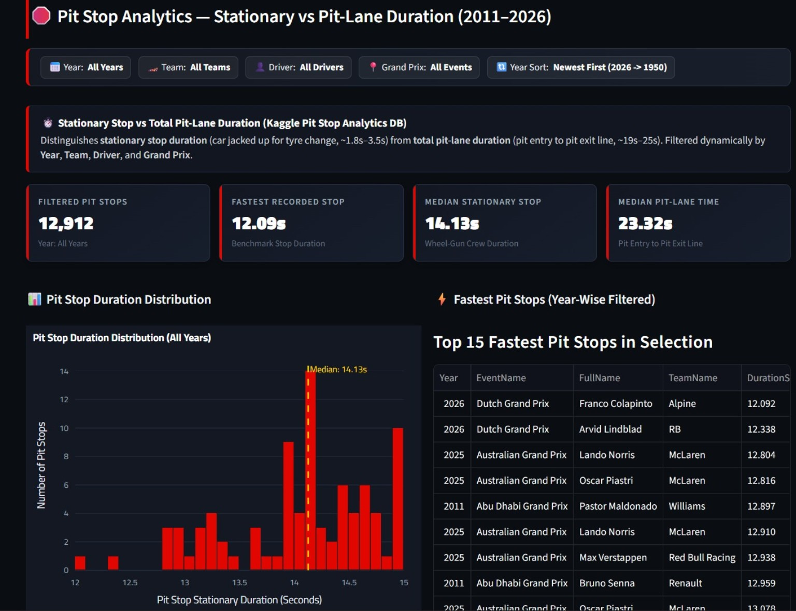
[PART 2/3: VISUAL ANALYTICS & STRATEGY] • STATIONARY CREW PERFORMANCE VS PIT-LANE LOSS
Pit Stop Analytics — Stationary vs Transit Duration
DUAL-DURATION SEGREGATION
Segregates stationary wheel-change duration (Median ~14.13s Ergast / ~2.3s Kaggle events) from total pit-lane transit loss (~23.32s).
CREW VARIANCE & VIOLIN DENSITY
Violin plots evaluate pit crew standard deviation and IQR variance by constructor, identifying operational mistakes.
REAL-TIME LEADERBOARD & SITOGRAPH
Ranked leaderboards highlight sub-13s pit stops, while stationary vs transit sitographs analyze pit-lane entry/exit delta.
10

Slide 11
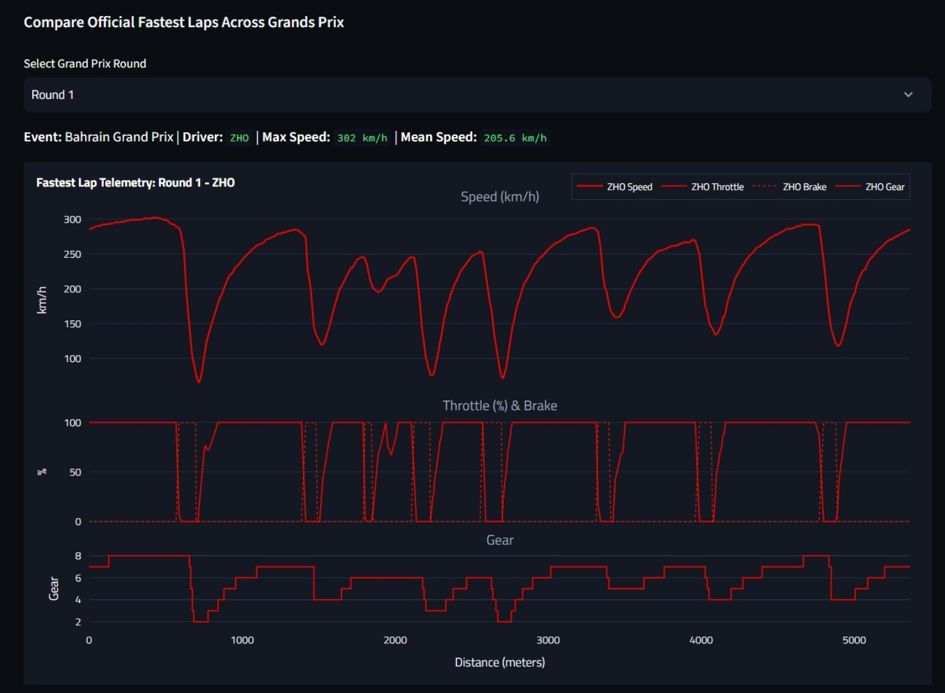
[PART 3/3: TELEMETRY & DATA QUALITY] • 100 Hz SIGNAL PROCESSING & TRACE VISUALIZATION
Lap-Time & Telemetry Analysis — Signal Decomposition
• Multi-Channel Telemetry Alignment: Synchronizes 100 Hz signals (Speed, Throttle %, Brake, Gear) along track distance (meters).
• Braking & Apex Detection: Telemetry troughs isolate exact threshold braking points, minimum corner apex speeds, and throttle pick-up points.
• Step-Function Gear Traces: Tracks transmission shift patterns, downshift engine braking, and high-speed gear optimization.
• Driver Pace Consistency (CV %): Computes the Coefficient of Variation (CV = σ / μ) of lap times to measure driver pace reliability.
• 5-Axis Driver Spider / Radar: Normalizes Scoring Power, Overtaking Delta, Consistency, Podium Conversion, and Qualifying Rank.
11

Slide 12
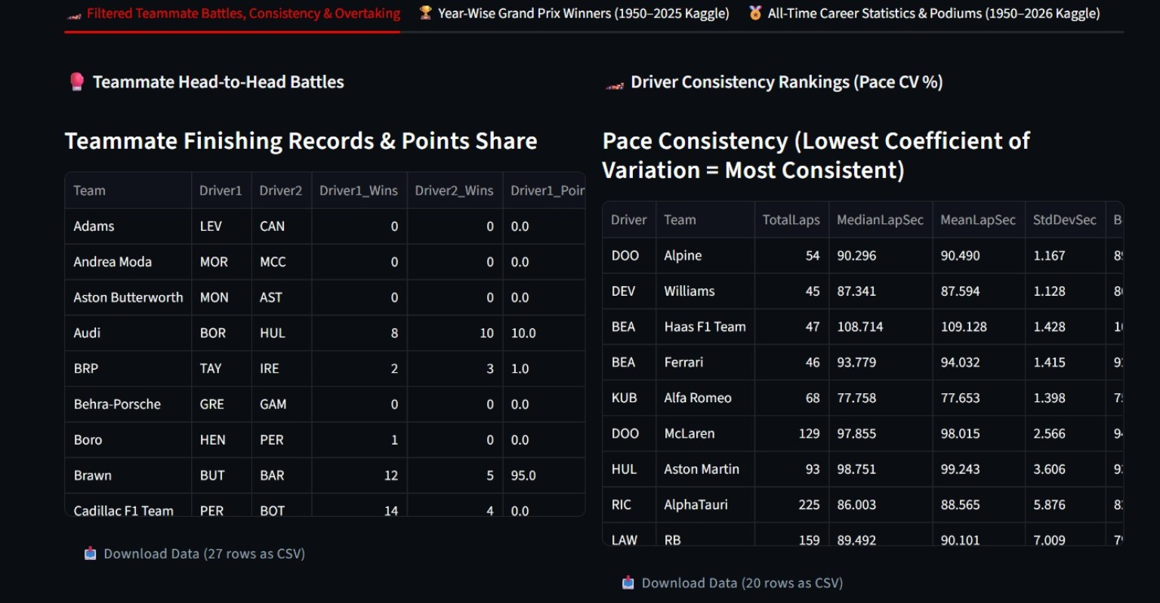
[PART 3/3: TELEMETRY & DATA QUALITY] • EVALUATING DRIVERS IN IDENTICAL MACHINERY
Driver & Team Performance — Intra-Team Normalization
• Intra-Team Performance Normalization: Isolates driver talent from car advantage by comparing teammate pairs driving identical cars.
• Head-to-Head Headcount & Points Share: Computes intra-team finishing records, qualifying battle records, and team points share.
• Pace Consistency Rankings: Ranks drivers across seasons using lap pace standard deviation (StdDevSec) and coefficient of variation.
• All-Time Historical Milestones: Joins Kaggle Drivers Career (868 drivers) and Podiums (1,158 records) to track lifetime win percentages.
• Grid-to-Finish Delta Waterfall: Quantifies race day overtaking conversion from Saturday qualifying positions.
12

Slide 13
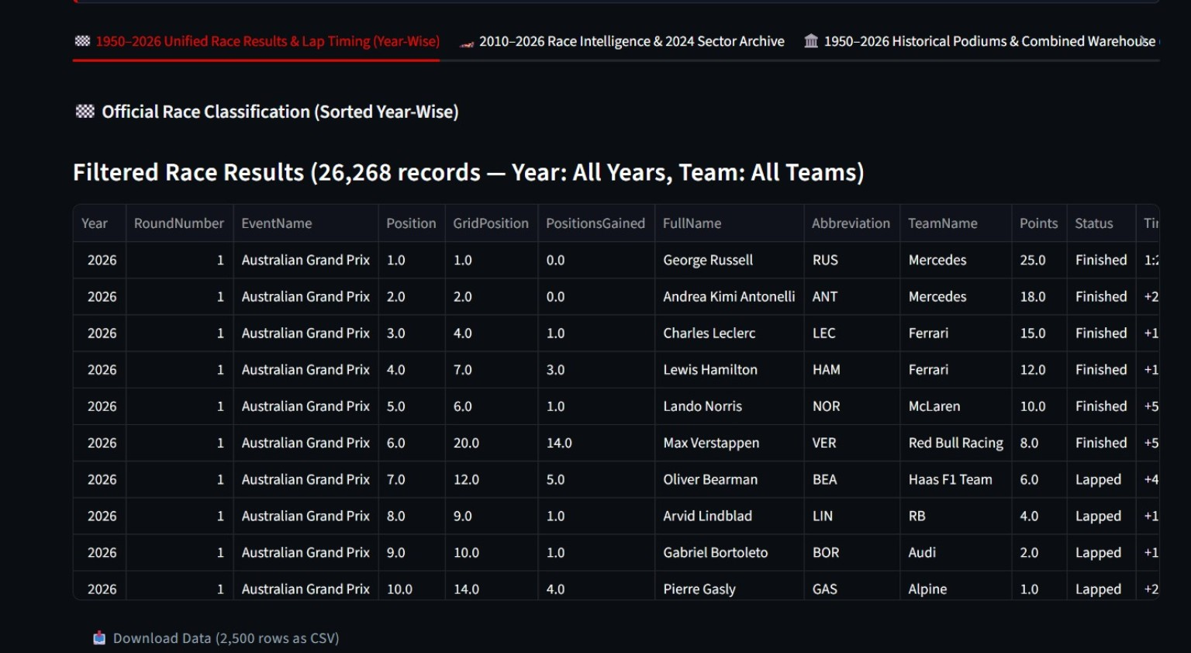
[PART 3/3: TELEMETRY & DATA QUALITY] • YEAR-WISE QUERY ENGINE & ARCHIVE EXPLORATION
Season and Race Explorer — 77 Years of Official Data
• 77-Season Query Engine: Enables instant filtering across 26,268 historical race records spanning from 1950 to 2026.
• Dual Year-Wise Sort Direction: Supports reverse chronological sorting (2026 -> 1950) for modern analysis and chronological sorting for historical research.
• Automated Position Gain Metrics: Calculates positions gained/lost (GridPosition - PositionOrder) for every competitor per round.
• Relational Foreign Key Traversal: Seamlessly links classifications with circuit names, driver IDs, and constructor affiliations.
• One-Click CSV Export: Provides direct scientific CSV downloads of filtered tabular slices for secondary research modeling.
13

Slide 14
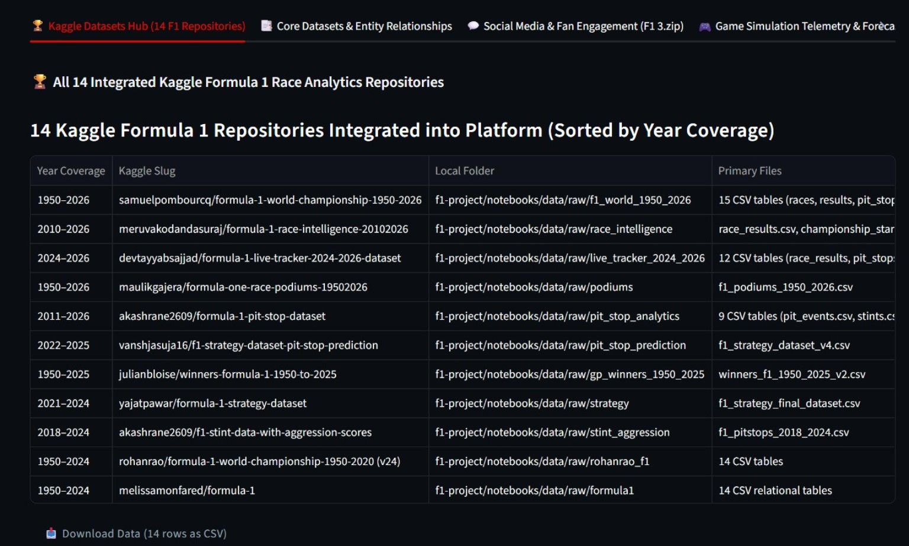
[PART 3/3: TELEMETRY & DATA QUALITY] • MULTI-REPOSITORY METADATA & DATA HEALTH AUDITING
Dataset Explorer & Data Quality Architecture
• 14 Kaggle Repositories Hub: Full metadata registry documenting year coverage, repository slug, local folder, and primary tables.
• Relational Schema Detection (schema_detection.py): Automatically maps 38 datasets and discovers 7 primary-to-foreign key links.
• Automated Data Health Profiling: Computes column-level null percentages, type conformance, duplicate rows, and schema drift.
• Broad Temporal Coverage: Unifies 1950–2026 World Championship, 2010–2026 Race Intelligence, and 2024–2026 Live Trackers.
• Research Lineage & Integrity: Guarantees complete data lineage and traceability from raw Kaggle CSVs to visual dashboard components.
• 14 Kaggle Repositories Hub: Full metadata registry documenting year coverage, repository slug, local folder, and primary tables.
• Relational Schema Detection (schema_detection.py): Automatically maps 38 datasets and discovers 7 primary-to-foreign key links.
• Automated Data Health Profiling: Computes column-level null percentages, type conformance, duplicate rows, and schema drift.
• Broad Temporal Coverage: Unifies 1950–2026 World Championship, 2010–2026 Race Intelligence, and 2024–2026 Live Trackers.
• Research Lineage & Integrity: Guarantees complete data lineage and traceability from raw Kaggle CSVs to visual dashboard components.
14

Slide 15
[PART 3/3: TELEMETRY & DATA QUALITY] • KEY TECHNICAL CONTRIBUTIONS & FUTURE SCOPE
Conclusion & Engineering Impact
The Formula 1 Race Strategy & Telemetry Analytics Platform transforms 14 disparate Kaggle archives into a high-performance visual intelligence system.
DATA ENGINEERING EXCELLENCE
RIGOROUS STATISTICAL ANALYTICS
INTERACTIVE VISUAL STUDIO
Unified 14 Kaggle repositories (1950–2026) and 100 Hz telemetry through automated cleaning, entity mapping, and timedelta normalization.
Engineered OLS tyre degradation slopes (s/lap), pit stop correlation (r), pace consistency (CV), and intra-team performance normalization.
Delivered 20+ specialized dark motorsport visualizations alongside an on-the-fly Custom Graph Studio integrated into the Left Dashboard.
Future scope
• Real-Time Telemetry Streaming: Ingestion of live session telemetry via FastF1 WebSockets.
• Predictive Machine Learning: Random Forest / XGBoost models predicting optimal pit stop windows and tyre life cliffs.
• Monte Carlo Strategy Simulation: Probabilistic modeling of race outcomes under Safety Car interventions.
🏁 THANK YOU!
Questions & Technical Discussion
15

