Slide 1
B.TECH • COMPUTER SCIENCE & ENGINEERING (AI & ML)
F1 RACE STRATEGY
& TELEMETRY PLATFORM
🏁 F1
FROM RAW TELEMETRY
TO RACE STRATEGY
A Unified Multi-Dataset Architecture for High-Performance Race Intelligence & Visual Analytics (14 Kaggle Repositories, 1950–2026)
PROJECT DOMAIN • PART 2: VISUAL ANALYTICS, STRATEGY MODELING & GRAPH STUDIO
Data Analytics & Visualization | Python • Streamlit • Pandas • Plotly Express
Lead Presenter: Member 2 (Visual Analytics & Strategy Lead) | Team: Member 1 • Member 2 • Member 3
01

Slide 2
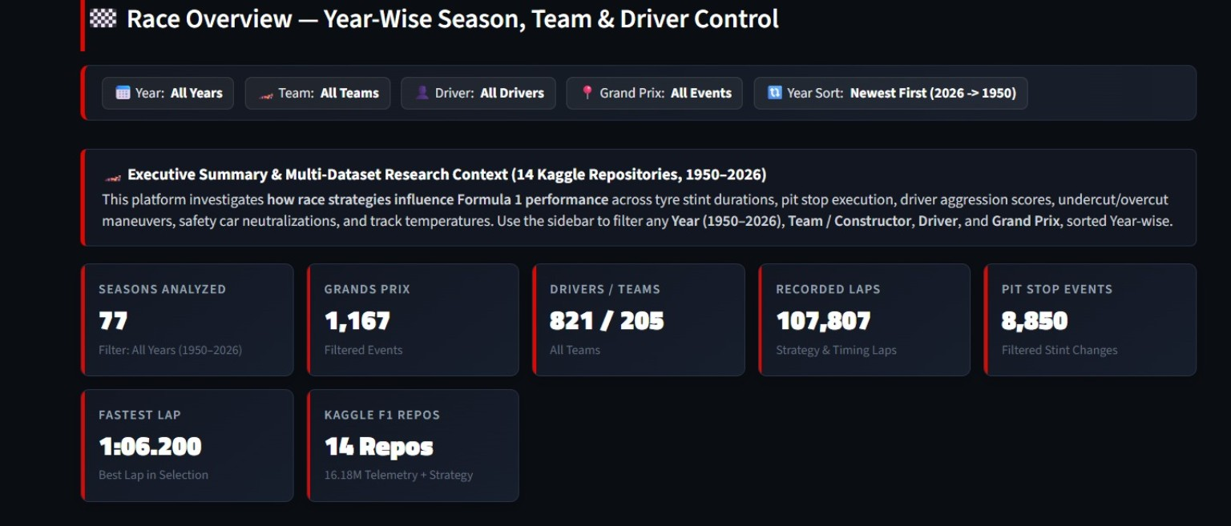
[PART 2/3: VISUAL ANALYTICS & STRATEGY] • EXECUTIVE RACE INTELLIGENCE & REAL-TIME KPI CONTROL
Race Overview — Unified Multi-Dataset Intelligence
• Unified 77-Season Data Lake: Merges Ergast, FastF1, and modern Kaggle archives to display live KPIs: 77 Seasons, 1,167 GPs, 821 Drivers, 205 Teams, 107,807 Laps.
• Single-Line HTML KPI Grid: Prevents markdown code-block parsing while delivering responsive metric cards with dynamic trend deltas.
• Constructor Points Donut: Visualizes team championship shares (hole=0.48) mapped to official constructor livery colors.
• Championship Sunburst: Hierarchical visualization (Constructor -> Driver -> Points) with interactive multi-layer zoom.
• Cumulative Points Area: Tracks multi-round championship momentum and lead shifts across the season.
• Driver Finish Heatmap: Categorical round-by-round matrix revealing driver consistency across Grand Prix circuits.
• Unified 77-Season Data Lake: Merges Ergast, FastF1, and modern Kaggle archives to display live KPIs: 77 Seasons, 1,167 GPs, 821 Drivers, 205 Teams, 107,807 Laps.
• Single-Line HTML KPI Grid: Prevents markdown code-block parsing while delivering responsive metric cards with dynamic trend deltas.
• Constructor Points Donut: Visualizes team championship shares (hole=0.48) mapped to official constructor livery colors.
• Championship Sunburst: Hierarchical visualization (Constructor -> Driver -> Points) with interactive multi-layer zoom.
• Cumulative Points Area: Tracks multi-round championship momentum and lead shifts across the season.
• Driver Finish Heatmap: Categorical round-by-round matrix revealing driver consistency across Grand Prix circuits.
06

Slide 3
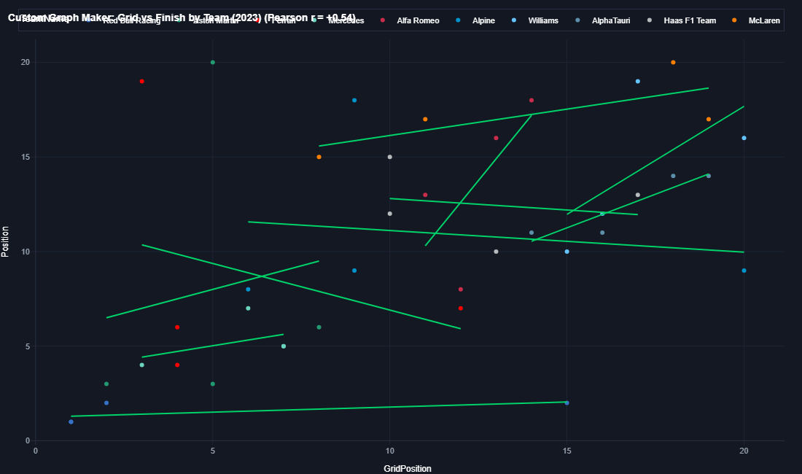
[PART 2/3: VISUAL ANALYTICS & STRATEGY] • ON-THE-FLY CUSTOM VISUALIZATION ENGINE
Custom Graph Studio for Selected Data (Left Dashboard)
• Embedded Sidebar Studio: Built directly into the Left Dashboard, enabling on-demand graph generation for any filtered slice.
• Real-Time Data Stream Selection: Dynamically queries Race Results, Lap Times & Pace, Pit Stops, Stints, or Career Standings.
• Live Filter-Coupled Row Counter: Instantly displays matching records (e.g. ⚡ 44 records in selection) as filters change.
• 8 Specialized Visual Types: Bar Chart, Line Chart, Sitograph (OLS Trendline + Pearson r), Pie/Donut, Histogram, Box Plot, Violin, and Area Chart.
• Custom Aggregations: Dynamic mathematical reductions (Sum, Mean, Count, Max, Min, or Raw data).
• Dual Display Architecture: Renders compact interactive preview in the sidebar + full-width high-resolution modal on the main dashboard.
07

Slide 4
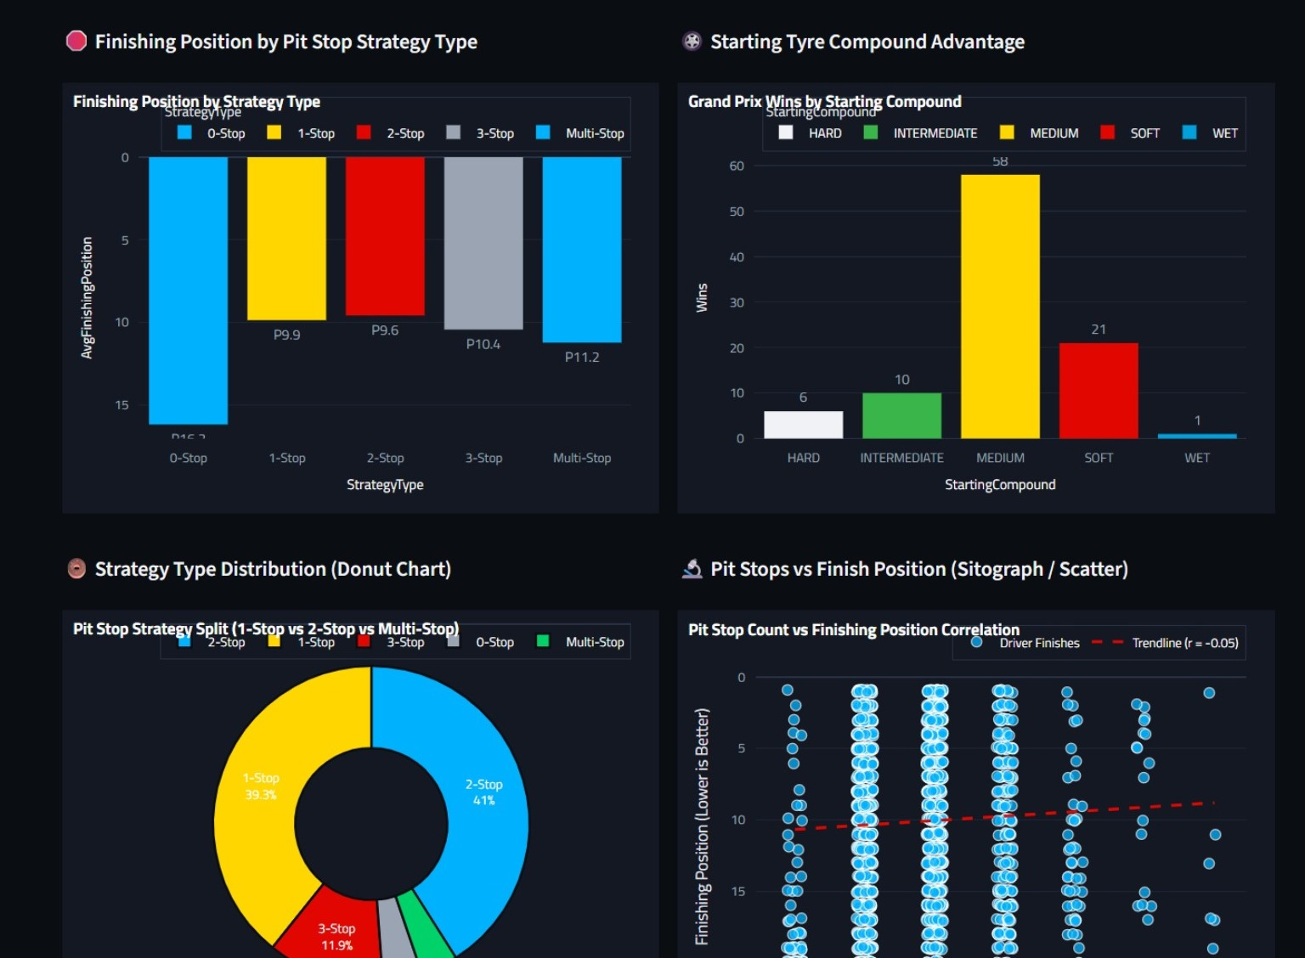
[PART 2/3: VISUAL ANALYTICS & STRATEGY] • STATISTICAL MODELING OF PIT DECIDERS & STINTS
Race Strategy Analysis — Pit Strategies & Correlations
• Stint Classification Algorithm: Evaluates pit stop records to segment race executions into 0-stop, 1-stop, 2-stop, 3-stop, and multi-stop groups.
• Finish by Strategy Type: Compares average finishing ranks across strategy categories to identify the mathematically optimal tactic.
• Starting Tyre Advantage: Cross-tabulates starting tyre compounds against GP wins (e.g. Medium compound accounting for 58 wins).
• Strategy Mix Donut Chart: Displays the strategic pit stop split across the field (1-stop: 39.3%, 2-stop: 41%, 3-stop: 11.9%).
• Sitograph (Scatter + Trendline): Computes Pearson correlation (r = -0.05) between pit stop count and finishing position to evaluate tactical penalty.
• Grid-to-Finish Waterfall: Diverging bar chart showing position delta from starting grid to chequered flag.
08

Slide 5
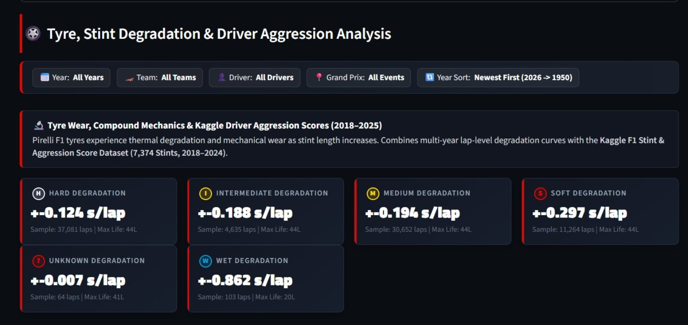
[PART 2/3: VISUAL ANALYTICS & STRATEGY] • MATHEMATICAL MODELING OF TYRE WEAR & DEGRADATION
Tyre and Stint Analysis — Thermal Wear & Stints
• Linear Regression Degradation Slopes (y = mx + c): Computes thermal wear per lap (s/lap) after filtering outlier and caution laps:
- Hard: +0.124 s/lap (37,081 laps | Max: 44L)
- Intermediate: +0.188 s/lap (4,635 laps | Max: 44L)
- Medium: +0.194 s/lap (30,652 laps | Max: 44L)
- Soft: +0.297 s/lap (11,264 laps | Max: 44L)
- Wet: +0.862 s/lap (103 laps | Max: 20L)
• Stint Length Violin Density: Plots kernel density estimates (KDE) and quartile spreads showing compound durability cliffs.
• Tyre Allocation Treemap: Hierarchical constructor tyre allocation mapping compound shares across teams.
• Driver Aggression Integration: Merges 7,374 Kaggle stint aggression records to model driver pace multipliers.
• Linear Regression Degradation Slopes (y = mx + c): Computes thermal wear per lap (s/lap) after filtering outlier and caution laps:
- Hard: +0.124 s/lap (37,081 laps | Max: 44L)
- Intermediate: +0.188 s/lap (4,635 laps | Max: 44L)
- Medium: +0.194 s/lap (30,652 laps | Max: 44L)
- Soft: +0.297 s/lap (11,264 laps | Max: 44L)
- Wet: +0.862 s/lap (103 laps | Max: 20L)
• Stint Length Violin Density: Plots kernel density estimates (KDE) and quartile spreads showing compound durability cliffs.
• Tyre Allocation Treemap: Hierarchical constructor tyre allocation mapping compound shares across teams.
• Driver Aggression Integration: Merges 7,374 Kaggle stint aggression records to model driver pace multipliers.
09

Slide 6
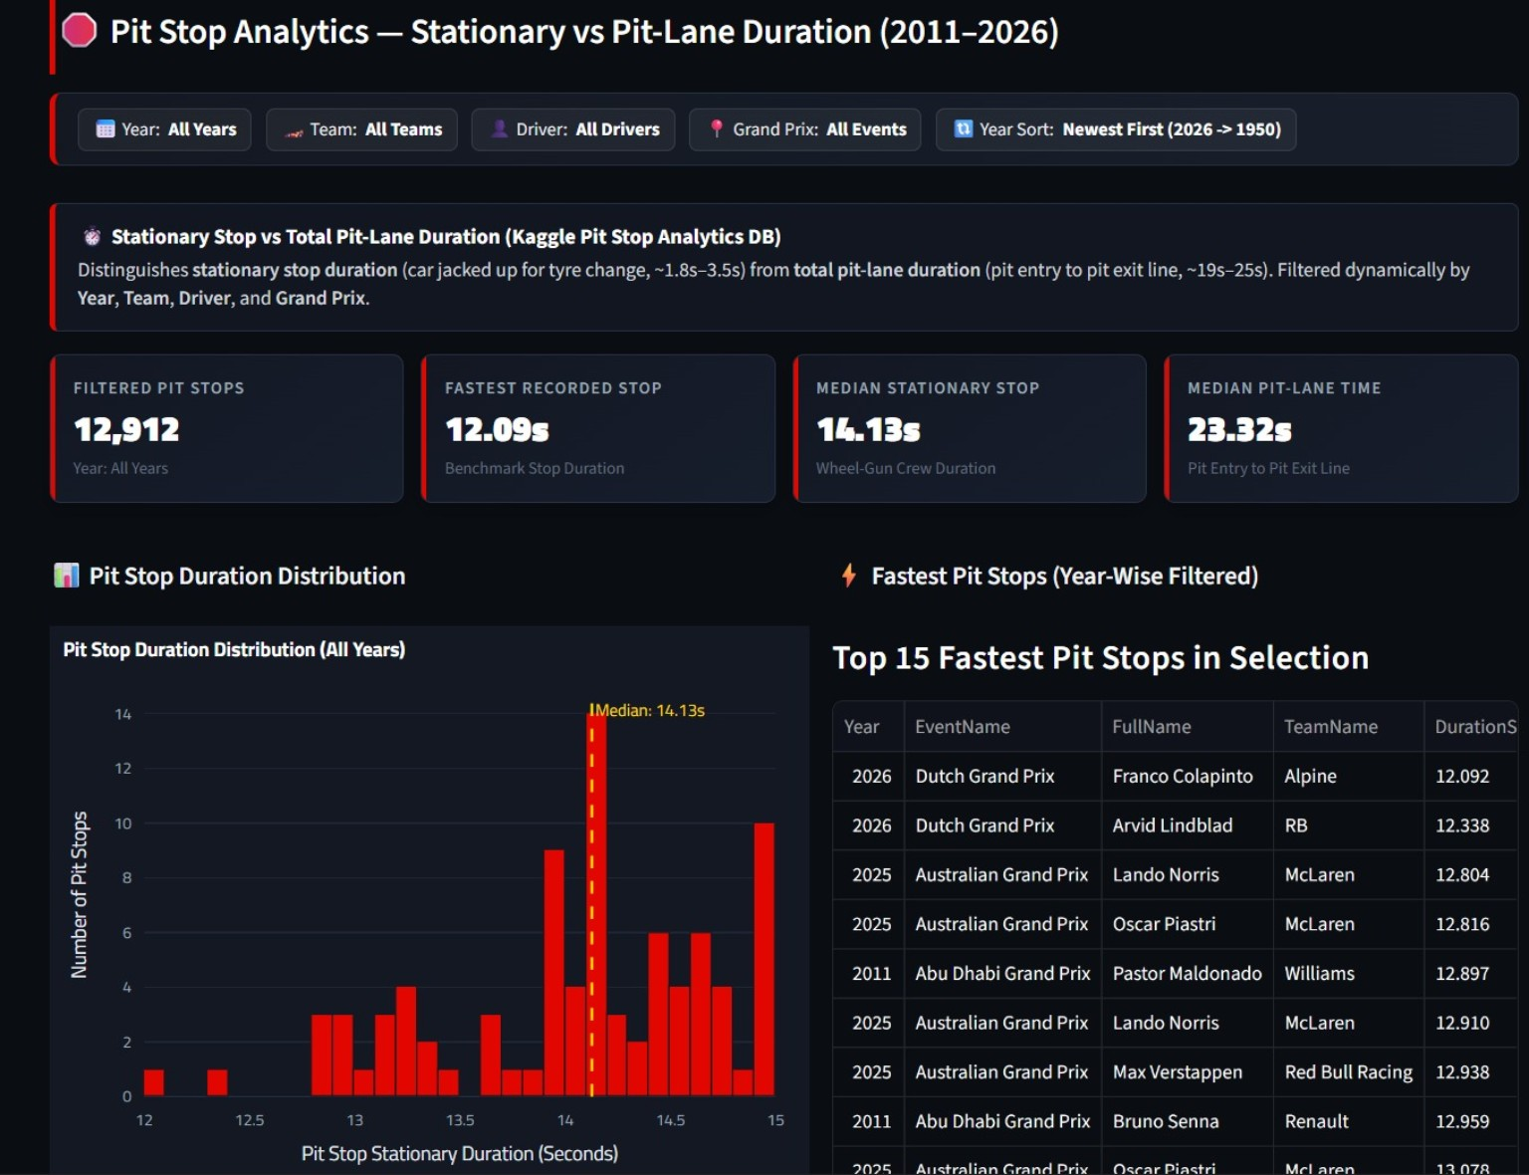
[PART 2/3: VISUAL ANALYTICS & STRATEGY] • STATIONARY CREW PERFORMANCE VS PIT-LANE LOSS
Pit Stop Analytics — Stationary vs Transit Duration
DUAL-DURATION SEGREGATION
Segregates stationary wheel-change duration (Median ~14.13s Ergast / ~2.3s Kaggle events) from total pit-lane transit loss (~23.32s).
CREW VARIANCE & VIOLIN DENSITY
Violin plots evaluate pit crew standard deviation and IQR variance by constructor, identifying operational mistakes.
REAL-TIME LEADERBOARD & SITOGRAPH
Ranked leaderboards highlight sub-13s pit stops, while stationary vs transit sitographs analyze pit-lane entry/exit delta.
10

