Slide 1
B.TECH • COMPUTER SCIENCE & ENGINEERING (AI & ML)
F1 RACE STRATEGY
& TELEMETRY PLATFORM
🏁 F1
FROM RAW TELEMETRY
TO RACE STRATEGY
A Unified Multi-Dataset Architecture for High-Performance Race Intelligence & Visual Analytics (14 Kaggle Repositories, 1950–2026)
PROJECT DOMAIN • PART 3: 100 HZ TELEMETRY, DRIVER PERFORMANCE & GOVERNANCE
Data Analytics & Visualization | Python • Streamlit • Pandas • Plotly Express
Lead Presenter: Member 3 (Telemetry, Quality & Architecture Lead) | Team: Member 1 • Member 2 • Member 3
01

Slide 2
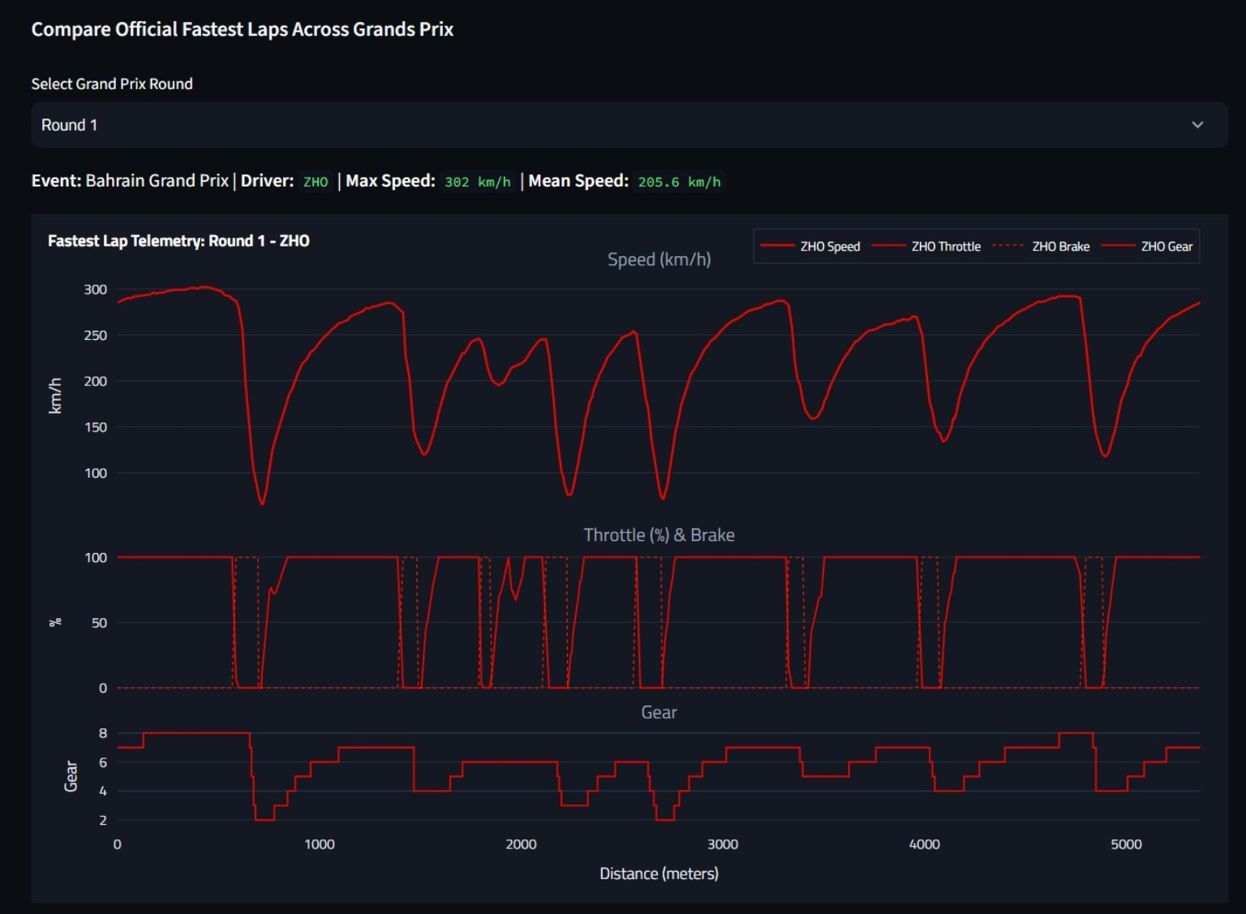
[PART 3/3: TELEMETRY & DATA QUALITY] • 100 Hz SIGNAL PROCESSING & TRACE VISUALIZATION
Lap-Time & Telemetry Analysis — Signal Decomposition
• Multi-Channel Telemetry Alignment: Synchronizes 100 Hz signals (Speed, Throttle %, Brake, Gear) along track distance (meters).
• Braking & Apex Detection: Telemetry troughs isolate exact threshold braking points, minimum corner apex speeds, and throttle pick-up points.
• Step-Function Gear Traces: Tracks transmission shift patterns, downshift engine braking, and high-speed gear optimization.
• Driver Pace Consistency (CV %): Computes the Coefficient of Variation (CV = σ / μ) of lap times to measure driver pace reliability.
• 5-Axis Driver Spider / Radar: Normalizes Scoring Power, Overtaking Delta, Consistency, Podium Conversion, and Qualifying Rank.
11

Slide 3
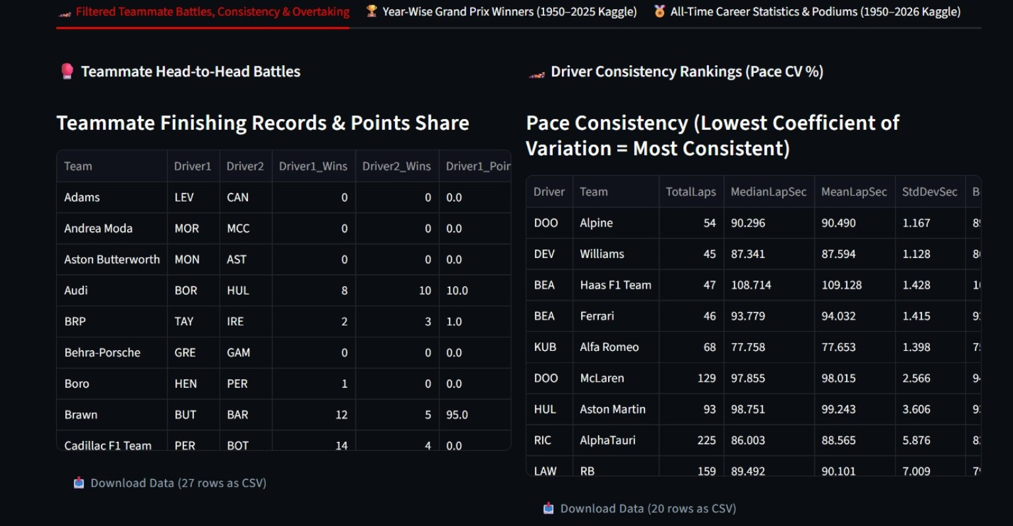
[PART 3/3: TELEMETRY & DATA QUALITY] • EVALUATING DRIVERS IN IDENTICAL MACHINERY
Driver & Team Performance — Intra-Team Normalization
• Intra-Team Performance Normalization: Isolates driver talent from car advantage by comparing teammate pairs driving identical cars.
• Head-to-Head Headcount & Points Share: Computes intra-team finishing records, qualifying battle records, and team points share.
• Pace Consistency Rankings: Ranks drivers across seasons using lap pace standard deviation (StdDevSec) and coefficient of variation.
• All-Time Historical Milestones: Joins Kaggle Drivers Career (868 drivers) and Podiums (1,158 records) to track lifetime win percentages.
• Grid-to-Finish Delta Waterfall: Quantifies race day overtaking conversion from Saturday qualifying positions.
12

Slide 4
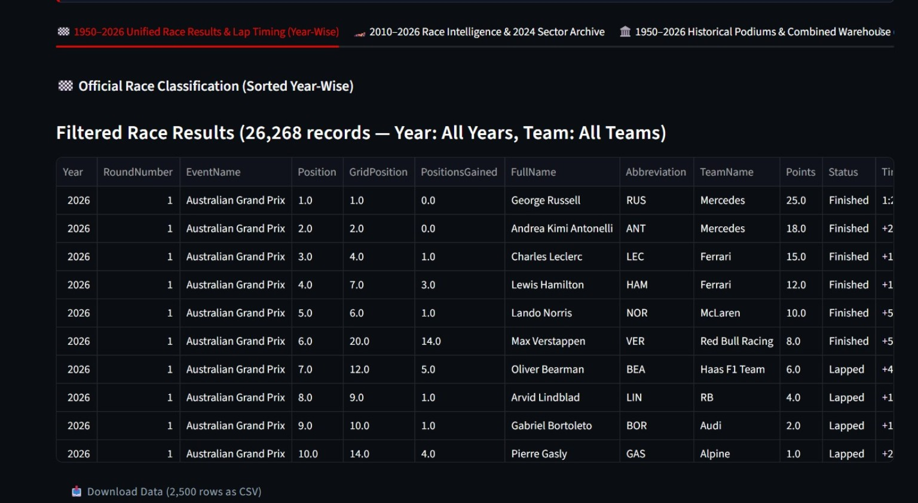
[PART 3/3: TELEMETRY & DATA QUALITY] • YEAR-WISE QUERY ENGINE & ARCHIVE EXPLORATION
Season and Race Explorer — 77 Years of Official Data
• 77-Season Query Engine: Enables instant filtering across 26,268 historical race records spanning from 1950 to 2026.
• Dual Year-Wise Sort Direction: Supports reverse chronological sorting (2026 -> 1950) for modern analysis and chronological sorting for historical research.
• Automated Position Gain Metrics: Calculates positions gained/lost (GridPosition - PositionOrder) for every competitor per round.
• Relational Foreign Key Traversal: Seamlessly links classifications with circuit names, driver IDs, and constructor affiliations.
• One-Click CSV Export: Provides direct scientific CSV downloads of filtered tabular slices for secondary research modeling.
13

Slide 5
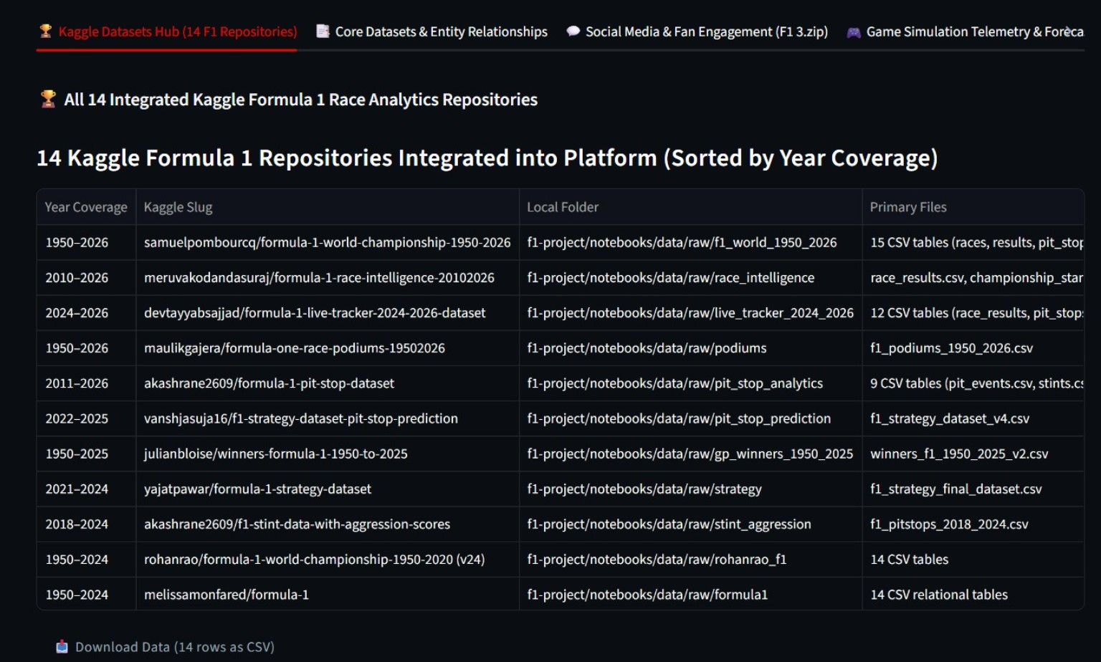
[PART 3/3: TELEMETRY & DATA QUALITY] • MULTI-REPOSITORY METADATA & DATA HEALTH AUDITING
Dataset Explorer & Data Quality Architecture
• 14 Kaggle Repositories Hub: Full metadata registry documenting year coverage, repository slug, local folder, and primary tables.
• Relational Schema Detection (schema_detection.py): Automatically maps 38 datasets and discovers 7 primary-to-foreign key links.
• Automated Data Health Profiling: Computes column-level null percentages, type conformance, duplicate rows, and schema drift.
• Broad Temporal Coverage: Unifies 1950–2026 World Championship, 2010–2026 Race Intelligence, and 2024–2026 Live Trackers.
• Research Lineage & Integrity: Guarantees complete data lineage and traceability from raw Kaggle CSVs to visual dashboard components.
• 14 Kaggle Repositories Hub: Full metadata registry documenting year coverage, repository slug, local folder, and primary tables.
• Relational Schema Detection (schema_detection.py): Automatically maps 38 datasets and discovers 7 primary-to-foreign key links.
• Automated Data Health Profiling: Computes column-level null percentages, type conformance, duplicate rows, and schema drift.
• Broad Temporal Coverage: Unifies 1950–2026 World Championship, 2010–2026 Race Intelligence, and 2024–2026 Live Trackers.
• Research Lineage & Integrity: Guarantees complete data lineage and traceability from raw Kaggle CSVs to visual dashboard components.
14

Slide 6
[PART 3/3: TELEMETRY & DATA QUALITY] • KEY TECHNICAL CONTRIBUTIONS & FUTURE SCOPE
Conclusion & Engineering Impact
The Formula 1 Race Strategy & Telemetry Analytics Platform transforms 14 disparate Kaggle archives into a high-performance visual intelligence system.
DATA ENGINEERING EXCELLENCE
RIGOROUS STATISTICAL ANALYTICS
INTERACTIVE VISUAL STUDIO
Unified 14 Kaggle repositories (1950–2026) and 100 Hz telemetry through automated cleaning, entity mapping, and timedelta normalization.
Engineered OLS tyre degradation slopes (s/lap), pit stop correlation (r), pace consistency (CV), and intra-team performance normalization.
Delivered 20+ specialized dark motorsport visualizations alongside an on-the-fly Custom Graph Studio integrated into the Left Dashboard.
Future scope
• Real-Time Telemetry Streaming: Ingestion of live session telemetry via FastF1 WebSockets.
• Predictive Machine Learning: Random Forest / XGBoost models predicting optimal pit stop windows and tyre life cliffs.
• Monte Carlo Strategy Simulation: Probabilistic modeling of race outcomes under Safety Car interventions.
🏁 THANK YOU!
Questions & Technical Discussion
15

