Slide 1
RETAIL ANALYTICS
Chip Category Review
Customer purchasing behaviour and trial store performance

Slide 2
RETAIL ANALYTICS
Executive summary
01
Two very different customer stories
Mainstream Young Singles & Couples and Mainstream Retirees drive sales through sheer customer numbers. Families drive sales through heavy, frequent per-household consumption.
02
A clear, price-tolerant growth segment
Mainstream Young & Midage Singles/Couples pay significantly more per pack and over-index on Kettle, Doritos, Tostitos, Tyrrells, Cobs and Pringles.
03
The store trial worked
Stores 77 and 88 show sustained, statistically significant sales and customer uplift in March and April. Store 86 shows a strong, real effect concentrated in March.
04
Uplift is driven by new customers
Across all three trial stores, more shoppers — not bigger baskets — is the consistent driver of the sales increase.
Chip Category Review | Confidential
2

Slide 3
RETAIL ANALYTICS
Category Analysis
Who buys chips, and what drives their spend
Chip Category Review | Confidential
3

Slide 4
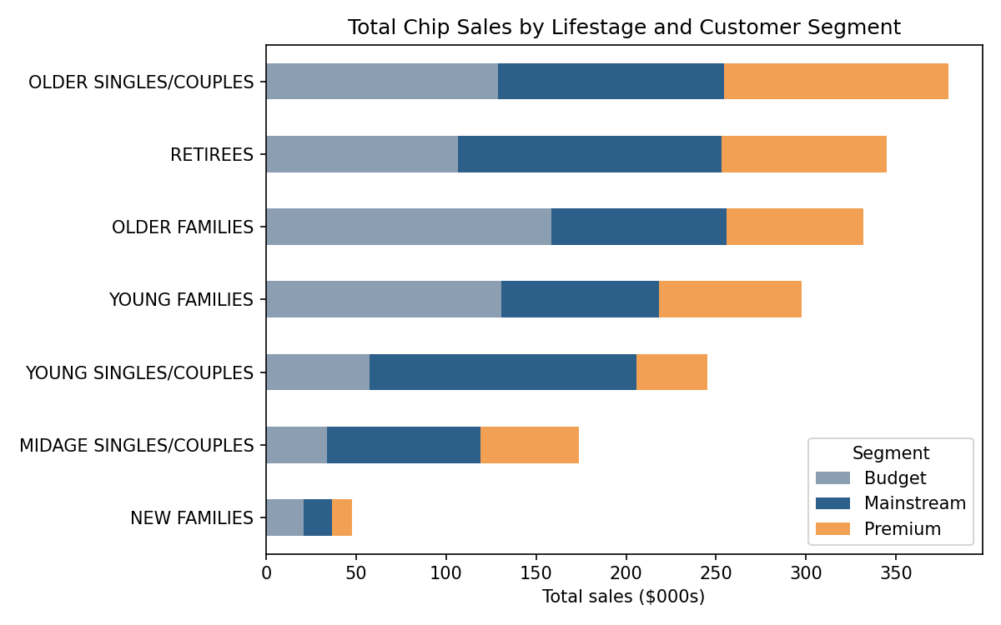
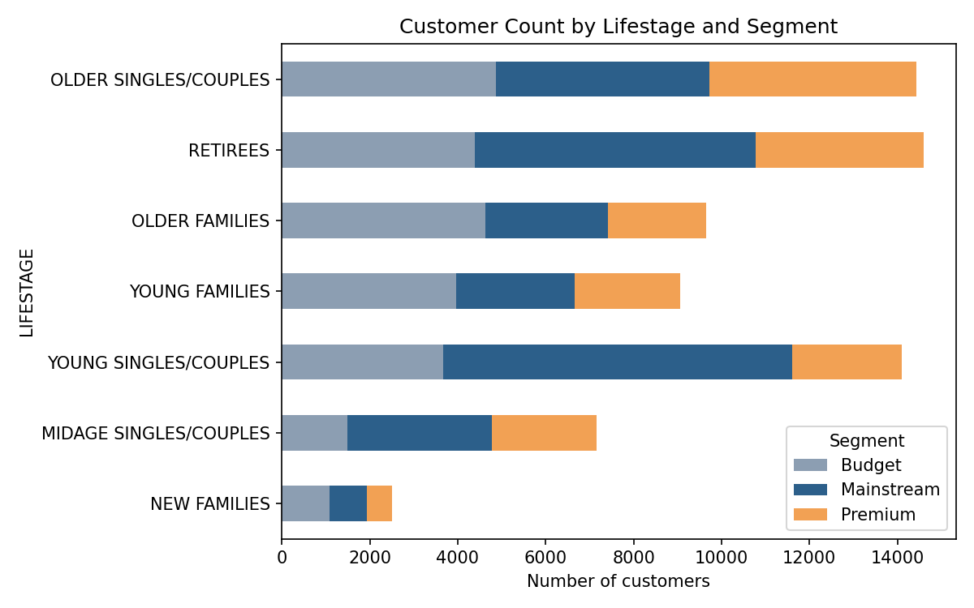
RETAIL ANALYTICS
Two different segments drive total sales — for opposite reasons
Older Families & Young Families (Budget) reach the top on high spend per customer. Mainstream Young Singles/Couples & Retirees reach the top on customer count alone.
Chip Category Review | Confidential
4

Slide 5
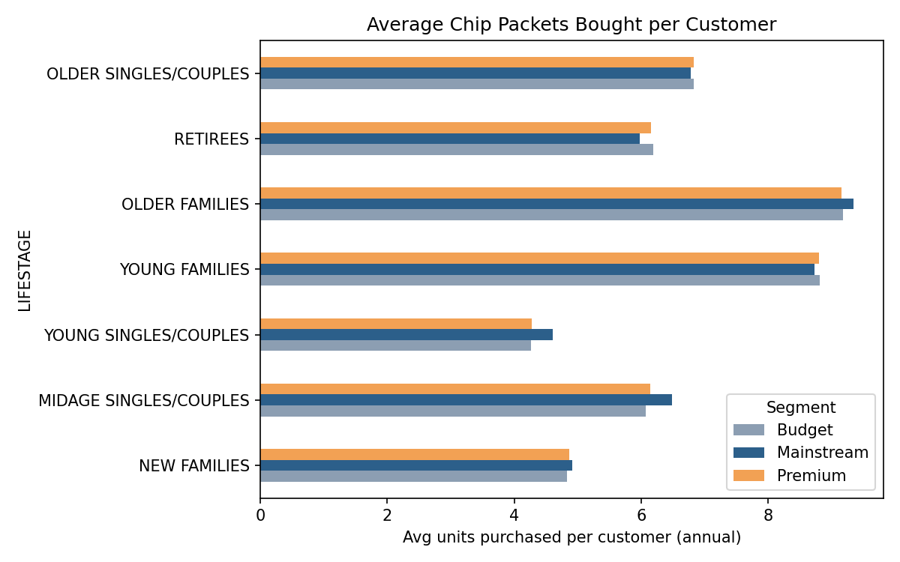
RETAIL ANALYTICS
Families are the heaviest chip consumers, per household
Older & Young Families buy ~9 packets/customer/year — noticeably more than singles, couples, or retirees (4–7), regardless of Budget/Mainstream/Premium tier.
Chip Category Review | Confidential
5

Slide 6
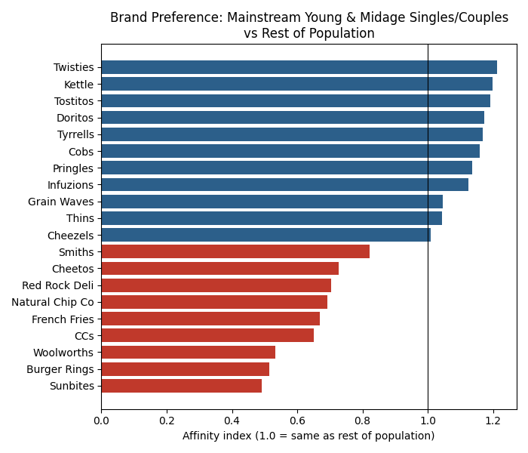
RETAIL ANALYTICS
Deep dive: Mainstream Young & Midage Singles/Couples
Large, price-tolerant, and currently under-leveraged relative to families
Chip Category Review | Confidential
6

Slide 7
RETAIL ANALYTICS
Trial Store Performance
Stores 77, 86 and 88 — did the new layout increase sales?
Chip Category Review | Confidential
7

Slide 8
RETAIL ANALYTICS
Matched control stores to isolate the trial's true effect
1
2
3
Match
Scale
Test
Ranked every full-year store by pre-trial correlation & similarity in sales and customer count
Scaled each control store to the trial store's pre-trial baseline level
Compared trial vs. scaled control during Feb–Apr 2019 against normal pre-trial variation (t-test)
Matched control stores
Trial store | Control store | Pre-trial scaling factor
77 | 233 | 1.02
86 | 155 | 0.97
88 | 237 | 1.00
Chip Category Review | Confidential
8

Slide 9
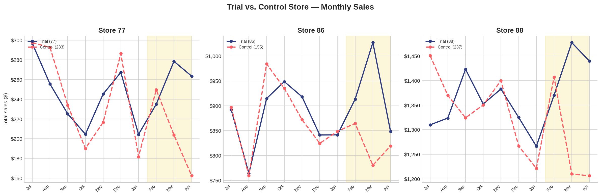
RETAIL ANALYTICS
Trial stores 77 and 88 pulled ahead of control from March onward
Shaded region = trial period (Feb–Apr 2019). Control store sales are scaled to each trial store's pre-trial baseline.
Chip Category Review | Confidential
9

Slide 10
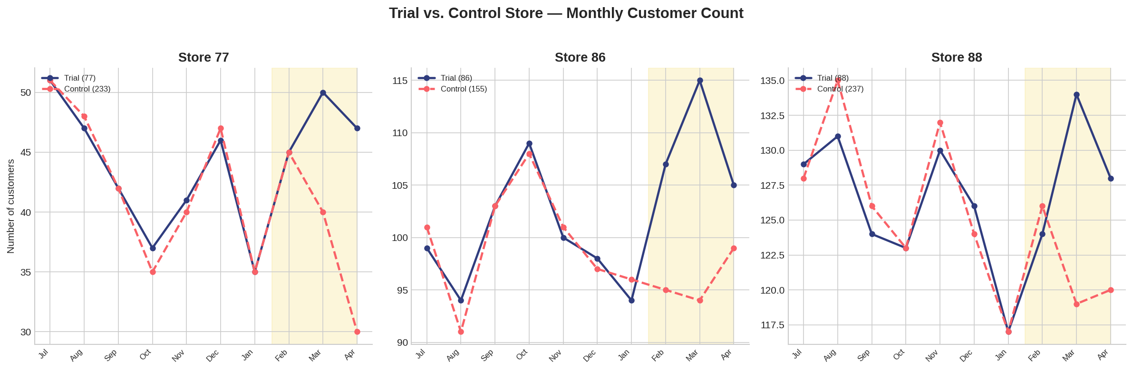
RETAIL ANALYTICS
Customer counts rose in every trial store during the trial
Store 86's customer count rose in all three trial months — even in months where total sales did not rise significantly.
Chip Category Review | Confidential
10

Slide 11
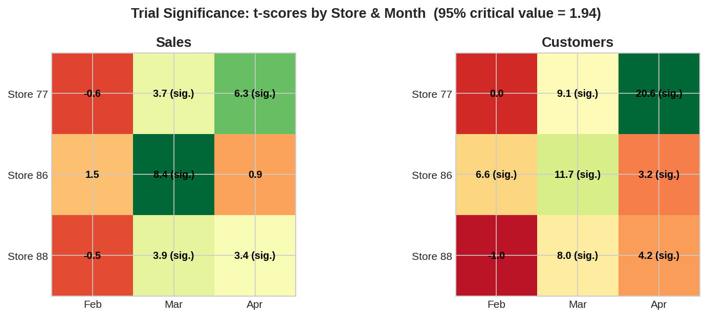
RETAIL ANALYTICS
Store 86 shows a real but less complete effect than 77 and 88
Stores 77 & 88: sales AND customers significant in Mar & Apr — a clean, sustained effect. Store 86: customers significant all 3 months, but sales only significant in March.
Chip Category Review | Confidential
11

Slide 12
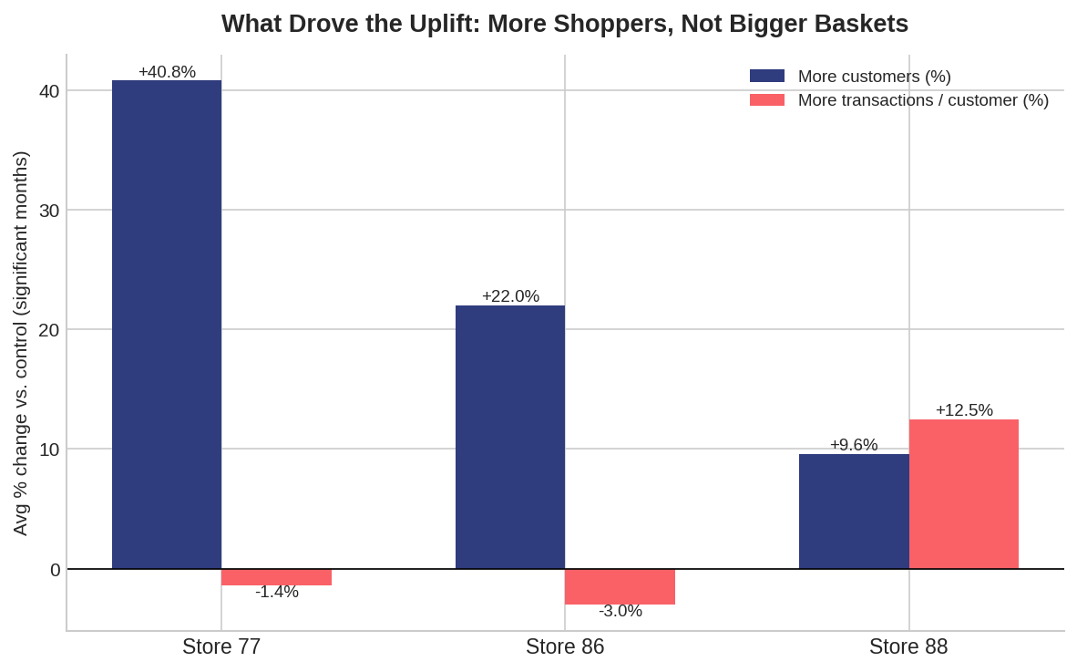
RETAIL ANALYTICS
The uplift is driven by more shoppers, not bigger baskets
Chip Category Review | Confidential
12

Slide 13
RETAIL ANALYTICS
Recommendations for Julia
1
Prioritise Kettle, Doritos, Tostitos, Tyrrells, Cobs & Pringles
in stores with a strong Mainstream Young/Midage Singles & Couples footprint — this segment is price-tolerant and already engaged.
2
Protect and grow the family segments
with multi-buy or family-pack promotions — they are the heaviest per-household consumers and their spend is driven by basket size, not price.
3
Roll out the trial store layout to stores 77 and 88's profile first
where the effect was sustained across two months — then investigate store 86's execution before a full rollout there.
4
Track customer counts as the primary rollout success metric
since the uplift is driven by new shoppers, not bigger baskets, across all three trial stores.
Chip Category Review | Confidential
13

Slide 14
RETAIL ANALYTICS
Thank you

