Slide 1
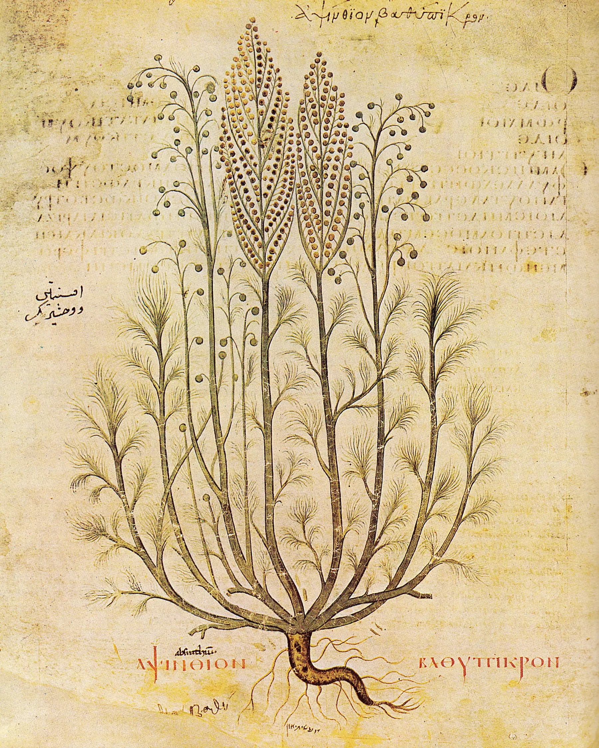

ἀψίνθιον
ETHNOHACK 2026 · TRACK 1 — TRADITIONAL KNOWLEDGE
Palimpsest
reading 2,000 years of herbal medicine against modern evidence
Dioscorides c. 60 CE
Culpeper 1653
Evidence 2026
Bridges to Track 2 (drug discovery) and Track 3 (conservation)
Code & data github.com/KaraAliOsman/palimpsest
Explorer karaaliosman.github.io/palimpsest
Team Palimpsest · EthnoHack 2026
ἀψίνθιον βαθύπικρον, “very bitter wormwood”
Vienna Dioscurides, c. 512 CE, public domain
Notes:
Palimpsest. A palimpsest is a manuscript that was scraped and written over, where the older text still shows through, like the faint Greek word behind this title: apsinthion, wormwood. On the right is wormwood as the Vienna Dioscurides painted it around 512. European herbal medicine was built the same way. Culpeper in 1653 wrote over Galen, who wrote over Dioscorides around 60 CE. We recover those layers computationally, starting from the original Greek, and ask two things: which plant–disease claims survived sixteen centuries of copying, and has modern science looked at them?
We are in Track 1, traditional knowledge, but the outputs feed Track 2, with a ranked and explainable drug-discovery shortlist, and Track 3, with conservation flags for the plants behind each lead. Everything is open: code and data on GitHub, and a live explorer at the address and QR code on screen.

Slide 2
Herbals are mined for leads, but resist being read
I · THE PROBLEM
THE LANGUAGE
THE PLANTS
Three questions
ἰκτερικούς θεραπεύει
ἀψίνθιον = ?
1
What persisted across 1,600 years of copying?
“treats the jaundiced”: inflected, accented Ancient Greek
Artemisia absinthium? A. pontica? A. maritima?
2
Does persistence carry a modern signal?
THE DISEASES
THE EVIDENCE
dropsy · king's evil · strangury
“supported”, compared with what?
3
What has modern science ignored?
today: oedema, scrofula, painful urination
earlier surveys counted supported claims with no base rate
Notes:
Historical herbals are among the oldest structured records of pharmacology, and they are regularly mined for drug leads. Four things make them hard to use as data.
The language: Dioscorides wrote in Ancient Greek. "Ikterikous therapeuei", he treats the jaundiced: inflected, accented, never meant to be searched. The plants: what exactly is apsinthion? Wormwood, most likely, but Pontic and sea wormwood are candidates too. The diseases: Culpeper treats dropsy, the king's evil and strangury, which today are oedema, scrofula and painful urination. And the evidence: earlier surveys counted how many historical claims were "supported", without asking how often an unclaimed use of the same plant would be supported too.
So we ask three questions. What persisted? Does persistence carry a modern signal? And what has modern science ignored?

Slide 3
Three layers of text and evidence, 60 CE to 2026
II · DATA
c. 60 CE
1,593 years
1653
373 years
2026
ORIGINAL GREEK
EARLY MODERN ENGLISH
OPEN DATABASES
Dioscorides, De materia medica
Culpeper, The Complete Herbal
Modern literature and data
822
328
48.2 M
chapters
monographs
Europe PMC records
Wellmann's critical edition (First1KGreek TEI). We repaired a nesting bug that hid 199 chapters from parsers.
Project Gutenberg #49513. Only the “government and virtues” sections are mined; astrology is ignored.
plus ClinicalTrials.gov, LOTUS phytochemistry via Wikidata, GBIF, IUCN status and MeSH
Notes:
We work with three layers. The oldest is Dioscorides' De materia medica, around 60 CE, in Wellmann's critical Greek edition as digitised by First1KGreek. While parsing the TEI we found a nesting bug that hides 199 chapters from standard parsers. We repair it, so we analyse all 822.
The middle layer is Culpeper's Complete Herbal of 1653: 328 monographs. We mine only the "government and virtues" sections and leave the astrology aside.
The top layer is today's evidence: Europe PMC, with 48.2 million records, ClinicalTrials.gov, LOTUS phytochemistry through Wikidata, GBIF occurrences, IUCN threat status, and MeSH as the shared disease vocabulary. Notice the timeline: sixteen centuries between the two herbals, under four between Culpeper and us. Every API response is cached, so the pipeline reruns offline and gives the same numbers.

Slide 4
From the original words to one shared key
III · METHOD: READING ACROSS ERAS
DIOSCORIDES · DE MATERIA MEDICA 3.23
1 NAME CONCORDANCE
ἀψίνθιον … καὶ ἀνορεξίας καὶ ἰκτερικούς θεραπεύει
ἀψίνθιον · Wormwood → Artemisia absinthium
SHARED KEY
confidence high · all names: 99.2% on GBIF; 64% / 72% agree with independent Greek / English checks
Artemisia absinthium
× Jaundice
wormwood … “and treats loss of appetite and the jaundiced”
CULPEPER · COMPLETE HERBAL · WORMWOOD
2 INDICATION EXTRACTION
MeSH D007565
claimed in both → persistent
“The sun never shone upon a better herb for the yellow jaundice than this”
ικτερ- · yellow jaundice → Jaundice
accent-free, offset-preserving Greek stems · 17th-century English disease crosswalk
1653, “government and virtues”
85
10,399
BLIND REFERENCE EVALUATION · 50 + 49 EVALUABLE RANDOM MONOGRAPHS
Greek precision 0.88 · recall 0.83 · F1 0.86 [0.81–0.89]
English precision 0.90 · recall 0.90 · F1 0.90 [0.88–0.92]
Reference annotation AI-assisted; human double annotation is next.
MeSH-linked indication concepts
claims, each with a verbatim span
Notes:
This is the reading step, on one real example. Dioscorides, book three, chapter twenty-three: apsinthion "treats the jaundiced". Culpeper on wormwood: "the sun never shone upon a better herb for the yellow jaundice".
First, a cross-era name concordance maps the Greek lemma and the English heading to one accepted GBIF taxon, Artemisia absinthium, with a confidence level, alternatives and a written justification, checked against independent names: 99.2% resolve on GBIF, and 64% and 72% agree with Wikidata Greek and GBIF English names, which are lower bounds.
Second, extraction. For Greek we strip accents and breathings without changing the string length, so the stem "ikter-" catches every inflection and still points to the exact characters in the source. For English, a crosswalk translates 17th-century disease words. Both land on 85 MeSH concepts: 10,399 claims in all. Against a blind reference annotation, F1 is 0.86 for Greek and 0.90 for English. That reference was AI-assisted, so human double annotation is our next step.

Slide 5
Each question is tested against its own control
IV · METHOD: TESTING AGAINST CHANCE
Q1 · TRANSMISSION
Q2 · MODERN SIGNAL
Did Culpeper repeat Dioscorides more often than chance?
Is a claimed use studied more than unclaimed uses of the same plant?
observed
Artemisia absinthium
claimed
12 random unclaimed indications, same plant
chance: 10,000 label shuffles
log μ = log E + β · group + γ_{indication}
Culpeper's claim sets are shuffled among the shared plants: claims per plant and disease frequencies stay fixed.
Logit with indication fixed effects → odds of any study; Poisson GLM with volume offset → depth. Cluster-robust by plant.
ROBUSTNESS
Genus level · high-confidence IDs only · therapeutic categories
TRANSPARENT LEAD SCORE
0.35 persistence + 0.25 chemistry + 0.25 gap + 0.15 tractability
Notes:
Each question is tested against its own control. For transmission, the statistic is the number of plant–indication pairs claimed by both authors. To estimate chance, we shuffle Culpeper's claim sets among the shared plants ten thousand times. That keeps how much each author says per plant and how common each disease is, and breaks only the same-plant link.
For modern evidence, the main confounder is that some plants are simply studied far more. So we compare within the plant: each claimed indication against twelve random indications that neither herbal claims for it. A Poisson model with indication fixed effects and an offset for expected co-mentions gives rate ratios, clustered by plant; a logit gives the odds of any study at all.
Everything is rerun at genus level and with high-confidence identifications only. The lead score is a transparent weighted sum; safety and conservation are flags, never folded in.

Slide 6
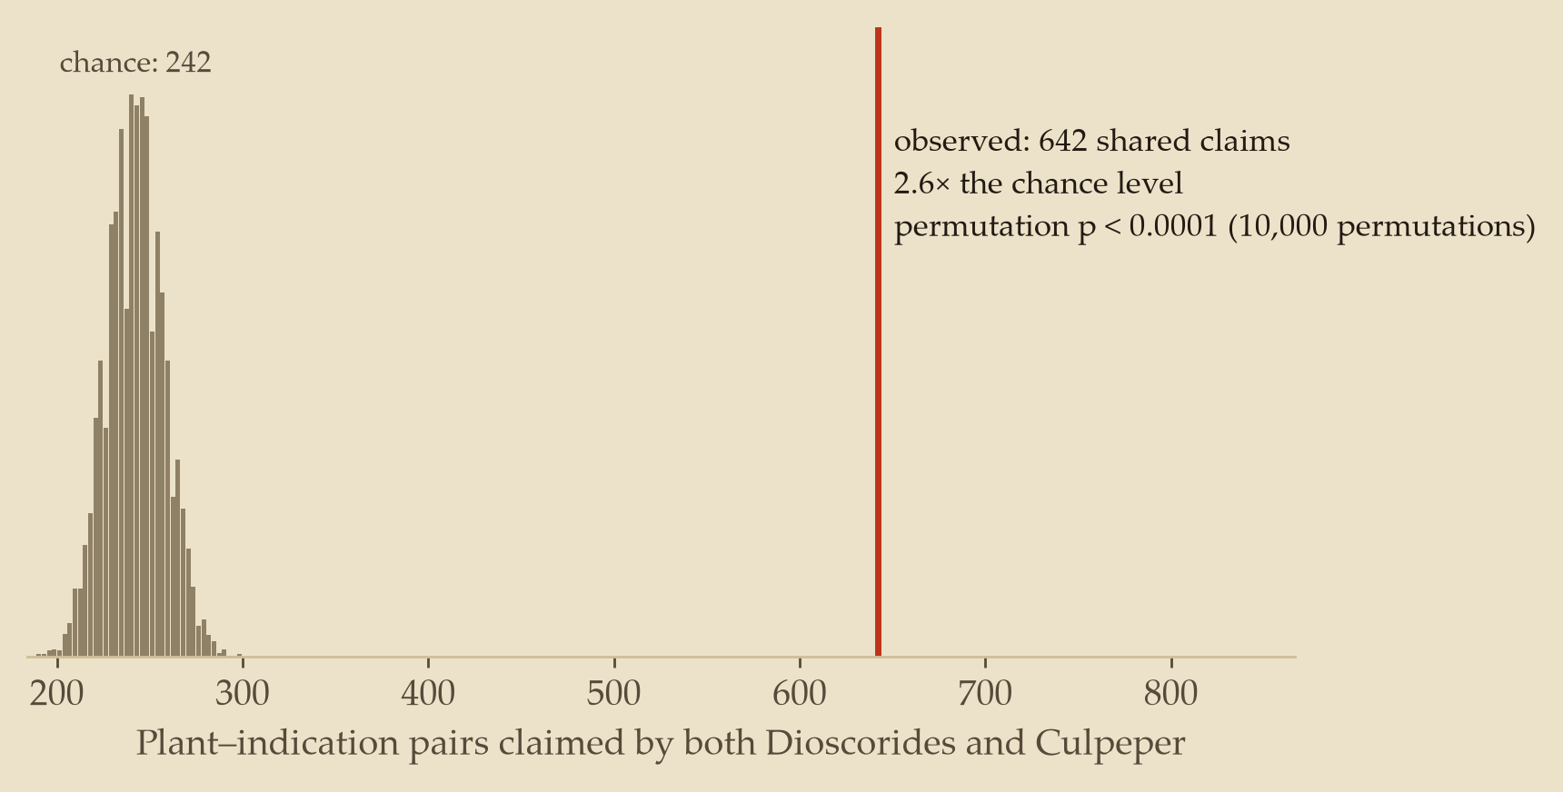
Culpeper repeats Dioscorides 2.6× more often than chance
V · RESULT: TRANSMISSION
642
plant–indication pairs claimed by both authors
242
expected if Culpeper's claims were shuffled among the same plants
p < 0.0001 · z = 26.1
one-sided, 10,000 permutations
2.1× even when matching plants by entry length; 1.6× even within the same botanical family (both p < 0.001)
Genus level 2.39× · high-confidence IDs 2.49×
136 species in both herbals; 36% of Culpeper's claims for them were already in Dioscorides (13% expected by chance). Persistence of a textual tradition, not independent rediscovery.
Notes:
First result: transmission. Among the 136 species identified in both herbals, 642 plant–indication pairs are claimed by both authors. If Culpeper's claims were shuffled among the same plants, we would expect about 242: 2.6 times chance, z of 26.1, permutation p below 0.0001. Put differently, 36% of what Culpeper says about these plants was already in Dioscorides, against 13% by chance.
We also tried stricter nulls. Matching plants by how long their entries are, it is still 2.1 times; shuffling only within the same botanical family, 1.6 times; both p below 0.001. It also holds at genus level and with high-confidence identifications only.
One caution: Culpeper is not independent of Dioscorides; the tradition ran through Galen, Mattioli and Gerard. This measures persistence of a textual tradition, not independent rediscovery.

Slide 7
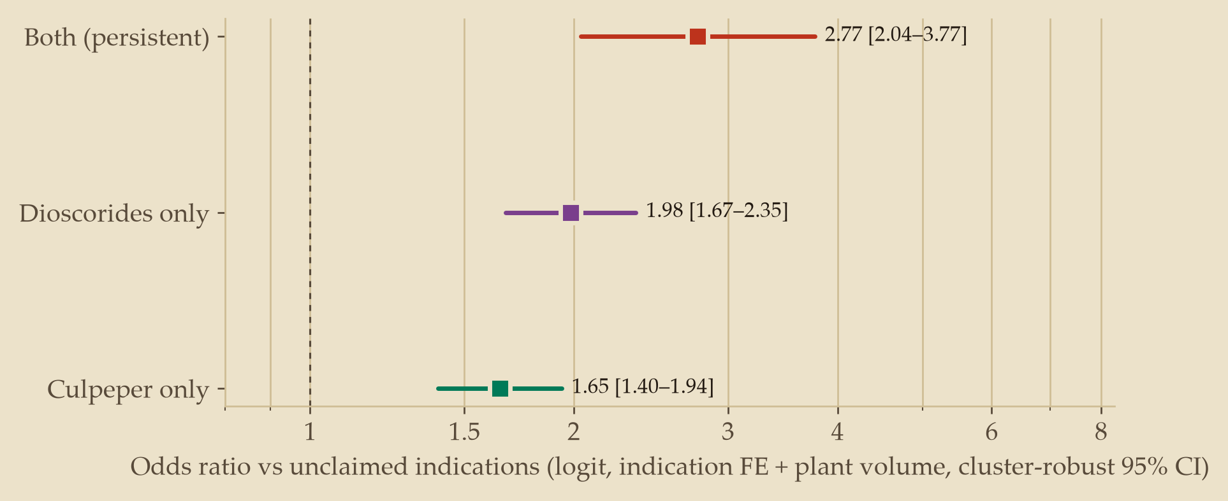
Claimed uses are more often studied, not studied more
VI · RESULT: MODERN EVIDENCE
AT LEAST ONE CO-MENTIONING PAPER
45% vs 32%
persistent claims vs matched unclaimed indications of the same plants
Both herbals
45% vs 32% · OR 2.77
Dioscorides only
37% vs 25% · OR 1.98
Culpeper only
35% vs 24% · OR 1.65
BUT NOT IN DEPTH
Once studied, not studied more: rate ratio 1.04 [0.61–1.76], n.s. That gap is what the leads target.
Logit with indication fixed effects and plant research volume, cluster-robust 95% CI; within-plant Wilcoxon p = 10⁻¹⁵. Co-mention measures research attention, not efficacy.
ROBUST TO SYNONYMS
With synonym-expanded search (e.g. rosemary 211 → 2,179 papers) conclusions hold: none of the 60 leads drops out; OR 2.48 [1.84–3.36]; once studied RR 1.03, n.s.
Notes:
Second result: does persistence carry a modern signal? Partly. Against matched controls, unclaimed indications of the same plants, claimed uses are more often investigated at all: 45% of persistent claims have at least one modern paper, against 32% of their controls; 37% against 25% for Dioscorides-only and 35% against 24% for Culpeper-only. With indication fixed effects the odds ratio is 2.77 for persistent claims, 1.98 and 1.65 for single-source claims; the within-plant test gives p of ten to the minus fifteen.
But once studied, they are not studied more: the rate ratio is 1.04, not significant. Looked at, not studied in depth. That gap is what our leads target.
We reran everything with synonym-expanded searches, which take rosemary from 211 to 2,179 papers: the odds ratio is still 2.48, the once-studied rate ratio 1.03, and none of the leads drops out. Co-mention measures attention, not efficacy.

Slide 8
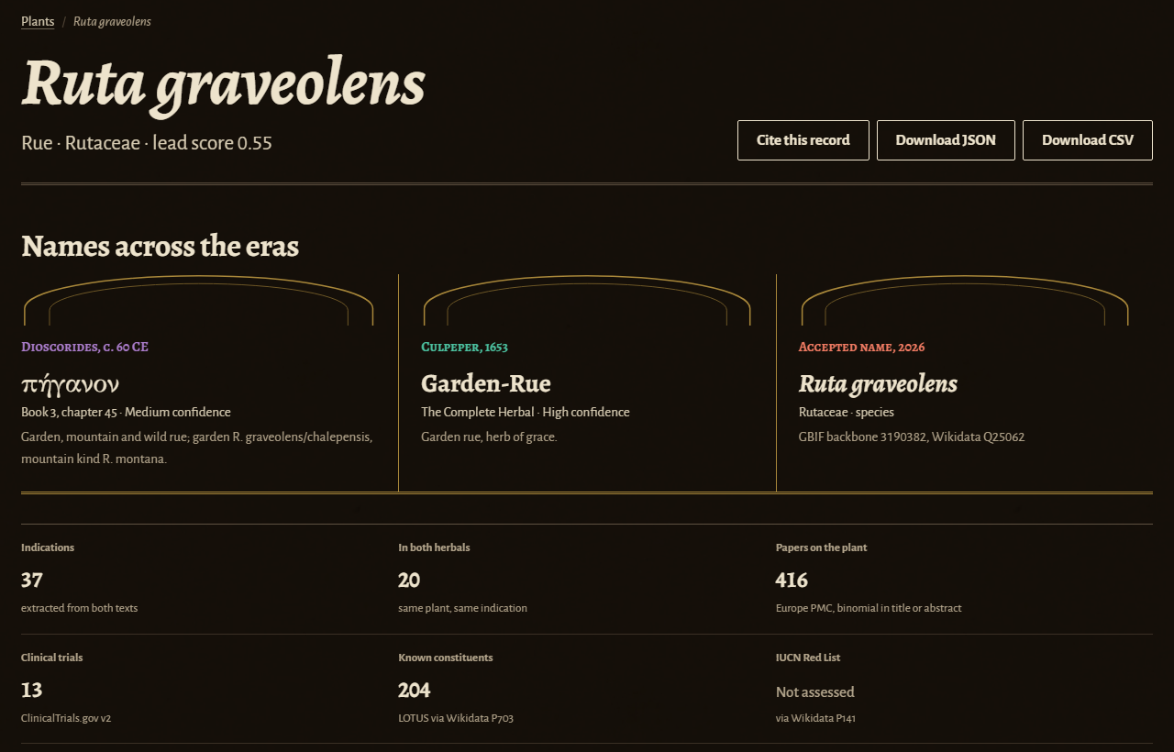
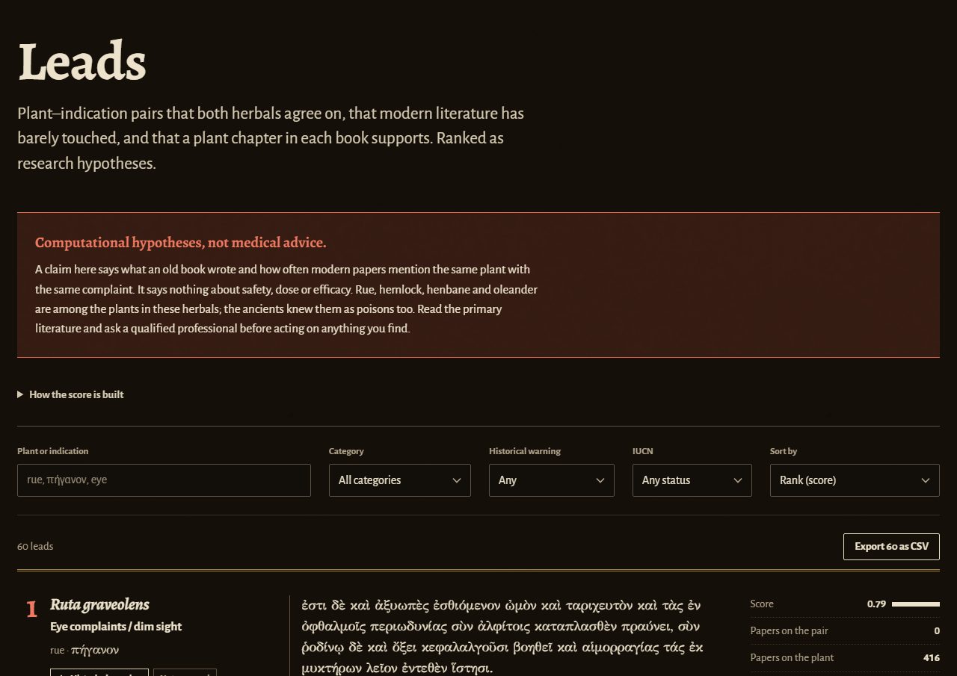
Every number links back to the passage it came from
VII · DEMONSTRATION
Plant page names across the eras, every claim highlighted in the Greek and English, evidence per indication
Leads ranked, filterable, with historical warnings and the Greek quotation
Notes:
This is the explorer, live at karaaliosman.github.io/palimpsest. On the left is a plant page: Dioscorides' Greek with every extracted claim highlighted in place, Culpeper's English beside it, and for each indication the modern evidence: papers, trials and the expected count. Nothing is a black box. Click a number and you land on the sentence it came from.
On the right is the leads table: persistent but under-studied pairs, ranked, filterable by therapeutic area, with phytochemistry and conservation status, and the score broken into its four parts. It is a static site built from the same JSON files the pipeline writes, so anyone can audit or reuse the data.
Live demo, if time allows: open Rue, click an indication, then switch to Leads.

Slide 9
60 persistent but under-studied leads
VIII · LEADS AND IMPACT
# | Plant | Indication | D + C | Papers | Compounds | Safety
1 | Ruta graveolens | Eye complaints / dim sight | 2 + 1 | 0 | 204 | flag
2 | Vicia faba | Bleeding / staunching blood | 1 + 1 | 0 | 297 | flag
3 | Ocimum basilicum | Venomous bites & stings | 2 + 3 | 0 | 268 | –
4 | Juglans regia | Ulcers & sores | 1 + 4 | 0 | 190 | flag
5 | Cannabis sativa | Ear-ache / running ears | 1 + 2 | 1 | 528 | flag
Drug discovery · Track 2
An explainable shortlist with LOTUS constituents attached
Conservation · Track 3
No lead depends on a species assessed as threatened (19 of 60 assessed by IUCN)
ETHCSTWIN knowledge graph
20,425 nodes, 51,430 edges: 10,399 claims with quote and offsets, 18,498 compounds
Top 5 of 60 diversified leads from 517 candidates: persistent pairs with ≤ 4 co-mentioning papers. D + C = mentions in Dioscorides + Culpeper; compounds from LOTUS. Flag = the historical text itself warns of harm (shown, never scored).
Hypotheses for laboratory follow-up, not therapeutic claims.
History of medicine
Transmission measured passage by passage, from the Greek
Notes:
What comes out is a ranked shortlist: 60 diversified leads, chosen from 517 candidates, where both herbals agree but modern papers are scarce. The top five are on screen: rue for the eyes, broad bean to staunch bleeding, basil for venomous bites, walnut for ulcers and hemp for ear-ache. At most one paper pairs each plant with its indication, yet each has a known chemistry in LOTUS. Four carry a flag because the historical texts themselves warn of harm, and rue is a known toxic plant; flags are shown, never scored.
For conservation, no lead depends on a species assessed as threatened, though only 19 of the 60 have been assessed by IUCN. For ETHCSTWIN, everything is a knowledge graph of 20,425 nodes and 51,430 edges, where each of the 10,399 claims keeps its verbatim quote and offsets.

Slide 10
What these results are not, and what comes next
IX · RESPONSIBLE RESEARCH AND NEXT STEPS
Responsible research
Limitations
Next
Computational hypotheses, never medical advice; several remedies are toxic
Only published, openly licensed texts; nothing collected from living communities
AI-assisted curation disclosed; every row has a confidence level and a justification
Circularity: tradition motivates research, so co-mention ≠ efficacy
A co-mention may report a null or toxic result
Ancient plants are identified retrospectively
Culpeper inherits Dioscorides: persistence, not rediscovery
Searches use accepted binomials; a synonym-expanded rerun (rosemary 211 → 2,179 papers) changes no conclusion
Add Galen, Pliny, Byzantine and Arabic sources to trace the whole chain
Outcome-aware evidence: classify findings, add ChEMBL targets
Expert review with ETHCSTWIN, then lab follow-up of top leads
Code & data github.com/KaraAliOsman/palimpsest
Explorer karaaliosman.github.io/palimpsest
Code MIT · Greek-derived data CC BY-SA 4.0
Notes:
To be explicit about limits. These are computational hypotheses, never medical advice, and several of these remedies are toxic. Modern research is partly motivated by tradition, so co-mention is attention plus evidence, not efficacy, and a co-mention can be a negative finding. Ancient plants are identified retrospectively; that is why every identification has a confidence level and why we rerun everything at genus level. And Culpeper inherits Dioscorides, so persistence means a claim was kept, not rediscovered. Searches use accepted binomials; a synonym-expanded rerun changes no conclusion.
We used only published, openly licensed texts, and AI assistance in curation is disclosed row by row.
Next: add Galen, Pliny, Byzantine and Arabic sources to trace the full chain; move from co-mention to outcome-aware evidence; and review the concordance and top leads with ETHCSTWIN pharmacognosists and historians before any lab work. Thank you. The code, data and explorer are open.

