Slide 1
House Price Trends!
@lenkiefer

Slide 2
AK
12-month percent change in house prices
NSA index
20%
10%
0%
-10%
-20%
1980
1990
2000
2010
@lenkiefer Source: Freddie Mac House Price Index through June 2017

Slide 3
AL
12-month percent change in house prices
NSA index
10%
5%
0%
-5%
1980
1990
2000
2010
@lenkiefer Source: Freddie Mac House Price Index through June 2017

Slide 4
AR
12-month percent change in house prices
NSA index
10%
5%
0%
-5%
1980
1990
2000
2010
@lenkiefer Source: Freddie Mac House Price Index through June 2017

Slide 5
AZ
12-month percent change in house prices
NSA index
40%
20%
0%
-20%
1980
1990
2000
2010
@lenkiefer Source: Freddie Mac House Price Index through June 2017

Slide 6
CA
12-month percent change in house prices
NSA index
30%
20%
10%
0%
-10%
-20%
1980
1990
2000
2010
@lenkiefer Source: Freddie Mac House Price Index through June 2017

Slide 7
CO
12-month percent change in house prices
NSA index
20%
10%
0%
1980
1990
2000
2010
@lenkiefer Source: Freddie Mac House Price Index through June 2017

Slide 8
CT
12-month percent change in house prices
NSA index
30%
20%
10%
0%
-10%
1980
1990
2000
2010
@lenkiefer Source: Freddie Mac House Price Index through June 2017

Slide 9
DC
12-month percent change in house prices
NSA index
20%
10%
0%
1980
1990
2000
2010
@lenkiefer Source: Freddie Mac House Price Index through June 2017

Slide 10
DE
12-month percent change in house prices
NSA index
10%
0%
1980
1990
2000
2010
@lenkiefer Source: Freddie Mac House Price Index through June 2017

Slide 11
FL
12-month percent change in house prices
NSA index
30%
20%
10%
0%
-10%
-20%
1980
1990
2000
2010
@lenkiefer Source: Freddie Mac House Price Index through June 2017

Slide 12
GA
12-month percent change in house prices
NSA index
15%
10%
5%
0%
-5%
-10%
1980
1990
2000
2010
@lenkiefer Source: Freddie Mac House Price Index through June 2017

Slide 13
HI
12-month percent change in house prices
NSA index
60%
40%
20%
0%
-20%
-40%
1980
1990
2000
2010
@lenkiefer Source: Freddie Mac House Price Index through June 2017

Slide 14
IA
12-month percent change in house prices
NSA index
10%
5%
0%
-5%
1980
1990
2000
2010
@lenkiefer Source: Freddie Mac House Price Index through June 2017

Slide 15
ID
12-month percent change in house prices
NSA index
20%
10%
0%
-10%
1980
1990
2000
2010
@lenkiefer Source: Freddie Mac House Price Index through June 2017

Slide 16
IL
12-month percent change in house prices
NSA index
10%
0%
-10%
1980
1990
2000
2010
@lenkiefer Source: Freddie Mac House Price Index through June 2017

Slide 17
IN
12-month percent change in house prices
NSA index
15%
10%
5%
0%
-5%
1980
1990
2000
2010
@lenkiefer Source: Freddie Mac House Price Index through June 2017

Slide 18
KS
12-month percent change in house prices
NSA index
15%
10%
5%
0%
-5%
1980
1990
2000
2010
@lenkiefer Source: Freddie Mac House Price Index through June 2017

Slide 19
KY
12-month percent change in house prices
NSA index
10%
5%
0%
1980
1990
2000
2010
@lenkiefer Source: Freddie Mac House Price Index through June 2017

Slide 20
LA
12-month percent change in house prices
NSA index
20%
10%
0%
1980
1990
2000
2010
@lenkiefer Source: Freddie Mac House Price Index through June 2017

Slide 21
MA
12-month percent change in house prices
NSA index
30%
20%
10%
0%
-10%
1980
1990
2000
2010
@lenkiefer Source: Freddie Mac House Price Index through June 2017

Slide 22
MD
12-month percent change in house prices
NSA index
20%
10%
0%
-10%
1980
1990
2000
2010
@lenkiefer Source: Freddie Mac House Price Index through June 2017

Slide 23
ME
12-month percent change in house prices
NSA index
10%
0%
1980
1990
2000
2010
@lenkiefer Source: Freddie Mac House Price Index through June 2017

Slide 24
MI
12-month percent change in house prices
NSA index
10%
0%
-10%
1980
1990
2000
2010
@lenkiefer Source: Freddie Mac House Price Index through June 2017

Slide 25
MN
12-month percent change in house prices
NSA index
10%
0%
-10%
1980
1990
2000
2010
@lenkiefer Source: Freddie Mac House Price Index through June 2017

Slide 26
MO
12-month percent change in house prices
NSA index
15%
10%
5%
0%
-5%
1980
1990
2000
2010
@lenkiefer Source: Freddie Mac House Price Index through June 2017

Slide 27
MS
12-month percent change in house prices
NSA index
15%
10%
5%
0%
-5%
-10%
1980
1990
2000
2010
@lenkiefer Source: Freddie Mac House Price Index through June 2017

Slide 28
MT
12-month percent change in house prices
NSA index
20%
10%
0%
1980
1990
2000
2010
@lenkiefer Source: Freddie Mac House Price Index through June 2017

Slide 29
NC
12-month percent change in house prices
NSA index
10%
5%
0%
-5%
1980
1990
2000
2010
@lenkiefer Source: Freddie Mac House Price Index through June 2017

Slide 30
ND
12-month percent change in house prices
NSA index
20%
10%
0%
-10%
1980
1990
2000
2010
@lenkiefer Source: Freddie Mac House Price Index through June 2017

Slide 31
NE
12-month percent change in house prices
NSA index
15%
10%
5%
0%
1980
1990
2000
2010
@lenkiefer Source: Freddie Mac House Price Index through June 2017

Slide 32
NH
12-month percent change in house prices
NSA index
20%
10%
0%
-10%
1980
1990
2000
2010
@lenkiefer Source: Freddie Mac House Price Index through June 2017

Slide 33
NJ
12-month percent change in house prices
NSA index
20%
10%
0%
1980
1990
2000
2010
@lenkiefer Source: Freddie Mac House Price Index through June 2017

Slide 34
NM
12-month percent change in house prices
NSA index
10%
0%
1980
1990
2000
2010
@lenkiefer Source: Freddie Mac House Price Index through June 2017

Slide 35
NV
12-month percent change in house prices
NSA index
40%
20%
0%
-20%
1980
1990
2000
2010
@lenkiefer Source: Freddie Mac House Price Index through June 2017

Slide 36
NY
12-month percent change in house prices
NSA index
20%
15%
10%
5%
0%
-5%
1980
1990
2000
2010
@lenkiefer Source: Freddie Mac House Price Index through June 2017

Slide 37
OH
12-month percent change in house prices
NSA index
10%
5%
0%
-5%
1980
1990
2000
2010
@lenkiefer Source: Freddie Mac House Price Index through June 2017

Slide 38
OK
12-month percent change in house prices
NSA index
20%
10%
0%
-10%
1980
1990
2000
2010
@lenkiefer Source: Freddie Mac House Price Index through June 2017

Slide 39
OR
12-month percent change in house prices
NSA index
20%
10%
0%
-10%
1980
1990
2000
2010
@lenkiefer Source: Freddie Mac House Price Index through June 2017

Slide 40
PA
12-month percent change in house prices
NSA index
15%
10%
5%
0%
-5%
1980
1990
2000
2010
@lenkiefer Source: Freddie Mac House Price Index through June 2017

Slide 41
RI
12-month percent change in house prices
NSA index
30%
20%
10%
0%
-10%
1980
1990
2000
2010
@lenkiefer Source: Freddie Mac House Price Index through June 2017

Slide 42
SC
12-month percent change in house prices
NSA index
10%
5%
0%
-5%
1980
1990
2000
2010
@lenkiefer Source: Freddie Mac House Price Index through June 2017

Slide 43
SD
12-month percent change in house prices
NSA index
15%
10%
5%
0%
-5%
1980
1990
2000
2010
@lenkiefer Source: Freddie Mac House Price Index through June 2017

Slide 44
TN
12-month percent change in house prices
NSA index
10%
5%
0%
-5%
1980
1990
2000
2010
@lenkiefer Source: Freddie Mac House Price Index through June 2017

Slide 45
TX
12-month percent change in house prices
NSA index
10%
0%
1980
1990
2000
2010
@lenkiefer Source: Freddie Mac House Price Index through June 2017

Slide 46
UT
12-month percent change in house prices
NSA index
20%
10%
0%
-10%
1980
1990
2000
2010
@lenkiefer Source: Freddie Mac House Price Index through June 2017

Slide 47
VA
12-month percent change in house prices
NSA index
20%
10%
0%
-10%
1980
1990
2000
2010
@lenkiefer Source: Freddie Mac House Price Index through June 2017

Slide 48
VT
12-month percent change in house prices
NSA index
15%
10%
5%
0%
-5%
1980
1990
2000
2010
@lenkiefer Source: Freddie Mac House Price Index through June 2017

Slide 49
WA
12-month percent change in house prices
NSA index
20%
10%
0%
-10%
1980
1990
2000
2010
@lenkiefer Source: Freddie Mac House Price Index through June 2017

Slide 50
WI
12-month percent change in house prices
NSA index
10%
0%
-10%
1980
1990
2000
2010
@lenkiefer Source: Freddie Mac House Price Index through June 2017

Slide 51
WV
12-month percent change in house prices
NSA index
20%
10%
0%
-10%
-20%
1980
1990
2000
2010
@lenkiefer Source: Freddie Mac House Price Index through June 2017

Slide 52
WY
12-month percent change in house prices
NSA index
20%
10%
0%
-10%
1980
1990
2000
2010
@lenkiefer Source: Freddie Mac House Price Index through June 2017

Slide 53
CA
12-month percent change in house prices
NSA index
30%
20%
10%
0%
-10%
-20%
1980
1990
2000
2010
@lenkiefer Source: Freddie Mac House Price Index through June 2017

Slide 54
CO
12-month percent change in house prices
NSA index
20%
10%
0%
1980
1990
2000
2010
@lenkiefer Source: Freddie Mac House Price Index through June 2017

Slide 55
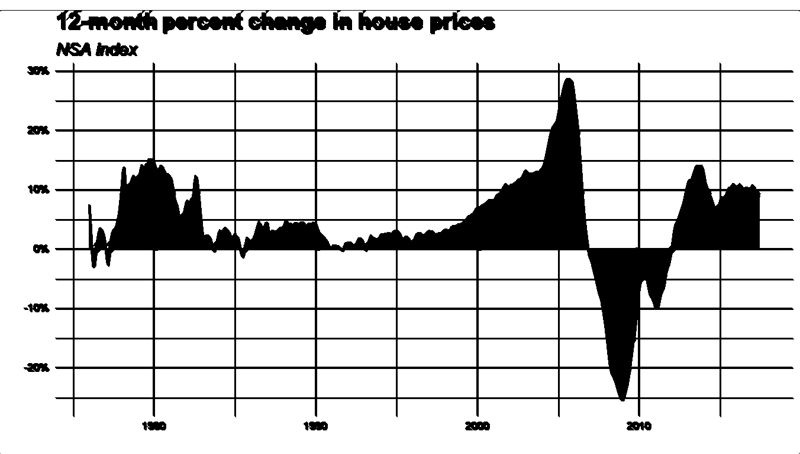
FL
@lenkiefer Source: Freddie Mac House Price Index through June 2017

Slide 56
NY
12-month percent change in house prices
NSA index
20%
15%
10%
5%
0%
-5%
1980
1990
2000
2010
@lenkiefer Source: Freddie Mac House Price Index through June 2017

Slide 57
VA
12-month percent change in house prices
NSA index
20%
10%
0%
-10%
@lenkiefer Source: Freddie Mac House Price Index through June 2017
1980
1990
2000
2010

Slide 58
DC
12-month percent change in house prices
NSA index
20%
10%
0%
1980
1990
2000
2010
@lenkiefer Source: Freddie Mac House Price Index through June 2017

