Slide 1
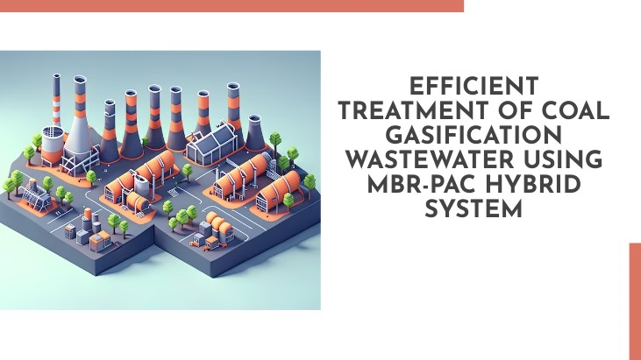
DESIGN CREDIT COURSE UNDER VIKKY ANAND

Slide 2
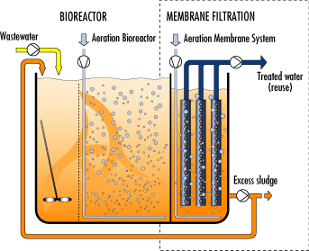
INTRO DUCTION
CGW(coal gasification wastewater) contains high concentration of pollutants.
It causes severe deterioration of the environment.
It mainly comprises phenolic compounds, polycyclic aromatic hydrocarbons, nitrogenous heterocyclic compounds, cyanide, and thiocyanate.
ZLD-zero liquid discharge system is a wastewater management system that ensures no environmental CGW discharge.
UASB uses an anaerobic process while forming a blanket of granular sludge, which suspends in the tank. Wastewater flows upward through the veil and is processed (degraded) by the anaerobic microorganisms. The upward flow, combined with the settling action of gravity, suspends the blanket with the aid of flocculants.

Slide 3
Preferred Anaerobic and Aerobic Treatment Processes for Contaminated Groundwater
Preferred Anaerobic Process: Anaerobic treatment processes have been preferred for treating CGW. The passage cites anaerobic processes like a two-continuous up-flow anaerobic sludge bed (UASB) system and a thermophilic anaerobic system as options for effective pollutant removal.
Thermophilic Anaerobic System: The thermophilic anaerobic system is reported to yield improved removal of pollutants like chemical oxygen demand (COD) and total phenols (TPh) compared to the mesophilic anaerobic system.
Aerobic Treatment for Compliance: To meet stringent discharge standards, aerobic processes are necessary. The passage mentions a laboratory-scale moving bed biofilm reactor that achieved high COD, TPh, SCN-, and NH4+ removal efficiencies.
Activated Carbon and Adsorption: Powdered activated carbon technology (PACT) is highlighted as a promising method for removing aromatic compounds like phenol from CGW. This method involves coupling activated sludge with activated carbon adsorption to enhance pollutant removal.

Slide 4
WHAT IS MBR-PAC HYBRID SYSTEM
MBR for ZLD: Membrane bioreactors (MBRs) are deemed suitable for achieving ZLD due to high effluent quality, low excess sludge production, and high organic loading rates. However, membrane fouling is a challenge.
MBR-PAC Hybrid Process: The combination of MBR with powdered activated carbon (PAC) is suggested to counteract membrane fouling and enhance the biodegradation of extracellular polymeric substances (EPS) and total organic carbon (TOC). PAC promotes the biodegradation of proteins and polysaccharides due to increased bacterial attachment.
MBR-PAC for CGW Treatment: The study proposes the MBR-PAC process as a feasible and efficient approach for treating CGW, offering benefits like shorter hydraulic residence time (HRT) and improved pollutant removal efficiency.

Slide 5
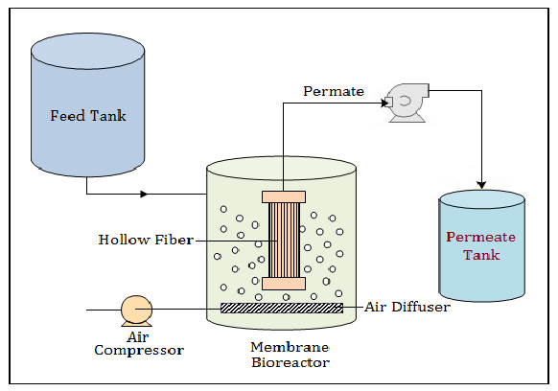
METHOD AND MATERIAL
1) EXPERIMENTAL SETUP-
MBR reactor constructed with the use of Plexiglas.
Length=50cm, width=20cm, height=120cm.
What is Plexiglas-Plexiglass is a solid, transparent plastic made of polymethyl methacrylate, or a transparent acrylic plastic often used in place of glass.
A flat sheet membrane is there in MBR, which is made up of CHLORINATED POLYVINYL CHLORIDE, which have a pore size of 0.4um and filtration area of 0.11 m2
Temprature is maintained at 28-32 degree of celsius.

Slide 6
2) CHARACTERISTICS OF SLUDGE AND CGW-
Seed Sludge: The seed sludge used for the experiment was obtained from a full-scale aerobic tank that had been treating complex greywater at China Coal Longhua Harbin Coal Chemical Industry for over 3 years. The sludge from this tank was grey-black in color and had good settlement properties.
Inoculation and Sludge Characteristics: The suspended solids (SS) in the membrane bioreactor (MBR) were inoculated with approximately 5 g/L of sludge. The volatile suspended solids (VSS) to suspended solids (SS) ratio was around 0.7. This suggests that the sludge used for inoculation was relatively stable and well-suited for the MBR process.
Inoculation and Sludge Characteristics: The suspended solids (SS) in the membrane bioreactor (MBR) were inoculated with approximately 5 g/L of sludge. The volatile suspended solids (VSS) to suspended solids (SS) ratio was around 0.7. This suggests that the sludge used for inoculation was relatively stable and well-suited for the MBR process
MACRO NUTRIENT IN FEED
50mg/L | MgSo4.7H2O
20mg/L | K2HPo4
20mg/L | CaCl2.2H2o
15mg/L | FeSo4.7H2o
10mg/L | KH2Po4
15mM | NaHCo3
COMPOSITION OF COMPLEX GREY WATER
PARAMETER | RANGE
COD(chemical oxygen demand) | 2-3 g/L
BOD(biochemical oxygen demand) | 500-700 mg/L
TPh(total phenols) | 400-600 mg/L
Volatile acids | 5-10 mg/L
NH4+ | 120-200 mg/L
pH | 6.5-8
BOD:COD | 0.29
Phenolic compound | 60% of COD

Slide 7
3) START-UP & OPERATION
Operational Conditions:
Continuous operation of the MBR.
Constant Hydraulic Residence Time (HRT) of 12 hours.
Constant air flow of 0.3 m3/h using an aeration pump.
Maintained Dissolved Oxygen (DO) concentration between 3 and 6 mg/L.
Influent and effluent obtained by peristaltic pumps.
Effluent operated using a time controller with a filtration/pause cycle of 8 min/2 min.
Transmembrane pressure (TMP) measured using a vacuum manometer to regulate permeate flow.
Initial Period:
Influent initially diluted with tap water to acclimatize microbes to the complex greywater (CGW).
Concentrations of COD, TPh, and NH4+ in influent increased stepwise.
Stage I operated for 52 days.
Influent COD increased from 439 mg/L to 1.78 g/L.
Influent TPh increased from 117 to 414 mg/L.
Influent NH4+ increased from 25 to 100 mg N/L.
Methanol (250 mg/L COD) added in stage I to facilitate treating CGW by aerobic process.
Stage II (Day 53–110):
Study focused on the influence of PAC on MBR performance.
PAC added five times with a dosage of 1 g/L each time.
Influent COD, TPh, and NH4+ ranged from 1.71 to 2.37 g/L, 379 to 525 mg/L, and 90 to 165 mg N/L, respectively.
Batch Experiments:
Conducted to assess PAC influence on MBR at increasing loading rates.
Influent similar to stage I conditions.
Experiments operated under the same conditions.
Each influent loading rate maintained for 10 days.

Slide 8
4) PAC EXTRACTION AND TEST
Extraction Efficiency (EE) Assessment:
EE used to evaluate the removal of pollutants from complex greywater (CGW) through extraction.
EE determined using batch assays.
Different dosages of powdered activated carbon (PAC) used in the experiments.
PAC dosages tested: 1 g/L, 2 g/L, 3 g/L, 4 g/L, and 5 g/L.
Experiments conducted in sealed vials.
Each experiment performed in triplicate.
Experiments conducted at a temperature of 30°C.
Experiments conducted with a duration of 12 hours.
Sample Preparation:
To mimic MBR effluent conditions, a membrane filter with a pore size of 0.45 μm (Membrane Solutions) was used for permeation.
Samples filtered through the membrane filter before further analysis or determination.
5) ANALYTICAL METHODS
Parameters Measured:
Measured parameters for water quality assessment:
COD, BOD, SS, VSS, TPh, NH4+, NO2-, and NO3-.
Followed Standard Methods (APHA, 1998) for measurements.
Frequency of Analysis:
Daily measurements for specific parameters:
COD, TPh, NH4+, NO2-, and NO3-.
DO and pH values determined daily using a hybrid meter (HACH 30 d).
Elemental Analysis:
Determined C element weight percent using elemental analyzer (vario EL cube, Elementar).
Provided insights into sample carbon content.
Organic Content Analysis:
Measured TOC using a TOC analyzer.
Analyzed Soluble EPS for protein and polysaccharide content.
Fluorescence Measurements:
Conducted Fluorescence EEM measurements with spectrometer (FP-6500, JASCO).
EEM measurements offer insights into the fluorescent properties of sample substances

Slide 9
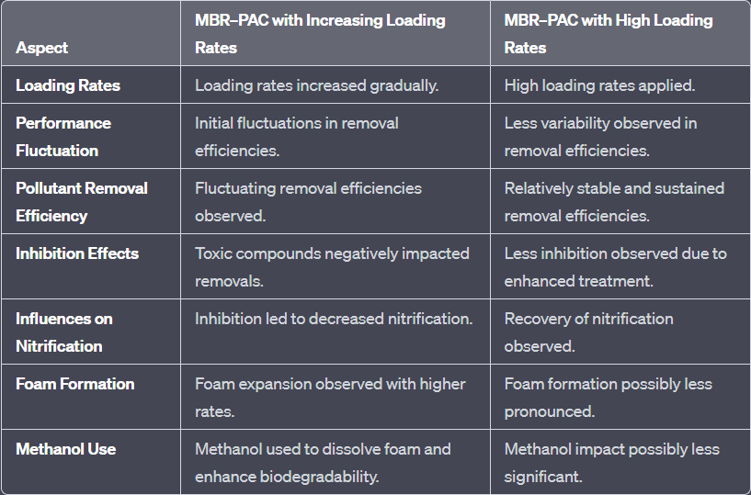
RESULT AND DISCUSSION
1)Performance of SMBR with increasing loading rates-
Initial Period I: Fluctuating COD removal efficiency due to toxic compounds (TPh, CN-, SCN-, NH4+) inhibiting bacteria activity and negatively affecting nitrification.
Period II: Increasing loading rates (OLR, TPhLR, NLR) led to decreased removal efficiencies: 69% (COD), 68% (TPh), and 32% (NH4+), with foam expansion observed.
Period III: Methanol (250 mg COD/L) used to dissolve foam and improve biodegradability; pollutant removals improved, NO2- and NO3- levels increased slightly, indicating nitrification recovery.
Period IV: Despite high loading rates (3.3 kg COD/m³/d, 0.8 kg/m³/d), COD and TPh removal efficiencies remained high, no further improvement in pollutant removal achieved.

Slide 10
3)Influences of PAC on the characteristics of permeation)
Influences of PAC on TMP Variations:
TMP (Transmembrane Pressure) is crucial for evaluating MBR performance.
Effects of 4 g/L PAC on TMP variations.
Initial 20 days: Slight TMP difference between SMBR and MBR–PAC due to pore blocking resistance dominated by solutes and colloid.
After day 20: SMBR reached TMP of 6.0 kPa in 10 days, MBR–PAC took 25 days.
PAC effects: Promoted coagulation, migration of larger particles, and slight TMP increase.
PAC influence on sEPS (Soluble Extracellular Polymeric Substances) composition affected biofilm formation and membrane fouling.
TMP decreased 34% in MBR–PAC after 50 days.
Membrane Fouling Analysis:
MBR–PAC in stages 1–3: Slight membrane fouling due to biodegradation of polysaccharides in sEPS.
Higher protein/polysaccharide ratio in MBR–PAC indicated higher hydrophobicity, contributing to fouling.
MBR–PAC sEPS concentration in stage 3 lower than SMBR (day 21–30), affecting TMP rise.
TMP Rise-up Rate:
Rate of TMP rise-up (R1) in MBR–PAC stage 4 lower than SMBR (R2).
Severe fouling in stage 5 led to significant increase in R1, reaching 1.5-fold enhancement compared to R2.
Higher sEPS concentration and unique cake layer mechanism contributed to enhanced fouling.
PAC Accumulation and C Element Distribution:
Increase in C element weight percent through membrane fouling depth indicated PAC accumulation.
Dominant microbial attachment on PAC due to high PAC concentration.
PAC likely trapped on membrane due to higher hydrophobicity than microbes.
Initial cake layer formation involved PAC as support, delaying fouling progression.
Long-term operation led to increased sEPS, enhancing PAC accumulation and causing secondary pore blocking.

Slide 11
THANKS
This work was supported by Sino-Dutch Research Program (SDRP: 2012-2016) and the independent subject sponsored by State Key Laboratory of Urban Water Resource and Environment, Harbin Institute of Technology (No. 2013DX10).

