Slide 1

solidjs slides
Nicolas Modrzyk - 2023

Slide 2
Get started
mkdir solidjs-tutorial && cd solidjs-tutorial
npm init solid@latest
// choose options
npm install
npm run dev -- --open

Slide 3
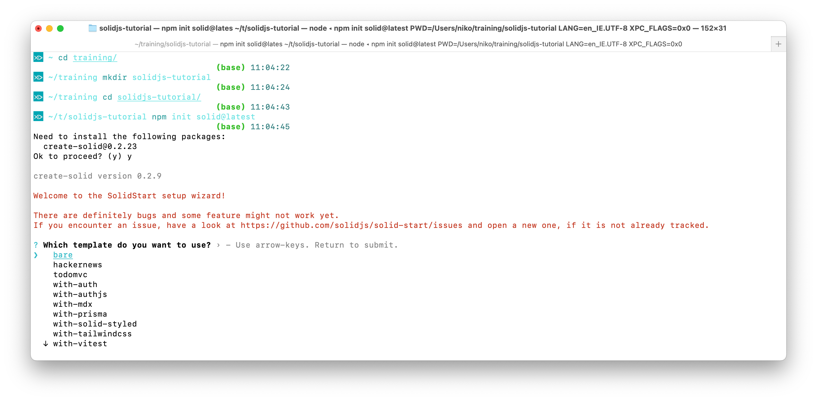
Screenshot

Slide 4
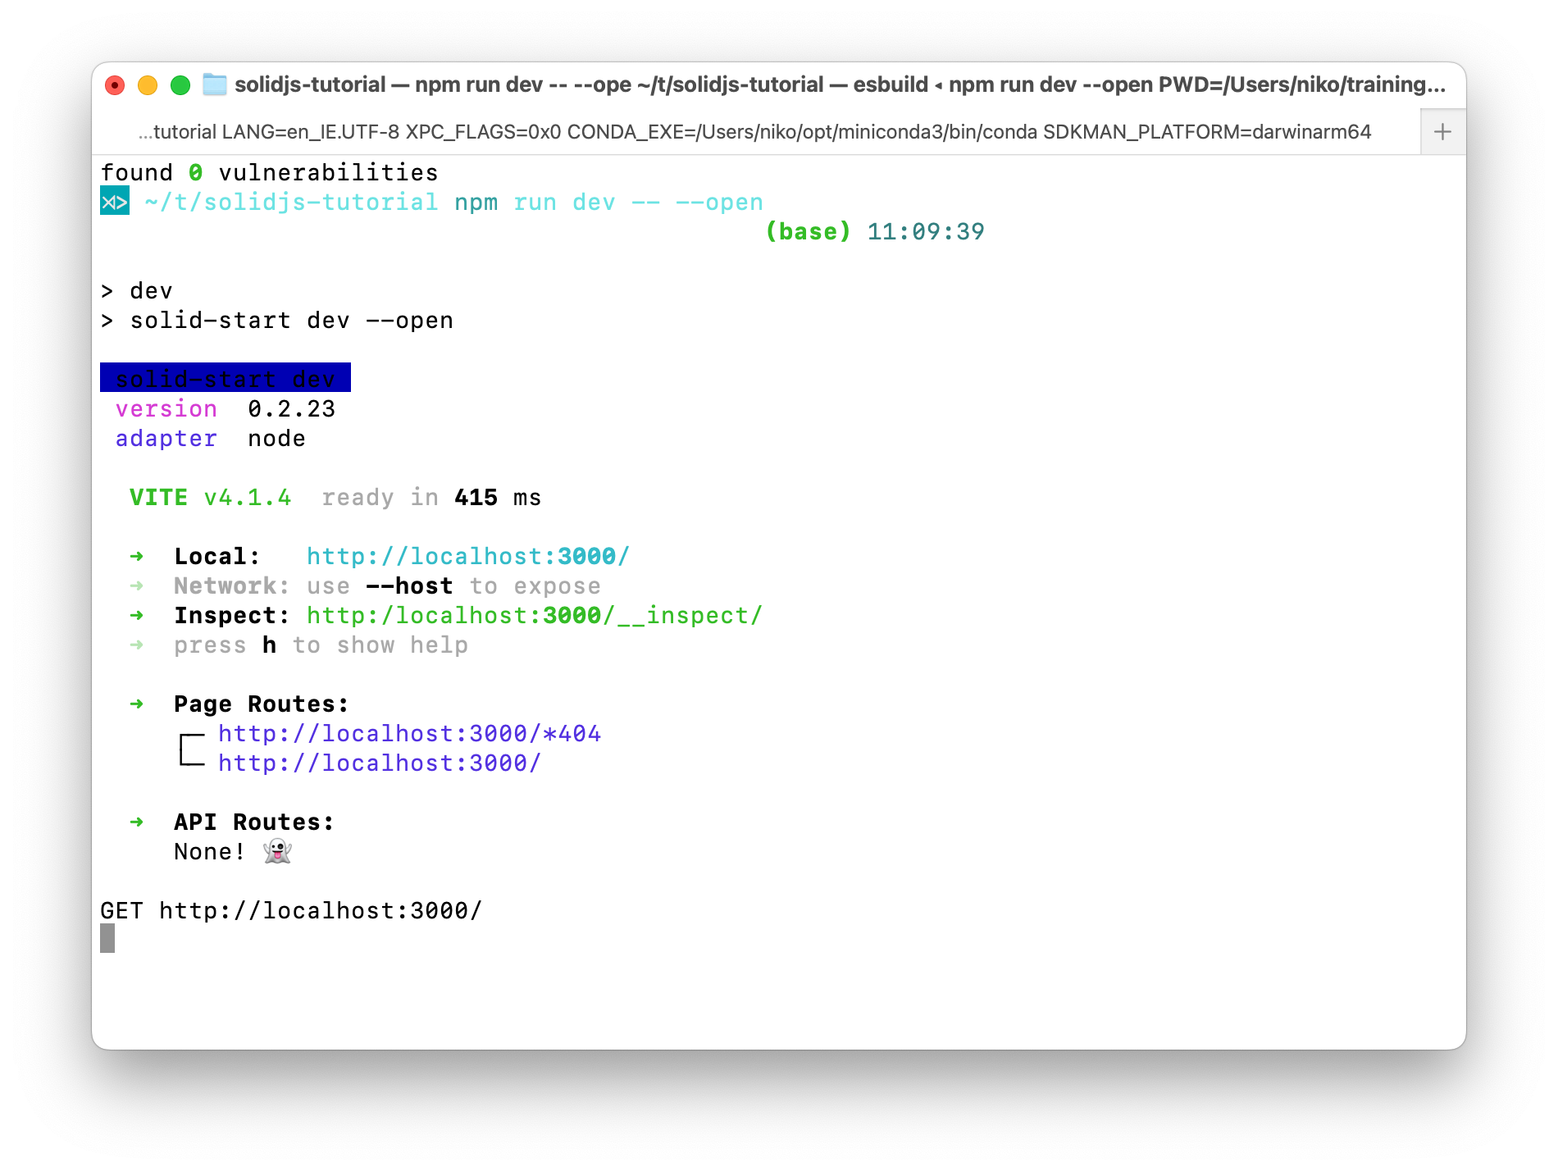
Screenshot

Slide 5
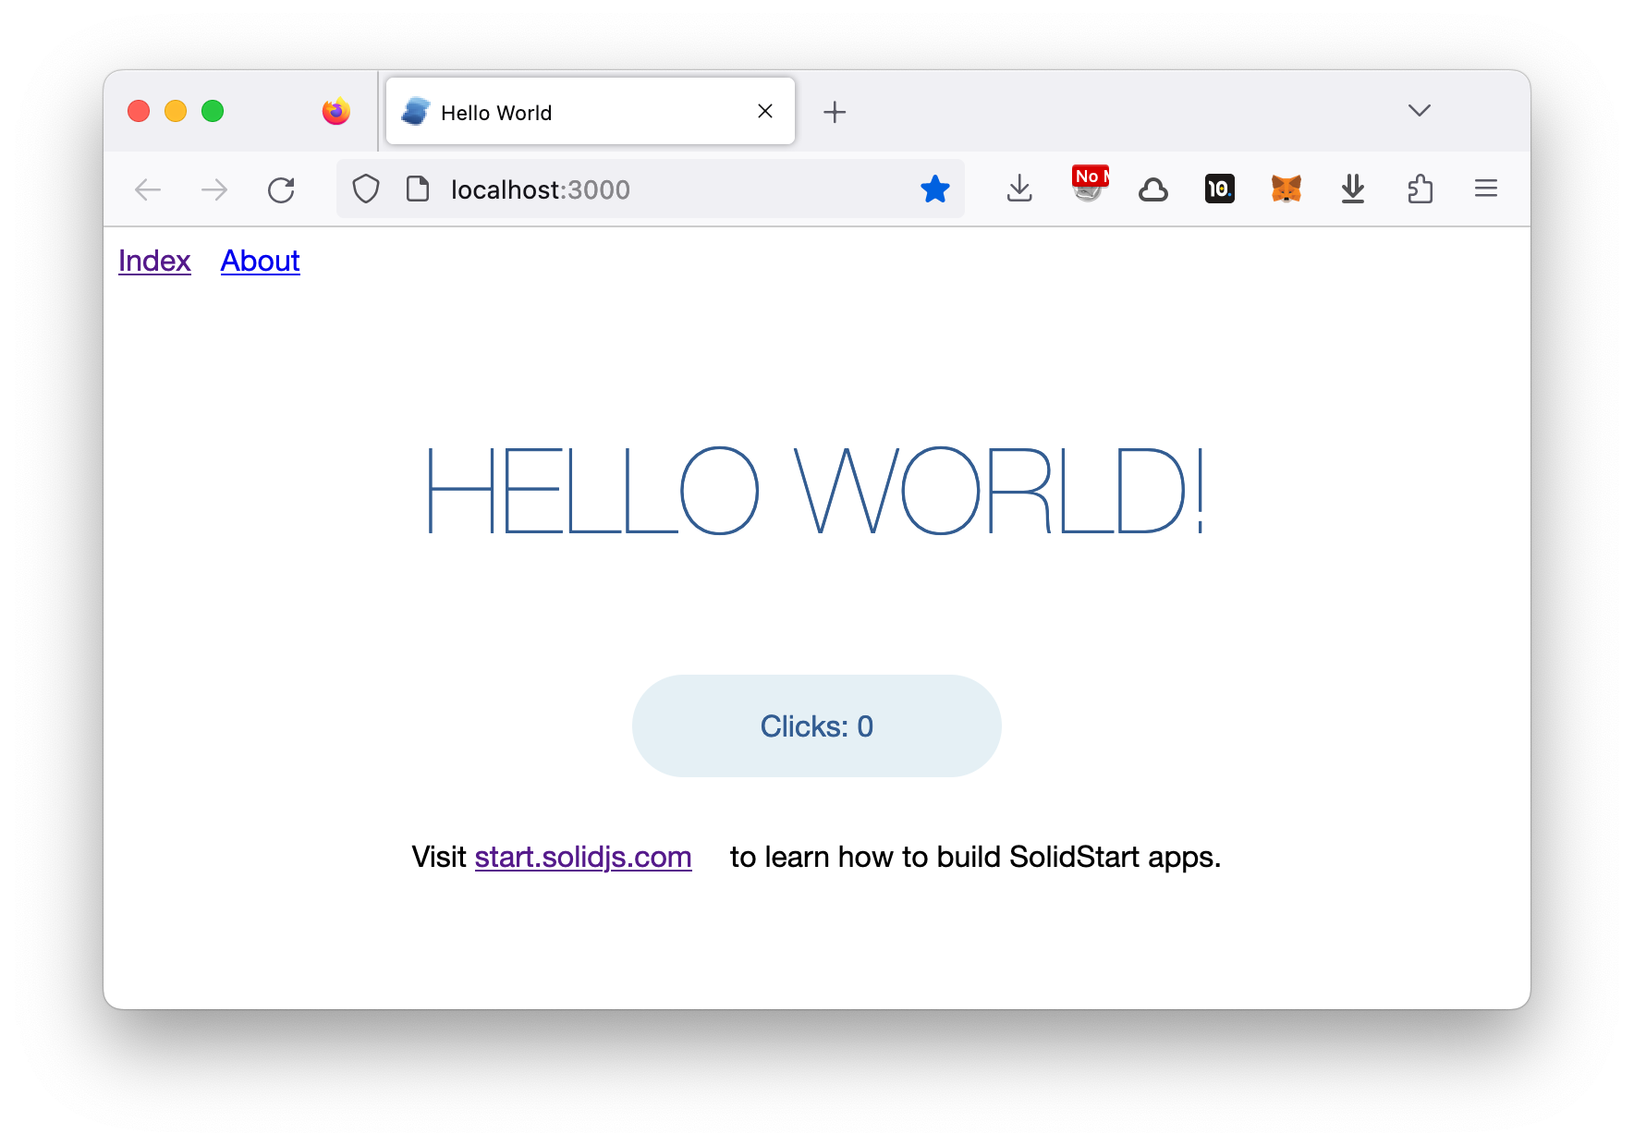
Screenshot

Slide 6
Real-time
Add about page
Add another counter

Slide 7
New Route
➜ Page Routes:
┌─ http://localhost:3000/*404
├─ http://localhost:3000/about
└─ http://localhost:3000/
➜ API Routes:
None! 👻

Slide 8
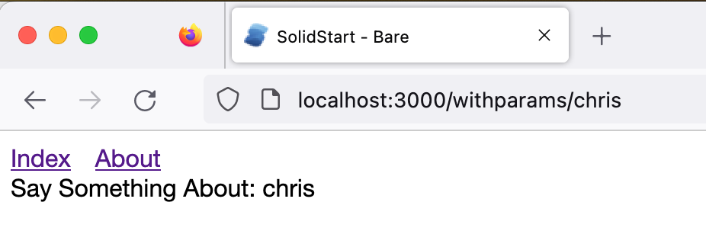
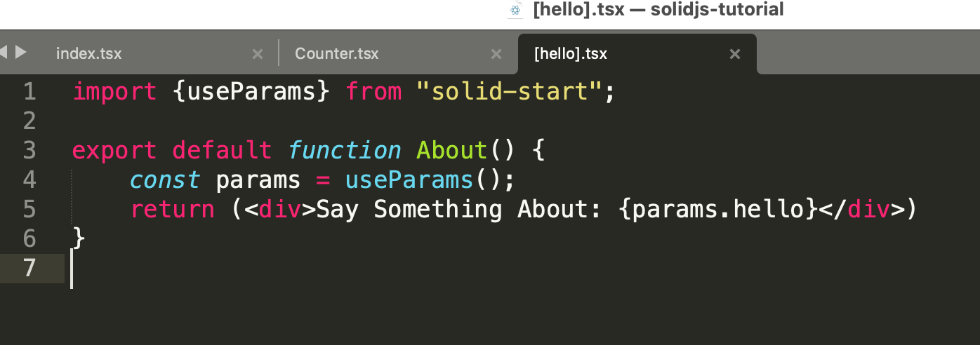
Parameters

Slide 9
Links
Vite
https://vitejs.dev/
https://vitejs.dev/guide/why.html
SolidJS
https://www.solidjs.com/
SolidStart
https://start.solidjs.com/getting-started/what-is-solidstart

Slide 10
SolidStart
Fine-grained reactivity. Since SolidStart is a SolidJS meta-framework, it benefits from the fine-grained reactivity offered by SolidJS.
Isomorphic, nested routing. You write the same routes regardless of whether the page is rendered on the client or server. Route nesting provides parent-child relationships that simplify application logic.
Multiple rendering modes. SolidStart can be used to create CSR, SSR, streaming SSR, or SSG applications.
Command Line Interface (CLI) and templates. Get up and running quickly with starters.
Deployment adapters. SolidStart provides adapters to support deployment to your favorite platform—Netlify, Vercel, AWS, and Cloudflare, to name a few.

