Slide 1

Olist Marketplace Analysis: Revenue, Logistics & Growth Drivers
A data-driven analysis of customer behavior, geography, and marketplace structure
by Daulet Nassakayev
Tools Used: SQL, Python (Pandas, SciPy, Pingouin), Power BI

Slide 2

Dataset Snapshot
Dataset from Olist, a leading Brazilian e-commerce marketplace
Public dataset of real e-commerce transactions
Covers period: Sep 2016 - Oct 2018
Order- and item-level data
~100 000 orders
SKU count: 32 951

Slide 3
Business Objective
Identify key drivers of revenue, customer behavior, and operational efficiency to uncover growth opportunities.
Analyze revenue distribution across categories to identify concentration risks
Evaluate customer behavior patterns and purchasing dynamics
Assess the impact of geography on sales and logistics performance
Identify key growth levers across the marketplace

Slide 4
Tools & Methodology
• Data processing & analysis: Python (Pandas, NumPy) - Visualization: Matplotlib / Seaborn
• Statistical analysis: - Hypothesis testing (ANOVA, Kruskal-Wallis) for group differences - Regression modeling (OLS) to quantify key relationships
• Business analysis frameworks: - ABC/XYZ segmentation for demand structure - Revenue concentration analysis (Pareto principle)

Slide 5

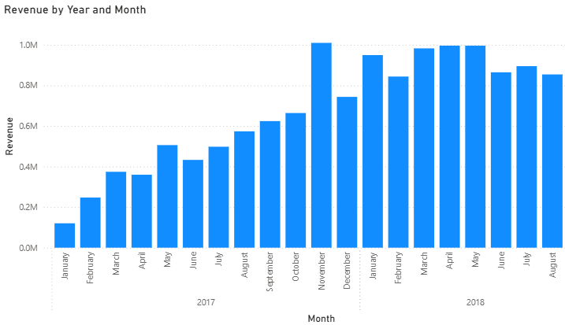
Marketplace Overview
Total revenue 13.6M BRL
3095 Sellers
41.6% of customers located in Sao Paulo
No strong seasonal patterns observed
Rapid 7.7x growth in 2017 followed by stabilization in 2018

Slide 6
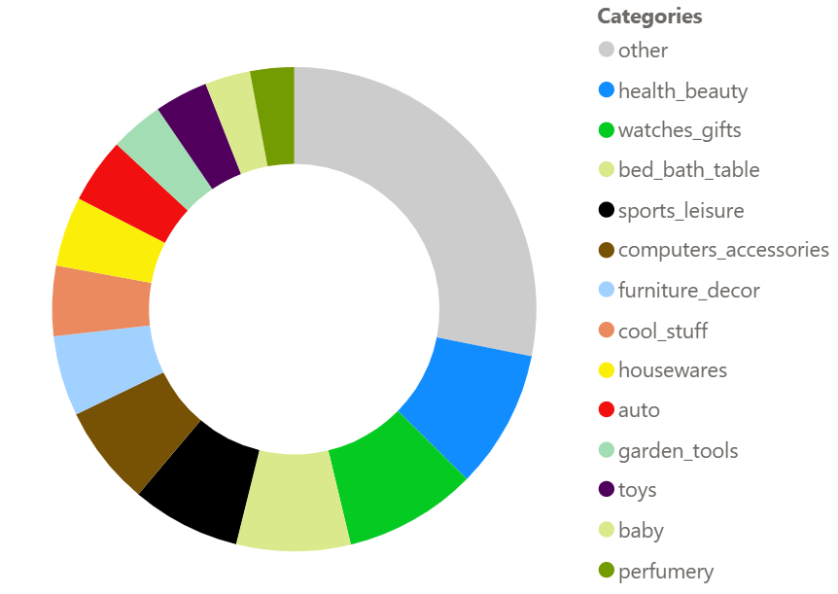
Revenue by Categories
72 product categories in total
TOP-13 categories generate 70% of all revenue
Revenue is highly concentrated, indicating limited diversification

Slide 7
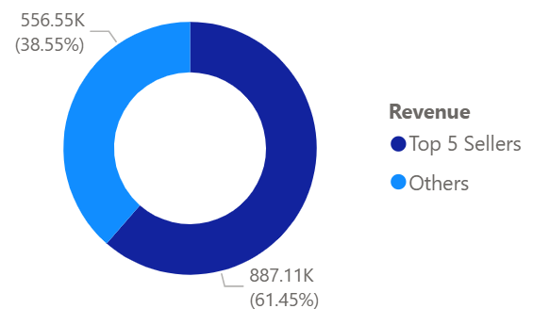
Top 5 Sellers’ Revenue Share
Average share of TOP-5 Sellers within categories is 67%
45% for TOP-25 categories
High seller concentration increases marketplace risk and limits competitive dynamics
The share for “Watches Gifts” Category (2nd by revenue)

Slide 8
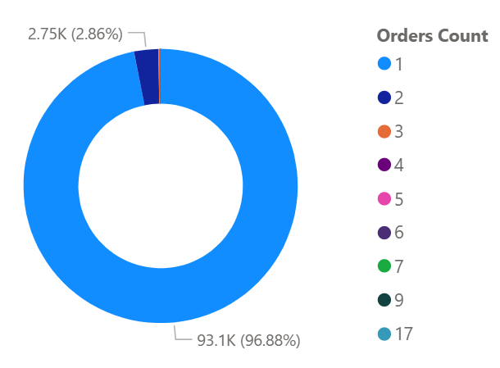
Customer Loyalty
96 000 unique customers
97% made only one purchase
Only 3% placed repeat orders
Extremely low repeat purchase rate

Slide 9
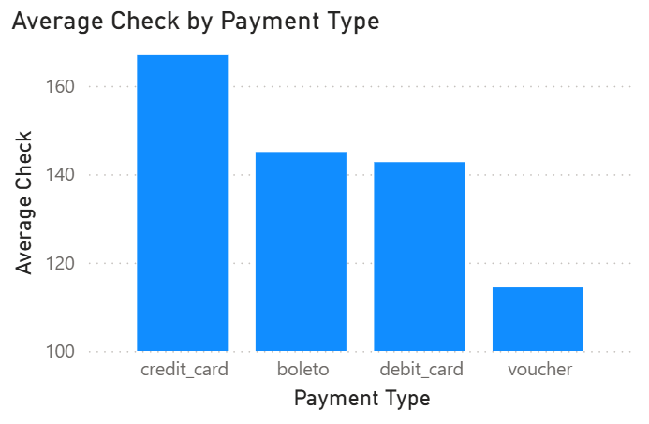
AOV by Payment Type
Credit cards yield the highest AOV
Vouchers have the lowest AOV
Differences are statistically significant (H = 724, p < 0.001)

Slide 10
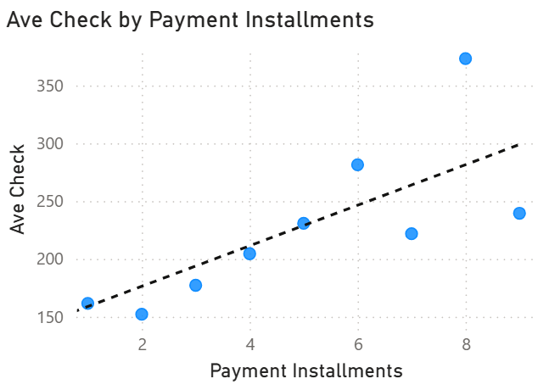
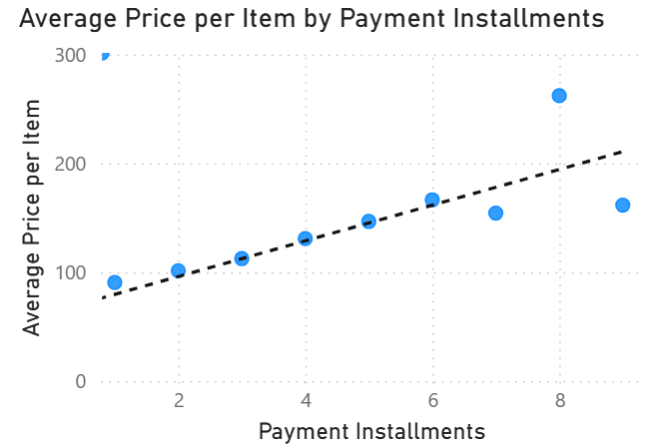
Installments as a Growth Lever
AOV increases with the number of installments
Higher-priced items are more frequently purchased with installment plans

Slide 11
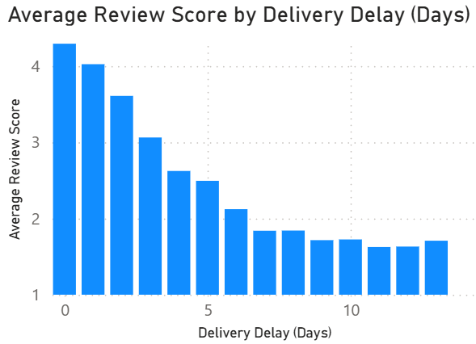
Delivery Delays Drive Customer Dissatisfaction
Delivery delays significantly reduce review scores (p = 0.000)
46% of rating variability is explained by delays (R² = 0.465)
The impact is non-linear: early delays have the strongest effect

Slide 12
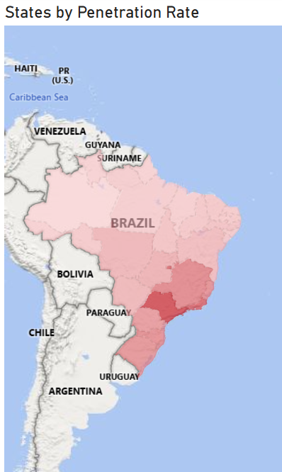
Market Penetration by State
Market penetration is the share of population with at least one order
High-penetration states are concentrated in the South-East
Marketplace activity is geographically concentrated

Slide 13
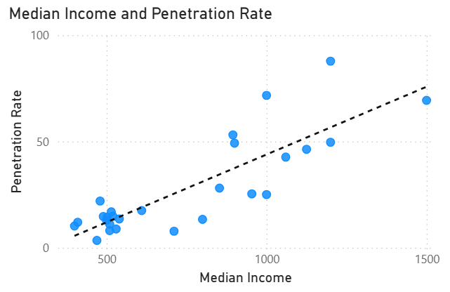
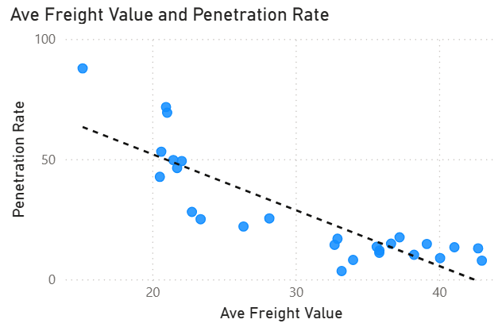
Drivers of Market Penetration
Strong positive correlation with purchasing power
Negative correlation with logistics cost (freight value)
High explanatory power (R² ≈ 0.8, p < 0.001)
Income level and logistics efficiency are key drivers of regional penetration
Source: IBGE (Brazilian Institute of Geography and Statistics), 2018

Slide 14
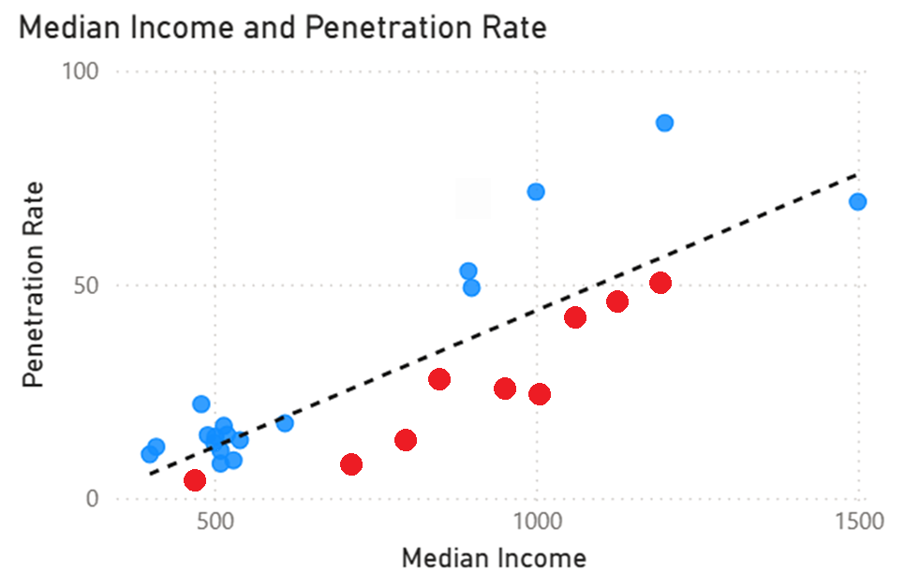
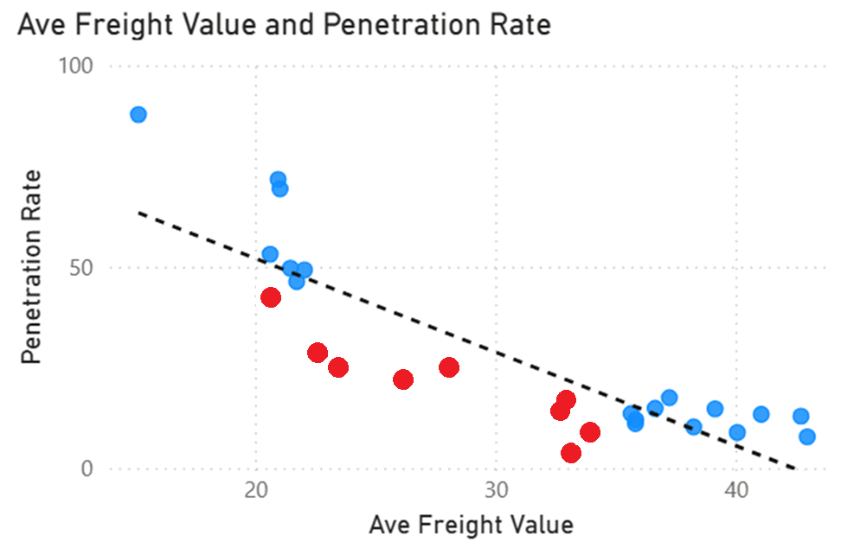
Underpenetrated High-Potential Regions
Several states show lower-than-expected penetration given their income and logistics profile
These regions represent untapped growth potential
Notably, high-potential states cluster near the South-East hub (e.g., Mato Grosso, Mato Grosso do Sul, Paraná, Goiás)

Slide 15
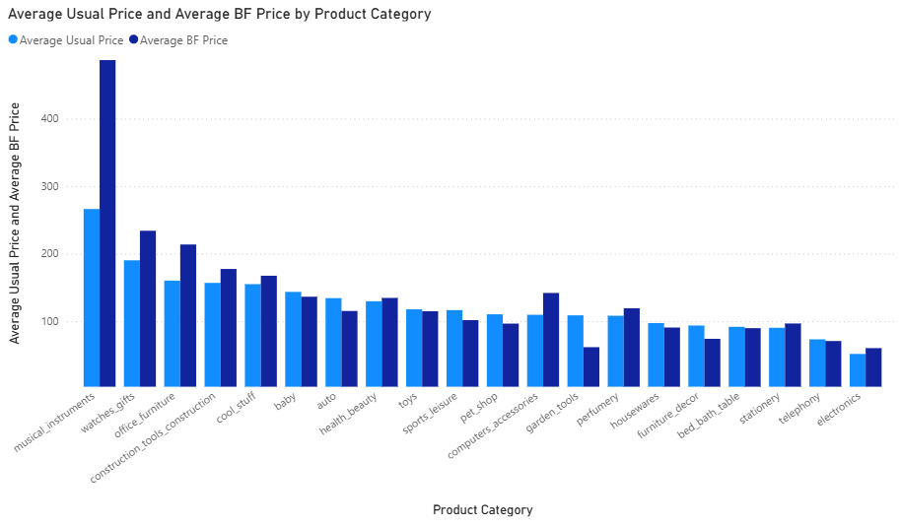
Black Friday Does Not Always Lower Prices
Average price in some categories increases by 30%*
It can be explained by premiumization: customers tend to buy more expensive products using the discounts
*Musical Instruments category has shown 82% price increase

Slide 16
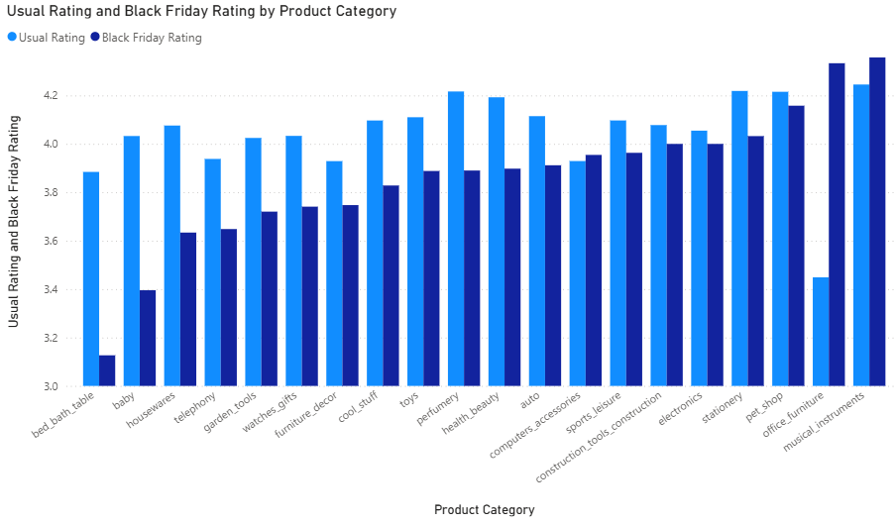
Customer Satisfaction Drops During Black Friday
22 of TOP-25 categories show lower ratings
Average rating decrease is -0.45 points (out of 5)

Slide 17
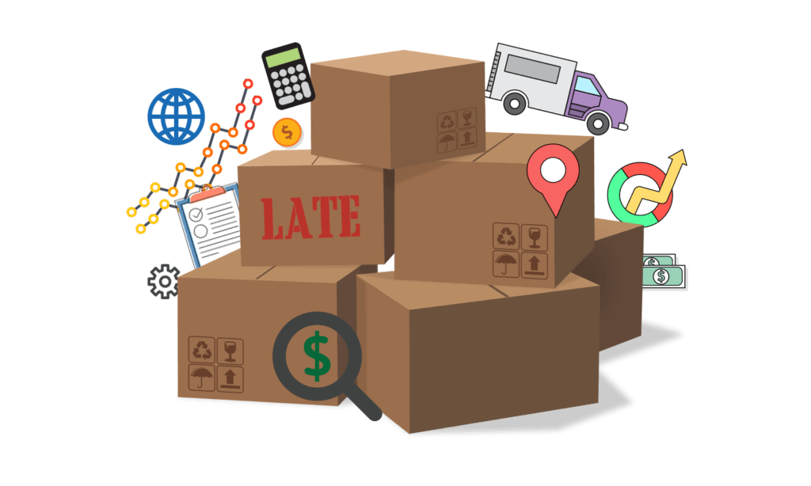
Black Friday: Drivers of Rating Decline
No significant relationship with order volume (p = 0.34)
Strong correlation with delivery delays (p < 0.001, R² = 0.27)
Each additional day of delay reduces rating by ~0.1 points
Logistics delays are a key contributor to rating decline

Slide 18
Secondary Insights
Freight cost is driven more by product weight than distance (R²: 0.37 vs 0.10)
Delivery delays within the same state are ~0.5 days less on average (p < 0.001)
Higher-priced items are typically purchased individually rather than in larger baskets
Delivery delays have a stronger negative impact when shipping costs are high relative to product price (p < 0.001)
Order value increases with delivery cost, suggesting customers avoid high shipping fees for low-value purchases
Most sellers have extremely low sales volume (median ~1 order/month)

Slide 19
Strategic Recommendations
1. Fix Logistics as the Core Pain Point
Reduce delivery delays and improve delivery time accuracy, especially during peak periods
2. Address the Retention Gap
Convert one-time buyers into repeat customers through post-purchase engagement
3. Reduce Seller Concentration Risk
Support mid-tier sellers and improve seller distribution across high-demand regions
4. Expand in High-Potential Regions
Focus growth efforts on underpenetrated states with strong income and manageable logistics

