Slide 1
ALGORITHMIC TRADING. MTH9894
SYSTEMATIC
Lecture 3
Quantitative Investment Framework: Part 2
Dmitry Rakhlin, PhD
Goldman Sachs Asset Management, Quantitative Investment Strategies
917-343-5355
Dmitry.Rakhlin@gs.com
1

Slide 2
Lecture Outline:
Return Factors (cont’d)
Factor Diagnostics
Multi-Factor return models
The curse of T-Cost (turnover, capacity)

Slide 3
VALUE & QUALITY: SUMMARY OF RECENT PERFORMANCE
Quality: R. Novy Marx, 2014, http://rnm.simon.rochester.edu/research/QDoVI.pdf
Value: A. Damoradan, 2012, http://papers.ssrn.com/sol3/papers.cfm?abstract_id=2042657
 | 2010 | 2011 | 2012 | 2013 | 2014 | 2015 | Average
Historical Book/Market Ratio | -0.2 | -1.2 | 0.6 | -1.4 | -1 | -1 | -0.70
Historical P/Cash Earnings Ratio | 0.3 | 0.3 | 0.5 | 0.4 | 0.1 | -1 | 0.10
Historical Earnings Yield | 1.2 | 1.1 | 1 | 0.2 | 0.7 | 0.5 | 0.78
1 year forward PE | 1.4 | 0.3 | 0.8 | -0.3 | 0.4 | -0.4 | 0.37
1 year forward PE rel history | 0.9 | 1.5 | 1.1 | 0 | 1.4 | 0.4 | 0.88
1 year forward PE rel sector | 2 | 0.8 | 0.7 | 0.1 | 0.4 | -0.2 | 0.63
1 year Historical Dividend Yield | 0.5 | 2.5 | 0.7 | -0.4 | 0.4 | 0 | 0.62
 | 2010 | 2011 | 2012 | 2013 | 2014 | 2015 | Average
Earnings Risk (Short high spread) | 0.6 | 1.5 | 1.3 | 1.2 | 1.1 | 1.8 | 1.25
Historical Return On Equity | 0.7 | 1.9 | 0.4 | 1 | 0.7 | 1 | 0.95
1 year ROE Growth | 0.5 | -0.3 | 1.2 | 1.4 | 1.3 | 0.9 | 0.83
Return On Assets | 0.1 | 0.5 | 0.4 | 1 | 0.2 | 0.8 | 0.50
VALUATION
‘Value Anomaly’ is widely recognized that low PE stocks outperform high PE stocks over the long term. Similar analysis has shown consistent results using P/Sales, P/Dividend and P/Book ratios. Earnings Growth can complement straight Value factors in many markets.
QUALITY
Tilt towards highly profitable and good quality businesses. Similarly over the long term the market also rewards 'earnings certainty' and penalize those stocks that carry a large degree of earnings risk.

Slide 4
MOMENTUM & SENTIMENT: SUMMARY OF RECENT PERFORMANCE
Earnings Momentum: R. Novy Marx, 2015, http://rnm.simon.rochester.edu/research/FMFM.pdf
Price Momentum: R. Novy Marx, 2012, http://rnm.simon.rochester.edu/research/MOM.pdf
Sentiment: P. Santusuosso, 2015, http://www.ccsenet.org/journal/index.php/ijef/article/view/50440
 | 2010 | 2011 | 2012 | 2013 | 2014 | 2015 | Average
Earnings Momentum (1Mth Change) | 1.7 | 1.5 | 1.3 | 1.8 | 1.6 | 1.1 | 1.50
Earnings Momentum (3Mth Change) | 1.3 | 1.3 | 0.8 | 1.5 | 1.8 | 0.9 | 1.27
Earnings Momentum Composite | 1.2 | 1.2 | 1.2 | 1.7 | 1.9 | 1 | 1.37
5 yrs Historical Earnings Growth | 0.4 | 1 | -0.1 | 0.2 | 0.7 | 0.9 | 0.52
Last Mth Net Revisions to FY1 | 1.4 | 0.7 | 0.8 | 1.6 | 1.5 | 0.5 | 1.08
Last Mth Net Revisions to FY2 | 1.8 | 0.5 | 1.1 | 1.5 | 0.8 | 1.4 | 1.18
 | 2010 | 2011 | 2012 | 2013 | 2014 | 2015 | Average
3 Mth Price Momentum | 0.4 | 0.5 | -1.8 | 0.6 | 1.5 | 0.3 | 0.25
6 Mth Price Momentum | 0.3 | 0.4 | -0.2 | 1.5 | 1.6 | 0.6 | 0.70
12 Mth Price Momentum | 1 | 1 | 2.7 | 2.5 | 1.7 | 1.9 | 1.80
Volatility Adjusted 12 Mth Price Mom | 1.2 | 1 | 2.2 | 2.4 | 1.5 | 2.1 | 1.73
Percent Off 52 Week High | 0.4 | 1.3 | 1.3 | 1.7 | 2.1 | 1.9 | 1.45
RSI 30 day | 0.5 | -0.5 | 0 | 1.3 | 1.5 | 0.5 | 0.55
 | 2010 | 2011 | 2012 | 2013 | 2014 | 2015 | Average
Consensus Recommendation | 0.1 | 0.8 | 1.2 | 1.3 | 0.7 | 0.3 | 0.73
1 Mth Change in Recom | 1.4 | 0.9 | 0.5 | 0.7 | 1.3 | 0.6 | 0.90
3 Mth Change in Recom | 0.8 | 0.5 | 0.7 | 1 | 1.2 | 1.3 | 0.92
MOMENTUM
Momentum theory for stock prices suggests that companies that do well in one (long term) investment period will continue to do well in the subsequent investment horizon. Over short time frames (<1month) studies have also highlighted the tendency of stocks to overreact leading to short term reversion.
EARNINGS & SENTIMENT
Market is not efficient at incorporating new information and a window of opportunity exists to exploit recent analyst revisions in earnings and recommendations. Similarly analyst behavioral biases suggest an exploitable serial correlation in earnings upgrades/downgrades.

Slide 5
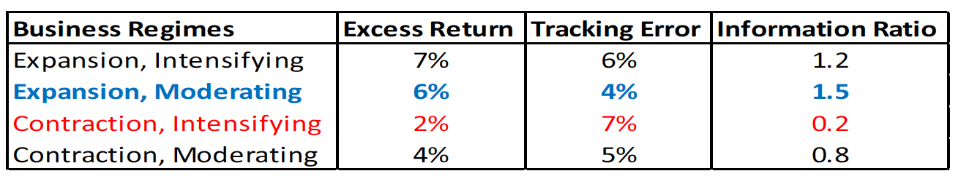
Return Factors: Value (Cont’d)
MSCI, “FINDING VALUE”, 2015: https://www.msci.com/documents/10199/67b801e5-43ef-4200-8531-540851378835
Damoradan, “Survey of Valuation Approaches”, 2006 http://people.stern.nyu.edu/adamodar/pdfiles/papers/valuesurvey.pdf
A. Damoradan, “Value. Investing for grown ups?”, 2012 http://people.stern.nyu.edu/adamodar/pdfiles/invphiloh/valinv.pdf
Common measures
Price-to-Book (Liquidation Value) – pioneered by B. Graham & D. Dodd – bet on ROE
Earning-to-Price (Current Value) – Basu (1977)
Cash Flow-to-Price
Enterprise multiple = [Common + Pref. Eq. + Debt – Cash] / Operating Income
Explanations
Most studies conclude that abnormal value returns are not a compensation for additional risk
Behavioral
investors put too much weight on past performance to project future)
Analysts more extensively cover “hot” trending stocks
Value tends to be concentrated in harder-to-trade, low institutional ownership stocks
Asset Managers are herding – less reputational risk if follow consensus (agency issue)
P/B performance (from Part 1):

Slide 6
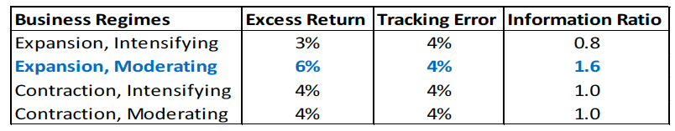
Other Factors: Current Value
P / E, P / Cash Flow Multiples
Go long firms with cheapest P / E multiples
Initiate short in firms with the highest P / E multiples, within the same sector
Fundamentally mean reversion strategy
Not applicable to all sectors: companies with lumpy earnings, or unpredictable cash flows or cash flows are ill-defined such as banks;
Effectiveness
Annual Excess Return: 5%
Tracking Error: 5%
Information Ratio: 1.0
Cyclicality: late expansion strategy

Slide 7
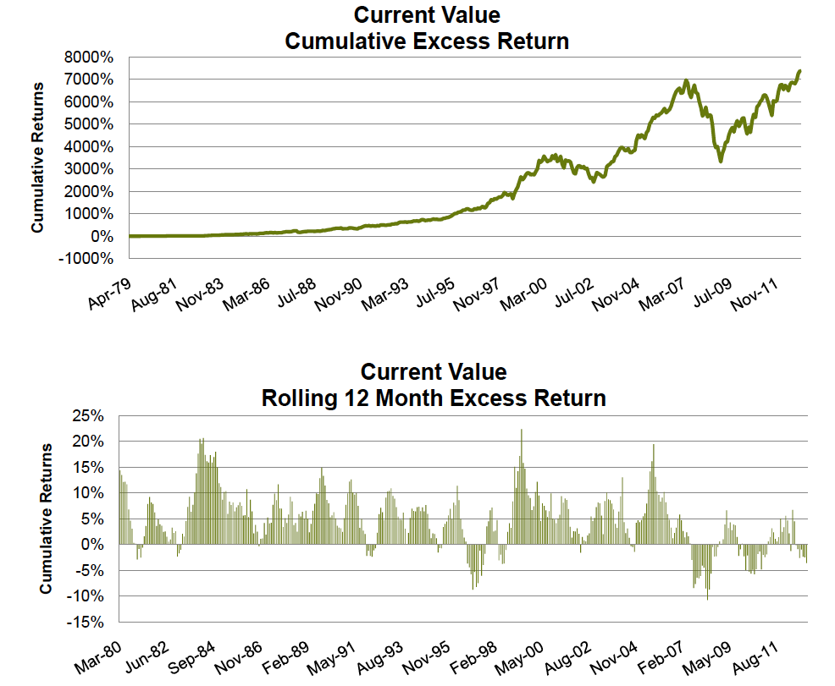
Other Factors: Current Value

Slide 8
Other Factors: Momentum
Empirically, stocks exhibit short-to-medium term (2-12mos) momentum followed by long-term reversals (3-5years)
DeBondt, Thaler (1987) – 3y/3y, 5y/5y returns are negatively autocorrelated
Jegadeesh, Titman (1993) – any combination of J/K, J,K=[2,12]mos is positively autocorrelated
Jegadeesh, Lehmann (1990) – weekly and monthly returns are negatively correlated.
Fama, French (1996) – momentum is profitable on risk-adjusted basis.
Economically significant price momentum (~1%/mos) is concentrated in top & bottom deciles. The middle is relatively flat, outperformance mostly comes from longs side.
Explanations, Improvements
Arena, Haggard, Yan (2008) – double sort by momentum & idiosyncratic volatility) = higher returns
Vassalou, Apeddjinou (2004) - explains momentum by corporate innovation (change in gross margin, that is not explained by change in labor and capital it utilizes)
Park (2010) – uses of 50/200 days moving averages ratio to improve Jegadeesh, Titman
Moskowitz, Grinblatt (1999) – cross-industry momentum subsumes stock momentum.
Number of authors conclude that a typical momentum strategy has very low capacity
Disposition effect (sell winners, hold on losers) = under-reaction to new information
Confirmation bias = in a medium term ignore new information if it contradicts prior belief.
Hong, Stein (1999) “news-watchers” set the trend, “momentum traders” follow.

Slide 9
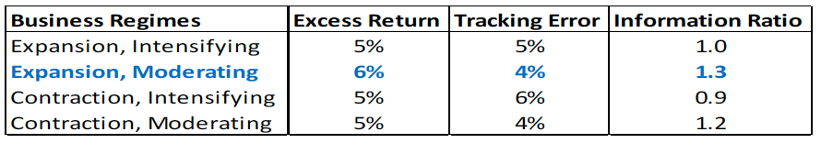
Other Factors: Momentum
Price Momentum, Analysts Sentiments
Price Momentum: long relative winners, short relative losers;
Earnings Surprise Momentum: long relative winners, short relative losers
Sentiments: long analyst upgrades, short analyst downgrades;
Significant drawdown risk around turning point;
Not applicable to all sectors: mature industries such as food products are inherently valuation driven;
Effectiveness
Annual Excess Return: 5.3%
Tracking Error: 5.8%
Information Ratio: 0.9
Cyclicality: works well during recession

Slide 10
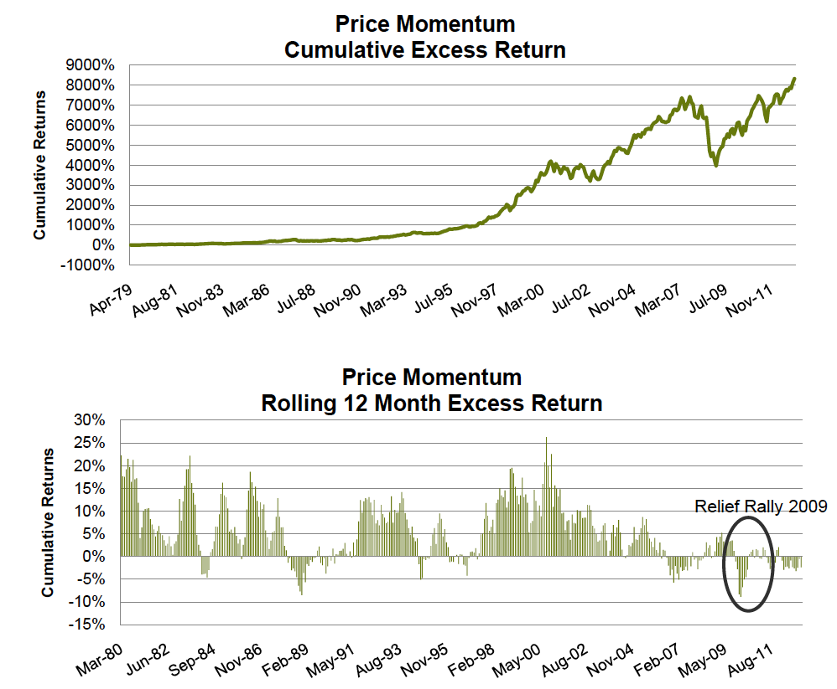
Other Factors: Momentum

Slide 11
Other Factors: Profitability
“The Other Side of the Value” by R. Novy-Marx, 2012
Profitability, measured by gross profits-to-assets, has roughly the same power as book-to-market predicting the cross-section of average returns.
Controlling for profitability also dramatically increases the performance of value strategies, especially among the largest, most liquid stocks.
Controlling for gross profitability explains most earnings related anomalies, and a wide range of seemingly unrelated profitable trading strategies
Explanations:
Profitable firms are less prone to distress, have longer cash flow durations, and lower levels of operating leverage.
Investors underreact to current profitability news. Under-reaction is stronger among firms with greater information uncertainty or more severe limits to arbitrage.

Slide 12
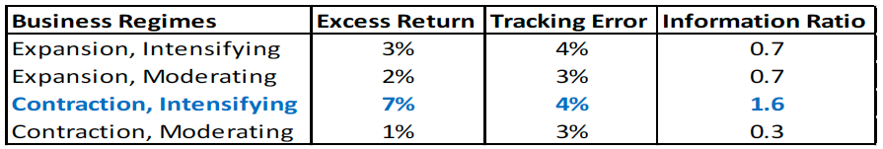
Other Factors: Profitability
Asset Turnover, ROE, Gross Margin
Asset Turnover: measures how quickly companies turn over their inventory, most effective for retails;
ROE: the profitability that ultimately matters to equity investors and the link between P/B to Earnings;
Gross Margin: pricing power measure; Apple vs. Nokia;
Not applicable to all sectors: gross margin ill-defined for financial firms;
Effectiveness
Annual Excess Return: 3.9%
Tracking Error: 4.6%
Information Ratio: 0.8
Cyclicality: best strategy during early phase of recession

Slide 13
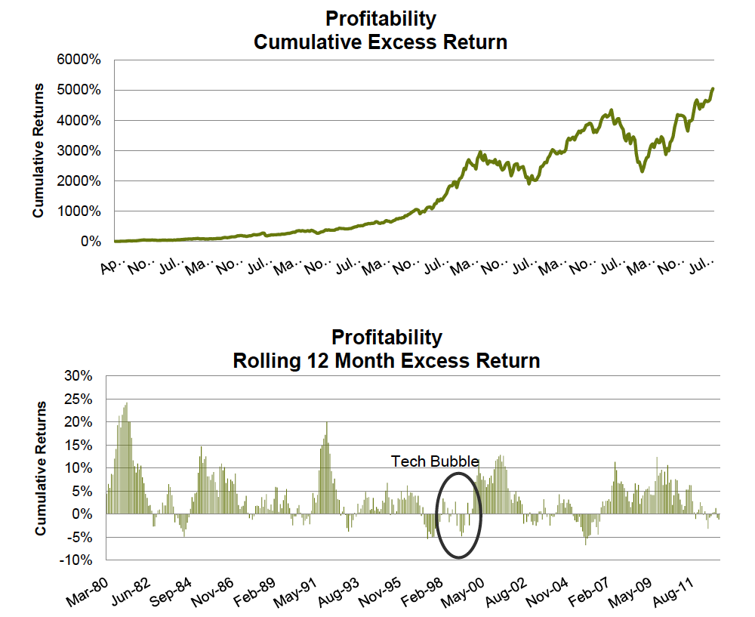
Other Factors: Profitability

Slide 14
Other Factors: Quality
Accruals, Change in Working Capital, Tax Paid
“Quality” typically mean “quality of earning”. It is straightforward to price earnings in cash. Projected future earnings in the form of unsold inventory, receivables (e.g. bad balance sheets) may need to be discounted
Sloan (1996) showed that analysts are fixated on total earnings, e.g. they do not discount low-quality earnings, and these companies underperform their peers over 2-3 years horizon.
Case in point: prior to mid-2007 banking industry reporting strong profits based on the projection of bad loans being repaid. High earnings encouraged to issue more and more loans … until this bubble burst. Yet missing the run-up in financials during 2003-07 could have been catastrophic for money managers.
Explanations:
Growth-related: high accruals identify “glamour” stocks with the high management projection for future growth. Extreme projections tend to be overly optimistic (see also Economist “Drop the Pops”, "Dimensions of Popularity", by Ibbotson, Idzorek)
Changes in earnings have high autocorrelation (momentum)… There is an incentive for management to manipulate earnings through accrual components….

Slide 15
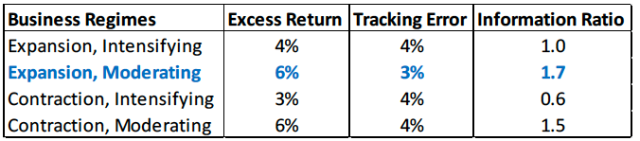
Other Factors: Quality
Types:
Change in Working Capital: increasing working capital needs suggest increasing
Chance of receivable/inventory write-downs;
Financing cost associated
Tax Paid vs. Tax Reported
Difference in tax item on income statements vs. cash flow statements
Under-payment of taxes, even if legitimate, suggest future reversal -> low quality earnings
Not applicable to all sectors: working capital ill-defined for financial firms;
Effectiveness
Annual Excess Return: 4%
Tracking Error: 6%
Information Ratio: 0.7
Cyclicality: best strategy during early phase of recession

Slide 16
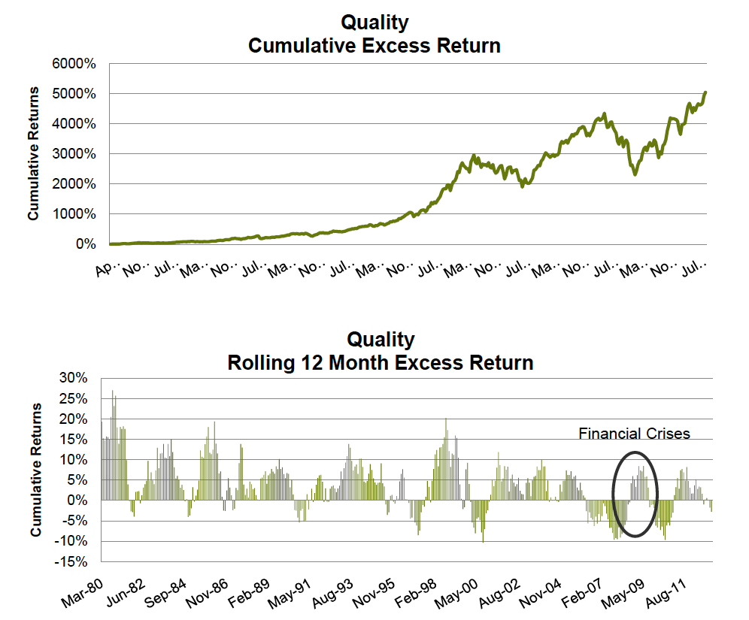
Other Factors: Quality

Slide 17
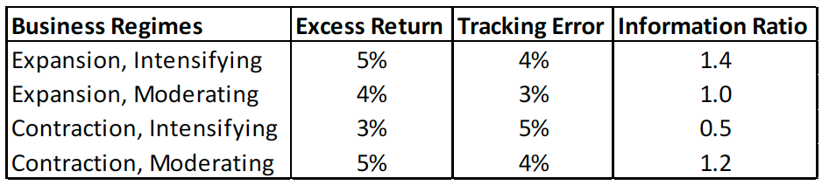
Other Factors: Capital Use
Dividends Paid, Share Buyback – defensive strategy.
A measure of shareholder friendliness or lack of growth prospect?
Net External Financing (Bradshaw, Richardson, Sloan: 2006) =
Sale or purchase of common & pref. stocks - cash dividends + net cash from issuance/retirement of debt
Sell top decile of cash inflows (issuers), buy top decile of cash outflows (repurchasers)
Explanations
Operating cash flows = net income – accruals. High accruals firms more frequently have higher amount of external financing (IPOs & secondary offerings, M&A, restructurings, etc.)
Firms time their activities to exploit temporary misvaluations of firm’s securities
Effectiveness
Annual Excess Return: 5%
Tracking Error: 5%
Information Ratio: 1.0
Cyclicality: skewed by recent experience

Slide 18
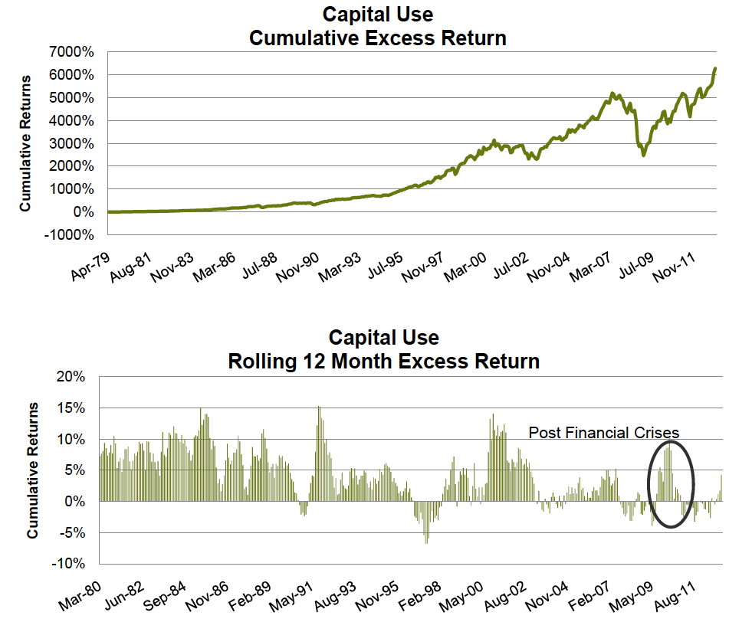
Other Factors: Capital Use

Slide 19
BUILDING AN ALPHA MODEL
FACTOR CONSTUCTION
Compute raw factor (price to book)
Normalize factor exposure (winsorize, demean within county/sector/industry and then normalize)
Compute factor returns (mean(F) = Factor Premia, cov(F) = Factor Risk)
Typically (BARRA): GARCH(1,1) to estimate factor variances and EWMA to estimates factor correlations
https://www.msci.com/documents/10199/67b801e5-43ef-4200-8531-540851378835
https://www.msci.com/resources/research/barra_risk_model_handbook.pdf
http://www.northinfo.com/documents/8.pdf
Compute residual (specific) risk
Compute view portfolios
Combine factor view portfolios into portfolio of factors
Compute implied alpha
Mean-variance optimization using alpha, risk and cost models

Slide 20
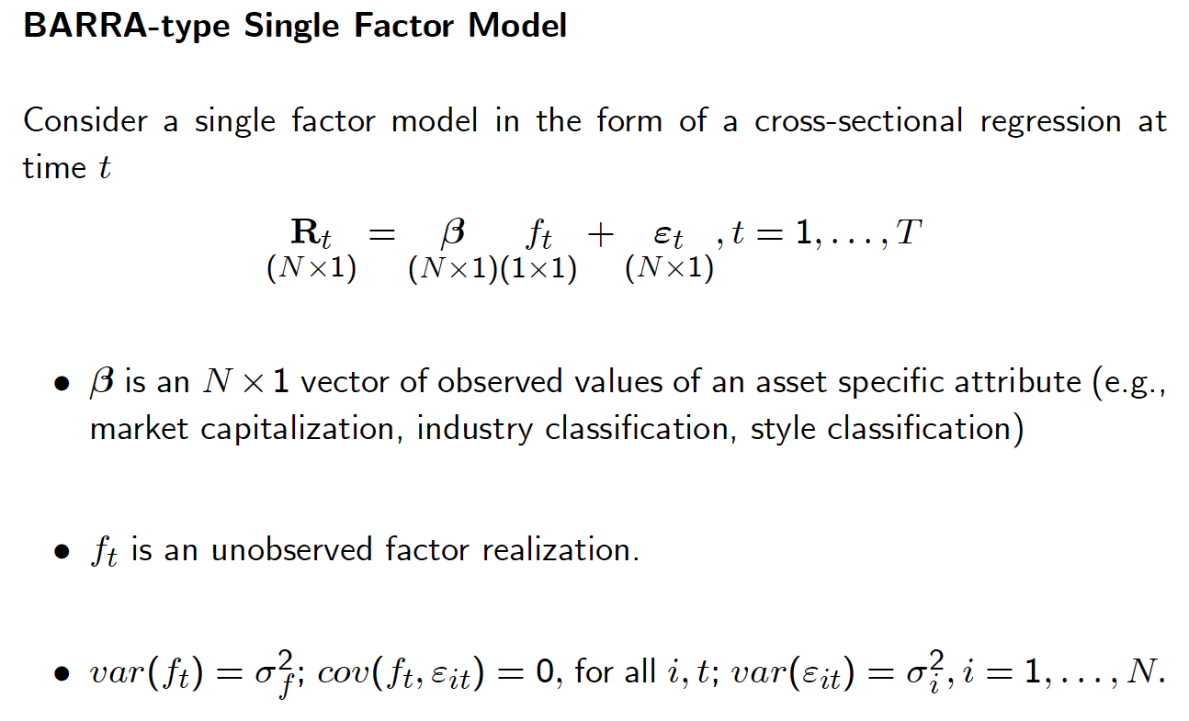
Multi-Factor Portfolios
http://faculty.washington.edu/ezivot/research/factormodellecture_handout.pdf

Slide 21
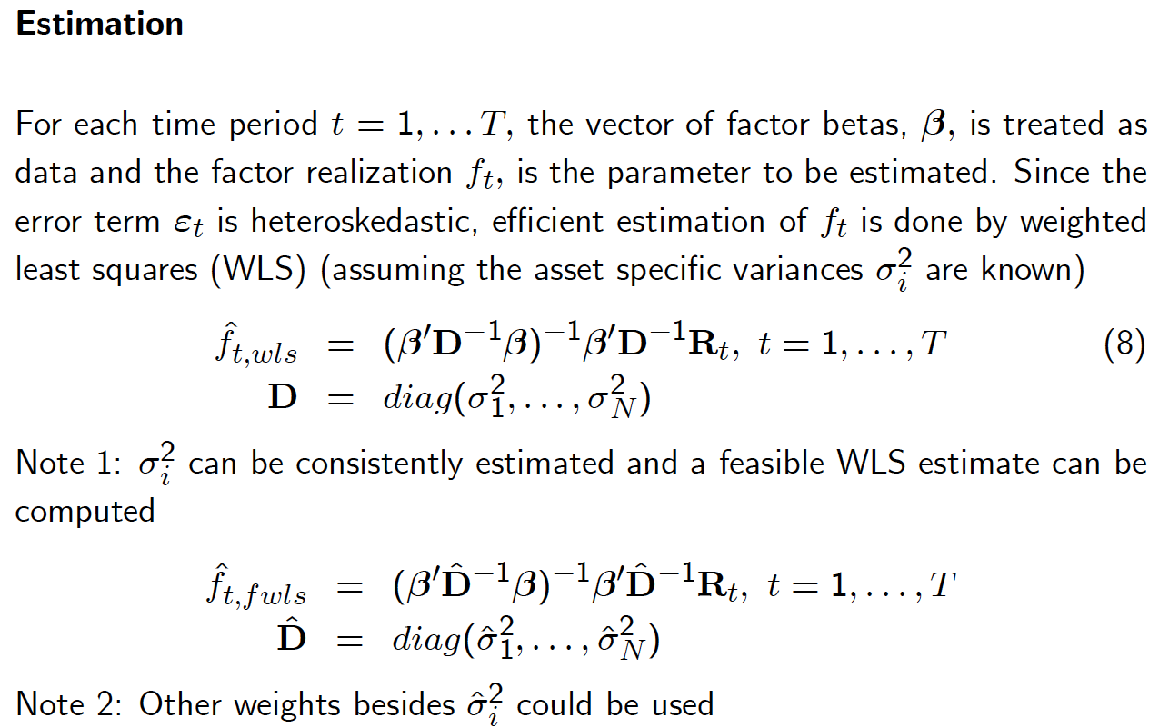
Multi-Factor Portfolios
Use Gauss Jordan elimination instead of matrix inversion

Slide 22
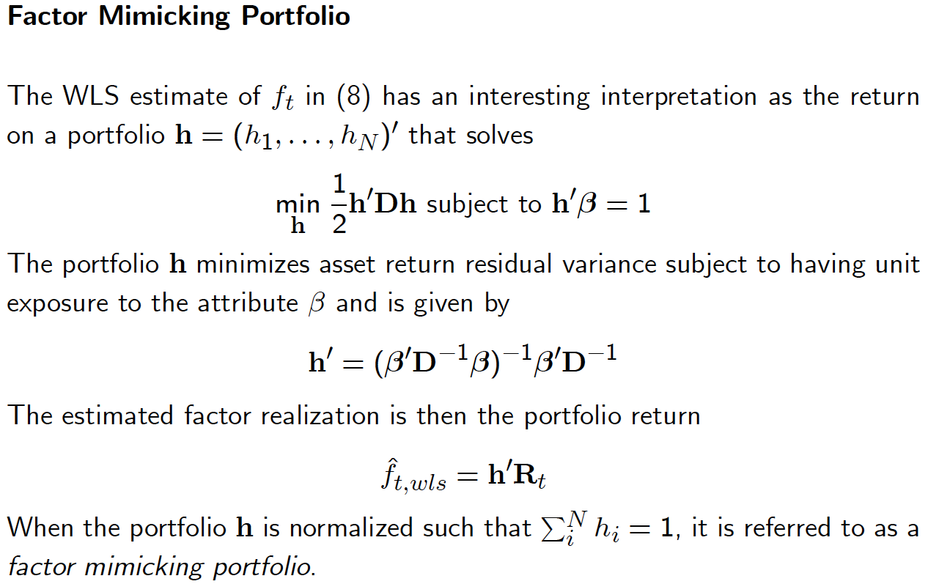
Multi-Factor Portfolios

Slide 23
Combining with Risk Model
Using daily estimates for factor returns compute GARCH(1,1) factor volatilities
Compute EWMA for factor correlations (typically 6-12mos half-life)
Consider shrinking off-diagonal elements
Calculate residual stock returns and fit GARCH(1,1) to these processes.
Full risk model is , where covariance matrix is estimated in steps A-C
Construct factor mimicking portfolios as
Using Woodbury matrix identity to avoid inversing ; inverse instead.
Covariance matrix of factor mimicking portfolios is naturally

Slide 24
Combining Factors
Optimal factor weights:
Combining into portfolio of factors:
Implied stock-level alphas:
Sometime alphas are rescaled such that portfolio of factors had certain level of IR consistent with historical observation

Slide 25
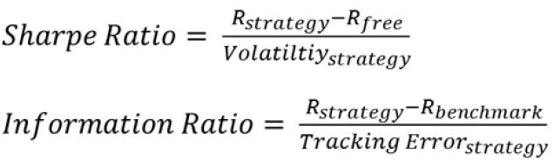

How To Assess Factors
Quantitative Equity Portfolio Management, by E. Qian, R. Hua, E. Sorensen
Rank Correlations
Sharpe Ratio and Information Ratio
Turnover (short-horizon strategies have higher turnover)
Maximum Drawdowns
Skewness / Kurtosis: 3rd and 4th moments of return distribution
Correlations with the market, other factors, co-linearity

Slide 26
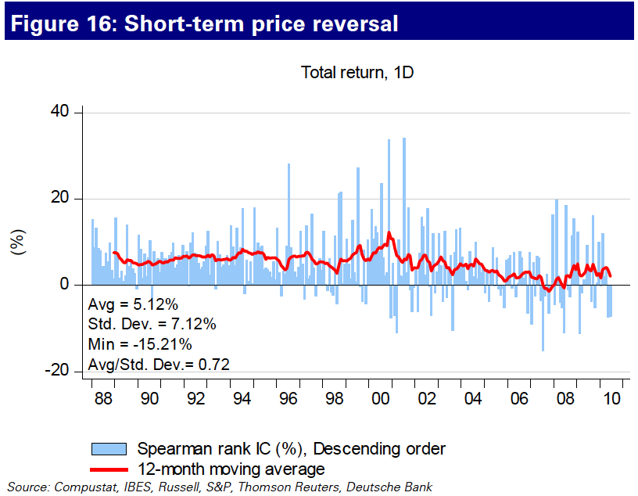
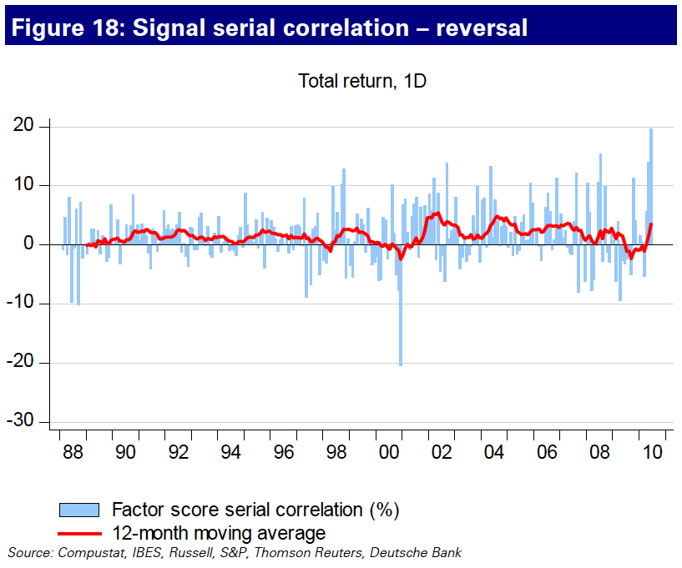
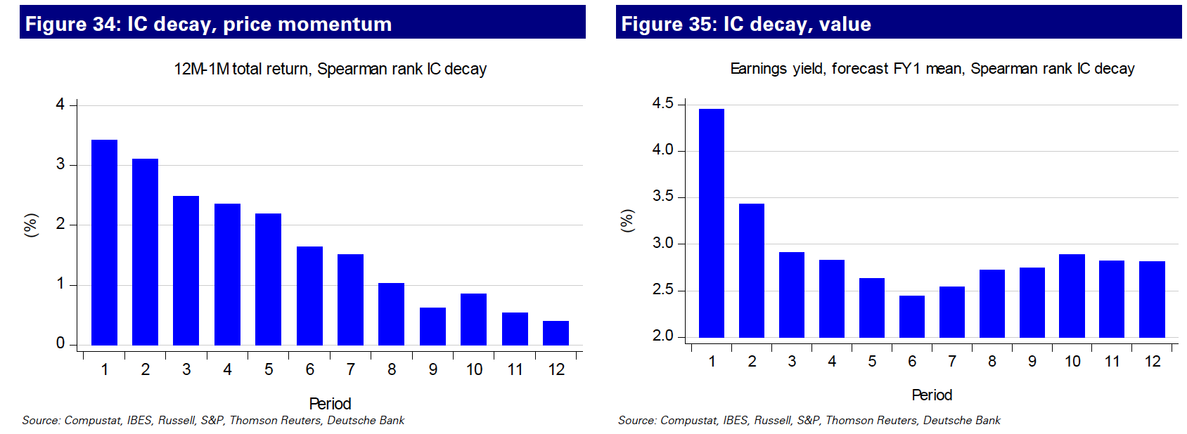
How To Assess Factors

Slide 27
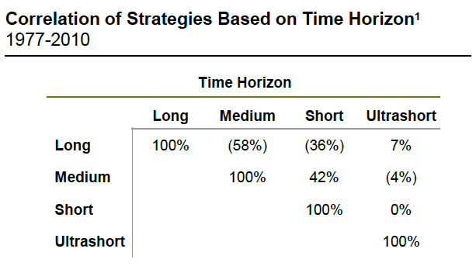
Time Horizon – Another Form of Diversification
Investment style is mostly defined by time horizon
Toolsets and performance systems
Analysts “style” and focus
Turnover – good proxy for horizon
Blending and varying different time horizons can improve performance
Works when traditional approaches fail
Time horizon diversification has worked well in every crisis
Lengthen Time Horizon in your strategies when risk subsides
Shorten your time horizon when risk aversion rises
and investors aren’t concerned with fundamentals

Slide 28

Combining Strategies
How to maximize a bag full of tricks?
Equal weight: no opinion on individual strategy efficacy
No opinion is actually an opinion on the risk/reward trade-offs
Results aren’t so bad!
A standard to beat
Cyclically adjusted:
Strategies have varying degrees of risk/reward profile depending on their relationships with risk
For example, in recession, we favor profitability and momentum, but caution is to the upside risk
Opinion Pooling:
Black-Litterman Framework: fundamentally mean-variance trade-off between factors;
Copula-based: similar to BL framework with more esoteric statistics, performs better in some rare cases
Black-Litterman Framework (http://papers.ssrn.com/sol3/papers.cfm?abstract_id=334304)
Fundamentally no different from a fundamental manager hedging his/her bet between growth and value;
Risk, Reward, as well as Correlation among strategies are considered simultaneously

Slide 29
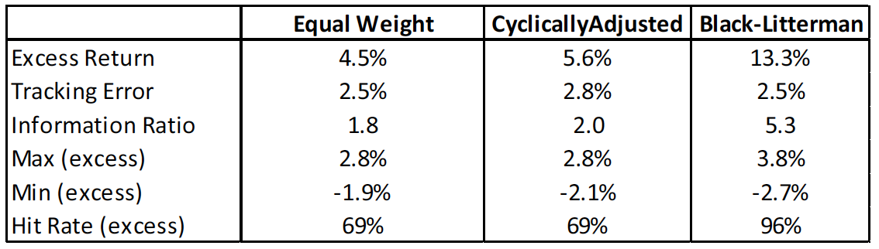
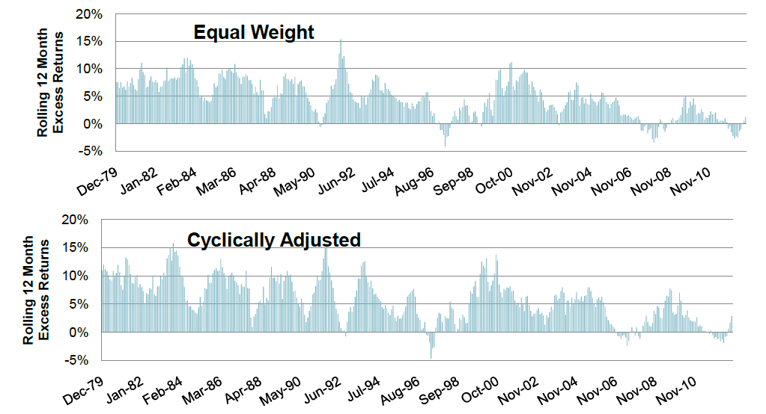
Combining Strategies
Centrality of risk allocation across strategies, not the expected returns
Expected returns, or alphas, can be derived as α=λ×Inv(COV)×W, where λ is the risk aversion parameter, COV is the covariance matrix of the strategies, W is allocation across strategies
Expected returns being a single number disguise the underlying economics behind the investment decision

Slide 30
Portfolio Construction
Accounting for the ingredients for constructing a portfolio
Client objective: tracking error, geographical preferences etc.
Benchmark selection: cap-weighted indices or custom benchmark or short-term instruments?
Rebalance frequencies / Turnover
T-Cost estimation (commissions, clearing charges, impact, cost of borrow)
Optimizer to glue them together
Objective
Generic optimizers like Matlab, financial apps from Barra, Axioma, Northfield
Where does “alpha modeling” stop and “portfolio construction” begin?
The more flexible the mandate, the more blurred the line between alpha model and portfolio construction
Flexibility means significant room to time strategies

Slide 31
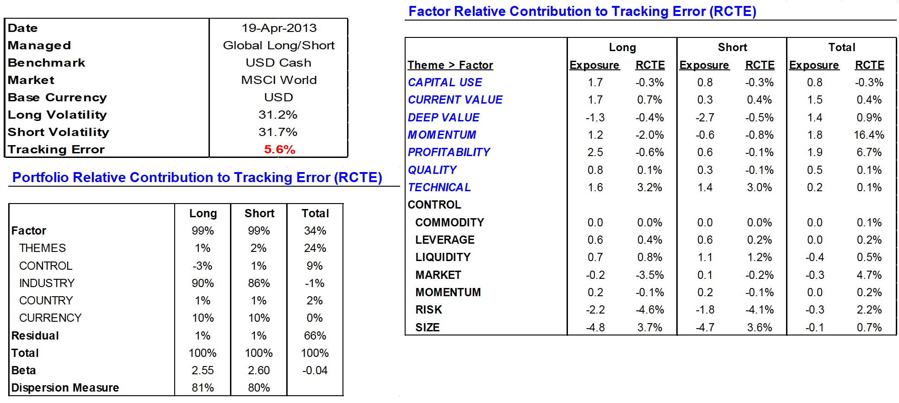
Performance Attributions – Risk Analysis

Slide 32
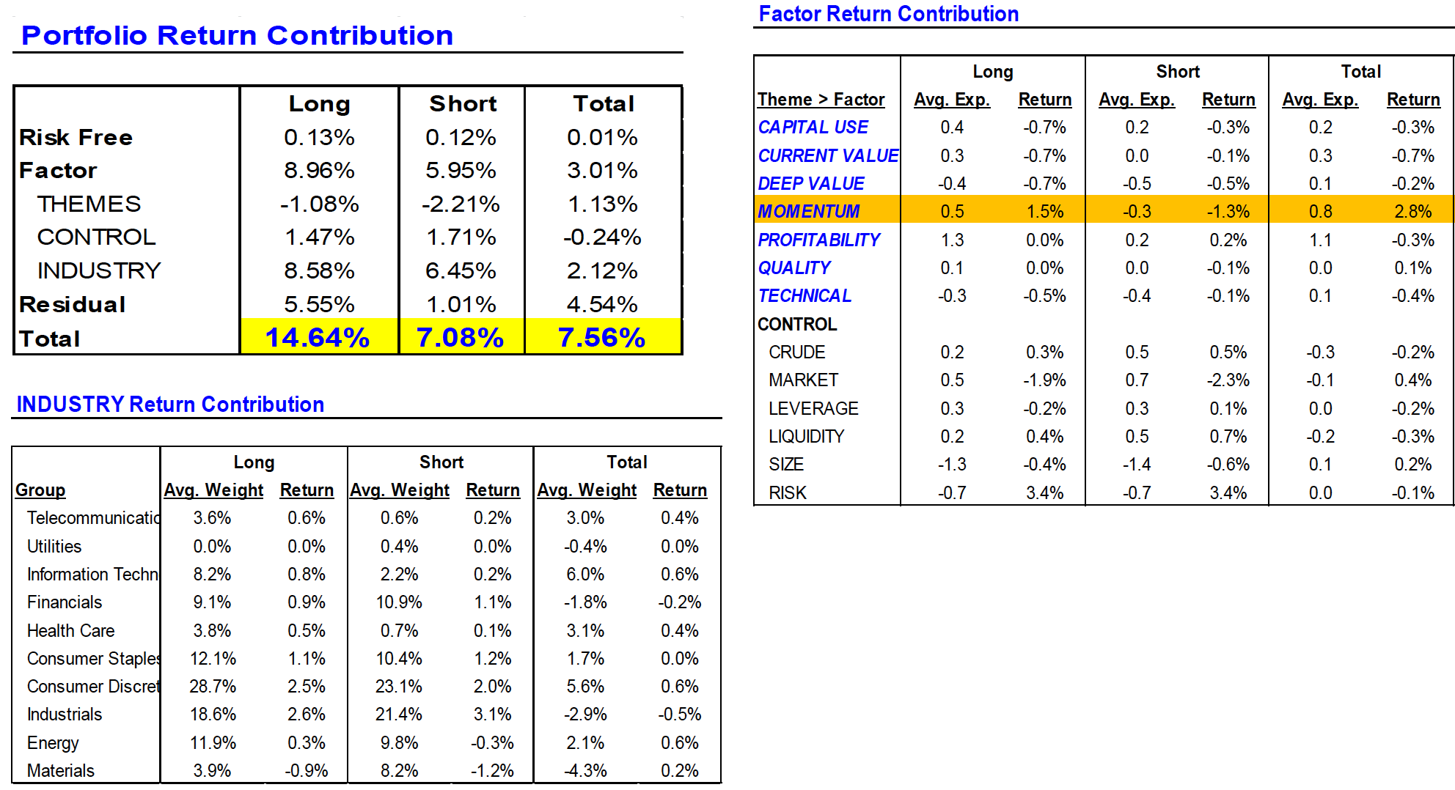
Performance Attributions – Factor Attributions

Slide 33
Fast Factors & the Curse of Portfolio Turnover
Equating T-Cost and Turnover leads to underutilization of faster factors and loss of alpha
“Slow” & “Fast” factors – similar IR if we use most recent values (no lag)
Factors have negative correlation
T-cost assumptions impose an artificial limit on exposure to the momentum factor and force the use of lagged factors
In the end, despite equally compelling levels given current information...we are forced to allocate more to Value because of execution inefficiency
“Information Horizon, Turnover & Optimal Alpha Models” by E. Qian, E. Sorensen, R. Hua, Jour. Portfolio Management, Fall 2007, pp.27-40

Slide 34
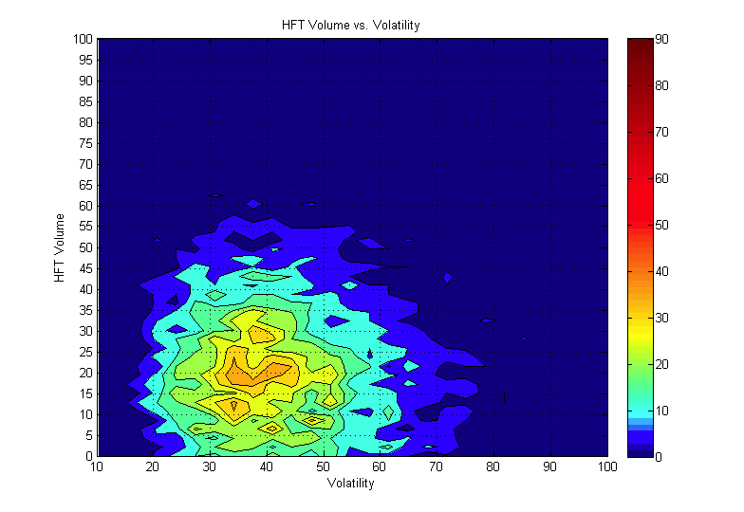
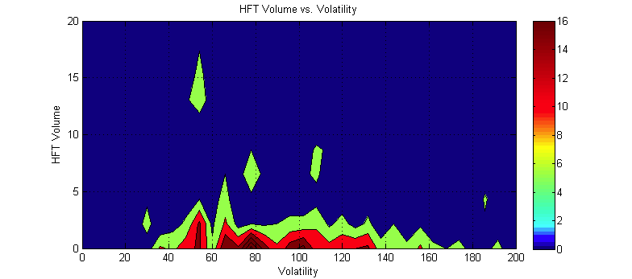
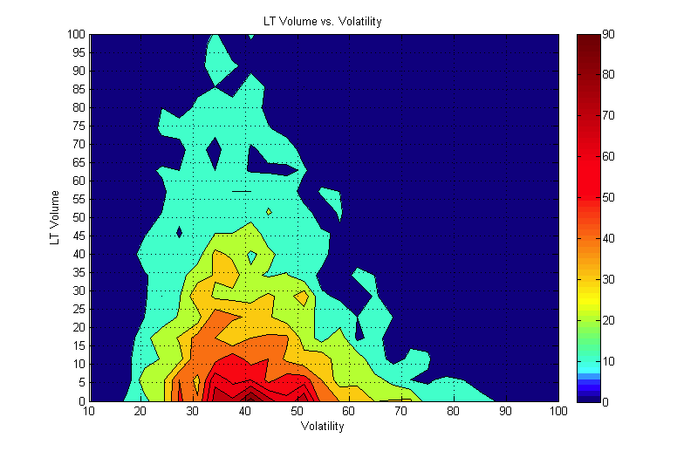
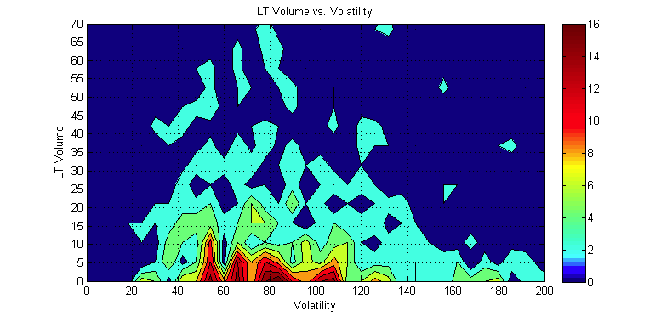
Trading Large Caps vs. Small Caps
Market makers supply average liquidity in LC names, but nearly non-exists in SC
Top 75 Nikkei stocks
Bottom 75 Nikkei stocks
Supply
Market Makers:
In top 75 names provide liquidity within “normal” volatility regime and non beyond that mark
%Participation in overall market volume
Demand
Institutional Investors:
Trade top and bottom names identically without realizing that liquidity supply is much different.
Frequently originate small trades across wide range of stocks: cash flows, rebalances
%Volatility over 30-min trading period, annualized
Color: Event probability: Frequent Event Rare Event
Outside of the most liquid names and “normal” volatility, investors need to (a) monitor fragmented market & patiently wait for rare natural liquidity or (b) dislocate the stock price to attract liquidity
N. Bershova, D. Rakhlin “The Non-Linear Market Impact of Large Trades: Evidence from Buy-Side Order Flow” J. of Investment Strategies, v2, n.2, pp 3-47, 2013

Slide 35
Course Projects: Literature
Course Projects: Study one of these. Implement. Suggest Improvements
The Little Book That Still Beats the Market by Joel Greenblatt
The Handbook of Equity Market Anomalies, by Leonard Zacks (editor)
Quantitative Equity Portfolio Management, by E. Qian, R. Hua, E. Sorensen
Momentum: http://papers.ssrn.com/sol3/papers.cfm?abstract_id=299107 By Narasimhan Jegadeesh, Sheridan Titman
Value and momentum everywhere by AQR (Asness, Moskowitz, and Pedersen) (posted on Forum)
What is Dividend Premium: Laura Liu (posted on Forum)
Generating Excess Returns through Global Industry Rotation: John Okunev http://papers.ssrn.com/sol3/papers.cfm?abstract_id=904106
Multifactor Evaluation of Style Rotation: Kevin Q. Wang http://papers.ssrn.com/sol3/papers.cfm?abstract_id=1339671

Slide 36
Course Projects: Suggestions
Improve StatArb model … Just a suggestion: calculate implied correlation:
For each stock in the universe for each day (or week) compute matrix A(t) of sign correlations of residual returns (e.g. after removing industry or sector returns) with residual returns of all other stocks over some trailing period (6-12 months). Retain top & bottom10% of highly correlated names (or set some minimum threshold). For a few stocks check most correlated names. Do they make sense?
Optional: replace A(t) with PCA(A(t)) only keeping top few eigenvectors (check spectrum & apply random matrix theory). You can also try A(t) squared instead to overweight highly-correlated names.
Your raw score for stock I (raw forward return) will be A(t) times stock returns over previous day minus the return of I (equivalent of replacing A(t) diagonal with -1). Smooth raw score by computing exponential moving average of this signal with 5-10 day half-life. Industry-neutralize and normalize raw score.
Form portfolio (top/bottom deciles or just a factor-mimicking portfolio). Compute all stats (see next page)
Fully replicate a momentum strategy (refer to chapter 8 or Zack’s book)
Fully replicate "Dimensions of Popularity", by Ibbotson, Idzorek. Think what else you can use besides turnover to quantify stock’s popularity.

Slide 37
Course Projects: Requirements
Factor Diagnostics
Define a signal (for example 6 month return from 7 to 2 months ago)
Define a universe (for example S&P500, Russell 1000, Nikkei 225 etc.)
If you measure index return from T₁ to T₂ (typically you will work with closing prices), take index weights as of one day before T₁
To evaluate forward performance of a signal from T₁ to T₂,include all stocks in your universe as of one day before T₁
Calculate raw signal exposures for your universe. Neutralize signal within industries (U.S.) or sectors (all other counties) by grouping exposures, subtracting group means, and dividing by stdev (typically of the whole universe, sometime by stdev of a group, if they are drastically different from each other). Winsorize exposures from -3 to 3.
Define your rebalance strategy (daily/weekly/monthly). Backtest should be at least 5 years, 10 or more is better.
Calculate IC: rank correlation of your exposures to forward total industry-adjusted returns (“total” means adjusted for corporate actions: dividends, splits, etc. “Industry-adjusted” means your subtract equal weighed industry return)
Report average IC, moving-average IC, variance(IC), IC/stdev(IC), IC decay (e.g.) rank correlations of the exposures to the returns and to forward exposures over multiple forward periods. If satisfied with the result, move forward.
Further factor diagnostics: decile (A-C) and factor-mimicking portfolios (D-F)
For each period form 10 decile sub-portfolios. For each decile calculate total industry-adjusted forward equal weighted returns for multiple periods – days/weeks/months – a.k.a. excess return (ER). Compute hit ratio (HR) – % of stocks outperforming industry.
Average across time for each forward period (e.g. 1,2,3,…N months). Report average ER, HR and t-stat: ER/stdev(ER).
Split your entire testing period into 2 or more sub-periods and report ER/HR/t-stats for each. Are they different?
Factor mimicking portfolios are most useful for multivariate case to evaluate the contribution of a new factor & also remove risk factors
Compute factor-mimicking portfolios. When computing WLS, either use total industry-adjusted returns or (better) include industry dummies as factors. For true multivariate regression, include other risk factors (Fama-French, you can get exposures from their website)
Assume your paper portfolio is a linear combination of your lagged factor-mimicking portfolios (how many – depends on the desired turnover of your strategy and/or optimal holding period from item 6 and 7B. Try a few. Lagged portfolios can be equal weighted or exponentially decayed.
Compute cumulative excess return (over the benchmark index) of your paper portfolio, as well as information ratio, turnover, maximum drawdowns, skewness, kurtosis, and correlation of paper returns to benchmark returns.

Slide 38
Course Projects: Requirements
Portfolio Construction & Trading
Based on 1-7 decide on portfolio construction rules
Simple: invest 1/n of AUM in buying top & selling bottom decile. Continue buying/selling for n periods (n can be 1, it regulates turnover)
At n+1 period sell/buy the portfolio you bought in the 1st period and buy/sell current top/bottom decides. Continue doing this
Keep track of all trades. Fill your paper trades at close prices less some T-cost penalty. Try varying costs: 5bps, 10bps, etc.
Do linear optimization. Maximize alpha while keeping maximum industry or sector exposures constrained. As a bonus, add T-Cost (as a linear function of size. Coefficient can be higher as stock capitalization goes down and/or stock volatility goes up). Will be happy to assist with providing more details on the T-Cost. For each optimization allocate some turnover (cumulative difference between current and optimized weights)
Actually do quadratic mean-variance optimization. Let me know if you have access to any Barra or Axioma models. I’ll be happy to assist you and you get extra points for doing it.
If you did simple portfolio construction (as in item 1), report cumulative portfolio performance (ER/IR/hit ratios, max drawdown, skewness, kurtosis of returns as a function of n and T-costs. If you did steps 2 or3, report the same stats as a function of turnover, level of T-Cost and sector constraints. Try to evaluate portfolio capacity.
Calculate correlation of portfolio returns to market. It shouldn’t be high… Does outperformance come from the long or short side of portfolio? If short side, you may need to add borrow costs (2-25 bps range per month of holding the position, make it higher as stock capitalization goes lower)
Bonus: you can regress portfolio returns on industry (sector) returns and check how much of the performance can be attributed to industry (sector) returns and how much to stock selection.

