Slide 1

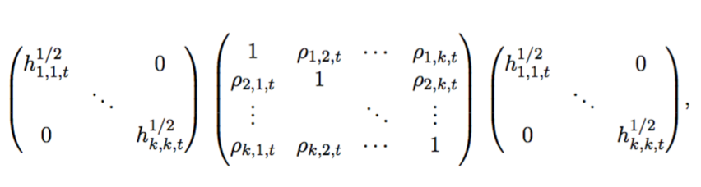
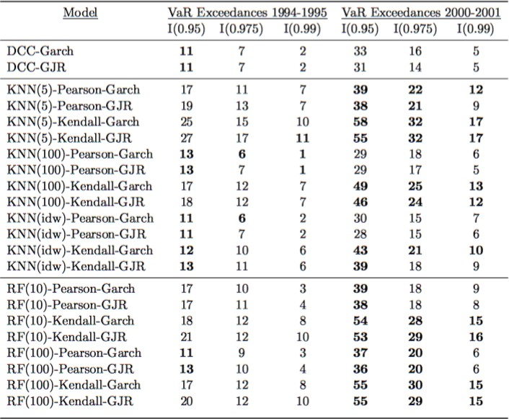
Conditional Correlation Modeling using Machine Learning and Multivariate GARCH
Paul Melkert
Operations, Planning, Accounting and Control Group,
Department of Industrial Engineering, Eindhoven University of Technology, The Netherlands
A new semiparametric multivariate volatility model is proposed, which integrates parametric univariate GARCH specifications for the conditional volatilities with nonparametric machine learning estimators for the conditional correlations. Consider a k-dimensional fi- nancial log return series r_{t} = (r_{1,t} , . . . , r_{k,t})':
an independence test (Christoffersen) are considered to statistically evaluate proposed model against a para- metric conditionally heteroscedastic class of models, the dynamic conditional correlation model of Engke [2], and to detect any misspecification of the risk model. It is demonstrated that proposed model is able to capture in- teresting conditional properties in correlations and that it shows competitive performance with the DCC model, both in tranquil market conditions (mid-1990’s) and volatile market conditions (2000-2001 Dot-com bubble); the likelihood of a VaR exceedance does not depend greatly on whether a VaR exceedance occurred on the previous day. Moreover, the null hypothesis that the total number of VaR exceedances equals the expected number of VaR exceedances, given independence, is sat- isfied for a variety of model specifications. This can also be seen in Figure1, which shows the backtest results for unconditional coverage (Kupiec test).
r_{t} = H^{1/2}z_{t},
t
where conditional variance-covariances of log returns r_{t}
is denoted by a k x k positive definite matrix H_{t} , H_{t}^{1/2}
its Cholesky decomposition, and z_{t} denotes a k × 1 vec-
tor of i.i.d. standard normal random variables. We consider a reparameterization of H_{t}, i.e. H_{t} = D_{t}R_{t}D_{t}, where D_{t} is a diagonal matrix with conditional volatil- ity of each marginal log return series on its diagonal and matrix R_{t} includes all pairwise correlations ρ_{i,j,t}:
Diagonal elements of matrix D_{t} are modeled para- metrically using GARCH(1,1) and GJR-GARCH(1,1) specifications and conditional correlation matrix R_{t} is estimated in a nonparametric manner using machine learning algorithms k-nearest neighbor (KNN) and ran- dom forest (RF) of Breiman [1]. A parsimonious learner model specification, with the covariate space constructed using Pearson and Kendall sample corre- lations from moving windows, ensures that the model remains flexible and easy to estimate in high dimen- sional systems. Proposed semiparametric multivariate volatility model is applied to the 30 constituents in- cluded in the Dow Jones Industrial Average index and model adequacy is verified in terms of a common down- side market risk measure Value-at-Risk (VaR):
Figure 1: Test results of unconditional coverage (Kupiec test) at higher quantiles of the loss distribution in tranquil and volatile market conditions. Bold face indicates rejection.
References
Leo Breiman. Random forests. Machine Learning, 45(1):5-32, 2001.
Robert Engle. Dynamic conditional correlation: A simple class of multivariate generalized autore- gressive conditional heteroskedasticity models. Journal of Business & Economic Statistics, 20 (3):339-350, 2002.
VaR_{α} = inf {l ∈ R : P (L > l) ≤ 1 − α},
where α ∈ (0, 1) and F_{L}(l) = P (L ≤ l), denotes the
distribution function of corresponding loss distribution. A failure test of unconditional coverage (Kupiec) and
/ department of industrial engineering and innovation sciences

