Slide 1
Financial Modeling with Matlab Portfolio Optimization and Simulation
Siraprapa Watakit
PhD Student(Finance)
Faculty of Commerce and Accountancy

Slide 2
Brief Overview
Problem Statement
Given Risk/Return Requirement, how can we achieve it?
Look into the future, what is going happen to the portflio?
From financial theory and concept, how can we translate it into programming language

Slide 3
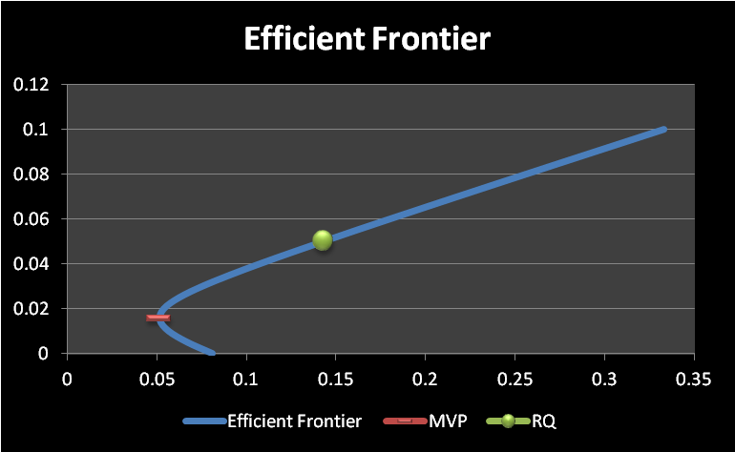
Optimal Portfolio
You can given this choices
1,000,000 baht
ADVANC, BBL, AOT, BIGC, PTT
How much in% should you allocate in order to achieve 5% return per month

Slide 4
Portfolio Optimization Problem
Portfolio Return/Risk
Portfolio Objective Function

Slide 5
Portfolio Optimization Problem(Con’t)
Solution 1:
Excel Solver
Solution 2:
Matlab!

Slide 6
Portfolio Simulation
Monte Carlo Simulation
10000 scenario
Cholesky Decomposition
Variance Covariance Matrix
N Period ahead
6 Assetx10000 Scenariox10Period=600,000

Slide 7
Programming Flows
Phase 1 Calculate Weights
Calculate Stock_{i} Units=(Investment*Weight_{i})/Stock_{i} Price
Phase 2 Simulate Stock Paths
Simulate 10000 scenarios where each stock price follows GBM from t=1…T
Phase 3 Calculate Final Values
Final value=Units*Final Price at t=T Calculate VaR.

Slide 8
Sample Output Results

Slide 9
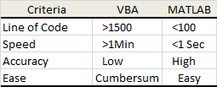
Summary
VBA vs. Matlab Comparison

