Slide 1

Portfolio Risk Analysis
Pantelis Isaiah
Sergio Ortiz Orendain
Jose Saad Canales
Ryan Shrott

Slide 2
Investment Allocations
Total Portfolio Value = 248.5M
The portfolio is mainly composed of fixed income instruments with the biggest currency exposure to USD.

Slide 3
Investment Allocations
Large exposure to Communications and Government sector while short on Utilities and Energy

Slide 4
Instruments
Bonds
25 in total
7 short positions
CDS
9 in total
6 sectors
Options
3 in total
1 American call
Stocks
3 long positions
3 sectors
2 short positions
5 sectors
2 European puts
3 in total
1 ILB
1 puttable bond

Slide 5
Pricing
Bonds
23 standard evaluations: discount the cashflows using the appropriate term structure
1 ILB: adjust for inflation the P.V. of each cashflow
1 puttable bond: incorporate the optionality in the spread

Slide 6
Pricing
Options
1 American call: the underlying pays dividends → binomial tree
CDS and Stocks
Standard

Slide 7
Implementation
Excel and Matlab
Started building a GUI, but turned out to be a project in itself so the idea was dropped.
Used some basic OO techniques to have stable interfaces despite changing requirements (e.g., where the data comes from, what is constant and what is variable, etc).

Slide 8
Risk Factors in Portfolio
125 risk factors
3 equities
3 underlying spot prices for options
2 FX rates
3 interest rate curves = 45 risk factors
72 CDS par spreads (9 CDS’s * 8 times point’s)
25 Corporate bond spreads (1 for each of our 25 bonds)

Slide 9
Modeling 1 Year Value at Risk
Geometric Brownian Motion: equities, spot prices
Cox–Ingersoll–Ross: CDS hazard rates, FX rates, bond spreads
Vasicek: interest rate term structures
Cash flows were reinvested at the risk free rate
One year computation allows us to consider the theta of the portfolio
Square root of time rule is inaccurate over a whole year

Slide 10

Credit Value at Risk
CreditMetrics Approach
Split CDS underlying firms and bond issuers into two separate computations
Sector correlations were used as a proxy for the correlations
Assumed migration shock occurred instantaneously since the theta of the portfolio is already considered in the Market Value at Risk computation
$CVaR=\sqrt{CVaR_{BONDS}^{2}+CVaR_{CDS}^{2}+ 2ρ∗CVaR_{BONDS}∗CVaR_{CDS}}$

Slide 11
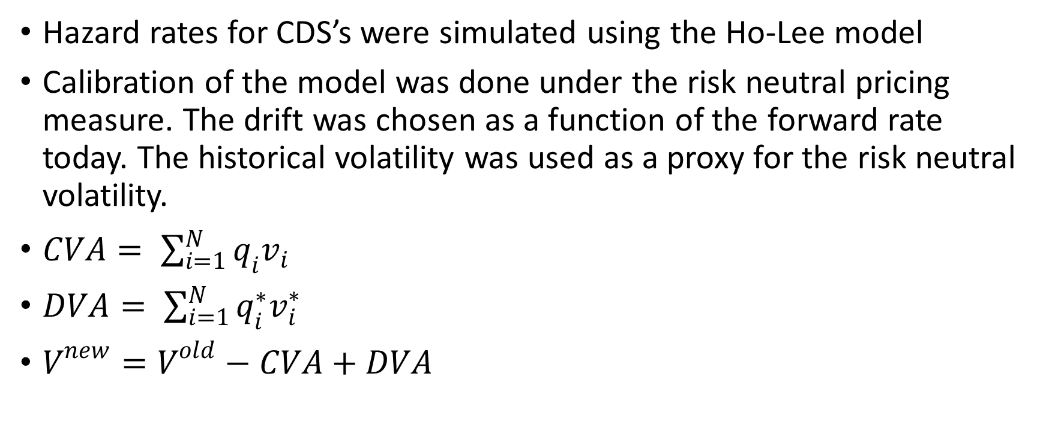
CVA and DVA
Hazard rates for CDS’s were simulated using the Ho-Lee model
Calibration of the model was done under the risk neutral pricing measure. The drift was chosen as a function of the forward rate today. The historical volatility was used as a proxy for the risk neutral volatility.
$CVA= \sum_{i=1}^{N}{q_{i}v_{i}}$
$DVA= \sum_{i=1}^{N}{q_{i}^{∗}v_{i}^{∗}}$
$V^{new}=V^{old}−CVA+DVA$

Slide 12
Model Vetting Techniques
Compare VaR magnitude to portfolio value
Compare pricing functions to current market prices today
Compare historical and Monte Carlo models
Compare 1 year VaR to scaled VaR from 1 day computation
Backtesting: moving window compared to out of sample data
Standard statistical tests could not reject the validity of our models

Slide 13
Value-at-Risk and ES
Monte Carlo Method
Time Horizon | VaR - 95% |  | VaR - 99% |  | US S&P IG Index | S&P 500 | ES – 95% | ES – 99%
1-day | $2.68M | 1.09% | $3.79M | 1.54% | 0.59% | 2.28% | $3.35M (1.36%) | $4.33M (1.76%)
10-day | $8.48M | 3.45% | $12M | 4.88% | 1.88% | 7.20%
1-year | $54.45M | 22.14% | $78.39M | 31.87% | 9.42% | 36.14%
Historical Method
Time Horizon | VaR - 95% |  | VaR - 99% |  | US S&P IG Index | S&P 500 | ES – 95% | ES – 99%
1-day | $2.97M | 1.19% | $4.57M | 1.84% | 0.59% | 2.28% | $5.40M (2.17%) | $11.33M (4.56%)
10-day | $9.38M | 3.77% | $14.46M | 5.82% | 1.88% | 7.20%
1-year | $47.08M | 18.94% | $72.61M | 29.22% | 9.42% | 36.14%

Slide 14
Marginal and Incremental VaR
Marginal VaR
1-day 99% MVaR
Bonds | 3.87M | 1.58%
CDS | -0.015M | 0.01%
Options | 0.01M | 0.005%
Stocks | 0.05M | -0.02%
Incremental VaR
1-day 99% IVaR
Bonds | 3.46M | 1.39%
CDS | 0.46M | 0.19%
Options | 0.54M | 0.22%
Stocks | 0.68M | 0.27%

Slide 15
Stressed VaR and Credit Risk
Stressed VaR
Daily (99%) | 5.5M | 11.09%
Ten Day (99%) | 17.4M | 19.62%
Credit VaR for the bond portfolio
95% | 20.04M | 8.07%
99% | 40.40M | 16.25%
99.9% | 50.64M | 20.38%
Credit VaR for the CDS portfolio
95% | 2.76M | 1.11%
99% | 4.88M | 1.96%
99.9% | 5.07M | 2.04%

Slide 16
Rates
Sensitivities
Duration | 8.05
Convexity | 0.96
DV01 | $210,300
CR01 | $-17,100
There is a large exposure to the 15 years node of the curve

Slide 17
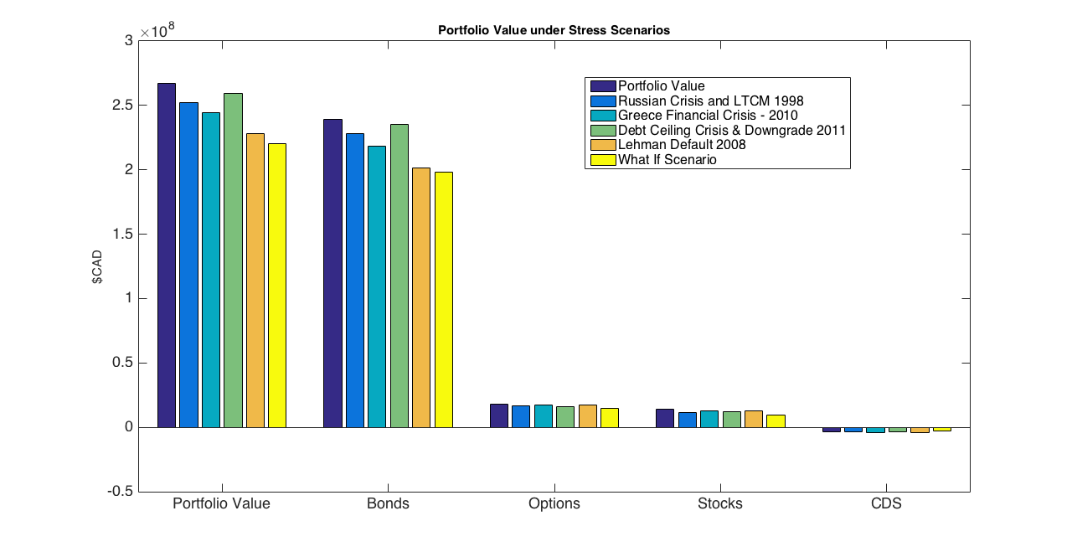
Stress Scenarios
4 historical scenarios considered: LTCM (1998), Lehman Default (2008), Greece Financial Crisis (2010) and Debt Ceiling & Downgrade (2011)
1 hypothetical scenario to consider a significant raise in interest rates

Slide 18
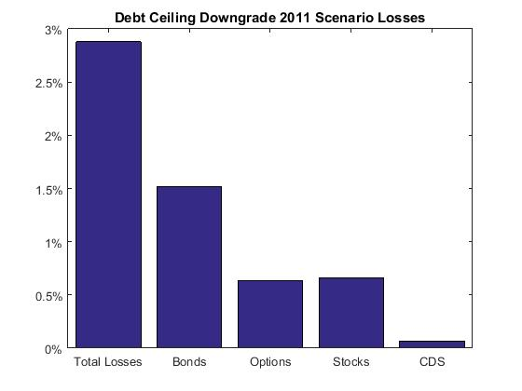
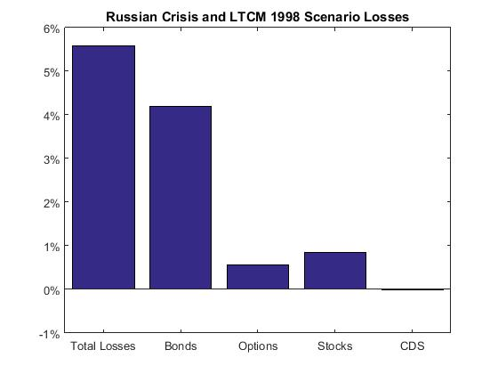
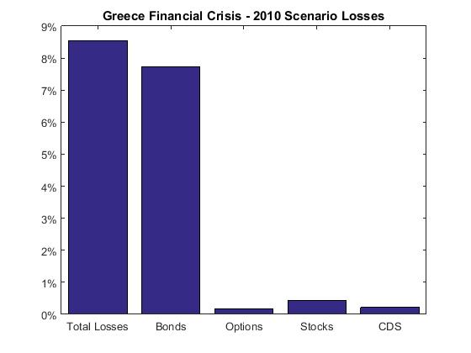
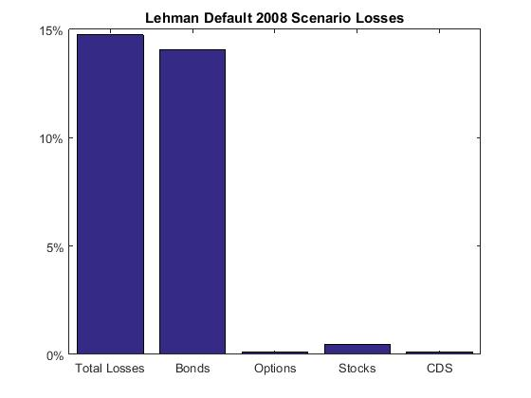
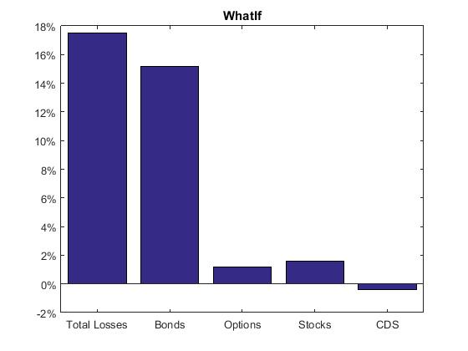
Stress Scenarios

Slide 19
Regulatory Capital
Capital Requirements
Market Risk (mc = 3.1 for AA rating according to Regulatory Authority) | 98.6M | 39.7%
Credit Risk (IRC VaR 99.9% 1Y) | 55.7M | 22.4%
Total | 154.3M | 62.1%
Capital Requirements
Economic Capital | 13.6M | 5.5%
Standardized Approach | 0.27M | 3.1%
Standardized CVA Capital | 0.22M | 2.6%

Slide 20
Q&A
“You can never know everything”, Lan said quietly, “and part of what you know is always wrong. Perhaps even the most important part. A portion of wisdom lies in knowing that. A portion of courage lies in going on anyway.”
“The Wheel of Time”, R. Jordan

